Slide 1
What Can I Do to Improve Care of Prostate Cancer Patients at Risk for Inequities?
Kelvin A. Moses, MD, PhD, FACS
Associate Professor of Urology
Vanderbilt University Medical Center
Nashville, TN

Slide 2



Resource Information
About This Resource
These slides are one component of a continuing education program available online at MedEd On The Go titled Intensifying ADT in mHSPC: How to Improve Patient Outcomes and Adherence
Program Learning Objectives:
Evaluate recent practice-changing clinical trial data and guideline recommendations for ADT intensification in the treatment of patients with mHSPC
Implement a shared-decision making approach in practice to inform treatment selection and sequencing to maximize exposure to life-prolonging therapies for patients with mHSPC
Explain the roles and responsibilities of oncology pharmacists and nurses in an interdisciplinary care model for patients with mHSPC
Incorporate interdisciplinary strategies to reduce barriers to access, care, and treatment that contribute to racial and ethnic disparities in prostate cancer
MedEd On The Go®
www.mededonthego.com
This content or portions thereof may not be published, posted online or used in presentations without permission.
This content can be saved for personal use (non-commercial use only) with credit given to the resource authors.
To contact us regarding inaccuracies, omissions or permissions please email us at support@MedEdOTG.com

Slide 3
Disclaimer
The views and opinions expressed in this educational activity are those of the faculty and do not necessarily represent the views of Total CME, LLC, the CME providers, or the companies providing educational grants. This presentation is not intended to define an exclusive course of patient management; the participant should use their clinical judgment, knowledge, experience, and diagnostic skills in applying or adopting for professional use any of the information provided herein. Any procedures, medications, or other courses of diagnosis or treatment discussed or suggested in this activity should not be used by clinicians without evaluation of their patient's conditions and possible contraindications or dangers in use, review of any applicable manufacturer’s product information, and comparison with recommendations of other authorities. Links to other sites may be provided as additional sources of information.

Slide 4
Landscape of Prostate Cancer in African-American Men
African-American men experience disparities on all points of the prostate cancer continuum:
Lack of diversity in the physician workforce, funding agency leadership and study sections, and clinical trials contribute to de-prioritization of a glaring public health crisis
Descriptive analyses, while a great basis for career advancement, are no longer sufficient for this high-risk population
Screening
Treatment
Treatment Outcomes
Mortality

Slide 5
Prostate Cancer Disparity Facts
Black men have 2.4x risk of death from PCa compared to white men
Black men are diagnosed with higher grade and stage disease, are less likely to receive treatment, and are more likely to develop cancer at a younger age
Overall, less likely to receive screening for PCa (PSA testing +/- DRE)
Consistently more likely to receive radiation or no treatment at all vs radical prostatectomy
PCa, prostate cancer.
Siegel R, et al. CA Cancer J Clin. 2011;61(4):212-36; Chornokur G, et al. Prostate. 2011;71(9):985-97; Schapira MM, et al. Med Care. 1995;33(11):1079-88; Moses KA, et al. J Clin Oncol. 2010;28(6): 1069–1074.

Slide 6
Odds of Receiving Definitive Therapy According to Risk Level
SEER data 2004-2011, >327,000 men
Definitive therapy—radical prostatectomy, external beam radiation, brachytherapy, cryotherapy, surgery + radiation
Risk level incorporates Gleason grade, PSA and clinical T classification
Moses KA, et al. Urology. 2017;99:76-83.

Slide 7
African American Men Enrolled in Prostate Cancer Clinical Trials
 | Number of African Americans enrolled (%) | Major Study Outcome | Study Description
TITAN | 19/1052 (1.8) | OS at 2 yrs.: 82.4% vs 73.5% | Apalutamide plus ADT vs ADT in patients with mHSPC
ENZAMET | Not provided | OS at 3 yrs.: 80% vs 72% | Efficacy of enzalutamide vs standard nonsteroidal antiandrogen therapy
ARCHES | 16/1150 (1.4) | Extended the median rPFS by 11 months | Efficacy and safety of enzalutamide plus ADT in patients with mHSPC
ARASENS | 54/1306 (4.1) | OS at 4 yrs.: 62.7% vs 50.4% | Darolutamide + standard ADT and docetaxel in patients with mHSPC
Total | 89/3508 (2.5)
ADT, androgen deprivation therapy; OS, overall survival; rPFS, radiographic progression free survival.
Chi KN, et al. N Engl J Med. 2019;381(1):13-24; Davis ID, et al. N Engl J Med. 2019;381(2):121-131; Armstrong AJ, et al. J Clin Oncol. 2022;40(15):1616-1622; Smith MR, et al. N Engl J Med. 2022;386(12):1132-1142.

Slide 8
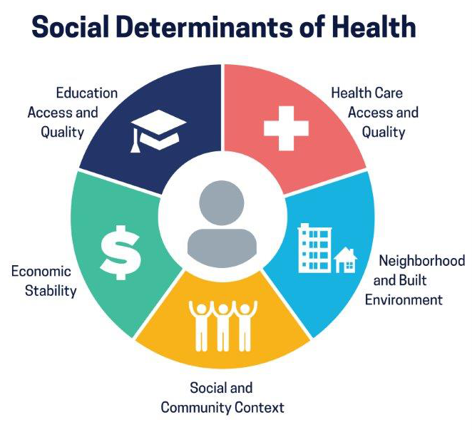
Social Determinants of Health
Non-medical factors which describe environments and circumstances “in which people grow, live, work, and age”
  Impact everyone
  Neither positive nor negative
Social needs: Dependent on people’s individual preferences and priorities
  Emphasizes the patient’s role in identifying and prioritizing social interventions
WHO, 2008; Alderwick H, Gottlieb LM. Milbank Q. 2019;97(2)407-419.

Slide 9
A Call to Arms
We are capable of recognizing shortcomings in our practices, and remedying them
  Opioids
Advocacy for African-American men doesn’t just occur in the clinical setting
  IMPACT (IMProving Access, Counseling & Treatment for Californians with Prostate Cancer) Program- Litwin and colleagues
Now is the time for action for the highest risk patients

Slide 10
What Can We As Clinicians Do?
Understand the historical context of disparities and inaction
Encourage community partnerships for PCa education and screening
Actively recruit Black men in PCa clinical trials and discuss strategies for clinical trial development with industry/cooperative groups
Promote expansion of care for uninsured/under-insured in academic and community practices
Align political activity with best outcomes for vulnerable patients
Advocate for diversity in the medical field and elevate cultural competency
PCa, prostate cancer.

Slide 11



Looking for more resources
on this topic?
CME/CE in minutes
Congress highlights
Late-breaking data
Quizzes
Webinars
In-person events
Slides & resources
www.MedEdOTG.com

