Slide 1
Choosing Between Doublets and Triplets in mHSPC: What Is the Data?
Alicia Morgans, MD, MPH
Medical Director, Survivorship Program
Dana-Farber Cancer Institute
Associate Professor, Harvard Medical School
Boston, MA

Slide 2



Resource Information
About This Resource
These slides are one component of a continuing education program available online at MedEd On The Go titled Intensifying ADT in mHSPC: How to Improve Patient Outcomes and Adherence
Program Learning Objectives:
Evaluate recent practice-changing clinical trial data and guideline recommendations for ADT intensification in the treatment of patients with mHSPC
Implement a shared-decision making approach in practice to inform treatment selection and sequencing to maximize exposure to life-prolonging therapies for patients with mHSPC
Explain the roles and responsibilities of oncology pharmacists and nurses in an interdisciplinary care model for patients with mHSPC
Incorporate interdisciplinary strategies to reduce barriers to access, care, and treatment that contribute to racial and ethnic disparities in prostate cancer
MedEd On The Go®
www.mededonthego.com
This content or portions thereof may not be published, posted online or used in presentations without permission.
This content can be saved for personal use (non-commercial use only) with credit given to the resource authors.
To contact us regarding inaccuracies, omissions or permissions please email us at support@MedEdOTG.com

Slide 3
Disclaimer
The views and opinions expressed in this educational activity are those of the faculty and do not necessarily represent the views of Total CME, LLC, the CME providers, or the companies providing educational grants. This presentation is not intended to define an exclusive course of patient management; the participant should use their clinical judgment, knowledge, experience, and diagnostic skills in applying or adopting for professional use any of the information provided herein. Any procedures, medications, or other courses of diagnosis or treatment discussed or suggested in this activity should not be used by clinicians without evaluation of their patient's conditions and possible contraindications or dangers in use, review of any applicable manufacturer’s product information, and comparison with recommendations of other authorities. Links to other sites may be provided as additional sources of information.

Slide 4
Prostate Cancer Treatment Guidelines
ADT with docetaxel and one of the following:
• Preferred regimens:
▸ Abiraterone (category 1)
▸ Darolutamide (category 1)
ADT + docetaxel couplet is no longer recommended
Three preferred couplet options include ADT and AR signaling inhibitors
If using ADT + docetaxel, use triplet
or
ADT with one of the following:
Preferred regimens:
▸ Abiraterone (category 1)
▸ Apalutamide (category 1)
▸ Enzalutamide (category 1)
M1
or
ADT with EBRT to the primary tumor for low metastatic burden M1
or
ADT
ADT, androgen deprivation therapy; AR, androgen receptor; EBRT, external beam radiation therapy.
Schaeffer TE, et al. NCCN Prostate Cancer V 3.2023

Slide 5
OS Benefit Confirmed in Long-Term Analyses of ADT plus ARTAs: Abiraterone Acetate
LATITUDE¹
STAMPEDE²
1.00
SOC + AAP
AAP + ADT
Proportion Surviving
OS, %
0.50
Placebo + ADT
SOC
HR = 0.66 (95% CI, 0.56-0.78); P<0.0001
HR = 0.60 (95% CI, 0.50-0.71);
P<0.0001
Time Since Randomization, months
Time Since Randomization, years
AAP, abiraterone acetate; ADT, androgen deprivation therapy;
ARTAs, androgen receptor targeted agents; OS, overall survival; SOC, standard of care.

Slide 6
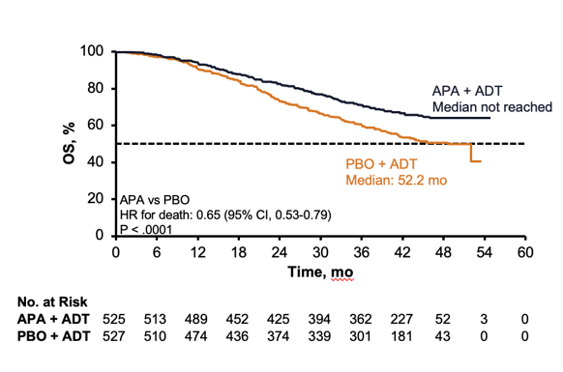
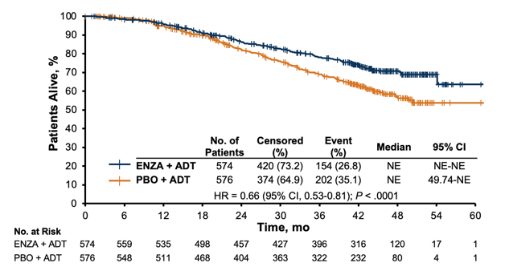
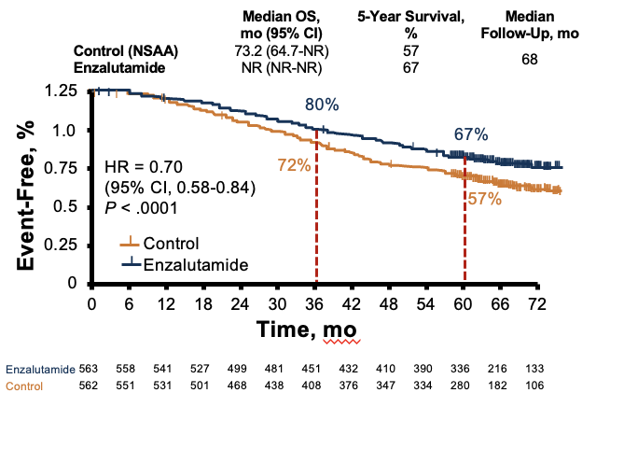
OS Benefit Confirmed With ADT plus Apalutamide and Enzalutamide
TITAN¹ (apalutamide)
ARCHES² (enzalutamide)
ENZAMET³ (enzalutamide)
1.00
APA vs PBO
HR for death: 0.65 (95% Cl, 0.53-0.79)
P < .0001
0.50
Time, mo
Time, mo
No. at Risk
APA + ADT
PBO + ADT
Enzalutamide + ADT
PBO + ADT
Time, mo
525 | 513 | 489 | 452 | 425 | 394 | 362 | 227 | 52 | 3 | 0
527 | 510 | 474 | 436 | 374 | 339 | 301 | 181 | 43 | 0 | 0
574 | 559 | 535 | 498 | 457 | 427 | 396 | 316 | 120 | 17 | 1
576 | 548 | 511 | 468 | 404 | 363 | 322 | 232 | 80 | 4 | 1
ADT, androgen deprivation therapy; APA, apalutamide; ENZA, enzalutamide; OS, overall survival.

Slide 7
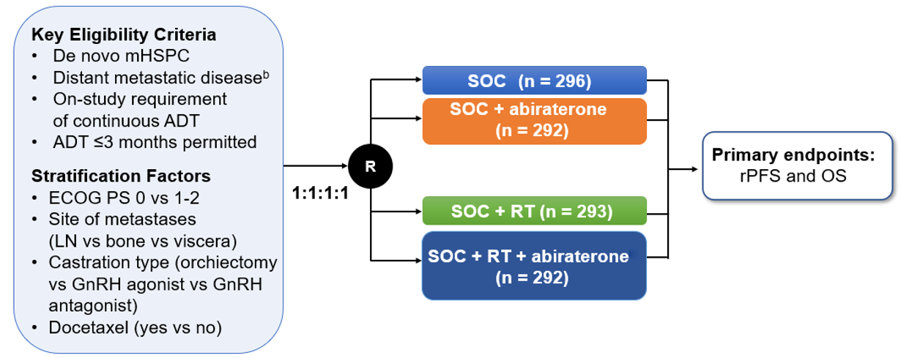
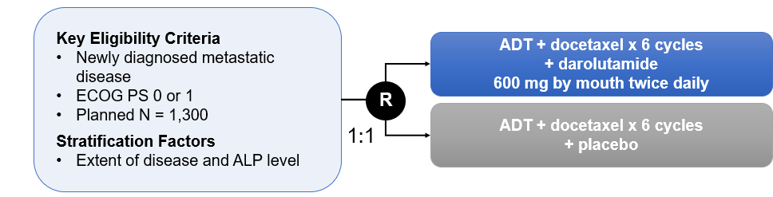
PEACE-1¹
ARASENS²
Primary Endpoint: OS
Key secondary endpoints: time to mCRPC, time to initiation of subsequent anticancer therapy, time to SSE-free survival, time to first SSE, time to pain progression
International trial conducted at >300 sites in 23 countries

Slide 8
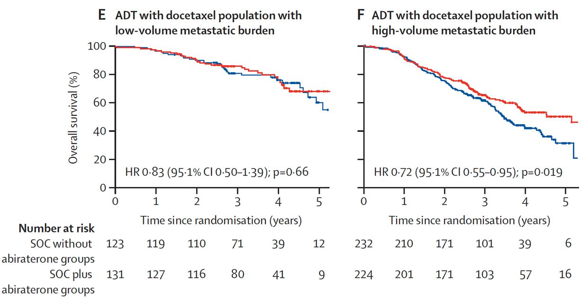
PEACE-1 Overall Survival (by Volume Status)
Low volume patients do not appear to benefit from the addition of abiraterone to ADT and docetaxel at this data cut
High volume patients benefit
ADT, androgen deprivation therapy; SOC, standard of care.
Fizazi K, et al. Lancet. 2022;399(10336):1695-1707.

Slide 9
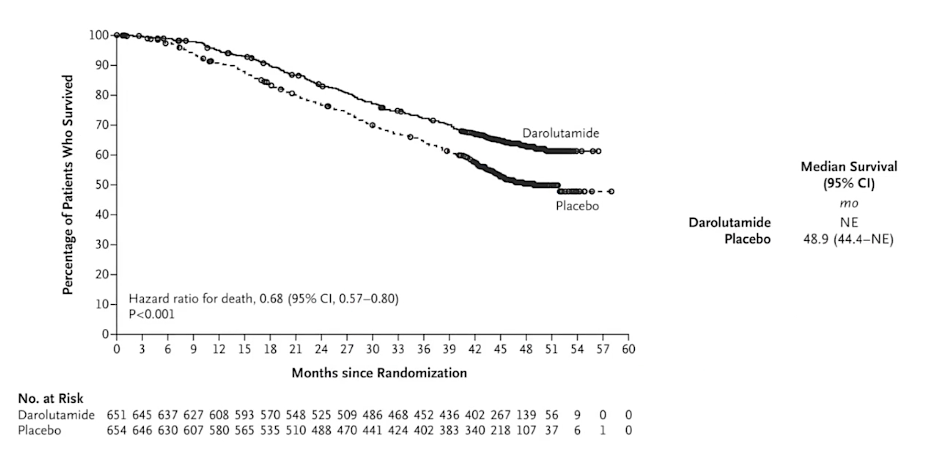
ARASENS Overall Survival
ADT, androgen deprivation therapy.
Smith MR, et al. ASCO GU 2022. Abstract 13; Smith MR, et al. N Engl J Med. 2022 Mar 24;386(12):1132-1142.

Slide 10
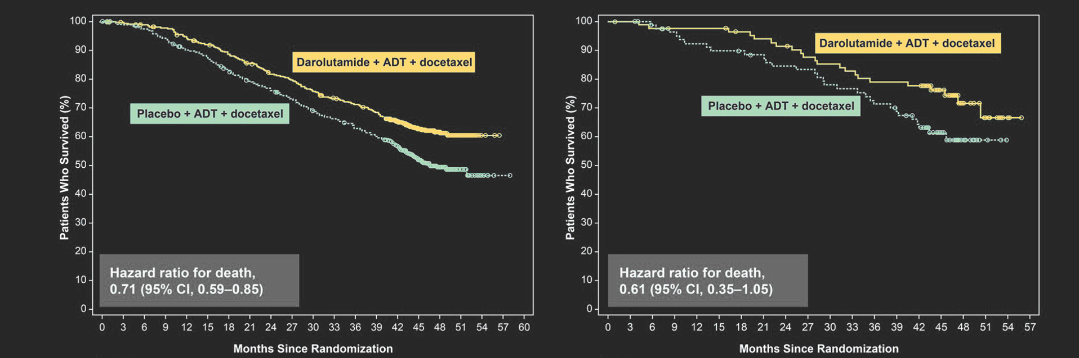
ARASENS Overall Survival Overall Survival By Metastatic Stage at Initial Diagnosis
De novo metastatic disease
Recurrent metastatic disease
ADT, androgen deprivation therapy.
Smith MR, et al. ASCO GU 2022. Abstract 13; Smith MR, et al. N Engl J Med. 2022 Mar 24;386(12):1132-1142.

Slide 11
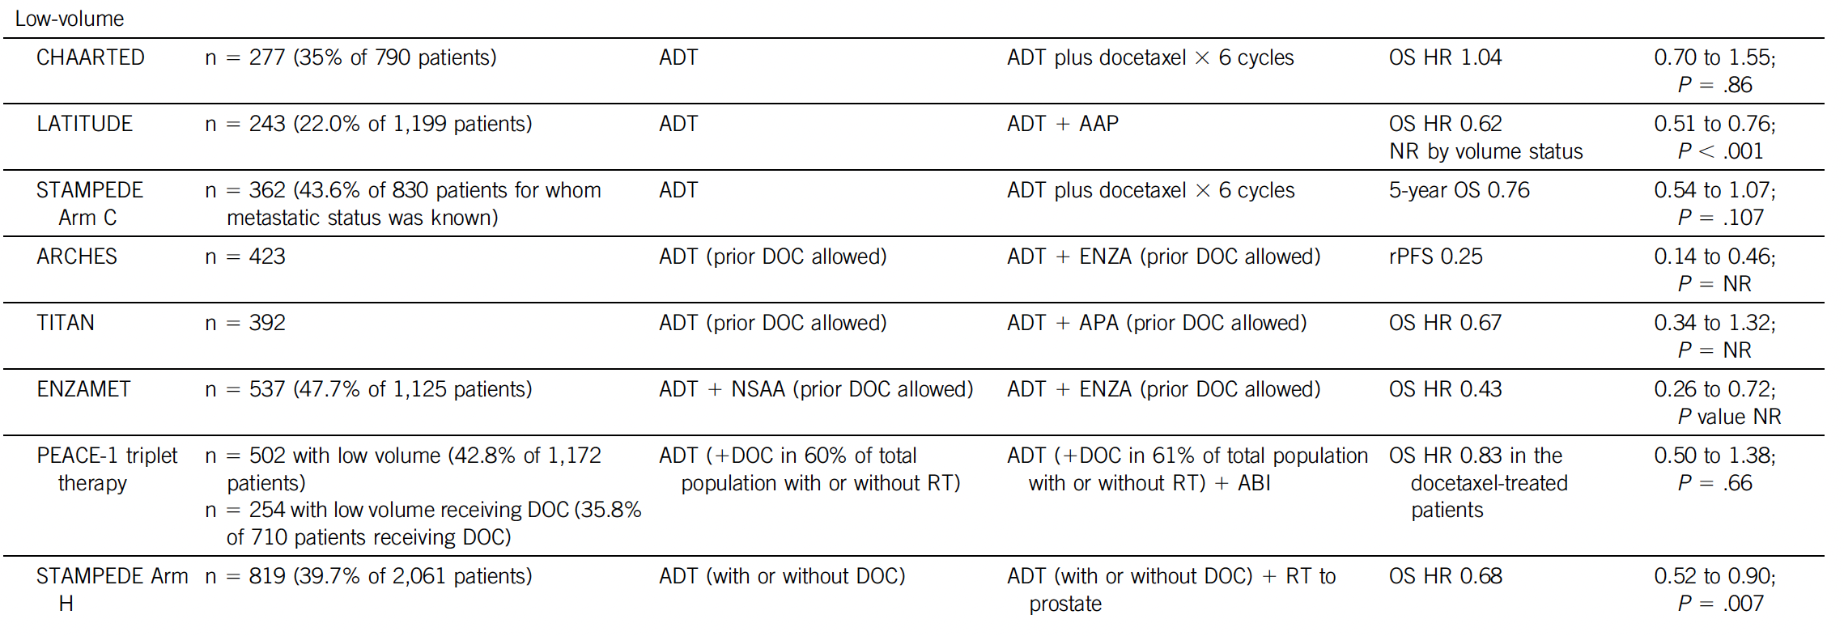
ADT Combination Therapies – Low Volume (A Majority of Patients)
ADT, androgen deprivation therapy; DOC, docetaxel.
Morgans AK, et al. J Clin Oncol. 2022;40(8):818-824.

Slide 12
ADT Combination Therapies – Low Volume (A Majority of Patients)
Triplet therapy and chemotherapy not clearly beneficial.
ADT, androgen deprivation therapy; DOC, docetaxel.
Morgans AK, et al. J Clin Oncol. 2022;40(8):818-824.

Slide 13
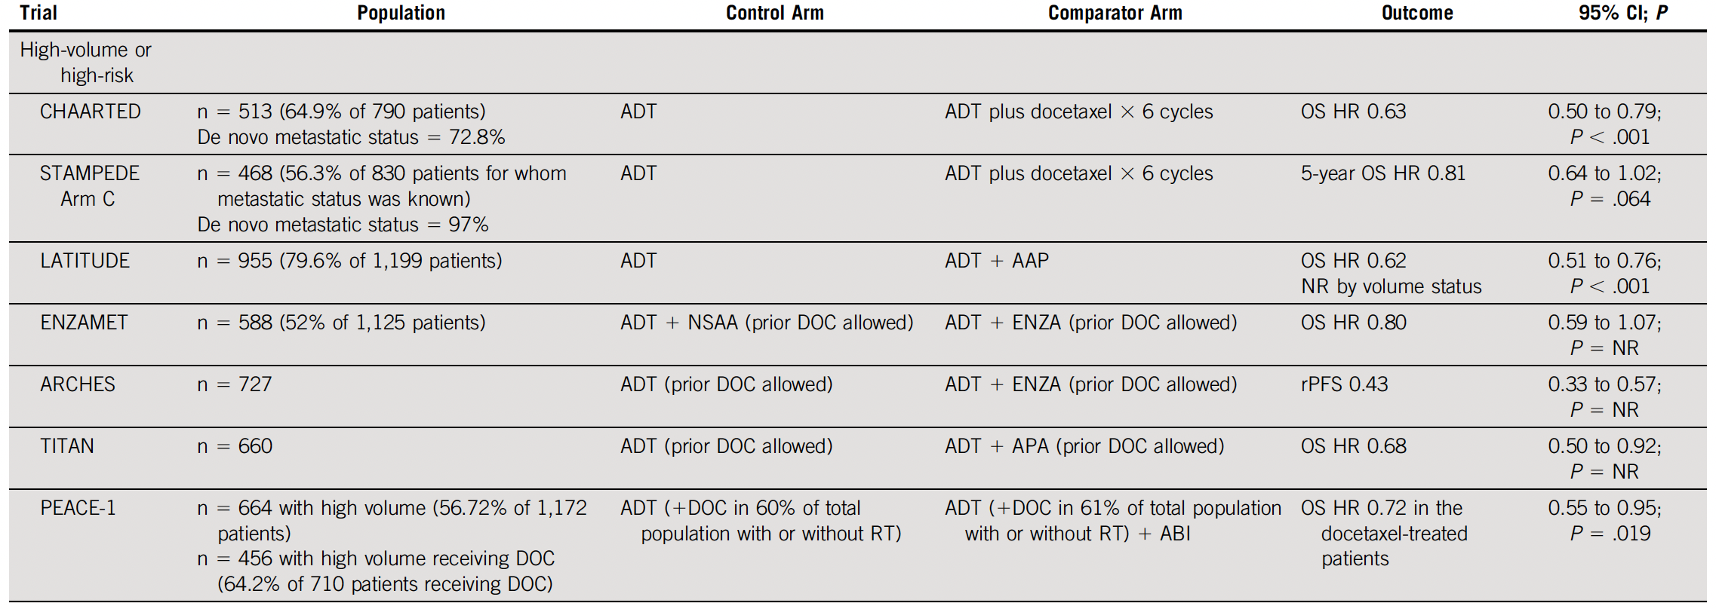
ADT Combination Therapies – High Volume (Consider in de novo with High-Risk Features)
ADT, androgen deprivation therapy; DOC, docetaxel.
Morgans AK, et al. J Clin Oncol. 2022;40(8):818-824.

Slide 14
Conclusions
Triplet therapy is the best option for chemofit patients with high volume, de novo mHSPC
Consider in low volume de novo patients with high-risk features
Couplet therapy is the best option for low volume and recurrent mHSPC
Also the best option for non-chemofit patients
Shared treatment decisions should be used to match the best treatment to the patient

Slide 15
Conclusions
Triplet therapy is the best option for chemofit patients with high volume, de novo mHSPC
Consider in low volume de novo patients with high-risk features
Couplet therapy is the best option for low volume and recurrent mHSPC
Also the best option for non-chemofit patients
Shared treatment decisions should be used to match the best treatment to the patient
Choose couplet or triplet for treatment for mHSPC.
ADT alone is no longer sufficient for the overwhelming majority of patients.

Slide 16



Looking for more resources on this topic?
CME/CE in minutes
Congress highlights
Late-breaking data
Quizzes
Webinars
In-person events
Slides & resources
www.MedEdOTG.com

