Slide 1
Lack of Concordance Between Radiologic and Pathologic Responses in Neoadjuvant ICI Treatment of Melanoma: How Do I Assess Radiologic Progression?
Brian Gastman, MD
Surgical and Co-Director
CCF Melanoma and High-Risk Skin Cancer Program
Taussig Cancer Center
Professor and Vice Chairman
Cleveland Clinic Department of Plastic Surgery
Cleveland OH

Slide 2
Disclaimer
The views and opinions expressed in this educational activity are those of the faculty and do not necessarily represent the views of TotalCME, Inc., the CME providers, or the companies providing educational grants. This presentation is not intended to define an exclusive course of patient management; the participant should use their clinical judgment, knowledge, experience, and diagnostic skills in applying or adopting for professional use any of the information provided herein. Any procedures, medications, or other courses of diagnosis or treatment discussed or suggested in this activity should not be used by clinicians without evaluation of their patient's conditions and possible contraindications or dangers in use, review of any applicable manufacturer’s product information, and comparison with recommendations of other authorities. Links to other sites may be provided as additional sources of information.

Slide 3
Conflict of Interest Statement
I have consulting agreements with: Quest imaging, Castle Biosciences, Merck, BMS, Alkermes, NIT, Instill Bio and IOVANCE.
I will not promote any product in this talk.

Slide 4
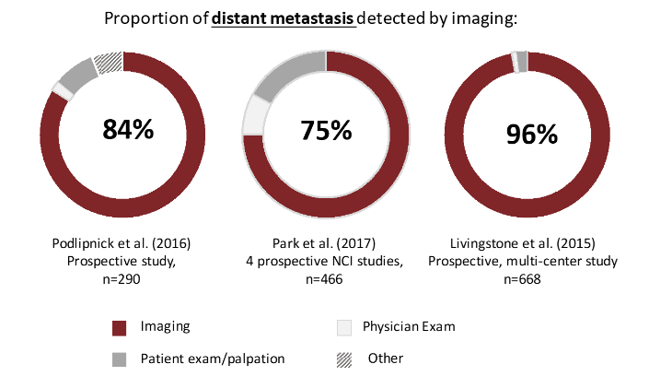
Paradigm
Early Recurrence in Completely Resected IIIB and IIIC Melanoma Warrants Restaging Prior to Adjuvant Therapy
120 patients
1/5 had recurrence after IIIB/C surgery prior to adjuvant therapy
Recommend more imaging prior to adjuvant treatment
Bloemendal M, et al. Ann Surg Oncol. 2019;26(12):3945-3952.

Slide 5
Paradigm
Early Recurrence in Completely Resected IIIB and IIIC Melanoma Warrants Restaging Prior to Adjuvant Therapy
120 patients
1/5 had recurrence after IIIB/C surgery prior to adjuvant therapy
Recommend more imaging prior to adjuvant treatment
Bloemendal M, et al. Ann Surg Oncol. 2019;26(12):3945-3952.
So, the best way to monitor metastatic disease
status is by imaging, right?

Slide 6
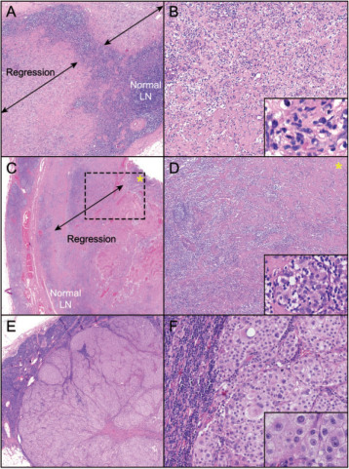
Neoadjuvant Therapy and Pathologic Response
Spectrum of pathologic responses
observed following treatment with
neoadjuvant ipilimumab-nivolumab
pPR
pCR
pNR

Slide 7
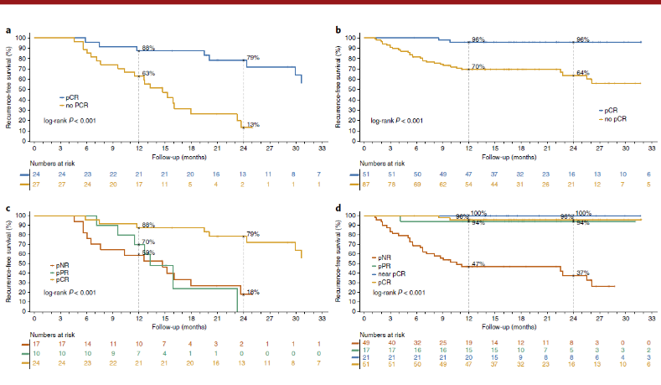
Neoadjuvant Therapy and Pathologic Response
Spectrum of pathologic responses
observed following treatment with
neoadjuvant ipilimumab-nivolumab
Kaplan-Meier estimates of RFS based on pathological response (treatment cohorts)
pPR
pCR
pNR

Slide 8
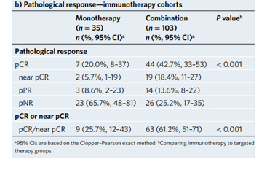
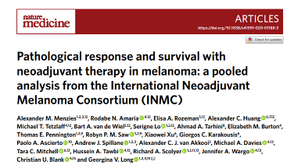
The Paradox with Neoadjuvant Therapy

Slide 9
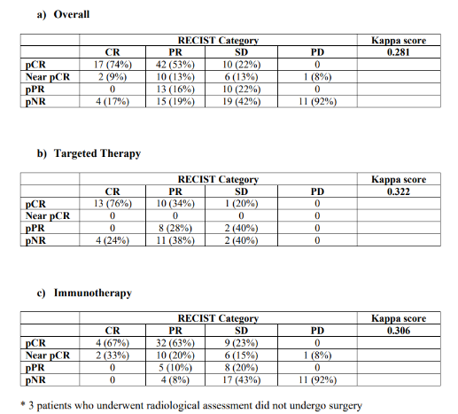
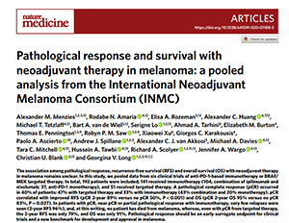
The Paradox with Neoadjuvant Therapy
Correlation of radiological response
and pathological response*

Slide 10
The Paradox with Neoadjuvant Therapy
Correlation of radiological response
and pathological response*

Slide 11
The Paradox with Neoadjuvant Therapy
Correlation of radiological response
and pathological response*

Slide 12
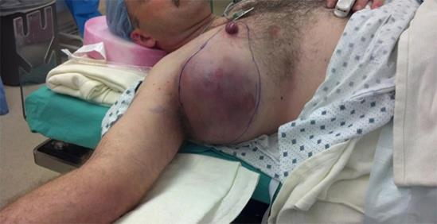
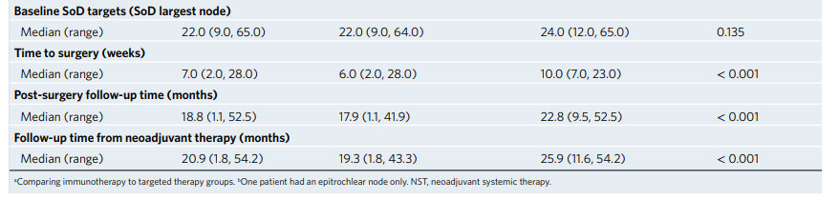
What Does This Mean?
What if radiologically the tumor is growing, but there is a pPR?
Does this apply to larger tumors?
Baseline patient characteristics

Slide 13
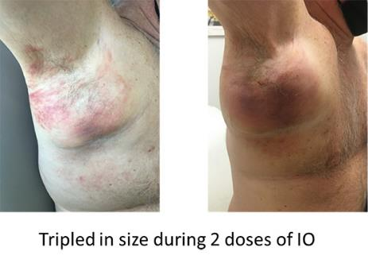
Outcome
Given 2 cycles of nivolumab/relatlimab
Had to take axillary vein and strip off pleura
Despite clinical and radiology enlargement there was 50% necrosis. What does that mean?

Slide 14
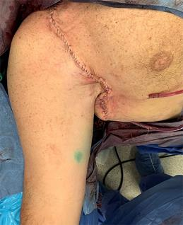
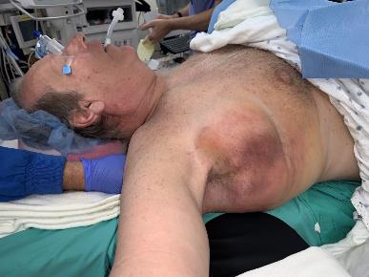
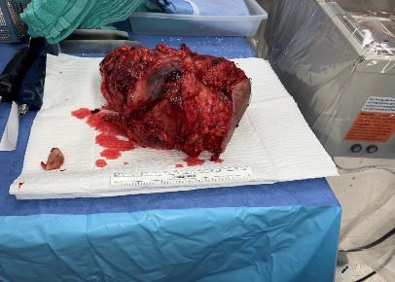
Outcome
Given 2 cycles of nivolumab/relatlimab
Had to take axillary vein and strip off pleura
Despite clinical and radiology enlargement there was 50% necrosis. What does that mean?

Slide 15
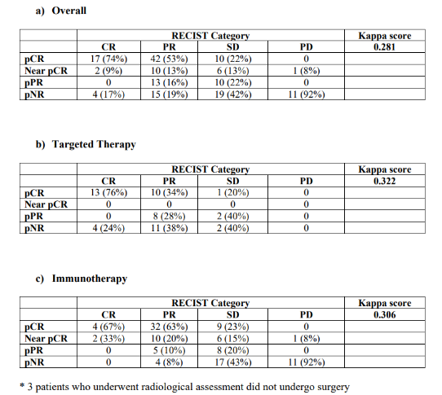
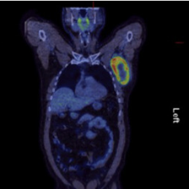
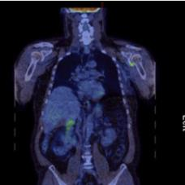
What To Do Without Any Radiologic Disease?
Correlation of radiological response
and pathological response*

Slide 16
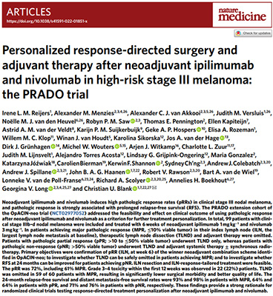
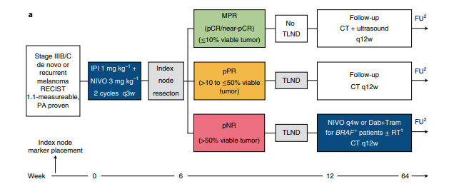
What if You Have a Great Neoadjuvant Response?
Note low dose ipilimumab + nivolumab

Slide 17
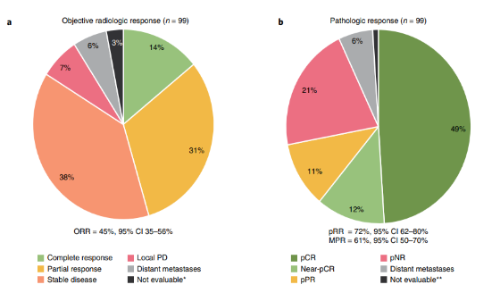
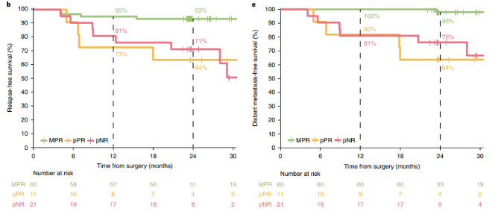
Pathologic and Radiologic Response
RFS by pathologic response subgroup
DMFS by pathologic response subgroup
Takeaway:
Radiology again is inaccurate
MPR is indicative that MAYBE no further surgery is necessary and that IO is effective enough
All reinforce the importance of pathologic assessment

Slide 18
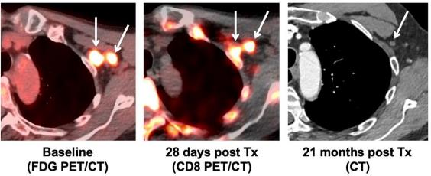
Neoadjuvant Therapy Ramifications
Most IO neoadjuvant paradigms have been 2 cycles
Should we re-image prior to surgery?
Yes:
We need more real-world data
IO CR may = pCR or MPR
Imaging is changing, e.g.,
CD8-PET
No:
You will get path anyway
Could have a false +/-
Won’t change your management?
Which modality?

Slide 19
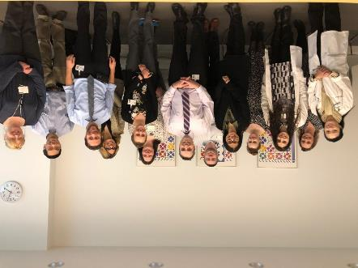
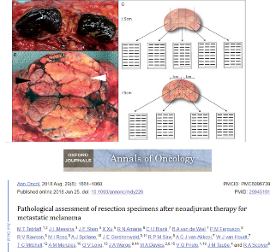
Neoadjuvant Therapy Ramifications
Key to have a multidisciplinary team to maximize patient benefit and outcome
We see difference between targeted and IO; but also nivolumab, ipilimumab/nivolumab; what about relatlimab/nivolumab, and others?
Specialties hearing from their own societies:
  Surgery
  Medical oncology
  Radiology: Does Recist; iRecist have to be redone?
  Pathology: Path likely to come out with new recommendations with new data
Cleveland Clinic Tumor Board Prepandemic

Slide 20


