Slide 1
Panel: How and When Should I Assess Response to Neoadjuvant and Adjuvant ICI Therapy?
Brian Gastman, MD
Surgical and Co-Director
CCF Melanoma and High-Risk Skin Cancer Program
Taussig Cancer Center
Professor and Vice Chairman
Cleveland Clinic Department of Plastic Surgery
Cleveland OH
Michael T. Tetzlaff MD, PhD
Clinical Professor, Departments of Pathology and Dermatology
University of California San Francisco
San Francisco, CA

Slide 2
Disclaimer
The views and opinions expressed in this educational activity are those of the faculty and do not necessarily represent the views of TotalCME, Inc., the CME providers, or the companies providing educational grants. This presentation is not intended to define an exclusive course of patient management; the participant should use their clinical judgment, knowledge, experience, and diagnostic skills in applying or adopting for professional use any of the information provided herein. Any procedures, medications, or other courses of diagnosis or treatment discussed or suggested in this activity should not be used by clinicians without evaluation of their patient's conditions and possible contraindications or dangers in use, review of any applicable manufacturer’s product information, and comparison with recommendations of other authorities. Links to other sites may be provided as additional sources of information.

Slide 3
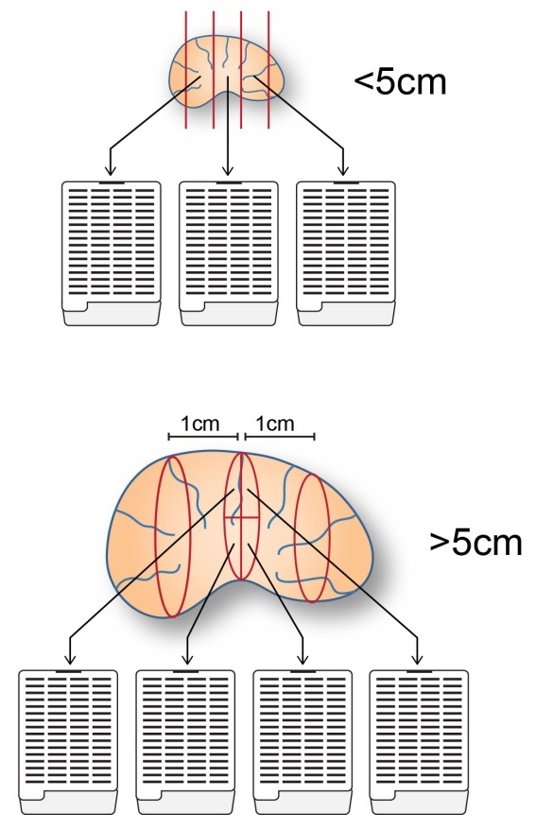
Determining Extent of Pathologic Response after Neoadjuvant Therapy in Melanoma: How Much Tissue Should Be Analyzed?

