Slide 1
Should a Patient with a BRAF-Mutated Tumor Receive Targeted or ICI Neoadjuvant Therapy?
Jeffrey S. Weber MD, PhD
Deputy Director, Laura and Isaac Perlmutter Cancer Center
New York, NY

Slide 2
Disclaimer
The views and opinions expressed in this educational activity are those of the faculty and do not necessarily represent the views of TotalCME, Inc., the CME providers, or the companies providing educational grants. This presentation is not intended to define an exclusive course of patient management; the participant should use their clinical judgment, knowledge, experience, and diagnostic skills in applying or adopting for professional use any of the information provided herein. Any procedures, medications, or other courses of diagnosis or treatment discussed or suggested in this activity should not be used by clinicians without evaluation of their patient's conditions and possible contraindications or dangers in use, review of any applicable manufacturer’s product information, and comparison with recommendations of other authorities. Links to other sites may be provided as additional sources of information.

Slide 3
BRAF + MEK Versus ICI Adjuvant Therapy?
The stage III, RFS data at 5 years from COMBI-A/D look just about as good as Checkmate-238 or Keynote-054
However, all the metastatic data suggest that IO should be the preferred first treatment, followed by targeted therapy if there is progression
I favor the use of targeted therapy for borderline stage IIIA patients with a good expected outcome, since irreversible toxicities are few
For most stage III/IV resected patients, I prefer IO therapy first since the back-of-the-napkin calculation suggested a slight advantage with RFS in that group

Slide 4
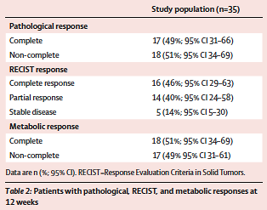
Neoadjuvant Dabrafenib and Trametinib in Stage IIIB/C Resectable Melanoma
Patients with pathological, RECIST, and metabolic responses
at 12 weeks

Slide 5
Relapse-Free Survival in Patients Receiving Neoadjuvant Dabrafenib and Trametinib by pCR vs No pCR
RFS for all pts; compare to NIVO or PEMBRO with 50% RFS at 5 years
RFS for pCR pts; inferior to IPI/NIVO or NIVO/RELA
RFS for non-pCR pts

Slide 6
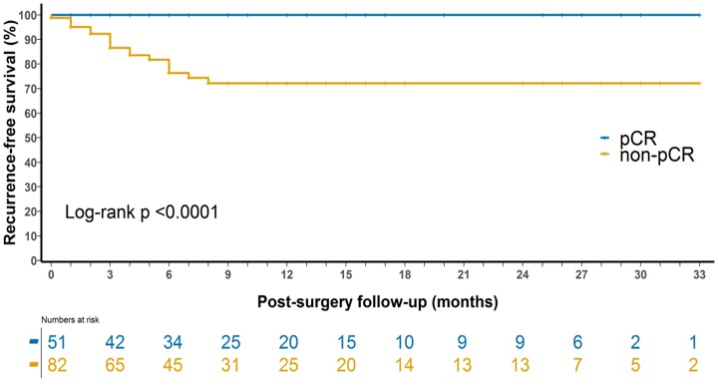
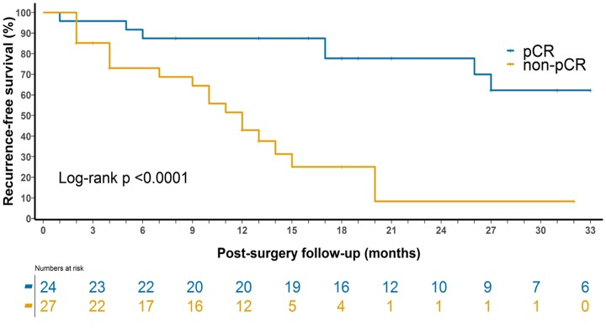
Neoadjuvant Therapy: Relapse by Pathological Complete Response for Targeted Versus Immune Therapy
Immunotherapy
Targeted Therapy
100%
100%
pCR*
88%
pCR
72%
72%
non-pCR
78%
43%
8%
non-pCR
Med f/u 10 mo
Med f/u 22 mo
* 1 pt died from toxicity without recurrence, censored at time of death

Slide 7
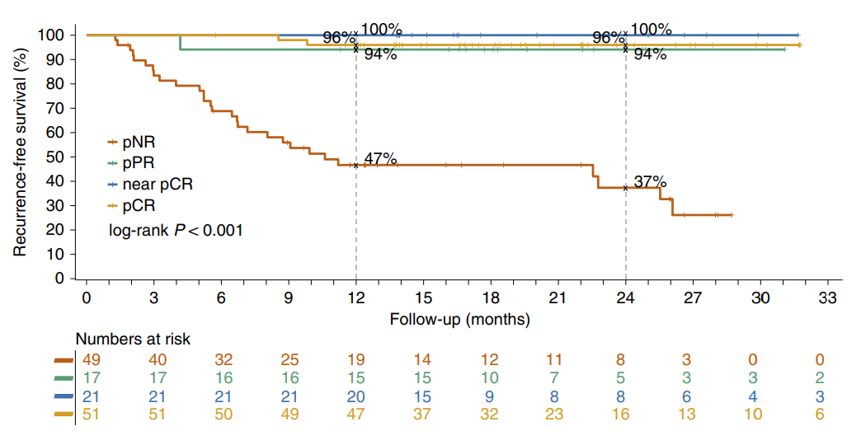
Neoadjuvant Immunotherapy: Pooled Analysis

Slide 8
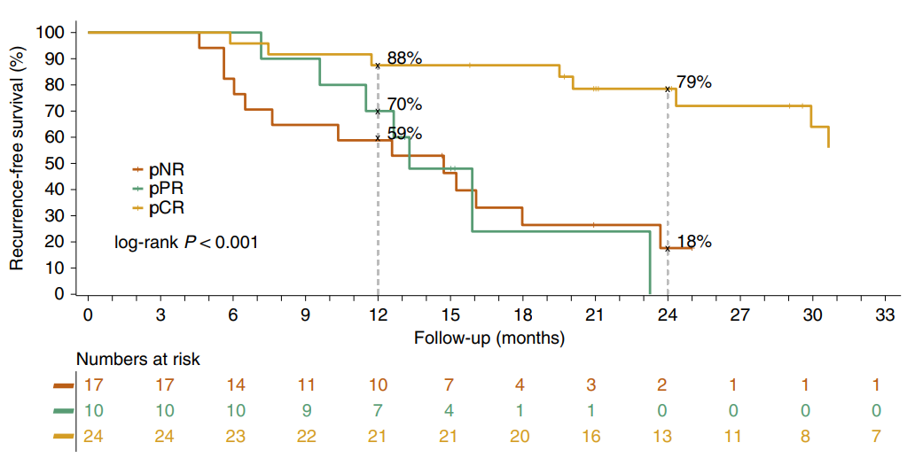
What About BRAF/MEK Neoadjuvant Therapy?

Slide 9
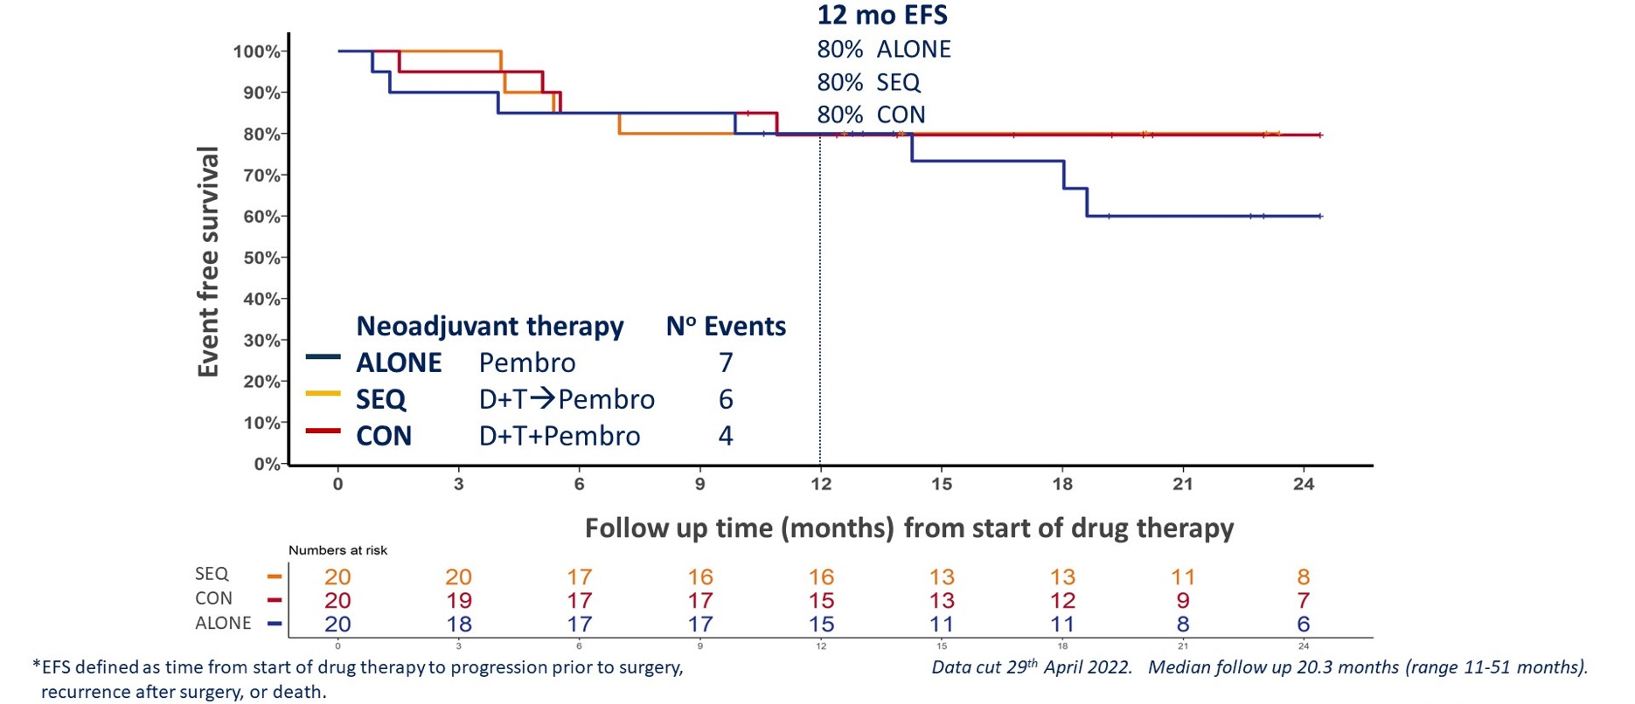
Event Free Survival (EFS)*
Does Targeted Neoadjuvant Therapy Add Anything to IO Neoadjuvant Therapy?
Data cut 29th April 2022. Median follow-up time 20.3 months (range 11-51 months).

Slide 10
DREAMSeq: Sequencing Therapies in Patients with BRAF-Mutated Metastatic Melanoma
IO >>TT
20%, (95% RCI: 3%-38%), Z-stat= 3.157 >2.743
TT>>IO
Atkins MB et al, Journal of Clinical Oncology 2021 39:36_suppl, 356154-356154

Slide 11
BRAF + MEK Versus ICI Neoadjuvant Therapy?
Several studies of BRAF + MEK neoadjuvant therapy in stage III resectable melanoma show RFS that are inferior to IO therapy for each category of patient; pathCR, near pathCR (90%+ necrosis) or pathologic PR or NR (nonresponder, less than 50% necrosis)
Targeted neoadjuvant therapy would be indicated only if a patient could not be treated with IO therapy, such as having an allograft transplant, a significant history of autoimmune disease, or if very fast-growing bulky disease that needed treatment to render a patient operable, etc.
At this time, the preponderance of evidence is that IO therapy should be preferred when neoadjuvant off-protocol or investigational treatment is used

