Slide 1
What Are the Data Supporting Neoadjuvant Therapy in Melanoma?
Jeffrey S. Weber, MD, PhD
Deputy Director, Laura and Isaac Perlmutter Cancer Center
Professor of Medicine, NYU Grossman School of Medicine
New York, NY

Slide 2
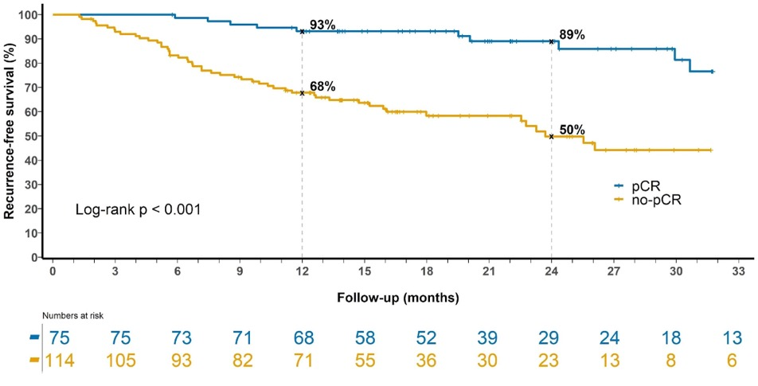
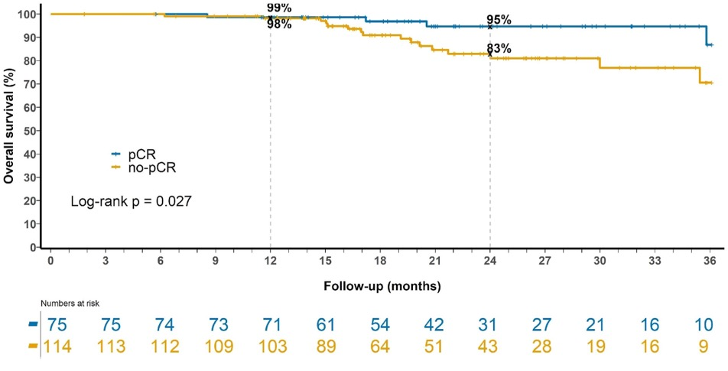
Pathologic Complete Response After Neoadjuvant Therapy in 189 Patients: Relapse-Free and Overall Survival

Slide 3
Recent Neoadjuvant Studies
Intralesional
Checkpoint Inhibition
TVEC
CMP-001 + nivolumab
Pembrolizumab monotherapy
Nivolumab monotherapy
IPI 3 mg/kg + NIVO 1 mg/kg
IPI 1 mg/kg + NIVO 3 mg/kg
IPI + NIVO + domatinostat
Relatlimab + nivolumab
BRAFi + MEKi
Dabrafenib + trametinib ± pembrolizumab
Vemurafenib + cobimetinib ± atezolizumab

Slide 4
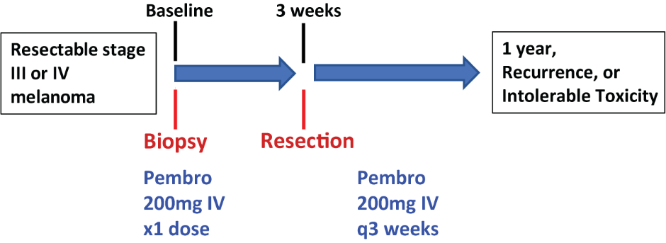
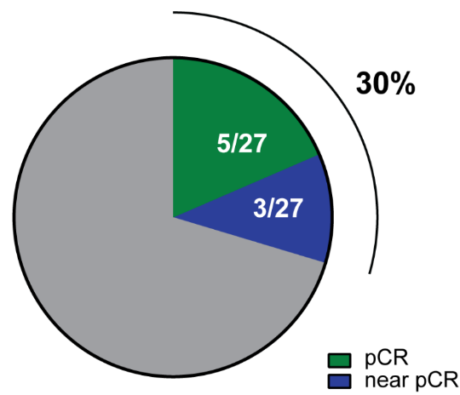
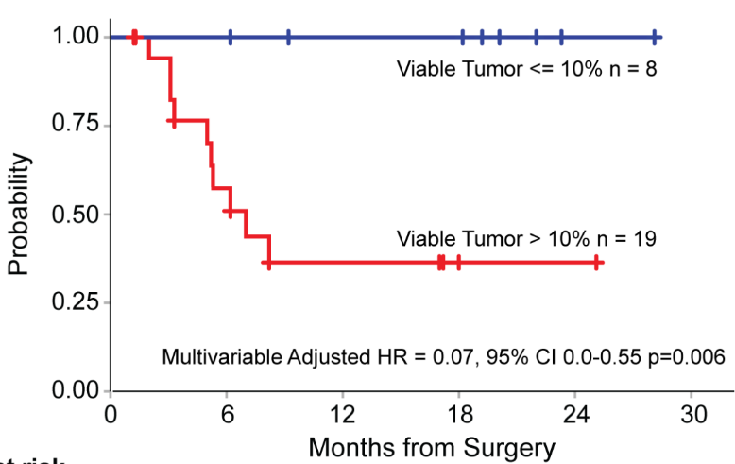
Neoadjuvant Pembrolizumab for Resectable Melanoma
Disease-Free Survival
(Median follow up = 18 months)

Slide 5
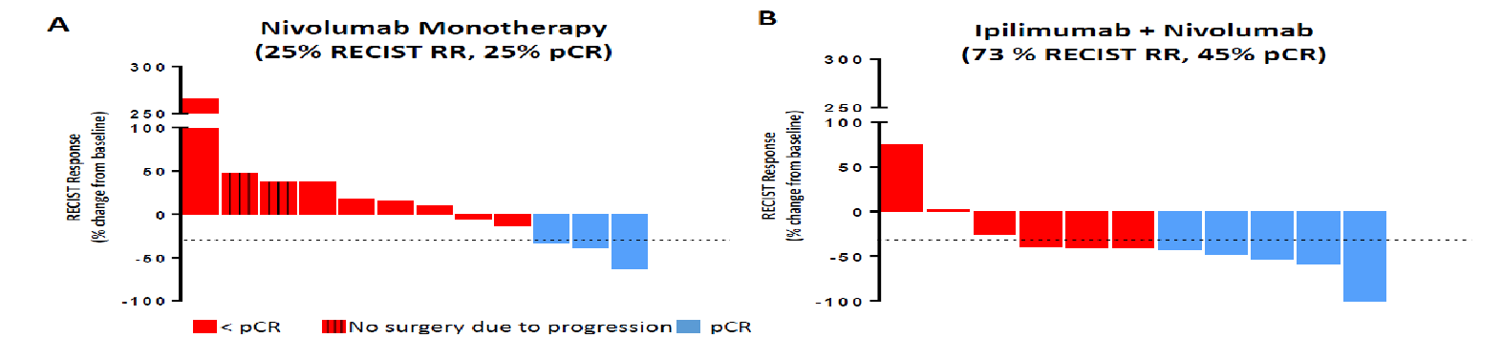
Nivolumab ± Ipilimumab
Nivolumab 3mg/kg IV q2 weeks x 4 doses prior to surgery
Ipilimumab 3mg/kg + Nivolumab 1mg/kg IV q3 weeks x 3 doses prior to surgery
2 patients progressed to metastatic during treatment
1 developed mets shortly after surgery
2 local recurrences after completing adjuvant therapy
8% Grade 3/4 AEs
No relapses noted
73% Grade 3/4 AEs

Slide 6
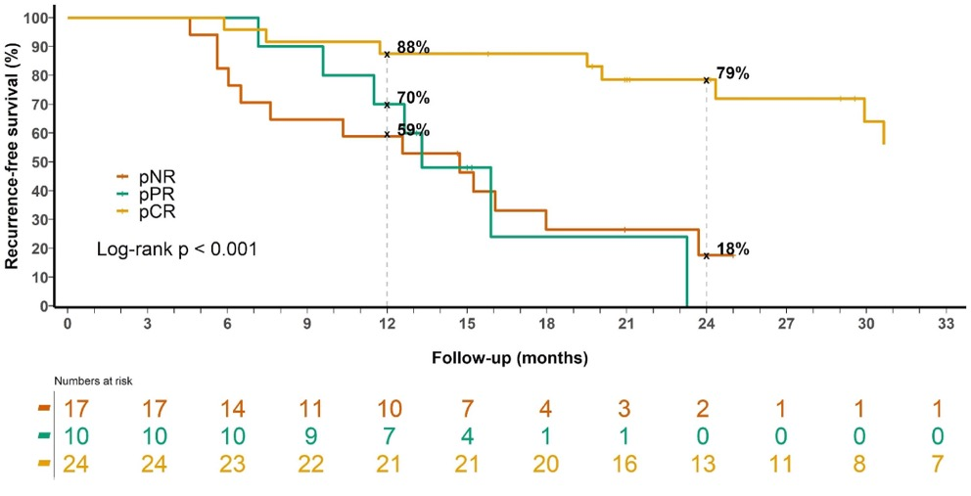
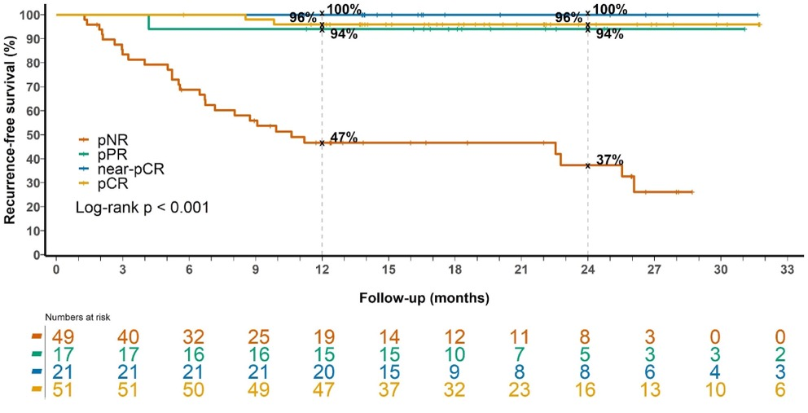
Any Pathological Response After Neoadjuvant Melanoma Therapy
Targeted Therapy Immunotherapy
Need a pCR with targeted therapy Any response with immunotherapy is enough

Slide 7
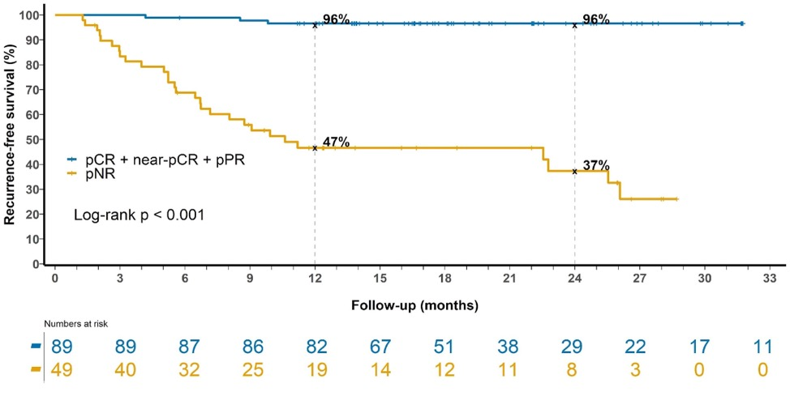
Any Pathological Response After Neoadjuvant Melanoma Therapy
Targeted Therapy Immunotherapy
Need a pCR with targeted therapy Any response with immunotherapy is enough

Slide 8

Relatlimab + Nivolumab
Key eligibility criteria
Resectable stage IIIB/IIIC or oligometastatic stage IV melanoma
ECOG PS 0-1
No prior anti-PD-1, -CTLA-4, or -LAG-3 antibody exposure
N = 30
Neoadjuvant phase
Adjuvant phase
Radiographic assessment
(ORR by RECIST v1.1)
RELA 160 mg + NIVO 480 mg Q4W x 2 doses
RELA 160 mg + NIVO 480 mg Q4W x 10 doses
Clinical and radiographic
follow-up
Pathologic assessment
(pCR rate)
Week
1 and 5
10-46
50-110
Biospecimen collections
Blood
Tumor
(Week 2)
Blood
Tumor
Blood
(Q12W)

Slide 9
Radiographic Response Underestimates Pathologic Response With NIVO-RELA Neoadjuvant Therapy
Of 19 patients with pCR/near pCR, 1 had radiographic PD, 3 SD, 15 PR
Of 8 patients with pNR, only 1 had radiographic PD, 7 had SD
No patients achieved a RECIST 1.1 CR
Pathologic response category
pCR
Near
pCR
Radiographic response
pPR
pNR
NE

Slide 10
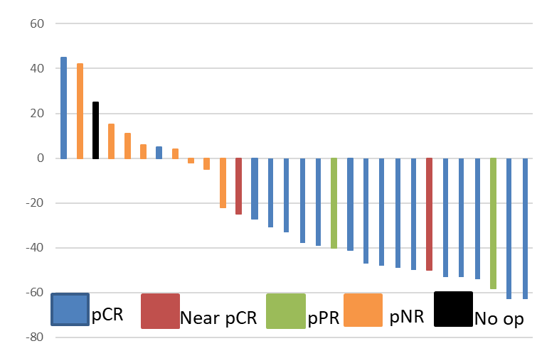
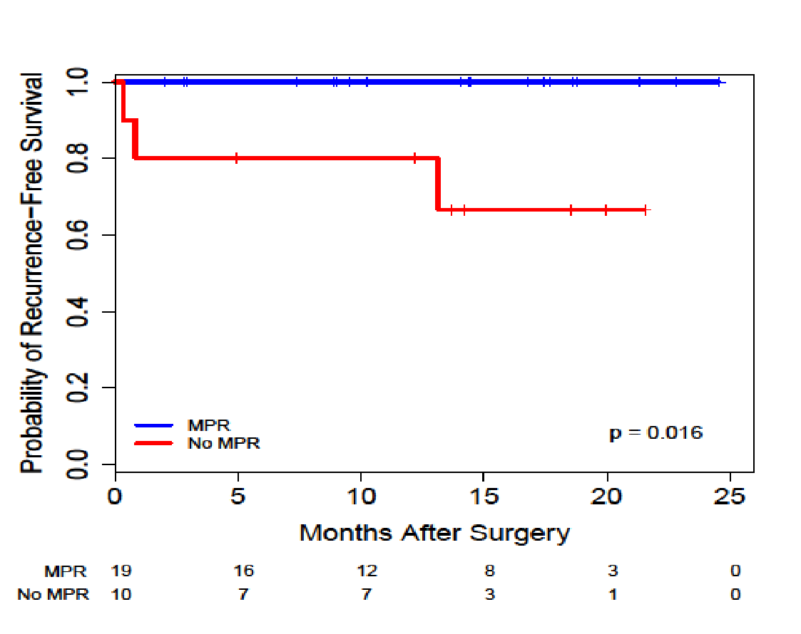
Relatlimab + Nivolumab: Safety and Responses
RECIST 1.1 ORR 57%
27%
59%
7%
7%
pCR
Near pCR
pPR
pNR
0% Grade 3/4 toxicity in neoadjuvant setting
26% Grade 3/4 toxicity in adjuvant setting
Grade 3/4 Toxicity | N (%)
Adrenal Insufficiency | 4 (13)
Transaminitis | 2 (8)
Hyponatremia | 2 (8)
Myalgia | 1 (4)
CPK increase | 1 (4)

Slide 11
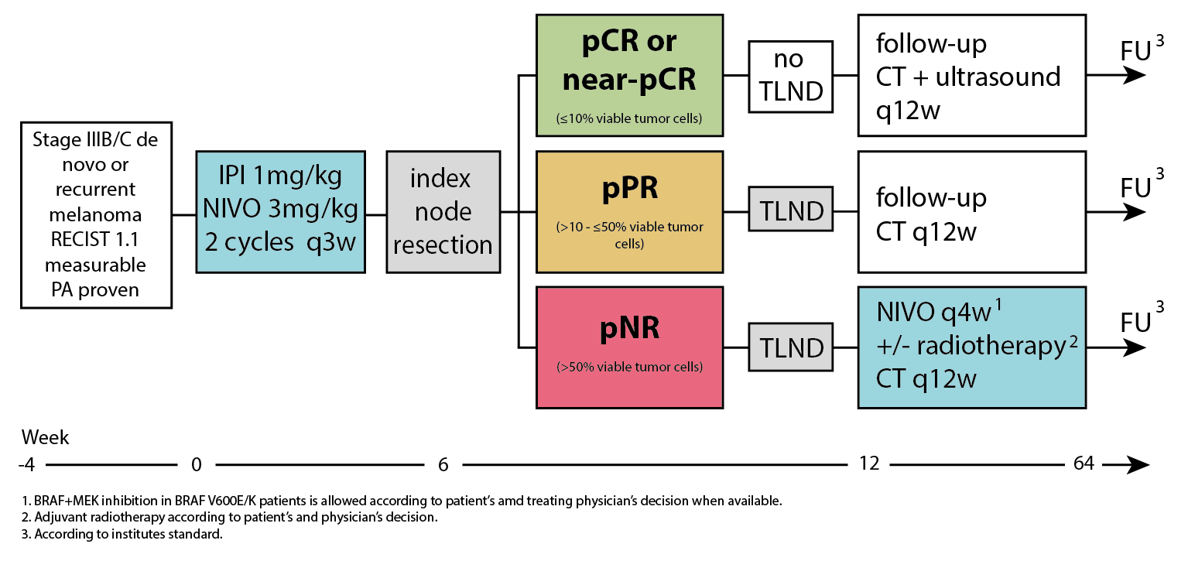
PRADO Neoadjuvant Melanoma Trial: Less Surgery?
High Correlation Between IND and TLND Specimens in OpACIN-neo Substudy
PRADO | Total cohort (n=99) ¹
pRR | 70 (71%)
pCR | 49 (50%)
Near-pCR | 11 (11%)
pPR | 10 (10%)
pNR | 21 (21%)
Not evaluable ² | 1 (1%)
Distant metastases | 7 (7%)
~2/3 avoided CLND and had improved QoL

Slide 12
NeoTrio Study Design (NCT02858921)
Median Follow-up 20.3 Months (Range* 11-51 Months)
ALONE (Pembro)
Pembrolizumab 200 mg IV Q3W x 2
Surgery
6 weeks
Therapeutic lymph node dissection
Adjuvant
Pembrolizumab
200mg IV Q3W
x 15
pNR – investigator choice switch to Dabrafenib+Trametinib
Key Eligibility Criteria
Stage III resectable nodal melanoma
RECIST measurable
V600 BRAF mutation
No in-transits
ECOG PS 0 or 1
n=60
SEQuential (D+T ➔ Pembro)
R 1:1:1
Dabrafenib + Trametinib
1 week
Pembrolizumab 200 mg IV x 2 (day 8 & day 22)
Follow-up
CONcurrent (D+T+Pembro)
Dabrafenib (150mg po bid) +
Trametinib (2mg po qd) + Pembrolizumab 200mg IV Q3W x 2
B
= Biopsy, Stool, Blood
B
B
B
B
B
Endpoints
Primary: Pathological response rate at 6 weeks (pCR + near pCR + pPR), pCR rate
Secondary: RECIST response, event-free survival (EFS), RFS, OS, safety, translational endpoints
Exploratory analyses: Metabolic response, gut microbiome, recurrence melanoma tissue
Data cut 29th April 2022.
*Range calculated for living patients at data cut.

Slide 13
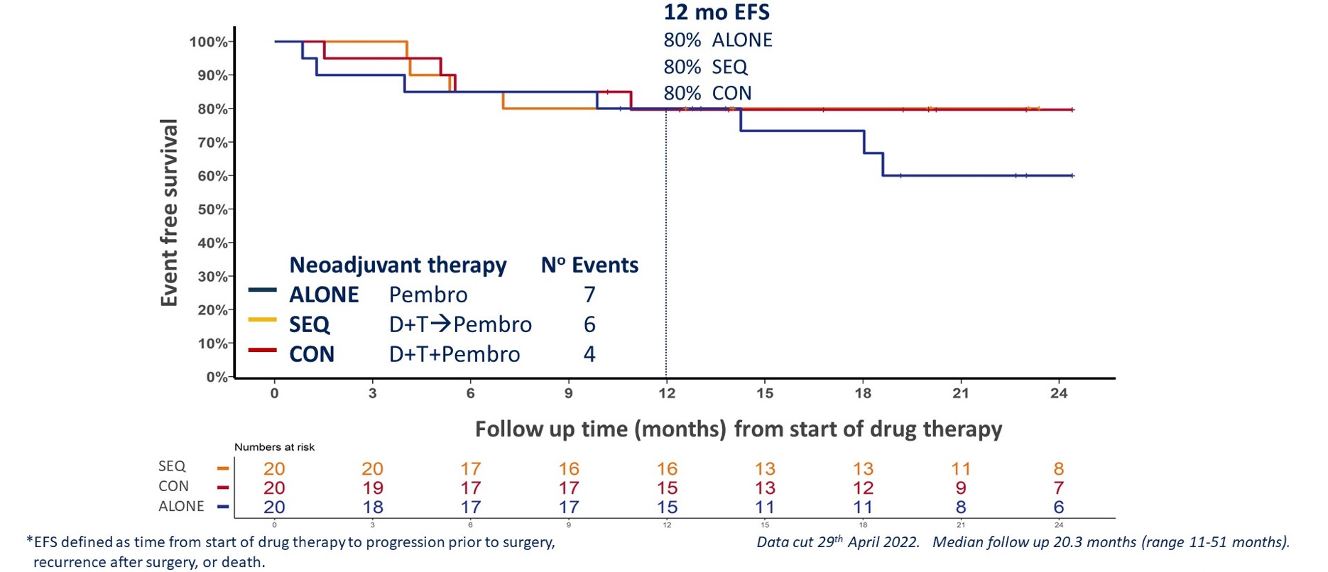
Event-Free Survival (EFS)*

Slide 14
Overview of Neoadjuvant ICI Trials
Trial | Regimen | Doses, n | N | pCR Rate | Grade 3/4 TRAEs
Amaria et al^{1,2} (NCT02519322) | NIVO 480 mg + RELA 160 mg | Up to 2 | 30 | 59% | 26%
 | NIVO 3 mg/kg | Up to 4 | 12 | 25% | 8%
 | IPI 3 mg/kg + NIVO 1 mg/kg | Up to 3 | 11 | 45% | 73%
Rozeman et al^{3,4} (OpACIN-Neo) | IPI 3 mg/kg + NIVO 1 mg/kg | 2 | 30 | 47% | 40%
 | IPI 3 mg/kg ➔ NIVO 3 mg/kg | 2➔2 | 26 | 23% | 50%
 | IPI 1 mg/kg + NIVO 3 mg/kg | 2 | 30 | 57% | 20%
Blank et al⁵ (PRADO) | IPI 1 mg/kg + NIVO 3 mg/kg | 2 | 99 | 49% | 22%
Blank et al^{4,6} (OpACIN) | IPI 3 mg/kg + NIVO 1 mg/kg | 2 | 10 | 33% | 90%
Huang et al⁷ (NCT02434354) | Pembro 200 mg | 1 | 29 | 19% | NR
Cocorocchio et al⁸ | IPI 1 mg/kg + NIVO 3 mg/kg | 4 | 28 | 58% | 21%

Slide 15
S1801 Study Schema
Primary Endpoint: Event-Free Survival
scans
scans
18 cycles pembrolizumab 200 mg IV q3 wk
Adjuvant Arm
Surgery
Resectable stage IIIB-IV
clinically assessable
melanoma
1:1 randomization
scans
scans
scans
3 cycles pembrolizumab 200 mg IV q3 wk
15 cycles pembrolizumab 200 mg IV q3 wk
Neoadjuvant Arm
Surgery
radiographic assessment
(scans)
Additional criteria: strata included AJCC 8th ed. stage and LDH, adjuvant radiation allowed, concomitant radiation & pembrolizumab was not allowed, brain metastasis excluded, uveal melanoma excluded
Surgery type and extent was required to be prespecified and carried out regardless of radiologic response to therapy

Slide 16
Event-Free Survival (EFS): Primary Endpoint
Measured from the date of randomization to the first of the following events:
Progression or toxicity that rendered a study participant unable to receive surgery
Failure to begin adjuvant therapy within 84 days of surgery
Melanoma recurrence after surgery (local, regional, or distant)
Death from any cause
Study participants who did not register to adjuvant therapy were assigned an EFS of 84 days*
*Exceptions: Participant refusal of surgery in the neoadjuvant arm after complete radiographic response not considered an event. Cancellation of surgery or adjuvant therapy due to site-specific COVID-19-related trial limitations not considered an event.

Slide 17
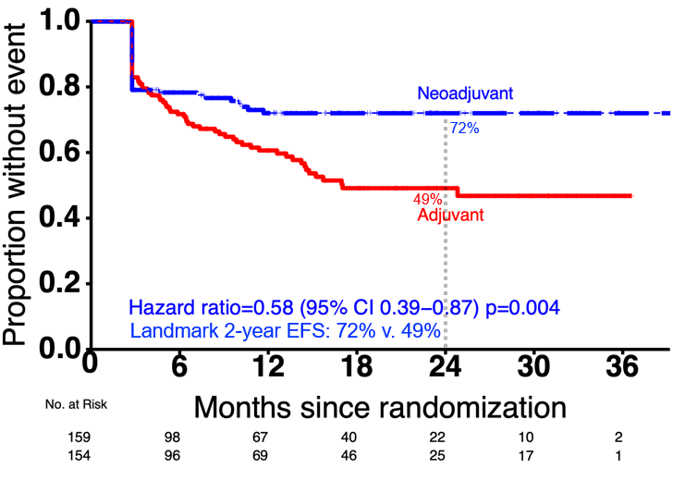
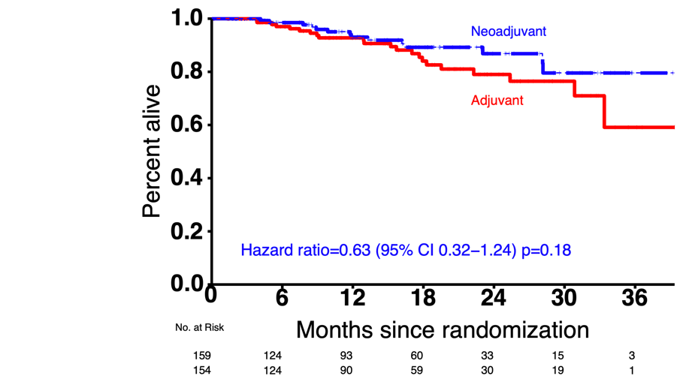
S1801 Results
S1801 primary endpoint: Event-free survival
Overall survival

