Slide 1
What Is the Rationale for Neoadjuvant and Adjuvant Therapy in Melanoma?
Jeffrey S. Weber MD, PhD
Deputy Director
Laura and Isaac Perlmutter Cancer Center
Professor of Medicine
NYU Grossman School of Medicine
New York, NY

Slide 2
Disclaimer
The views and opinions expressed in this educational activity are those of the faculty and do not necessarily represent the views of TotalCME, Inc., the CME providers, or the companies providing educational grants. This presentation is not intended to define an exclusive course of patient management; the participant should use their clinical judgment, knowledge, experience, and diagnostic skills in applying or adopting for professional use any of the information provided herein. Any procedures, medications, or other courses of diagnosis or treatment discussed or suggested in this activity should not be used by clinicians without evaluation of their patient's conditions and possible contraindications or dangers in use, review of any applicable manufacturer’s product information, and comparison with recommendations of other authorities. Links to other sites may be provided as additional sources of information.

Slide 3
Rationale Supporting the Use of Adjuvant Therapy
Tumor is removed with less immune suppression
Long track record of success of adjuvant trials in breast, lung, colon cancer
Patients have good performance status having recovered from surgery
Destruction of micrometastases → prevent distant disease spread
A potential pathway for new drug evaluation/registration

Slide 4
Rationale Supporting the Idea of Neoadjuvant Therapy
Tumor shrinkage → more resectable, with decreased surgical morbidity
Destruction of micrometastases → prevent distant disease spread
Objective measure of patient’s response to therapy → personalization of adjuvant therapy subsequently
Opportunity to collect serial biospecimens of tumor to promote our understanding of drug response and resistance
A potential pathway for new drug evaluation/registration

Slide 5
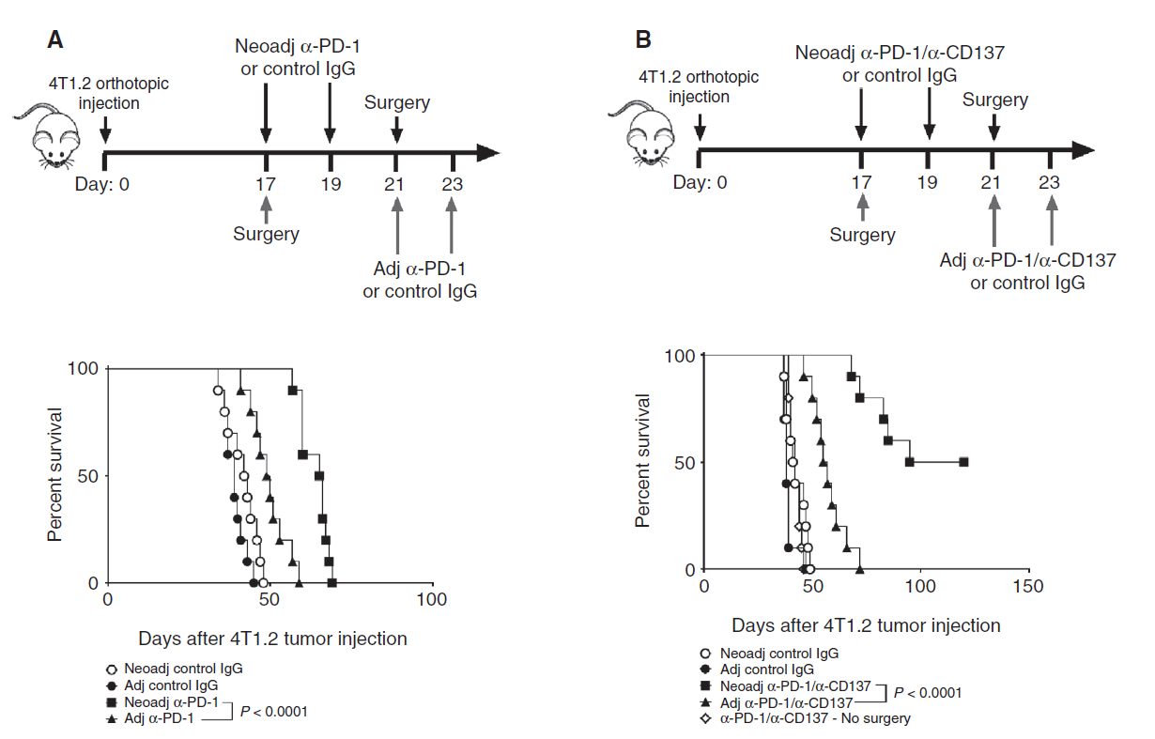
Preclinical Data Suggest that Neoadjuvant Checkpoint Inhibition is Superior to Adjuvant Checkpoint Inhibition

Slide 6
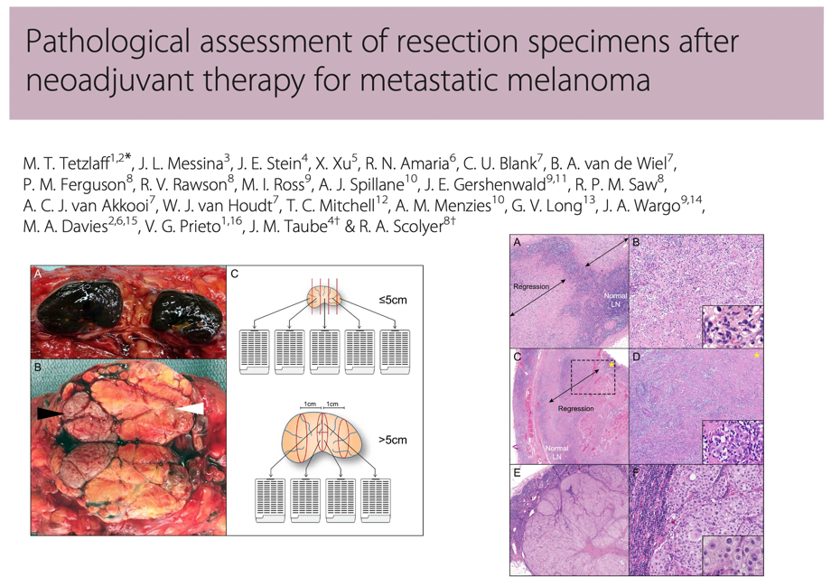
White paper on neoadjuvant trial design
Shaping the Future of Neoadjuvant Systemic Therapy in Melanoma: Recommendations of the International Neoadjuvant Melanoma Consortium (INMC)
Agreed principles for neoadjuvant trials:
Population
Duration of therapy
Biospecimens
Endpoints

Slide 7
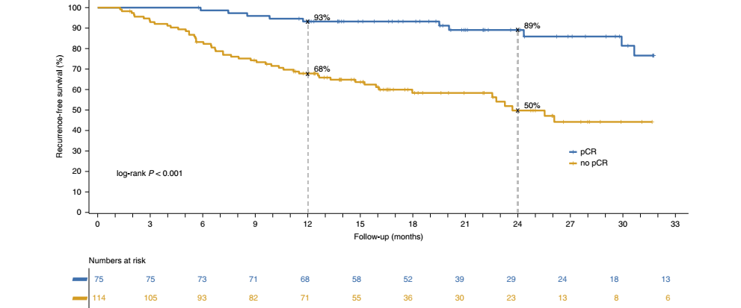
Improved RFS for Neoadjuvant Patients With Pathologic CR (pCR) Compared to Non-pCR Patients
Pooled Analysis of 189 Neoadjuvant Targeted Therapy and Immunotherapy-Treated Patients

Slide 8
Adjuvant Ipilimumab Prolongs Overall Survival in Stage III Melanoma
100
 | Ipilimumab | Placebo
Deaths/patients | 162/475 | 214/476
HR (95.1% CI)ª | 0.72 (0.58, 0.88)
Log-rank P valueª | 0.001
90
80
70
65%
60
54%
ªStratified by stage provided at randomization.
OS
50
Patients Alive (%)
40
30
20
10
0
0
1
2
3
4
5
6
7
8
Years
O
N
Number of patients at risk
162
475
431
369
325
290
199
62
4
Ipilimumab
214
476
413
348
297
273
178
58
8
Placebo

Slide 9
Recent Neoadjuvant Studies Carried Out or In Progress
Intralesional
Checkpoint Inhibition
TVEC
CMP-001 + nivolumab
Pembrolizumab monotherapy
Nivolumab monotherapy
IPI 3 mg/kg + NIVO 1 mg/kg
IPI 1 mg/kg + NIVO 3 mg/kg
IPI + NIVO + domatinostat
Relatlimab + nivolumab
BRAFi + MEKi
Dabrafenib + trametinib ± pembrolizumab
Vemurafenib + cobimetinib ± atezolizumab

Slide 10
Recent Adjuvant Studies Carried Out or In Progress
BRAFi + MEKi
Checkpoint Inhibition
Encorafenib and binimetinib for resected stage III disease
Nivolumab vs placebo for stage IIB/IIC disease
Nivolumab + relatlimab vs nivolumab for resected stages III/IV disease
Pembrolizumab + TIGIT vs pembrolizumab for resected stage III/IV disease

