Slide 1
Who is Eligible for Neoadjuvant or Adjuvant Immunotherapy?
Brian Gastman, MD
Surgical and Co-Director
CCF Melanoma and High-Risk Skin Cancer Program
Taussig Cancer Center
Professor and Vice Chairman
Cleveland Clinic Department of Plastic Surgery
Cleveland, OH

Slide 2
Disclaimer
The views and opinions expressed in this educational activity are those of the faculty and do not necessarily represent the views of TotalCME, Inc., the CME providers, or the companies providing educational grants. This presentation is not intended to define an exclusive course of patient management; the participant should use their clinical judgment, knowledge, experience, and diagnostic skills in applying or adopting for professional use any of the information provided herein. Any procedures, medications, or other courses of diagnosis or treatment discussed or suggested in this activity should not be used by clinicians without evaluation of their patient's conditions and possible contraindications or dangers in use, review of any applicable manufacturer’s product information, and comparison with recommendations of other authorities. Links to other sites may be provided as additional sources of information.

Slide 3
Conflict of Interest Statement
I have consulting agreements with: Quest imaging, Castle Biosciences, Merck, BMS, Alkermes, NIT, Instill Bio, and IOVANCE.
I will not promote any product in this talk.

Slide 4
Adjuvant therapy
Generally, a term used for postsurgical therapy after rendering a patient no evidence of disease (NED)
Neoadjuvant
Defined as a specific time/dose treatment to be given before a DEFINED surgery
This is distinct from giving a nonsurgical therapy for an unprescribed amount/length and then performing surgery when that does not work
Rarely given without ALSO giving adjuvant therapy

Slide 5
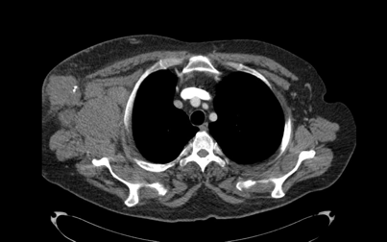
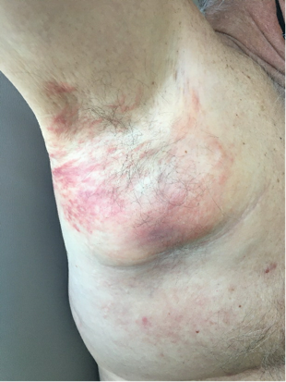
Case
61-year-old white man, healthy
5/26/21: Excision, right midback: Melanoma. Maximum tumor thickness 1.3 mm, ulceration not identified
7/6/21: WLE and SLNB: No residual melanoma, 0/3 sentinel lymph nodes involved with melanoma
6/9/22: Right axillary mass, FNA: Melanoma
6/21/22: MRI brain: NED; CT C/A/P: Bulky right axillary and subpectoral lymphadenopathy. Indeterminate sub-cm right posterolateral perinephric nodule
Stage IIIC, BRAF-negative

Slide 6
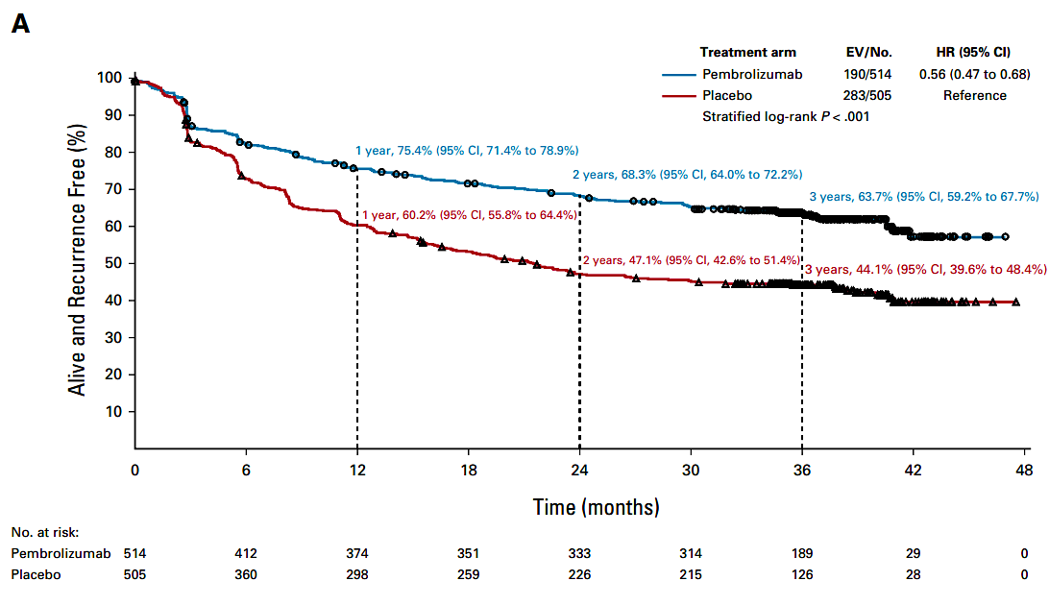
Considerations
Recurrence-free survival by treatment group in Keynote-054
High risk disease
There is a 4/10 chance will recur with surgery and adjuvant IO

Slide 7
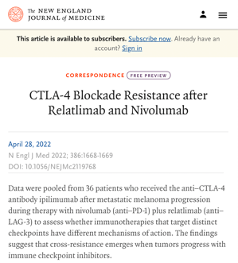
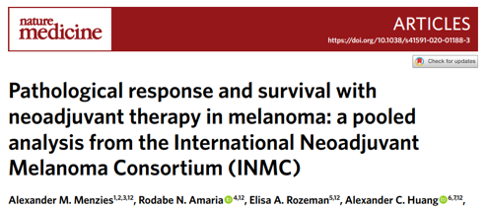
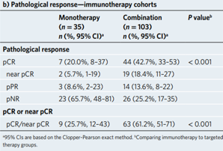
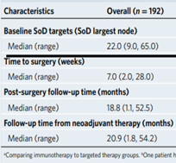
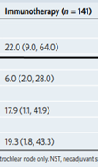
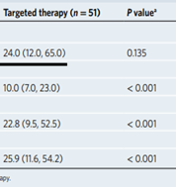
Considerations
What About Neoadjuvant?
New field
Monotherapy <1/3 chance of efficacy
Ipi/nivo- AEs? Save as back up
2021 ASCO – rela/nivo better than nivo, but not peer reviewed AND…
Apples and Oranges
Pathological response and survival with neoadjuvant therapy in melanoma¹
Pathological response – immunotherapy cohorts
Baseline Patient Characteristics

Slide 8
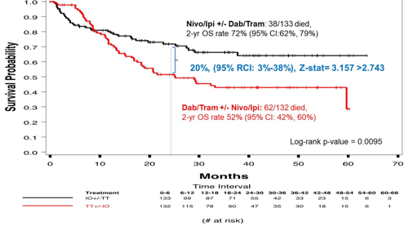
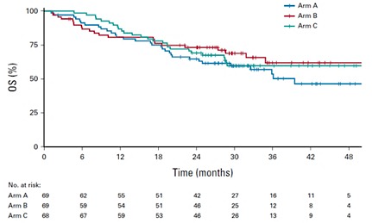
Considerations
DREAMseq Overall Survival Data
What if he was BRAF-positive?
Impact of Dreamseq¹? SECOMBIT²?
How important for QOL is having a pill vs q3-4wk IVs
Does age matter?
SECOMBIT Kaplan-Meier Survival Curves According to Treatment Arm

Slide 9
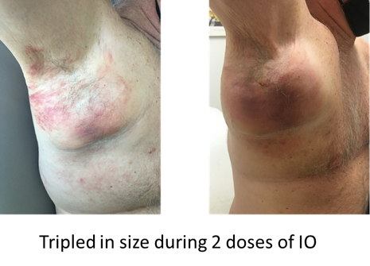
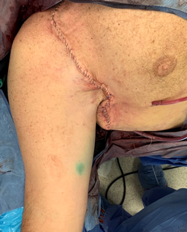
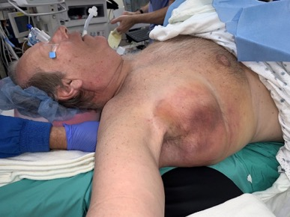
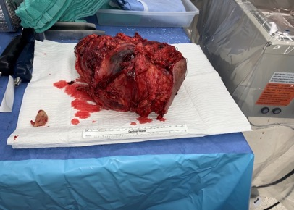
Outcome
Given 2 cycles of nivolumab/relatlimab
Had to take axillary vein and strip off pleura
Doing well; now what?

Slide 10
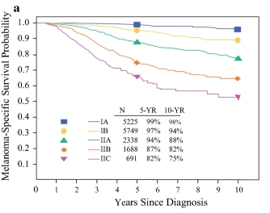
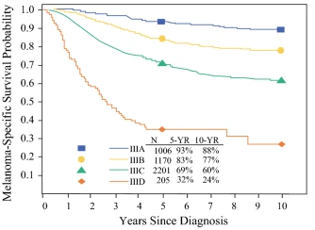
Indications: It is all about risk and toxicities, QOL . . .
Kaplan-Meier Melanoma-Specific Survival Curves According to Stage
Stages IIB and IIC almost as bad as IIIC
Stage IIIA almost as good as IB
Currently neoadjuvant therapy only for resectable macroscopic disease generally stage IIIC-IV

Slide 11
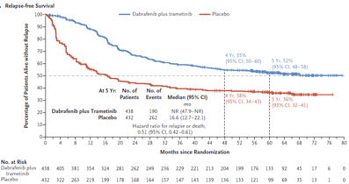
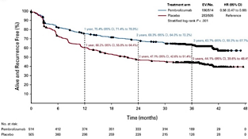
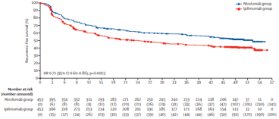
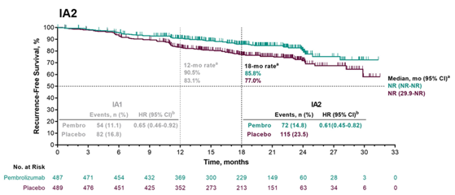
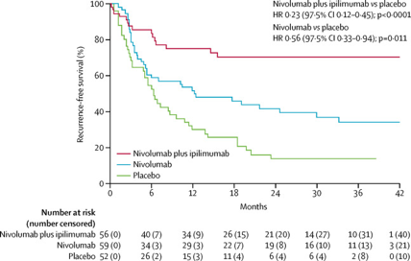
Stage IIIA-C; Keynote-054 (pembrolizumab vs placebo)²
Relapse Risk is Changed with Approval of Modern Adjuvant Therapies
Stage IIIB-IV; CheckMate-238 (nivolumab vs ipilimumab)¹
Stage IIIA (limited to lymph-node metastasis of >1 mm), IIIB, or IIIC; Combi-AD (dabrafenib/trametinib vs placebo)³
Stage IIB-IIC; Keynote-716 (pembrolizumab vs placebo)⁴
Stage IV; IMMUNED (ipilimumab/nivolumab (full dose) vs nivolumab vs placebo)⁵

Slide 12
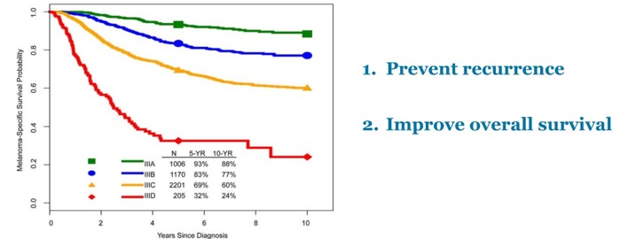
Why Do We Need Adjuvant Therapy?
The Current Problem With Adjuvant Therapy
Eggermont AMM, et al. J Clin Oncol. 2020;38(33):3925-3936.
Gershenwald JE, et al. CA Cancer J Clin. 2017;67(6):472-492.
Ramifications of SLNB
Outcomes With Macrometastases Not Good Enough
1. Eggermont AMM, et al. J Clin Oncol. 2020;38(33):3925-3936.
2. Luke JJ, et al. Lancet. 2022;399(10336):1718-1729.
1. Long GV, Haet al. N Engl J Med. 2017;377(19):1813-1823.
2. Weber JS, et al. J Clin Oncol. 2018;36(15)suppl.9502.

Slide 13
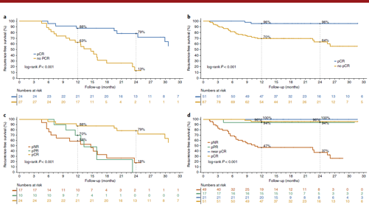
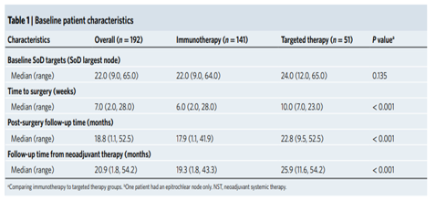
Neoadjuvant Therapy: Advantages
Kaplan-meier Estimates of RFS Based On
Pathological Response (Treatment Cohorts)
Can train the immune system while there is still gross tumor
In adjuvant setting there is no tumor microenvironment
Can be used to predict outcome
Based on pathological response
Need appropriate pathologist
Many research opportunities
Can build in a delay in surgery
May be necessary when tumor is growing and cannot get into surgery quickly
Was particularly helpful during COVID

Slide 14
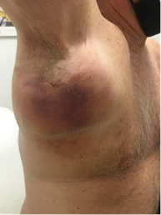
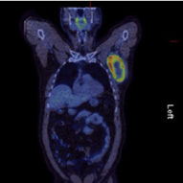
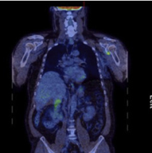
Neoadjuvant Therapy: Disadvantages
Tumor can grow in the interim and make surgery more difficult or even inappropriate
What to do if no radiologic disease left
Not operate?
Impact of PRADO?
Radiology shown not to be very predictive of tumor effect of therapy
Tripled in size during 2 doses of IO

Slide 15
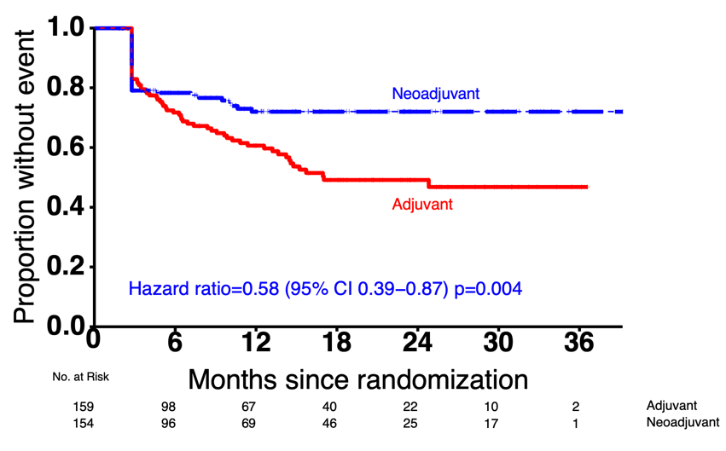
Hot Off the Presses: S1801
Primary Endpoint: Event-Free survival
72%
49%
Landmark 2-year EFS: 72% v. 49%

Slide 16
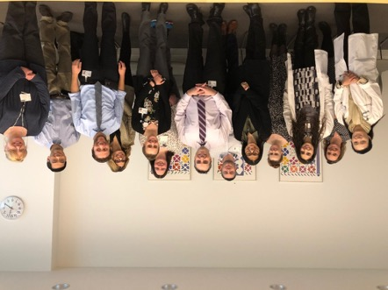
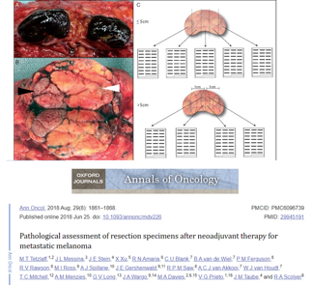
Neoadjuvant Therapy Ramifications for Surgeons
Need to know when and who to send for this therapy
Need a willing medical oncology partner to administer
Need to convince: Patient, referring physician, and YOURSELF that this is the right thing to do
Be prepared for the patient who gets adverse events from therapy; grows through therapy (inoperable?); has an amazing response
Consider being part of a multidisciplinary team to maximize patient benefit and outcome, including pathology
Cleveland Clinic Tumor Board Prepandemic

