Slide 1
Is There a Chemo-Free Approach for Early-Stage NSCLC?
Jonathan D. Spicer, MD, PhD, FRCSC
Associate Professor of Surgery
McGill University
Quebec, Canada

Slide 2
Disclaimer
The views and opinions expressed in this educational activity are those of the faculty and do not necessarily represent the views of TotalCME, Inc., the CME providers, or the companies providing educational grants. This presentation is not intended to define an exclusive course of patient management; the participant should use their clinical judgment, knowledge, experience, and diagnostic skills in applying or adopting for professional use any of the information provided herein. Any procedures, medications, or other courses of diagnosis or treatment discussed or suggested in this activity should not be used by clinicians without evaluation of their patient's conditions and possible contraindications or dangers in use, review of any applicable manufacturer’s product information, and comparison with recommendations of other authorities. Links to other sites may be provided as additional sources of information.

Slide 3
Why Consider a Chemo-Free Approach?
Comes with toxicity¹
  Grade 3-4 AE rate=66%
  Grade 5 AE rate=0.9%
NATCH trial shows similar rates of AEs when chemo is given before surgery²
Many patients are ineligible or decline chemotherapy despite the potential survival benefits

Slide 4
Chemo-Free Periadjuvant Therapy Data Are Sparse
No ongoing phase 3 registrational trials currently explore eliminating chemotherapy from perioperative regimen from existing indications for nondriver mutated resectable NSCLC
Many phase 2 data indicate promise of the approach but are not approved regimens

Slide 5
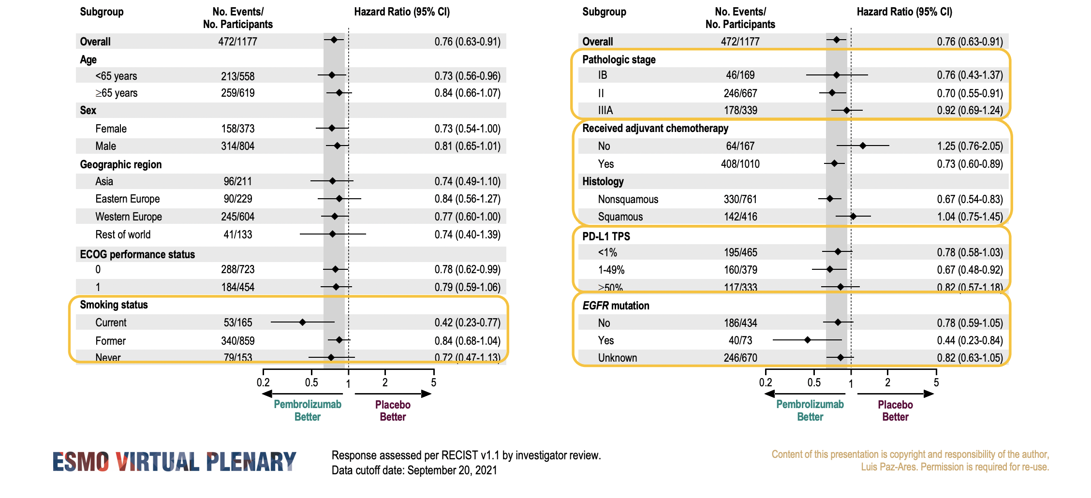
Chemo-Free Adjuvant Therapy
EORTC-1416-LCG/ETOP 8-15-PEARLS/KEYNOTE-091
DFS in Key Subgroups, Overall Population

Slide 6
Chemo-Free Neoadjuvant Therapy
No phase 3 data
Several promising phase 2 trials:
  IO monotherapy
  IO-IO combinations
  IO+radiation therapy
Pipeline:
  IO+targeted therapy (KRAS G12C)
  IO+microbiome manipulation

Slide 7
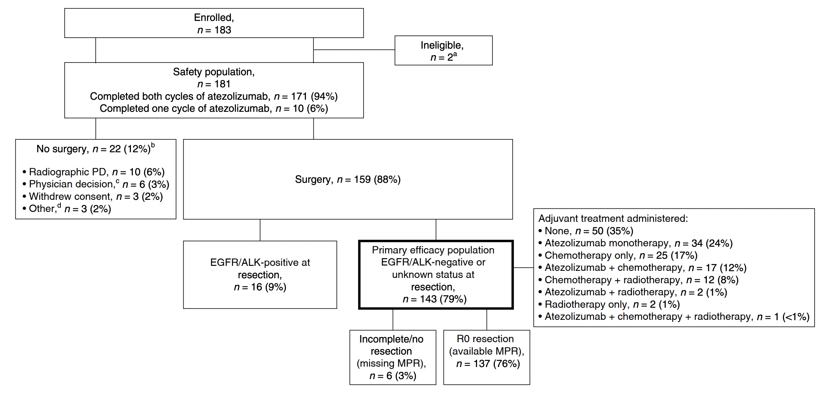
LCMC3 Trial: Neoadjuvant Atezolizumab

Slide 8
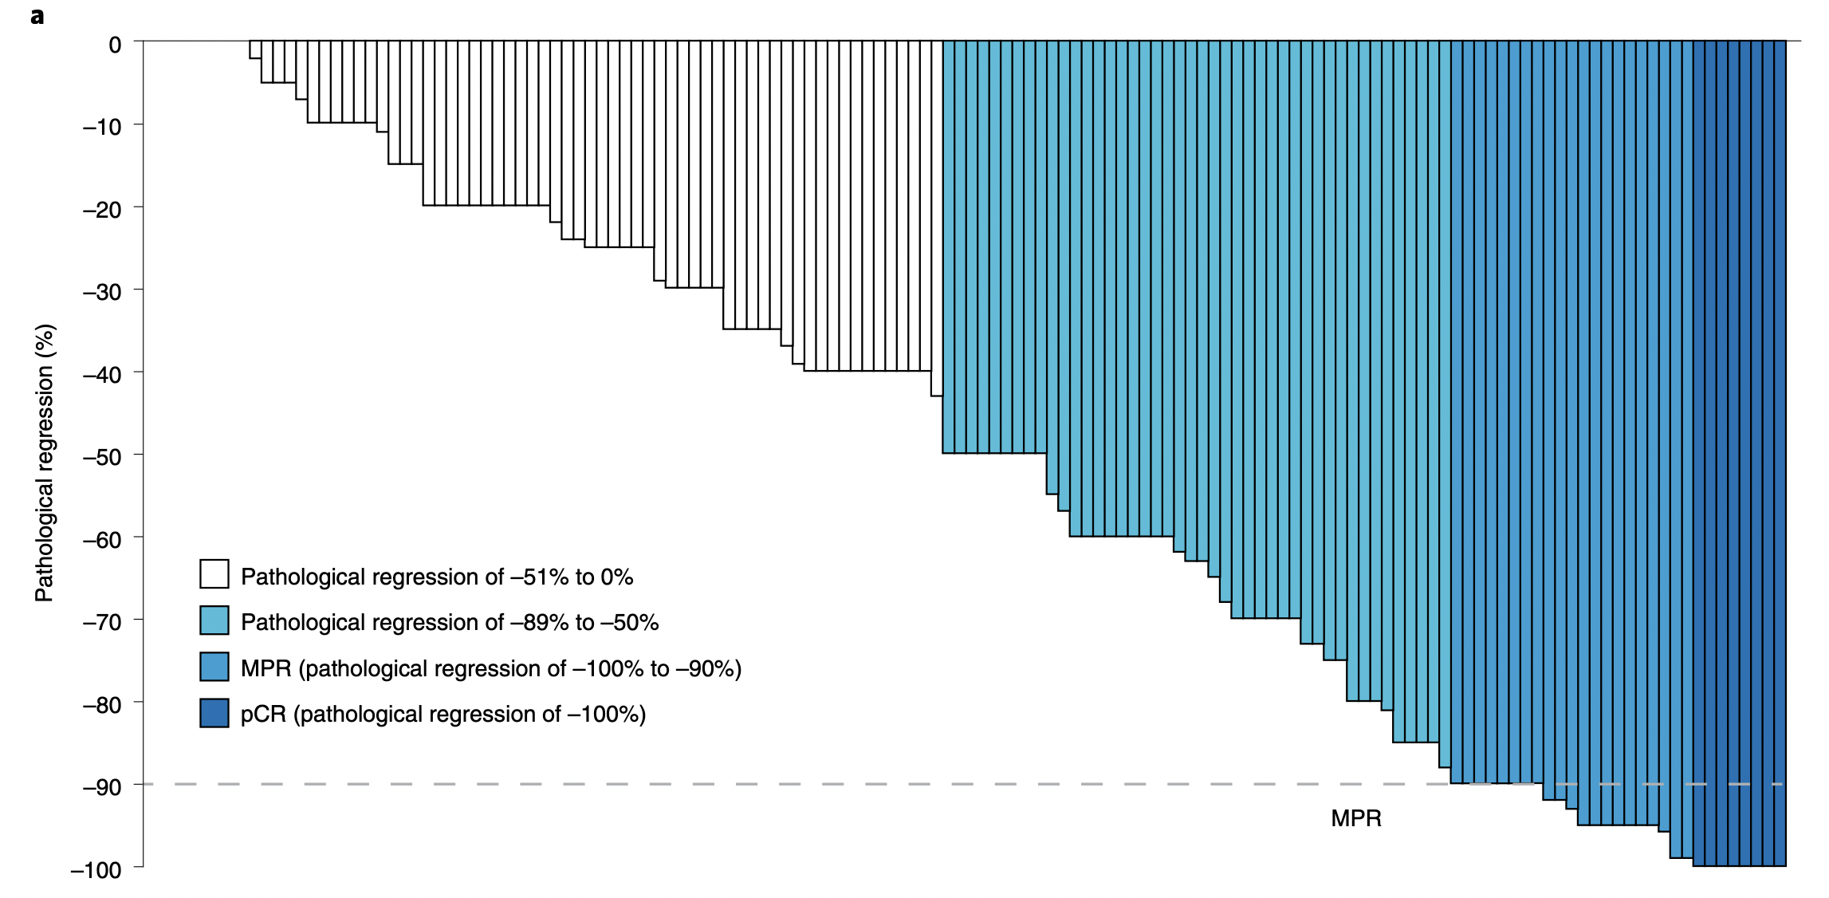
LCMC3: Pathological Response
n=143
Pathological regression is defined as percentage viable tumor cells – 100%

Slide 9
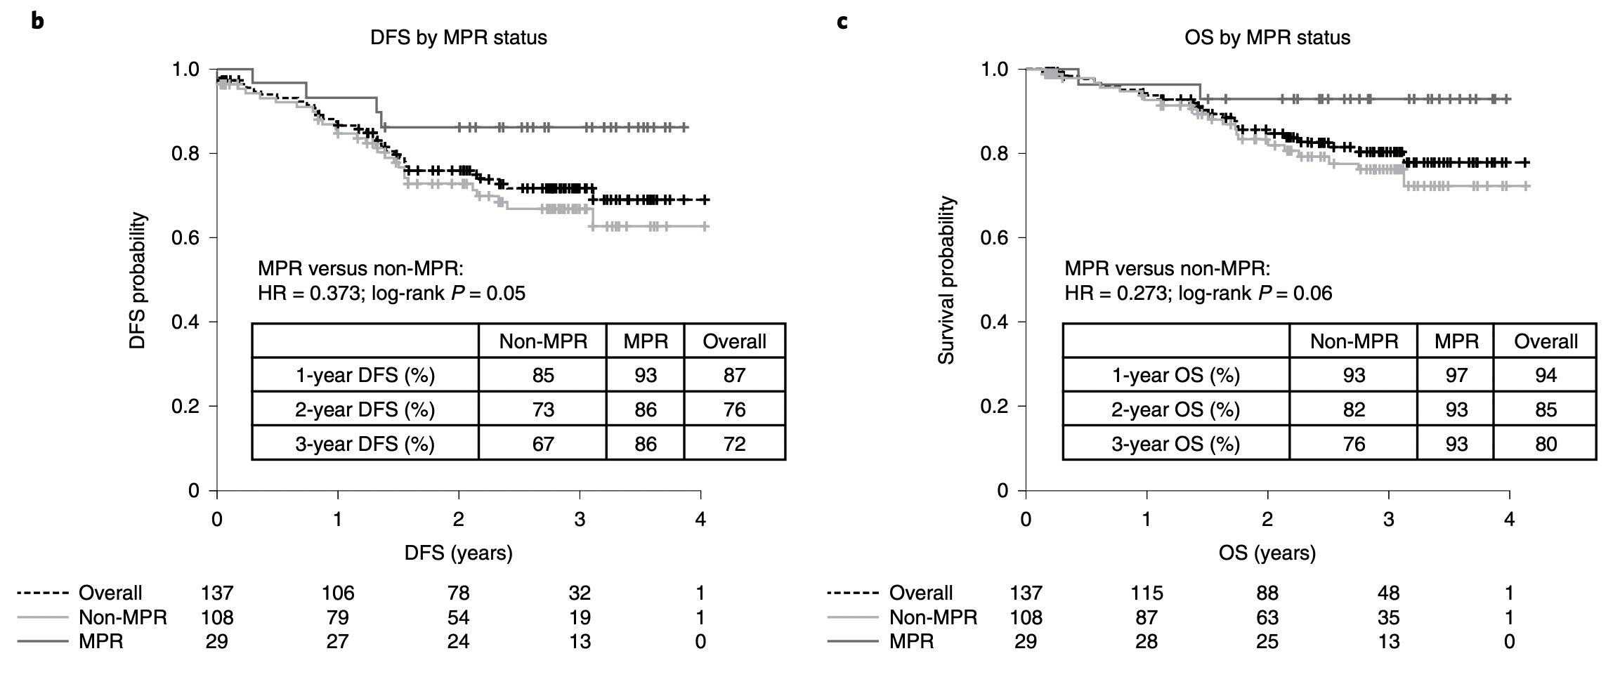
LCMC3: DFS and OS by MPR Status
DFS by MPR status in patients with R0 resections (n=137)
OS by MPR status in patients with R0 resections (n=137)

Slide 10
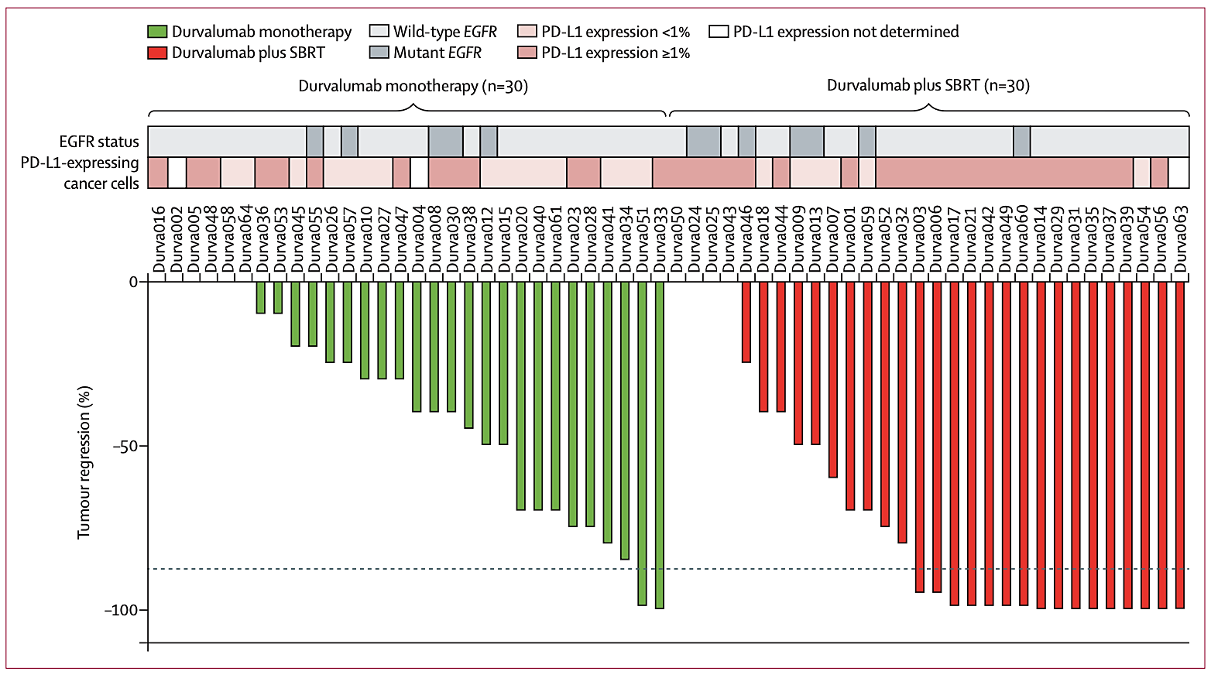
Neoadjuvant Durvalumab ± Stereotactic Body Radiotherapy (SBRT) in Early-Stage NSCLC: Phase 2

Slide 11
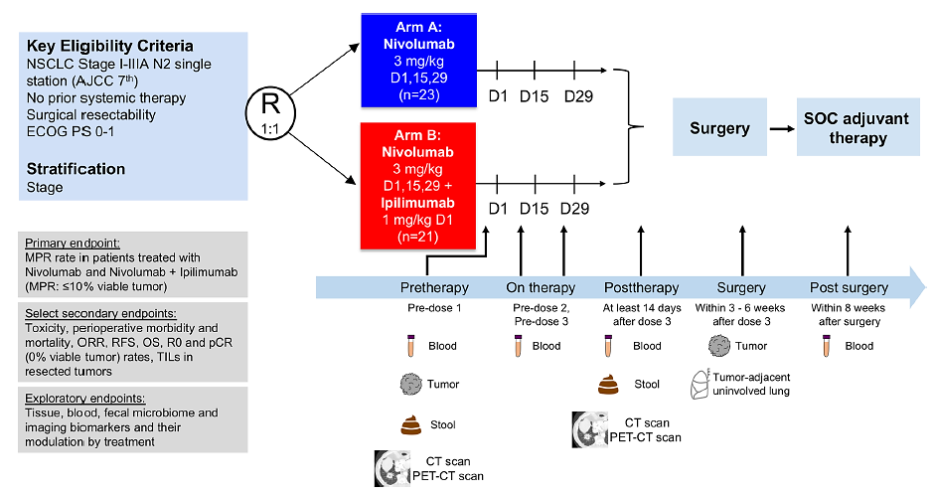
NEOSTAR Trial Schema

Slide 12
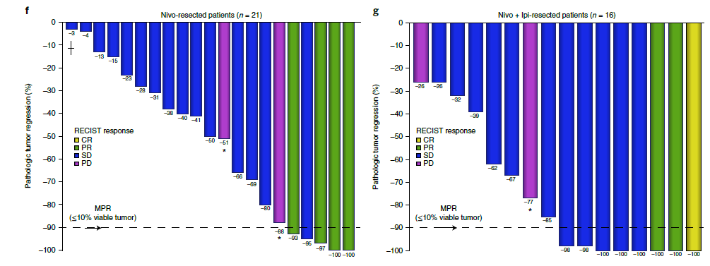
NEOSTAR: Pathologic Response to Neoadjuvant Nivolumab and Nivolumab + Ipilimumab
Pathologic tumor regression (% viable tumor − 100%) Dashed black line represents MPR
*Indicates the overall response of PD due to the presence of enlarging and/or new lesions
┼indicates that the solid lesion was <1 cm, considered to be SD

Slide 13
NeoCOAST: Neoadjuvant Durvalumab +/– Novel Agents in Resectable, Early-Stage (I [>2cm] to IIIA) NSCLC
One 28-day treatment cycle
 | Durva (n=27) | Durva + Ole (n=21) | Durva + Mona (n=20) | Durva + Danva (n=16)
Overall MPR (n/N, %) | 3/27 (11%) | 4/21 (19%) | 6/20 (30%) | 5/16 (31%)
PD-L1+ | 0/6 (0%) | 2/5 (40%) | 3/6 (50%) | 0/2 (0%)
PD-L1– | 0/3 (0%) | 1/6 (16.7%) | 0/2 (0%) | 0/5 (0%)
PD-L1 NE | 3/18 (17%) | 1/10 (10%) | 3/12 (25%) | 5/9 (56%)
Stage I (>2cm) to IIIA NSCLC*
Fully resectable
ECOG PS 0 or 1
No prior systemic therapy
Adequate organ and marrow function
N=84
Durva Q4W
Days 29–42
Day 105
Durva Q4W + Ole Q2W
Surgery
End of study
R
Stratification by lymph node involvement
(Yes/No)
Durva Q4W + Mona Q2W
7-day lead-in period
Danva
(Days 1, 3, and 5)
Durva Q4W + Danva QW†
Follow up
Primary endpoint: MPR rate (proportion of patients with ≤10% residual viable tumor cells in resected tumor specimen and sampled nodes at surgery) per investigator assessment
A single cycle of neoadjuvant durva combined with ole, mona, or danva produced numerically improved MPR rates (19-31.3%) compared with durva alone (11.1%)¹
MPR was associated with baseline tumor PD-L1 expression in durva+ole and durva+mona arms

Slide 14
Conclusions
Periadjuvant chemotherapy remains a cornerstone of therapy to optimize outcomes for resectable NSCLC
No approved therapies for chemotherapy-ineligible patients at this current time
Many compelling phase 2 data to suggest that a chemo-free option may be appropriate, and even desirable, in specific patient subsets
Many questions need to be addressed regarding how chemotherapy can be optimized in combination with IO to minimize adverse events, optimize quality of life and pathological/survival outcomes

