Slide 1
How and When Should I Assess Response to Neoadjuvant and Adjuvant ICI Therapy?
Jonathan D. Spicer, MD, PhD, FRCSC
Associate Professor of Surgery
McGill University
Quebec, Canada

Slide 2
Disclaimer
The views and opinions expressed in this educational activity are those of the faculty and do not necessarily represent the views of TotalCME, Inc., the CME providers, or the companies providing educational grants. This presentation is not intended to define an exclusive course of patient management; the participant should use their clinical judgment, knowledge, experience, and diagnostic skills in applying or adopting for professional use any of the information provided herein. Any procedures, medications, or other courses of diagnosis or treatment discussed or suggested in this activity should not be used by clinicians without evaluation of their patient's conditions and possible contraindications or dangers in use, review of any applicable manufacturer’s product information, and comparison with recommendations of other authorities. Links to other sites may be provided as additional sources of information.

Slide 3
Disclaimer
There is little definitive data to guide our decisions in this space

Slide 4
Key Measures of Response After Neoadjuvant Therapy
CT chest (contrast infused)
Required by all neoadjuvant immunotherapy protocols to date
Provides useful information on clinical downstaging
Helpful for surgical planning
Poor correlation of RECIST findings with pathological response¹
PET scan
Not required by all neoadjuvant protocols
Can provide helpful information on metabolic response
Might be more sensitive for assessment of metastatic progression
Can also provide spurious changes related to inflammation in response to ICI (nodal immune flare)²

Slide 5
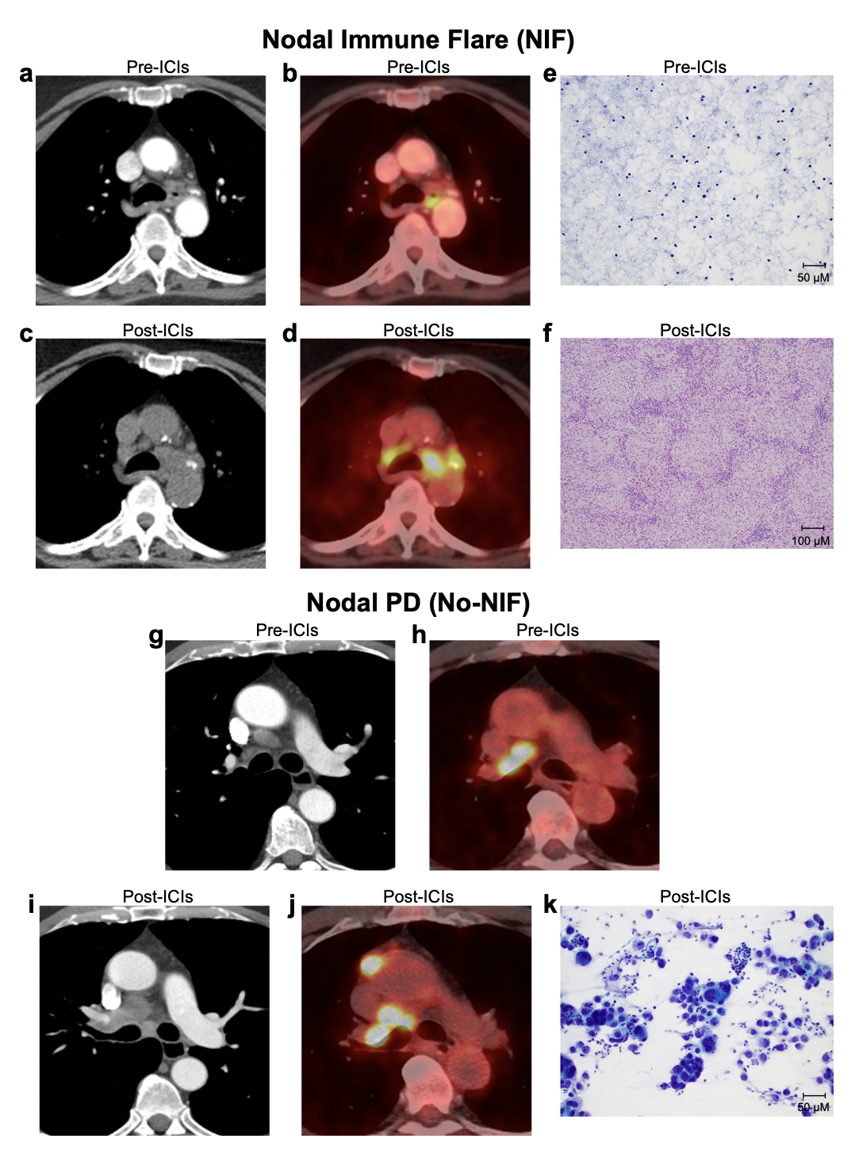
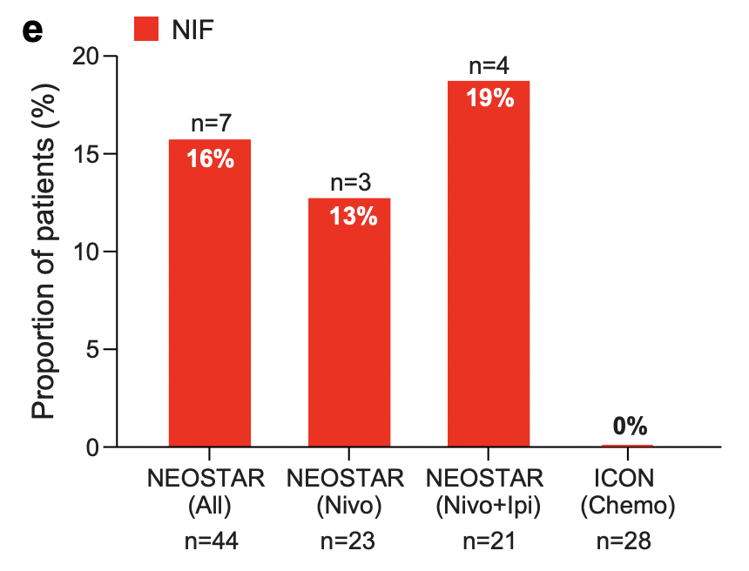
Radiological and Histopathological Features of Abnormal Nodes Following Neoadjuvant Immune Checkpoint Inhibitor Therapy

Slide 6
Key Measures of Response After Neoadjuvant Therapy
Invasive mediastinal restaging
Classically utilized based on data from neoadjuvant chemoradiation trials
Most helpful in setting of suspected contralateral nodal progression
Not mandated in most neoadjuvant immunotherapy trials
ctDNA
Complete molecular response associated with higher likelihood of complete pathological response¹
Sensitivity is still low, particularly for nonsquamous histologies
Pathological complete response (PCR)
Rigorous assessment for biological efficacy of neoadjuvant treatment
Tightly correlated with survival in two randomized studies^{1, 2}

Slide 7
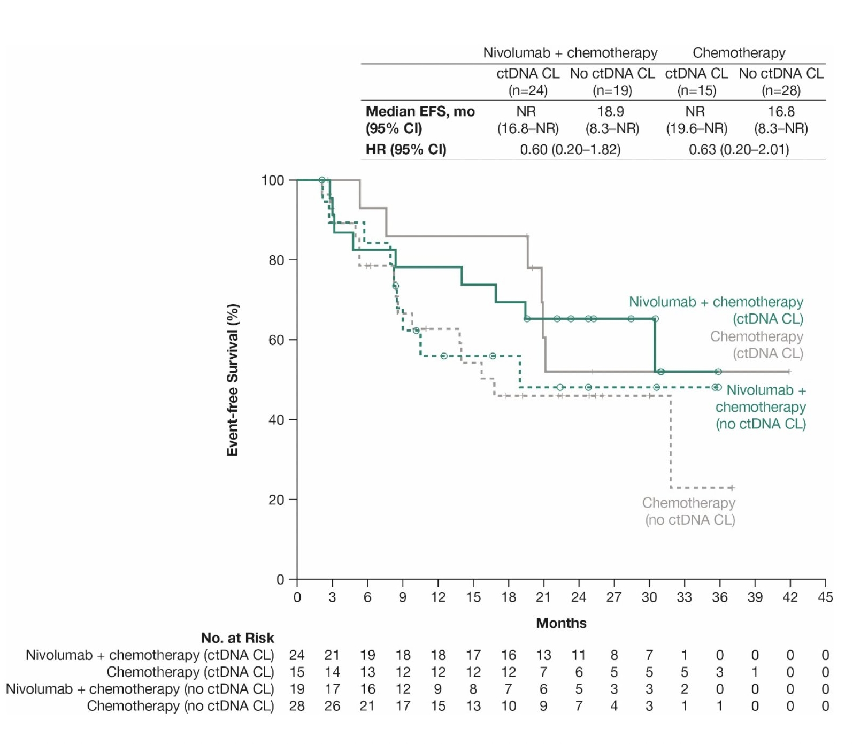
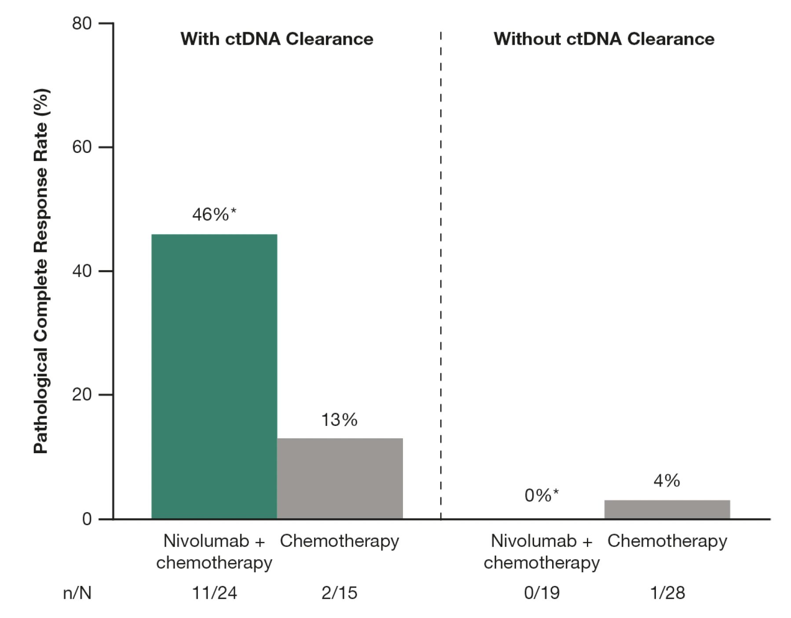
Event-Free Survival and pCR in Patients With and Without ctDNA Clearance (CheckMate 816)
ctDNA analyses were performed on plasma samples collected on day 1 before each of the
three treatment cycles
* 95% CI for pCR rate with nivolumab plus chemotherapy: with ctDNA CL, 26–67; without
ctDNA CL, 0–18
CI, confidence interval; HR, hazard ratio; NR, not reached

Slide 8
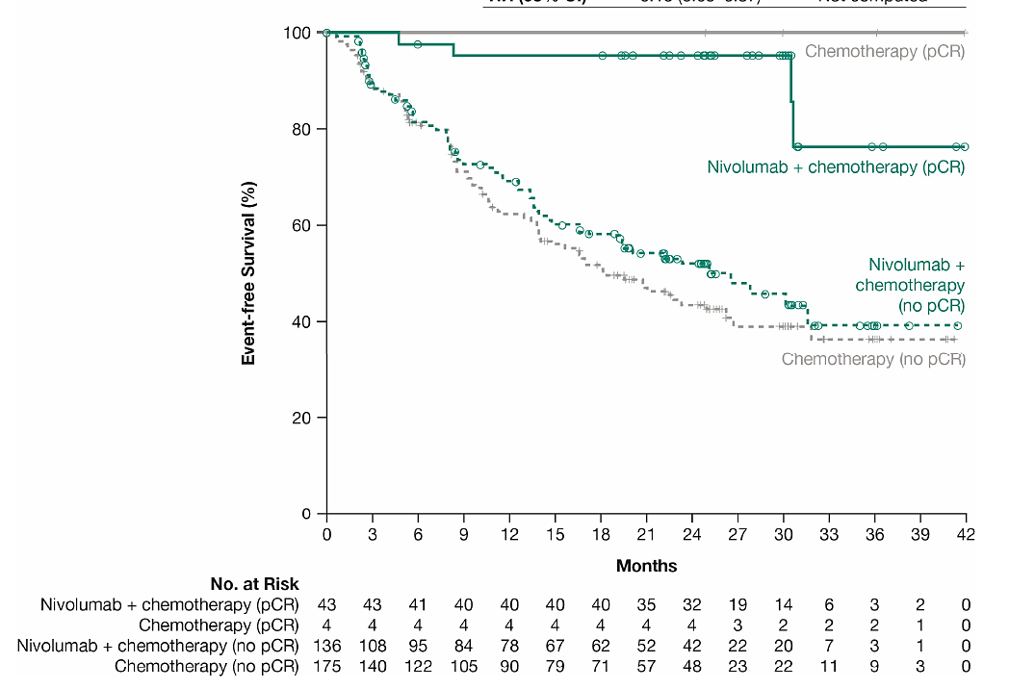
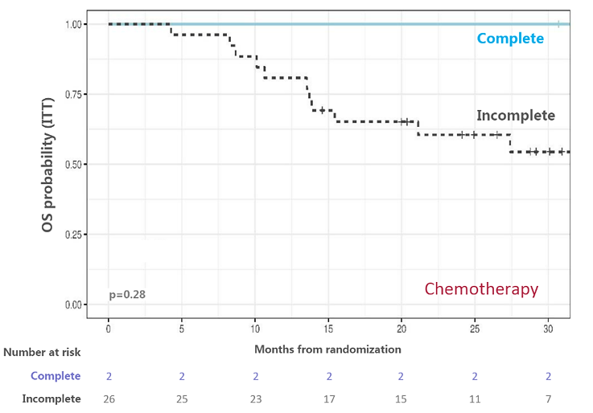
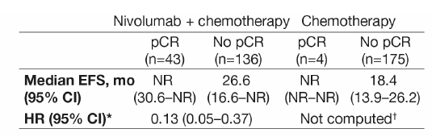
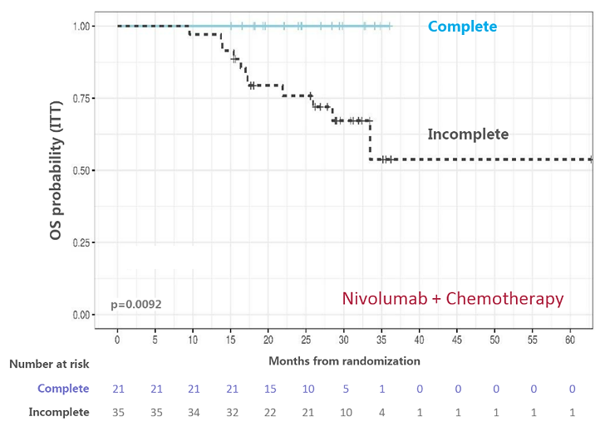
Pathological Complete Response and Survival Are Highly Correlated
CheckMate 816¹
NADIM II²
* Hazard ratio (HR) (95% confidence interval [CI]) for nivolumab plus chemotherapy versus
chemotherapy in patients without a pathological complete response (pCR) was 0.84 (0.61–1.17)
† HR was not computed for the chemotherapy arm due to only 4 patients having a pCR
EFS , event-free survival; NR, not reached

Slide 9
Summary: Assessing Response to Neoadjuvant Therapy
Limited data to support our decisions prior to surgery
Contrast infused CT of chest is minimal requirement
PET rarely changes management but can lead to confusing findings
There currently is no imaging modality that consistently predicts the degree of pathological response
Invasive mediastinal restaging should be done when there is convincing proof of contralateral nodal progression
ctDNA assessments remain in the realm of research with no proven utility at this time
pCR is currently the most meaningful measure of response after neoadjuvant chemo-immunotherapy

Slide 10
Key Measures of Response in the Adjuvant Setting
Recent trial demonstrated no survival benefit of CT chest over chest x-ray after complete resection¹
Tumor-informed ctDNA to measure molecular residual disease (MRD) is currently the only potential surrogate measure of response to adjuvant ICI
MRD positivity is highly prognostic for survival²
Adjuvant ICI seems to provide benefit regardless of ctDNA positivity post resection³
MRD remains research-based with no evidence of clinical utility to decide on pertinence of adjuvant ICI
No data on value of MRD-triggered therapy at this time

Slide 11
ctDNA Positivity Was Strongly Prognostic, With DFS Favoring Atezolizumab in Both ctDNA+ and ctDNA- Patients
DFS in ctDNA-Defined Subgroups (Stage II-IIIA Population)
In all ctDNA-evaluable stage II-IIIA patients, mDFS was NR (atezo) vs 31.4 mo (BSC), with an HR of 0.69 (95% CI, 0.53-0.89)
1.0
0.9
0.8
0.7
ctDNA- | Atezo (n=218) | BSC (n=204)
mDFS, mo | NR | NR
HR (95% CI) | 0.72 (0.52-1.00)
0.6
ctDNA-
DFS
0.5
0.4
0.3
ctDNA+ | Atezo (n=53) | BSC (n=59)
mDFS, mo | 19.1 | 7.9
HR (95% CI) | 0.61 (0.39-0.94)
0.2
Atezo, ctDNA-
Atezo, ctDNA+
BSC, ctDNA-
BSC, ctDNA+
ctDNA+
0.1
0
0
3
6
9
12
15
18
21
24
27
30
33
36
39
42
45
48
51
54
57
Time, mo
No. at Risk
Atezo, ctDNA- | 218 | 206 | 199 | 192 | 189 | 180 | 170 | 166 | 151 | 131 | 112 | 73 | 58 | 33 | 24 | 12 | 8 | 3 | 2 | 0
Atezo, ctDNA+ | 53 | 47 | 37 | 33 | 29 | 28 | 27 | 25 | 23 | 17 | 14 | 10 | 6 | 3 | 2 | 0 | 0 | 0 | 0 | 0
BSC, ctDNA- | 204 | 193 | 176 | 167 | 158 | 152 | 143 | 137 | 124 | 106 | 88 | 62 | 44 | 19 | 9 | 3 | 3 | 0 | 0 | 0
BSC, ctDNA+ | 59 | 53 | 34 | 24 | 21 | 16 | 15 | 13 | 13 | 9 | 8 | 6 | 4 | 1 | 1 | 0 | 0 | 0 | 0 | 0
NR, not reported

Slide 12
Conclusions
Need for more granular data about restaging practices and utility of such practices after neoadjuvant chemo-immunotherapy to guide management in real-world practice
How to utilize pCR data beyond prognostication remains to be determined
ctDNA is a promising technology but remains prognostic
Trials acting upon ctDNA data are needed to understand whether MRD can be a meaningful trigger for therapy

