Slide 1
What Are the Risks of Neoadjuvant and Adjuvant Immunotherapy in Resectable NSCLC?
Solange Peters, MD, PhD
Chair, Medical Oncology
Oncology Department – CHUV
Lausanne University Hospital
Ludwig Institute
Lausanne, Switzerland

Slide 2
Disclaimer
The views and opinions expressed in this educational activity are those of the faculty and do not necessarily represent the views of TotalCME, Inc., the CME providers, or the companies providing educational grants. This presentation is not intended to define an exclusive course of patient management; the participant should use their clinical judgment, knowledge, experience, and diagnostic skills in applying or adopting for professional use any of the information provided herein. Any procedures, medications, or other courses of diagnosis or treatment discussed or suggested in this activity should not be used by clinicians without evaluation of their patient's conditions and possible contraindications or dangers in use, review of any applicable manufacturer’s product information, and comparison with recommendations of other authorities. Links to other sites may be provided as additional sources of information.

Slide 3
Phase III Immunotherapy Trials in Early-Stage Resectable NSCLC Are Starting to Read Out
Atezolizumab
Nivolumab
Durvalumab
Pembrolizumab
Canakinumab
IMpower010
Resected
stage IB–IIIA‡
NCT02486718
ANVIL
Resected
stage IB–IIIA‡
NCT02595944
BR.31
Resected
stage IB–IIIA‡
NCT02273375
MERMAID-1
Resected stage II–III*
ctDNA selected
NCT04385368
KEYNOTE-091
/PEARLS
Resected stage IB–IIIA‡
NCT02504372
CANOPY-A
Resected
stage II–select IIIB*
NCT03447769
Adjuvant
MERMAID-2
Resected stage II–III*
ctDNA selected
NCT04642469
ALCHEMIST
Chemo-IO
Resected stage IB–IIIA‡
NCT04267848
Negative
Positive for DFS²
OS data awaited
Positive for DFS³
Awaiting OS data
IMpower030
Stage II–select IIIB*
NCT03456063
CheckMate 816
Stage IB–IIIA‡
NCT02998528
AEGEAN
Stage II–select IIIB*
NCT03800134
KEYNOTE-671
Stage II–select IIIB*
NCT03425643
Neoadjuvant
CheckMate 77T
Stage II–select IIIB*
NCT04025879
Positive for pCR & EFS¹
Awaiting OS data†
Positive for pCR ⁴
Awaiting EFS/OS data

Slide 4
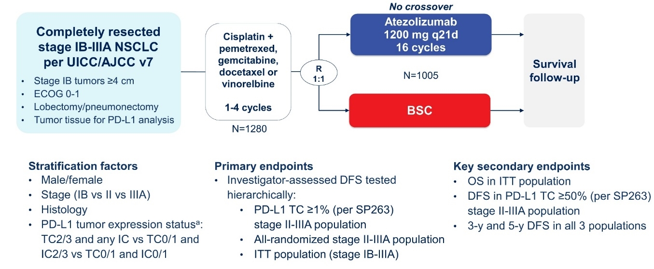
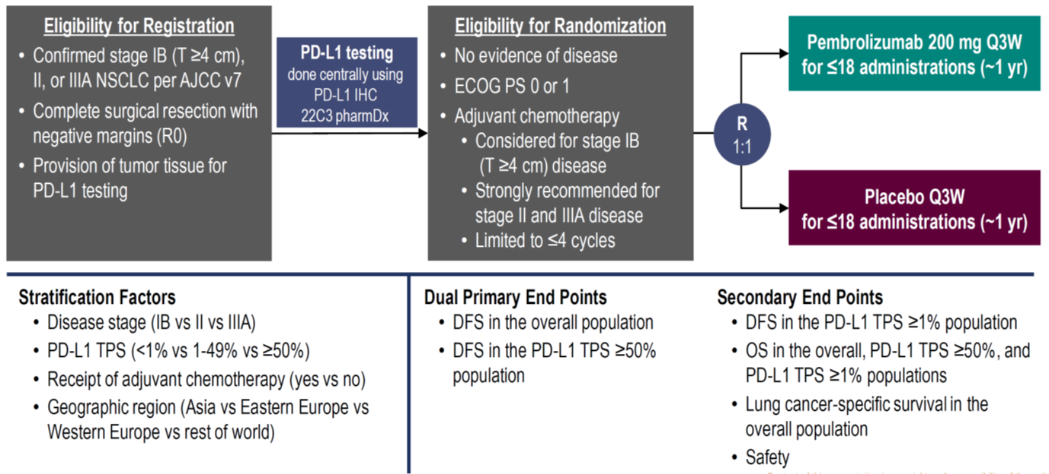
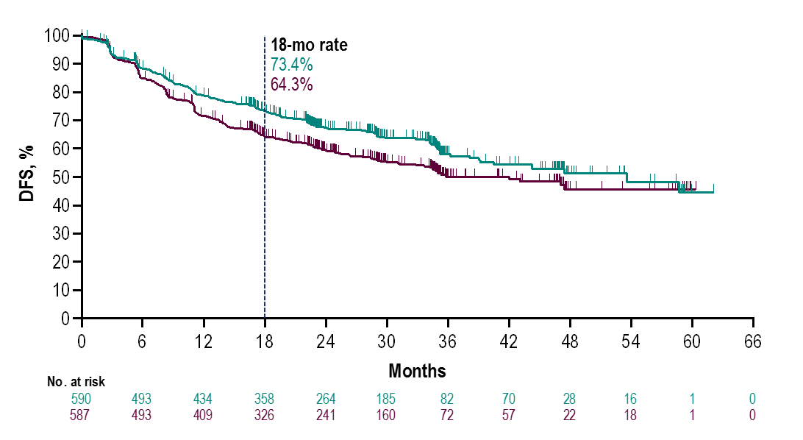
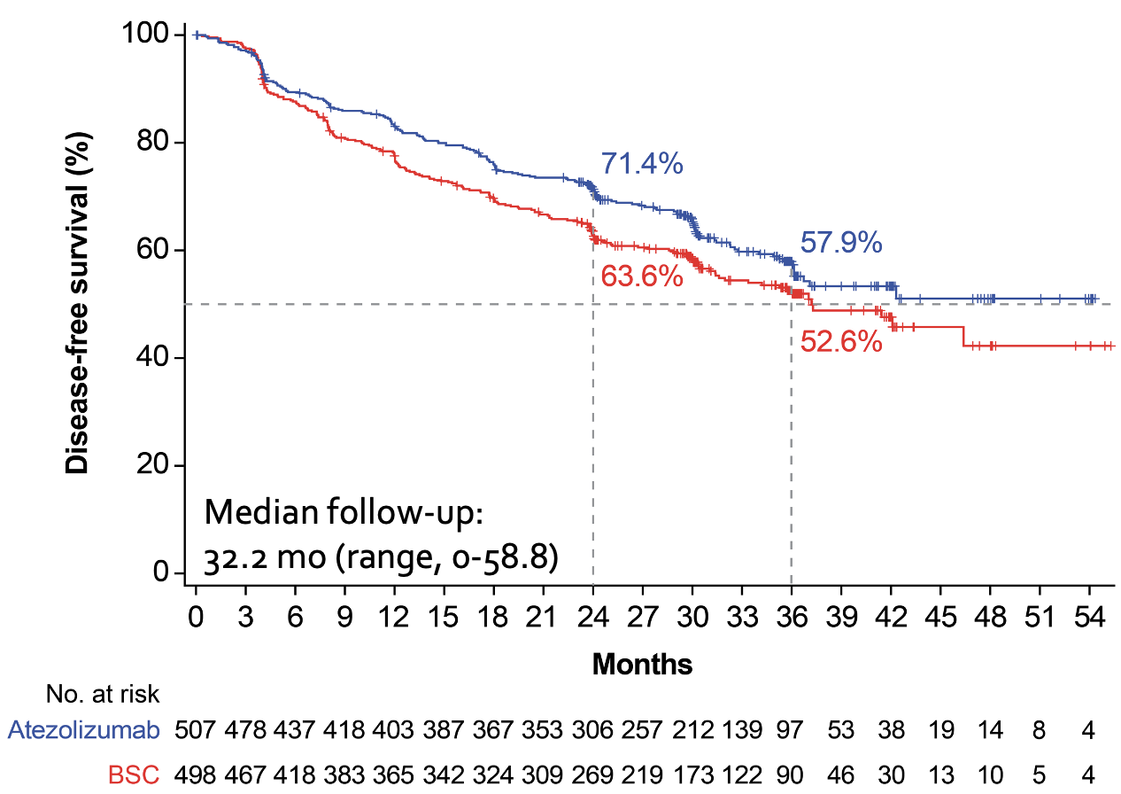
Adjuvant IO Phase III Randomized Trials
IMpower010¹
PEARLS/KEYNOTE 091²
Stage IB to IIIA
Stage IB to IIIA
HR: 0.81
mDFS: NE vs 37.2 months
HR: 0.76
mDFS: 53.9 vs 42 months

Slide 5
IMpower010: Expected and Manageable Safety Profileª
n (%) | Atezolizumab (n=495) | BSC (n=495)
Any-cause AE | 459 (92.7) | 350 (70.7)
Treatment-related AE | 335 (67.7) | –
Grade 3-4 AE | 108 (21.8) | 57 (11.5)
Treatment-related grade 3-4 AE | 53 (10.7) | –
Serious AE | 87 (17.6) | 42 (8.5)
Treatment-related serious AE | 37 (7.5) | –
Grade 5 AE | 8 (1.6)^{b} | 3 (0.6)^{c}
Treatment-related grade 5 AE | 4 (0.8) | –
AE leading to dose interruption of atezolizumab | 142 (28.7) | –
AE leading to atezolizumab discontinuation | 90 (18.2) | –
Immune-mediated AEs | 256 (51.7) | 47 (9.5)
Grade 3-4 immune-mediated AEs | 39 (7.9) | 3 (0.6)
Immune-mediated AEs requiring the use of systemic corticosteroids | 60 (12.1) | 4 (0.8)

Slide 6
No Unexpected AEs
All-Cause AEs, Incidence ≥10%
KEYNOTE-091
Grade
1-2
3ª
Pembrolizumab
Placebo
28.9
22.9
21.6
20.7
18.6
18.3
16.9
16.6
15.3
15.0
12.7
12.9
14.3
12.7
11.6
11.4
12.4
10.7
4.6
2.9
Weight
increased
Pruritus
Hypo-
thyroidism
Arthralgia
Diarrhea
Fatigue
Cough
Hyper-
tension
Dyspnea
Hyper-
thyroidism

Slide 7
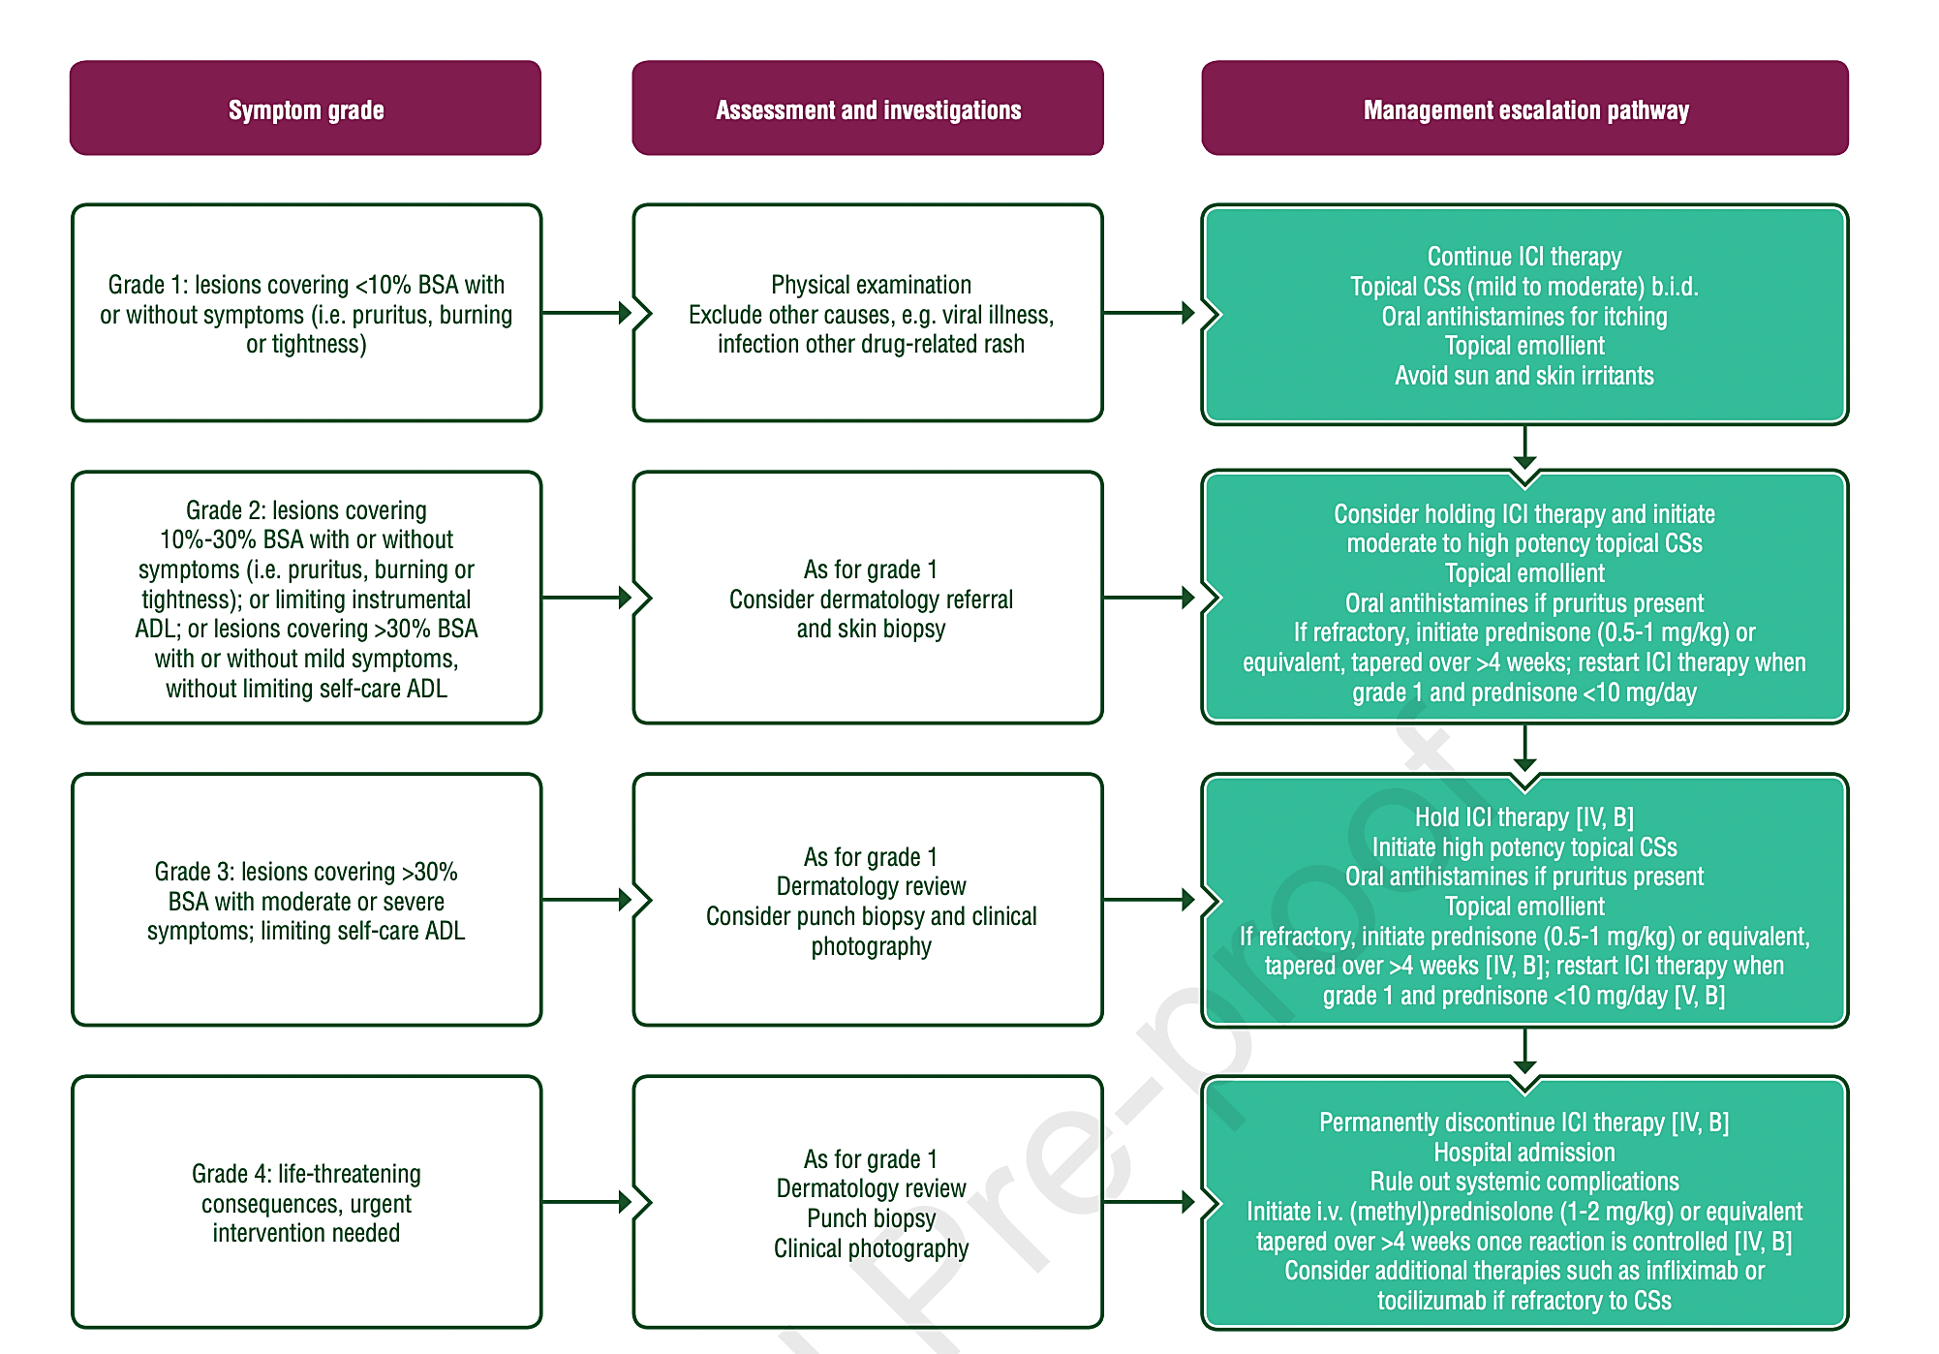
Apply ESMO Guidelines - Conservatively

Slide 8
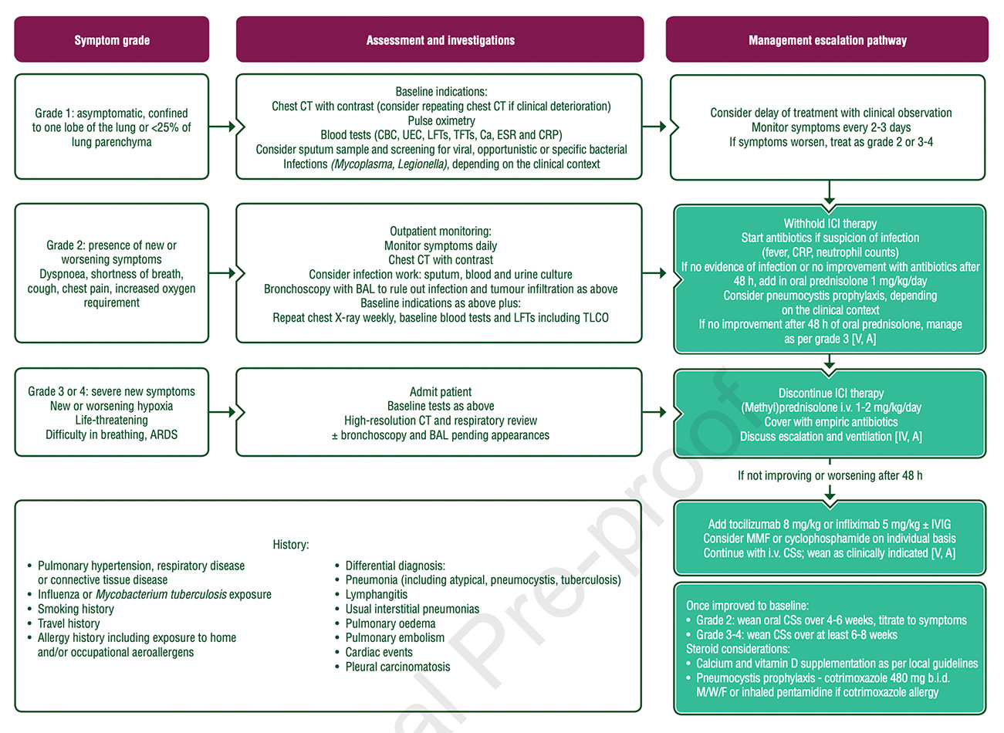
Apply ESMO Guidelines - Conservatively

Slide 9
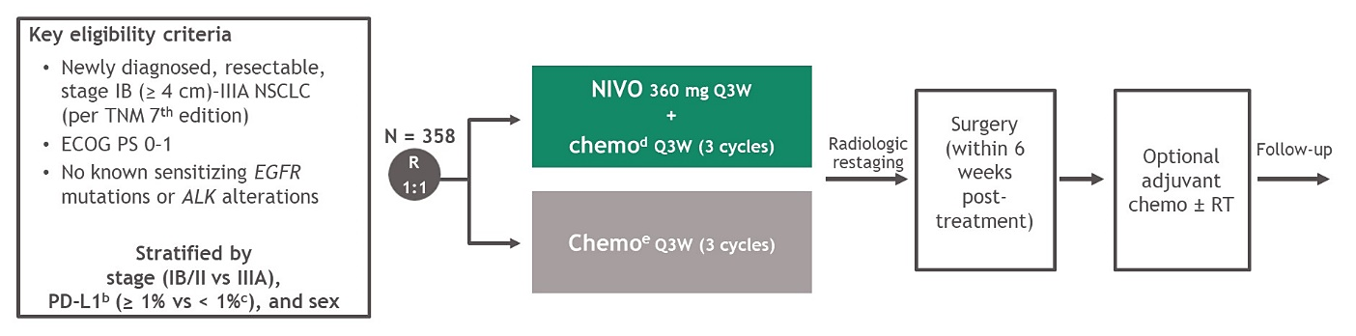
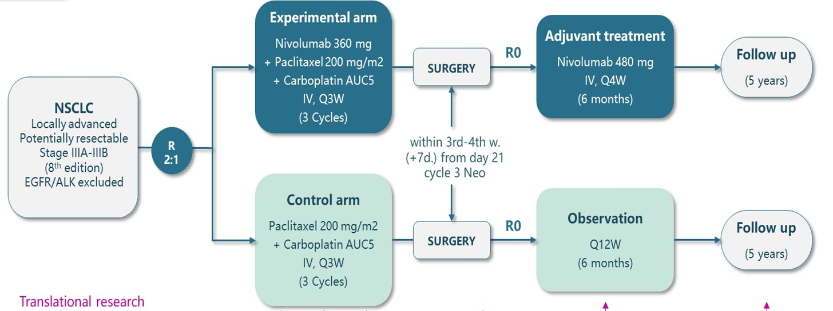
Neoadjuvant Nivolumab: CheckMate 816 and NADIM II
Primary endpoints:
pCR by BICR
EFS by BICR
CheckMate 816
NADIM II
Primary endpoints:
pCR

Slide 10
Neoadjuvant Nivolumab: Odds Ratio and EFS
CheckMate 816¹
NADIM II²
Odds ratio 13.94
(99% CI, 3.49, 55.75); p<0.001
Odds ratio 7.88
(95% CI, 1.70, 36.51); p=0.0068
HR 0.48
(95% CI, 0.25, 0.91); p=0.025
HR 0.63
(97.38% CI, 0.43, 0.91); p=0.005
mOS: NR (HR 0.57)
mOS: NR (HR 0.40)

Slide 11
CM 816: Patient Disposition and Surgeries
358 patients randomized
NIVO + chemo
Chemo
94% completed neoadjuvant treatment
85% completed neoadjuvant treatment
179 randomized
176 received treatment
179 randomized
176 received treatment
149 (83%) had definitive surgery
135 (75%) had definitive surgery
35 (20%) patients received
adjuvant therapy
56 (32%) patients received
adjuvant therapy
21 (12%) received chemo alone
9 (5%) received RT alone
5 (3%) received chemo and RT
39 (22%) received chemo alone
12 (7%) received RT alone
5 (3%) received chemo and RT

Slide 12
Why Could the Project Fail?
Reasons for not completing neoadjuvant treatment included disease progression (1% in both groups) and study drug toxicity (6% and 7% in the NIVO + chemo arm and chemo arm, respectively, with an additional 7% “other” in the chemo arm)
Reasons for cancelled surgeries in the NIVO + chemo arm (n = 28) and chemo arm (n = 37) included:
disease progression (NIVO + chemo, 7%; chemo, 9%)
adverse event (1% in both the NIVO + chemo and chemo arms)
other reasons
  NIVO + chemo: 8% of reasons for cancelled surgeries included patient refusal (n = 9), unfit for surgery due to poor lung function (n = 2), unresectability (n = 2), not treated (n = 1)
  Chemo: 11% of reasons for cancelled surgeries included patient refusal (n = 8), consent withdrawal (n = 3), COVID-19 (n = 1), unfit for surgery due to poor lung function (n = 4), unresectability (n = 2), not treated (n = 1)

Slide 13
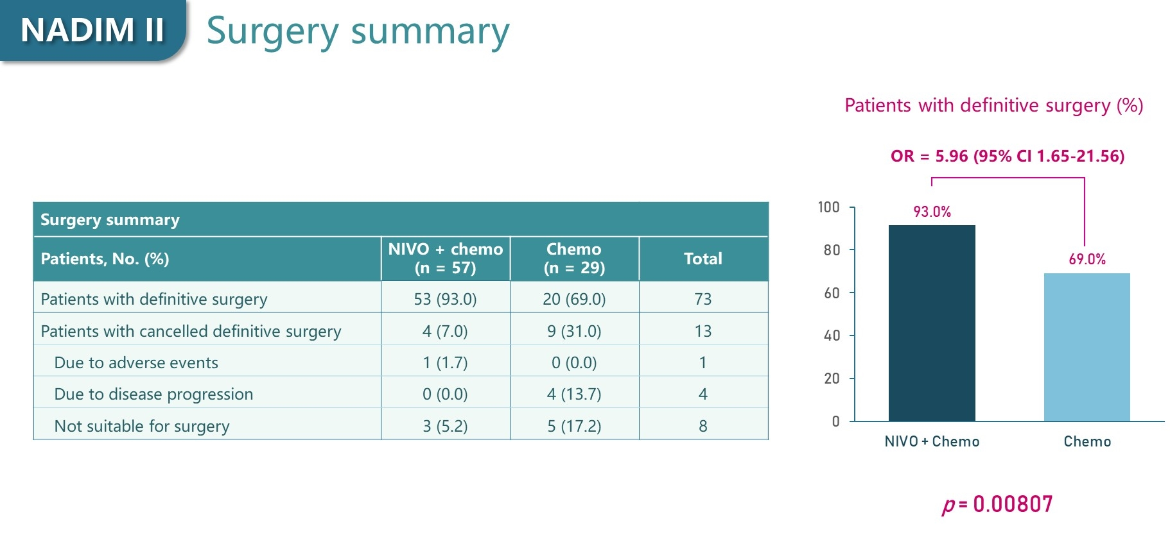
Slide 10

Slide 14
More Data Are Needed to Assess Risks of Neoadjuvant Immunotherapy Strategies
7–18%
AE Grade 3/4: 13–33%
 | Rate of unperformed surgery | 30 days mortality | Treatment-related AE
NADIM I | 11% | Non | G3/4: 13.5% in adjuvant phase
SAKK 16/14 | 18% | 2% (fatal bronchopulmonary Bleeding) | G3/4: 29% in perioperative phase G3/4: 50% in adjuvant phase
NADIM II | 7% | Non | Grade 3/4 AEs: 25%, nivolumab + CT; 10.3%, CT alone (OR: 2.82; 95% CI: 0.74-10.76; Chi-squared P = .201)*
Checkmate 816 | 17% | 1.1% (pulmonary embolism, aortic rupture) | Surgery-related G3/4: 11.4% G3/4: 33.5%

Slide 15
Summary: More Data Are Needed to Assess Risks of Neoadjuvant Immunotherapy Strategies
Fragilizing/endangering the delivery of radical local intervention (surgery) might be a risk related to the use innovative IO-based neoadjuvant strategies
More data are needed, particularly from the perspective of establishing new standards in stage Ib/II NSCLC
IO-related toxicities are consistent with those expected in early NSCLC and comparable with those observed in stage IV NSCLC
In the early disease setting, guidelines should be strictly followed to conservatively manage immune related toxicities

