Slide 1
What Is the Evidence Supporting Neoadjuvant Immunotherapy in Early-Stage NSCLC?
Patrick Forde, MBBCH
Co-Director, Division of Upper Aerodigestive Malignancies
Associate Professor of Oncology
The Johns Hopkins University
Baltimore, MD

Slide 2
Disclaimer
The views and opinions expressed in this educational activity are those of the faculty and do not necessarily represent the views of TotalCME, Inc., the CME providers, or the companies providing educational grants. This presentation is not intended to define an exclusive course of patient management; the participant should use their clinical judgment, knowledge, experience, and diagnostic skills in applying or adopting for professional use any of the information provided herein. Any procedures, medications, or other courses of diagnosis or treatment discussed or suggested in this activity should not be used by clinicians without evaluation of their patient's conditions and possible contraindications or dangers in use, review of any applicable manufacturer’s product information, and comparison with recommendations of other authorities. Links to other sites may be provided as additional sources of information.

Slide 3
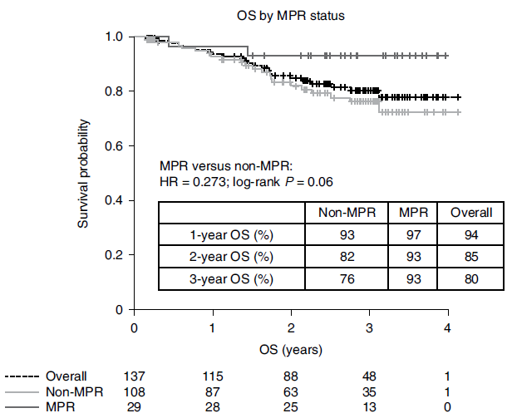
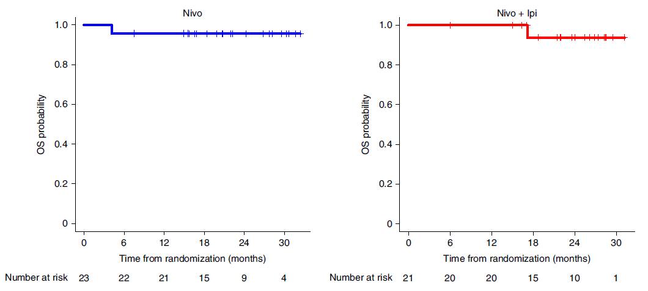
Neoadjuvant Immunotherapy Monotherapy
LCMC3¹
Neoadjuvant atezolizumab
NEOSTAR²
Neoadjuvant NIVO or NIVO + IPI

Slide 4
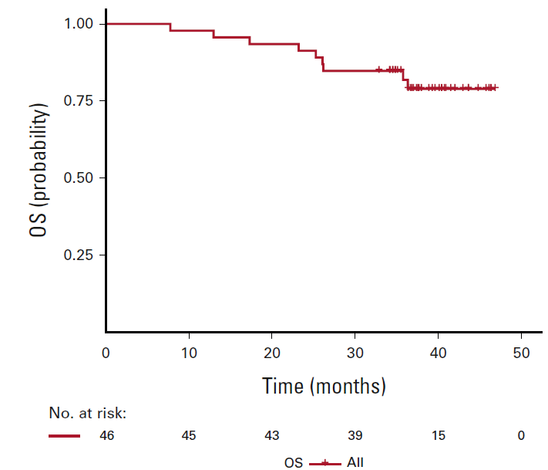
Neoadjuvant and Perioperative I-O Combinations Demonstrated Activity in Resectable NSCLC¹⁻¹⁰
NADIM¹ Neoadjuvant nivolumab + chemo, adjuvant nivolumab, Stage IIIA
NCT02716038²
Neoadjuvant atezolizumab + chemo, Stage IB-IIIA
100
75
ITT population
OS (%)
50
25
0
0
10
20
30
40
Time from treatment initiation (months)
No. at risk (no. censored)
30 (0)
18 (11)
8 (18)
4 (22)
-
Type of treatment | Perioperative
Surgical patients, n (ITT) | 41 (46)
MPR,* n (% of resected pts) | 34 (83%)
pCR, n (% of resected pts) | 26 (63%)
Type of treatment | Neoadjuvant
Surgical patients, n (ITT) | 29† (30)
MPR,* n (% of ITT pts) | 17 (57%)
pCR, n (% of ITT pts) | 10 (33%)
Historic pCR rate after neoadjuvant chemotherapy for NSCLC = 2-6%

Slide 5
CheckMate 816 Study Designª
Key eligibility criteria
Newly diagnosed, resectable, stage IB (≥4 cm)–IIIA NSCLC (per AJCC 7th edition^{b})
ECOG PS 0–1
No known sensitizing EGFR mutations or ALK alterations
Stratified by
Stage (IB–II vs IIIA), PD-L1^{c} (≥1% vs <1%^{d}), and sex
NIVO 360 mg Q3W +
chemo^{e} Q3W (3 cycles)
Surgery (within 6 weeks post-treatment)
Optional adjuvant chemo ± RT^{g}
N=358
Radiologic restaging
Follow-up
R
1:1
Chemo^{f} Q3W (3 cycles)
Primary endpoints
pCR by BIPR
EFS^{h} by BICR
Secondary endpoints
MPR by BIPR
OS
Time to death or distant metastases
Key exploratory analysis
EFS by pCR status
Database lock: October 20, 2021​; minimum follow-up: 21 months for NIVO (nivolumab) + chemo and chemo arms; median follow-up, 29.5 months
ªNCT02998528; ^{b}TNM Classification of Malignant Tumors 7th edition; ^{c}Determined by the PD-L1 IHC 28-8 pharmDx assay (Dako); ^{d}Included patients with PD-L1 expression status not evaluable and indeterminate; ^{e}NSQ: pemetrexed + cisplatin or paclitaxel + carboplatin; SQ: gemcitabine + cisplatin or paclitaxel + carboplatin; ^{f}Vinorelbine + cisplatin, docetaxel + cisplatin, gemcitabine + cisplatin (SQ only), pemetrexed + cisplatin (NSQ only), or paclitaxel + carboplatin; ^{g}Per healthcare professional choice; ^{h}EFS defined as the time from randomization to any progression of disease precluding surgery, progression or recurrence of disease after surgery, progression for patients without surgery, or death due to any cause; patients with subsequent therapy were censored at the last evaluable tumor assessment on or prior to the date of subsequent therapy.

Slide 6
Baseline Characteristics
 | NIVO + chemo (n=79) | Chemo (n=179)
Age, median (range), years | 64 (41–82) | 65 (34–84)
Age category, % <65 years ≥65 years | 52 48 | 46 54
Male, % | 72 | 71
Region,ª % North America Europe Asia | 23 23 48 | 28 14 51
ECOG PS, % 0 1 | 69 31 | 65 35
Stage,^{b,c} % IB–II IIIA | 36 63 | 35 64
Histology, % Squamous Nonsquamous | 49 51 | 53 47
 | NIVO + chemo (n=179) | Chemo (n=179)
Smoking status,^{d} % Current/former Never | 89 11 | 88 11
Tumor PD-L1 expression,^{e} % Not evaluable <1% ≥1% 1–49% ≥50% | 7 44 50 28 21 | 7 43 50 26 24
TMB,^{f} % Not evaluable/not reported^{g} <12.3 mut/Mb ≥12.3 mut/Mb | 51 27 22 | 50 30 21
Type of platinum therapy, % Cisplatin Carboplatin | 69 22 | 75 18
ªRest of the world: 7% of patients in each of the nivo + chemo and chemo arm; ^{b}Disease stage by case report form, per AJCC 7th edition; 1 patient in the chemo arm had stage IA disease and 1 patient in each arm had stage IV disease; ^{c}Stage IB, IIA, IIB disease: 6%, 17%, and 14% of patients in the nivo + chemo arm and 4%, 18%, and 12% in the chemo arm, respectively; ^{d}One patient in the chemo arm had unknown smoking status; ^{e}Percentages are based on the primary analysis population; level of PD-L1 expression was determined using the PD-L1 IHC 28-8 pharmDx assay (Dako); patients with tumor tissue that could not be assessed for PD-L1 (≤10% of all randomized patients) were stratified to the PD-L1 expression <1% subgroup at randomization; ^{f}TMB was evaluated using the Illumina TSO500 assay. A 12.3-mut/Mb cutoff per TSO500 corresponds to 10 mut/Mb per the FoundationOne assay¹; ^{g}TMB was not analyzed for patients in China and these patients are included in the ‘not reported’ category.
1. Baden J, et al. Ann Oncol 2019;30(suppl 5):v28. doi:10.1093/annonc/mdz239.010

Slide 7
Treatment Disposition and Adjuvant Therapy
358 patients randomized
NIVO + chemo
Chemo
94% completed neoadjuvant treatmentª
85% completed neoadjuvant treatment^{b}
179 randomized
176 received treatment
179 randomized
176 received treatment
149 (83%) had definitive surgery^{c}
135 (75%) had definitive surgery^{c}
35 (20%) patients received adjuvant therapy^{d}
56 (32%) patients received adjuvant therapy^{d}
21 (12%) received chemo alone
9 (5%) received RT alone
5 (3%) received chemo and RT
39 (22%) received chemo alone
12 (7%) received RT alone
5 (3%) received chemo and RT
Database lock: October 20, 2021​; minimum follow-up: 21 months; median follow-up, 29.5 months.
ªReasons for not completing neoadjuvant treatment included disease progression (1%) and study drug toxicity (6%); ^{b}Reasons for not completing neoadjuvant treatment included disease progression (1%), study drug toxicity (7%), and other (7%); ^{c}Denominator based on randomized patients. Reasons for cancelled surgeries in the NIVO + chemo arm (n=28) and chemo arm (n=37) included disease progression (NIVO + chemo, 7%; chemo, 9%), adverse event (NIVO + chemo and chemo, 1% each), other reasons (NIVO + chemo, 8% [other reasons included patient refusal (n=9), unfit for surgery due to poor lung function (n=2), unresectability (n=2), not treated (n=1)]; chemo, 11% [other reasons included patient refusal (n=8), consent withdrawal (n=3), COVID-19 (n=1), unfit for surgery due to poor lung function (n=4), unresectability (n=2), not treated (n=1)]; Definitive surgery was not reported in 2 patients in the NIVO plus chemo group and 7 patients in the chemo group. ^{d}Denominator based on patients receiving neoadjuvant treatment.

Slide 8
Adverse Eventsª Summary
Patients (%) | NIVO + chemo (n=176) |  | Chemo (n=176)
 | Any grade | Grade 3–4 | Any grade | Grade 3–4
All AEs | 93 | 41 | 97 | 44
TRAEs | 82 | 34 | 89 | 37
All AEs leading to discontinuation | 10 | 6 | 11 | 4
TRAEs leading to discontinuation | 10 | 6 | 10 | 3
All SAEs | 17 | 11 | 14 | 10
Treatment-related SAEs | 12 | 8 | 10 | 8
Surgery-related AEs^{b,c} | 42 | 11 | 47 | 15
Treatment-related deaths^{d} | 0 |  | 2
Grade 5 surgery-related AEs^{e} were reported in 2 patients in the NIVO + chemo arm and were deemed unrelated to study drug per investigator (1 each due to pulmonary embolism and aortic rupture)
ªIncludes events reported between the first neoadjuvant dose and 30 days after the last neoadjuvant dose as per CTCAE Version 4.0; MedDRA Version 24.0; ^{b}Includes events reported up to 90 days after definitive surgery; ^{c}Denominator based on patients with definitive surgery (n=149 in the NIVO + chemo group, n=135 in the chemo group); ^{d}Treatment-related deaths (not limited to 30 days window after last neoadjuvant dose) in the chemotherapy arm were due to pancytopenia, diarrhea, acute kidney injury (all in 1 patient), enterocolitis, and pneumonia; ^{e}Grade 5 AEs are defined as events that led to death within 24 hours of AE onset.

Slide 9
Primary Endpoint: pCRª Rate With Neoadjuvant NIVO + Chemo vs Chemo
Primary Endpoint: ITT (ypT0N0)^{b}
Patients With Resection^{e} (ypT0N0)
OR = 13.94 (99% CI, 3.49–55.75)^{c}
P <0.0001
30.5%
Difference^{c}
21.6%
3.2%
24.0%^{d}
n/N 43/141 4/126
Primary Tumor Only in ITT (ypT0)
25.7%
2.2%^{d}
2.8%
n/N 43/179 4/179
pCR rate in the exploratory NIVO + IPI arm (ITT) was 20.4% (95% CI, 13.4–29.0)
n/N 46/179 5/179
ªPer BIPR; pCR: 0% residual viable tumor cells in both primary tumor (lung) and sampled lymph nodes; ^{b}ITT principle: patients who did not undergo surgery counted as nonresponders for primary analysis; ^{c}Calculated by stratified Cochran-Mantel-Haenszel method; ^{d}pCR rates 95% CI: NIVO + chemo, 18.0–31.0; chemo, 0.6–5.6; ^{e}Patients who underwent definitive surgery with an evaluable pathology sample for BIPR.

Slide 10
Primary Endpoint: EFS^{a,b} With Neoadjuvant NIVO + Chemo vs Chemo
 | NIVO + chemo (n=179) | Chemo (n=179)
Median EFS,^{c} mo | 31.6 | 20.8
HR (97.38% CI)^{d} P value^{e} | 0.63 (0.43–0.91) 0.0052
100
76%
80
64%
60
63%
EFS (%)
NIVO + chemo
40
45%
Chemo
20
0
0
3
6
9
12
15
18
21
24
27
30
33
36
39
42
No. at risk
Months from randomization
NIVO + chemo
179
151
136
124
118
107
102
87
74
41
34
13
6
3
0
Chemo
179
144
126
109
94
83
75
61
52
26
24
13
11
4
0
Minimum follow-up: 21 months; median follow-up, 29.5 months.
ªPer BICR; ^{b}EFS defined as the time from randomization to any progression of disease precluding surgery, progression or recurrence of disease after surgery, progression for patients without surgery, or death due to any cause; patients with subsequent therapy were censored at the last evaluable tumor assessment on or prior to the date of subsequent therapy; ^{c}95% CI=30.2–NR (NIVO + chemo) and 14.0–26.7 (chemo); ^{d}95% CI=0.45-0.87; ^{e}The significance boundary at this interim analysis was 0.0262.

Slide 11
EFS Subgroup Analysis
 | Median EFSª, mo |  | Unstratified HR (95% CI) | Unstratified HR
 | NIVO + chemo (n=179) | Chemo (n=179)
Overall (N=358) | 32 | 21 |  | 0.63
<65 years (n=176) ≥65 years (n=182) | NR 30 | 21 18 |  | 0.57 0.70
Male (n=255) Female (n=103) | 31 NR | 17 32 |  | 0.68 0.46
North America (n=91) Europe (n=66) Asia (n=177) | NR 32 NR | NR 21 16 |  | 0.78 0.80 0.45
ECOG PS 0 (n=241) ECOG PS 1 (n=117) | NR 30 | 23 14 |  | 0.61 0.71
Stage IB–II (n=127) Stage IIIA (n=228) | NR 32 | NR 16 |  | 0.87 0.54
Squamous (n=182) Nonsquamous (n=176) | 31 NR | 23 20 |  | 0.77 0.50
Current/former smoker (n=318) Never smoker (n=39) | 32 NR | 22 10 |  | 0.68 0.33
PD-L1 <1% (n=155) PD-L1 ≥1% (n=178) | 25 NR | 18 21 |  | 0.85 0.41
PD-L1 1–49% (n=98) PD-L1 ≥50% (n=80) | NR NR | 27 20 |  | 0.58 0.24
TMB <12.3 mut/Mb (n=102) TMB ≥12.3 mut/Mb (n=76) | 30 NR | 27 22 |  | 0.86 0.69
Cisplatin (n=258) Carboplatin (n=72) | NR NR | 21 11 |  | 0.71 0.31
Favors NIVO + chemo
Favors chemo

Slide 12
Type of Surgery by Baseline Stage of Disease
Patients (%)
BL stage
a
a
n/N 115/149 82/135 41/55 33/52 74/94 49/83
25/149 34/135 9/55 9/52 16/94 25/83
Patients may have had >1 surgery type. Patient numbers (n/N) for stage IB/II and stage IIIA, respectively, for Bilobectomy (NIVO + chemo: 1/55, 2/94; chemo: 2/52, 2/83), sleeve lobectomy (NIVO + chemo: 2/55, 0/94; chemo: 5/52, 5/83), and other (NIVO + chemo: 13/55, 11/94; chemo: 12/52, 9/83). ªPatients with all baseline stages of disease with surgery.

Slide 13
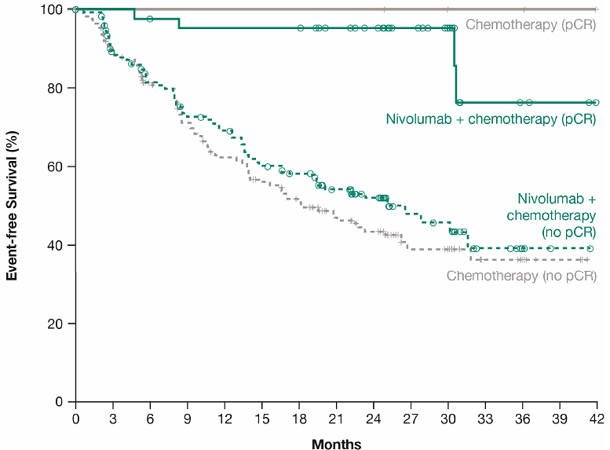
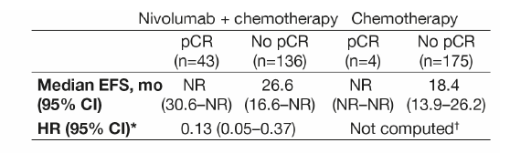
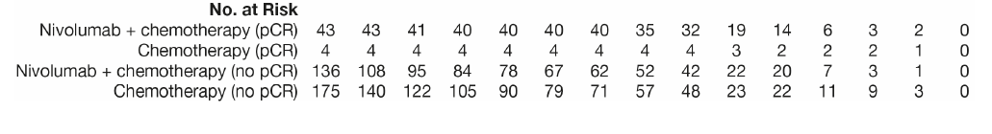
Exploratory Analysis: EFS by pCR Status
pCR rates were significantly improved with NIVO + chemo vs chemo (24.0% vs 2.2%)
In patients without pCR, HR (95% CI) for NIVO + chemo vs chemo was 0.84 (0.61–1.17)
Minimum follow-up: 21 months; median follow-up, 29.5 months.
ª95% CI=30.6–NR (NIVO + chemo, pCR), 16.6–NR (NIVO + chemo, no pCR) and NR–NR (chemo, pCR), 13.9–26.2 (chemo, no pCR); ^{b}In the pooled patient population (NIVO + chemo and chemo arms combined), EFS HR (95% CI) was 0.11 (0.04–0.29) for patients with pCR vs those without pCR; ^{c}HR was not computed for the chemo arm due to only 4 patients having a pCR

Slide 14
Overall Survival: Interim Analysis
 | NIVO + chemo (n = 179) | Chemo (n = 179)
Median OS,ª mo | NR | NR
HR (99.67% CI)^{b} P value^{c} | 0.57 (0.30–1.07) 0.0079
100
90%
83%
80
90%
NIVO + chemo
71%
Chemo
60
OS (%)
40
20
0
0
3
6
9
12
15
18
21
24
27
30
33
36
39
42
45
48
No. at risk
Months from randomization
NIVO + chemo
179
176
166
163
156
148
146
143
122
101
72
48
26
16
7
3
0
Chemo
179
172
165
161
154
148
133
123
108
80
59
41
24
16
7
2
0
Minimum follow-up: 21 months; median follow-up, 29.5 months.
ª95% CI = NR-NR (NIVO + chemo) and NR-NR (chemo); ^{b}95% CI = 0.38-0.87; ^{c}Significance boundary for OS (0.0033) was not met at this interim analysis.

Slide 15
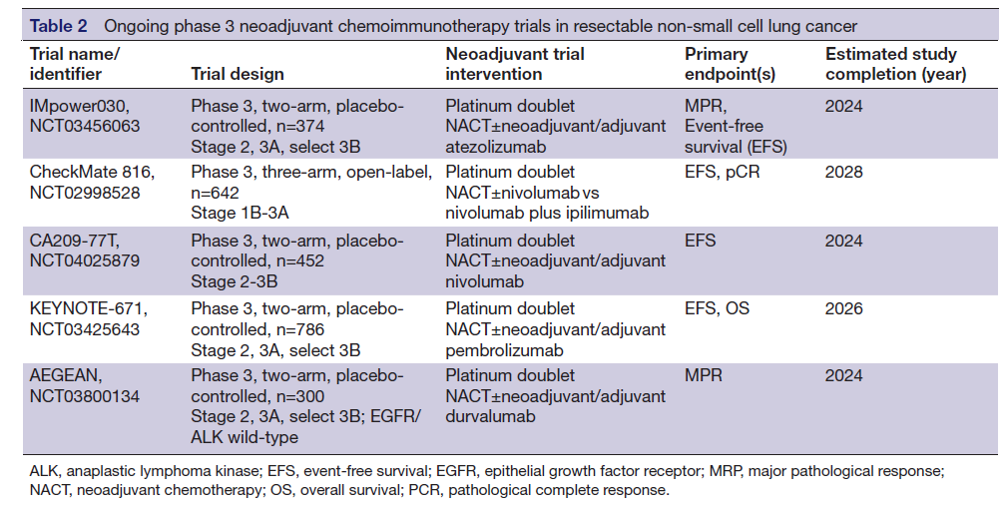
Ongoing Neoadjuvant Chemotherapy I-O Phase 3 Trials in Resectable NSCLC

Slide 16
Conclusions
Addition of anti-PD-1 to neoadjuvant chemotherapy does not increase toxicity and improves efficacy including surgical outcomes
Highest benefit in PD-L1+ and higher stage disease; however, benefit seen across enrolled patient subgroups

