Slide 1
What Is the Role of Biomarkers in Predicting Response?
Tricia R. Cottrell, MD, PhD
Assistant Professor, Department of Pathology and Molecular Medicine
Queen’s University
Kingston, Ontario, Canada

Slide 2
Disclaimer
The views and opinions expressed in this educational activity are those of the faculty and do not necessarily represent the views of TotalCME, Inc., the CME providers, or the companies providing educational grants. This presentation is not intended to define an exclusive course of patient management; the participant should use their clinical judgment, knowledge, experience, and diagnostic skills in applying or adopting for professional use any of the information provided herein. Any procedures, medications, or other courses of diagnosis or treatment discussed or suggested in this activity should not be used by clinicians without evaluation of their patient's conditions and possible contraindications or dangers in use, review of any applicable manufacturer’s product information, and comparison with recommendations of other authorities. Links to other sites may be provided as additional sources of information.

Slide 3
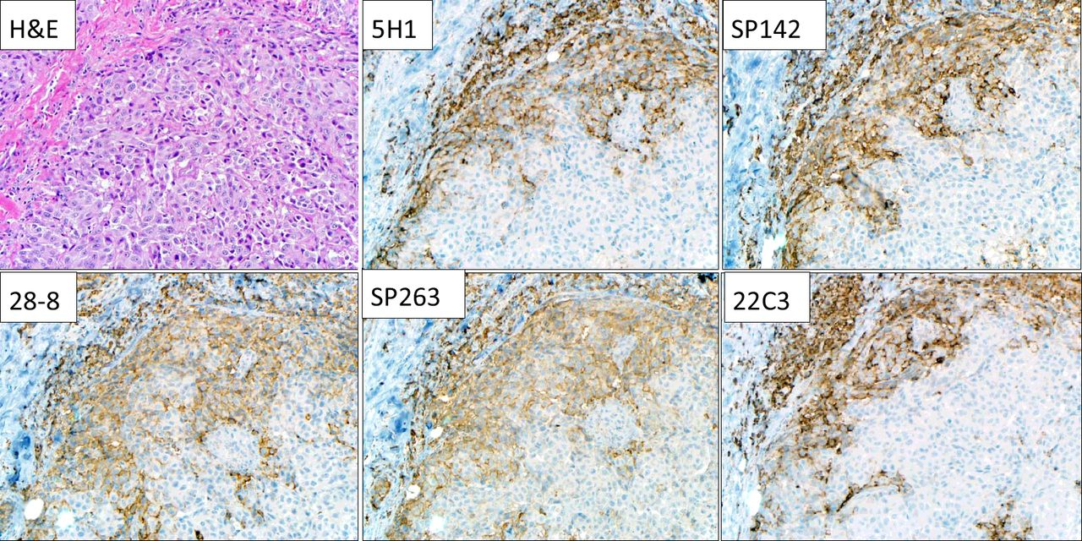
Predicting Response to Immune Checkpoint Blockade
H&E
PD-L1
Biomarker-driven therapy improves effectiveness, reduces toxicity, improves cost-effectiveness of care, and is necessary when many treatment options are available

Slide 4
Molecular Testing to Exclude EGFR/ALK Alterations from Neoadjuvant Immune Checkpoint Blockade
0/17 responses to neoadjuvant atezolizumab among patients with EGFR mutation or ALK rearrangements¹ (LCMC3)
Tumors with EGFR mutation or ALK rearrangements were excluded from CheckMate 816²

Slide 5
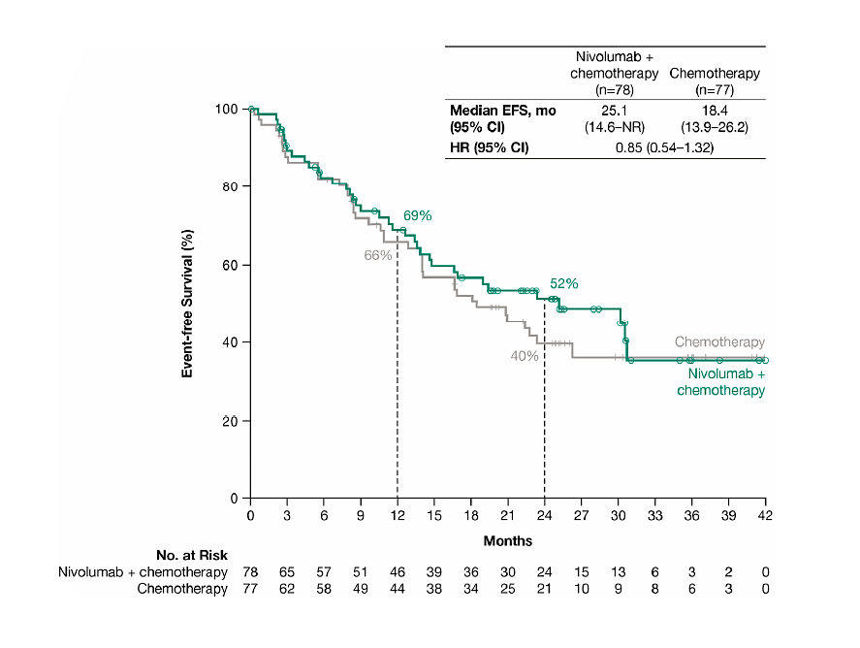
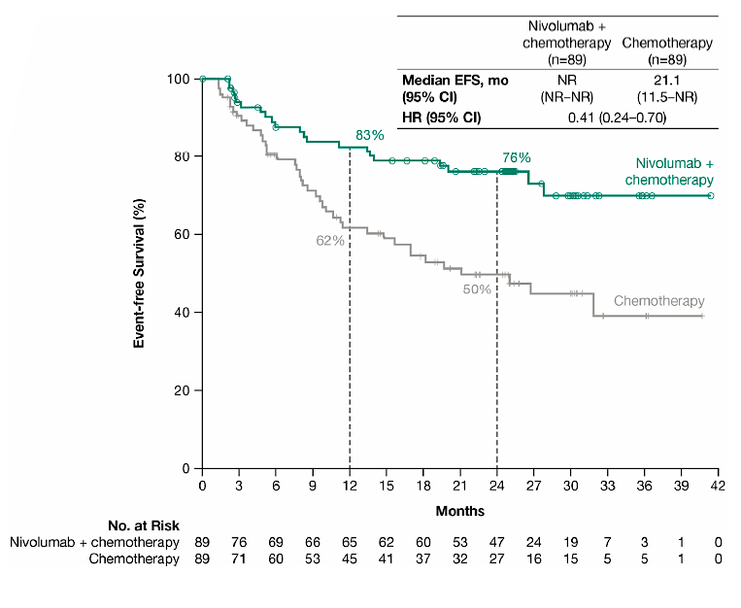
PD-L1 Status and Response to Neoadjuvant Nivolumab + Chemotherapy
PD-L1 < 1%
PD-L1 ≥ 1%

Slide 6
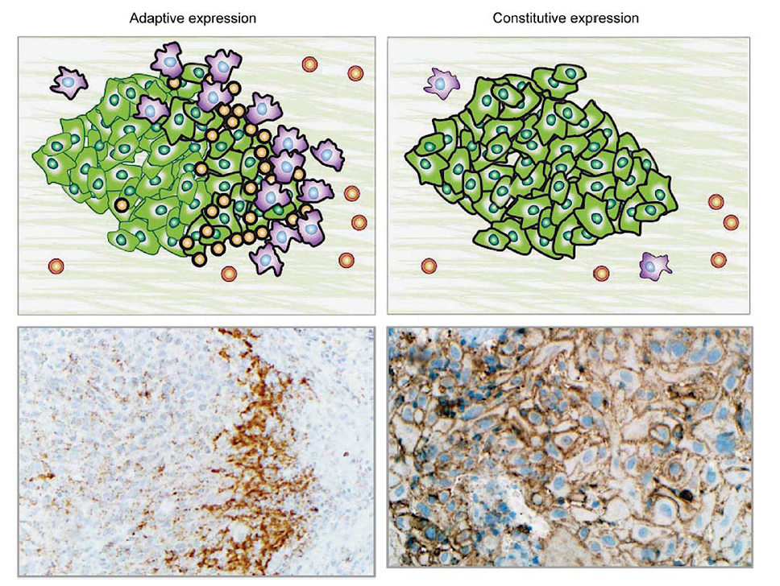
PD-L1 Expression in the Tumor Microenvironment
PD-L1(-) cells
PD-L1 (+) tumor cells
Adaptive or Inducible PD-L1
Lymphocyte infiltration (TIL)
Interferon gamma
Constitutive or Intrinsic PD-L1
Genomic
(e.g., amplification)
Epigenetic (e.g., hypomethylation)
PD-L1 (+) lymphocytes, macrophages
PD-L1 (–) lymphocytes, macrophages

Slide 7
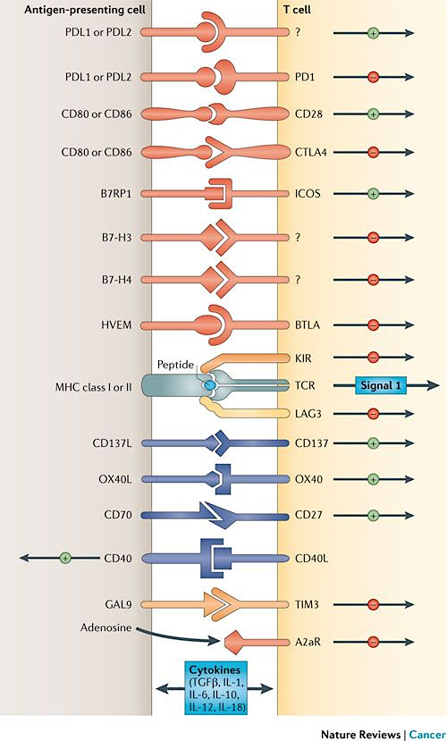
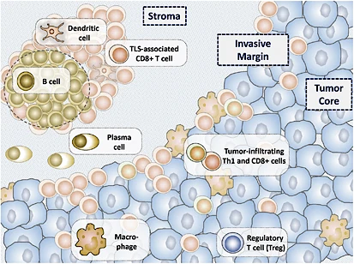
Putting PD-1/PD-L1 in Context

Slide 8
Multiplex IHC/IF Assays Show Superior Prediction of Anti-PD-(L)1 Response
Meta-analysis
8,135 patients
10 solid tumor types
Multiplex IHC/IF
Tumor Mutational Burden
PD-L1 IHC
Gene Expression Profiling
Notes:
10 different solid tumor types in 8135 patients

Slide 9
Conclusions and Future Directions
Biomarkers are valuable for increasing response rates, reducing toxicity, and controlling costs of therapy
Current data does not support the use of neoadjuvant immune checkpoint blockade in patients with EGFR or ALK alterations
PD-L1 expression enriches the response to neoadjuvant anti-PD-1 based therapies
Next generation multiplex-IHC/IF biomarkers are likely to improve response prediction
ctDNA may play a role in disease monitoring, but highly sensitive assays are needed

