Slide 1
What Are the Pathological Criteria and Markers for Assessing Response to Immune Checkpoint Blockade?
Tricia R. Cottrell, MD, PhD
Assistant Professor, Department of Pathology and Molecular Medicine
Queen’s University
Kingston, Ontario, Canada

Slide 2
Disclaimer
The views and opinions expressed in this educational activity are those of the faculty and do not necessarily represent the views of TotalCME, Inc., the CME providers, or the companies providing educational grants. This presentation is not intended to define an exclusive course of patient management; the participant should use their clinical judgment, knowledge, experience, and diagnostic skills in applying or adopting for professional use any of the information provided herein. Any procedures, medications, or other courses of diagnosis or treatment discussed or suggested in this activity should not be used by clinicians without evaluation of their patient's conditions and possible contraindications or dangers in use, review of any applicable manufacturer’s product information, and comparison with recommendations of other authorities. Links to other sites may be provided as additional sources of information.

Slide 3
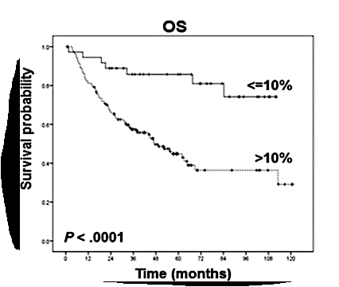
Why Does Pathologic Response Matter?
Major pathologic response (MPR)
≤10% residual viable tumor
Correlates with patient survival
Pathologic response is a valuable clinical trial endpoint
Rapid availability (6-8 weeks vs. years for survival data)
Proposed as a surrogate for survival for applications for FDA approval

Slide 4
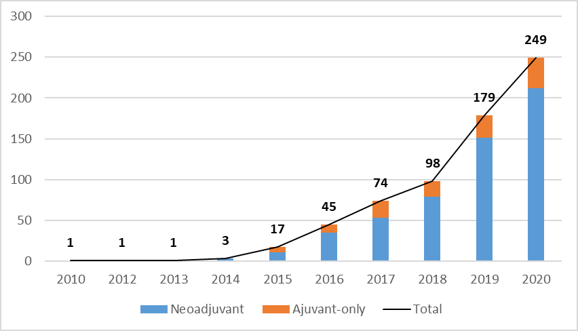
Why Does Pathologic Response Matter?
Major pathologic response (MPR)
≤10% residual viable tumor
Correlates with patient survival
Pathologic response is a valuable clinical trial endpoint
Rapid availability (6-8 weeks vs. years for survival data)
Proposed as a surrogate for survival for applications for FDA approval
Neoadjuvant
Adjuvant-only
Total

Slide 5
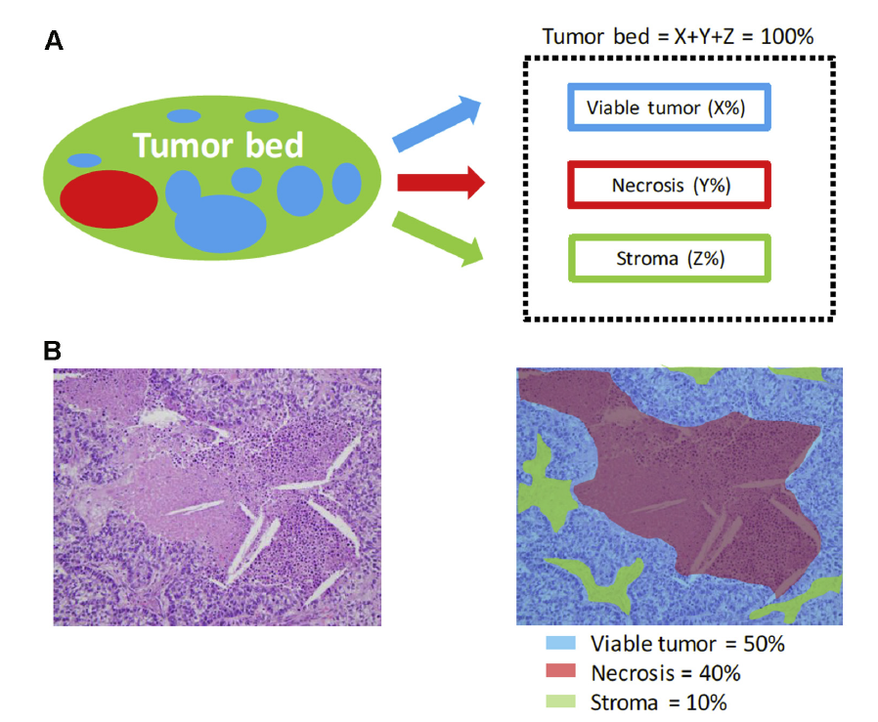

Assessment of Pathologic Response Following Neoadjuvant Chemotherapy in NSCLC
“stroma” does not distinguish between intra-tumoral stroma and treatment effect
“viable tumor” = tumor cellularity
Impact of lymph node evaluation is unknown

Slide 6
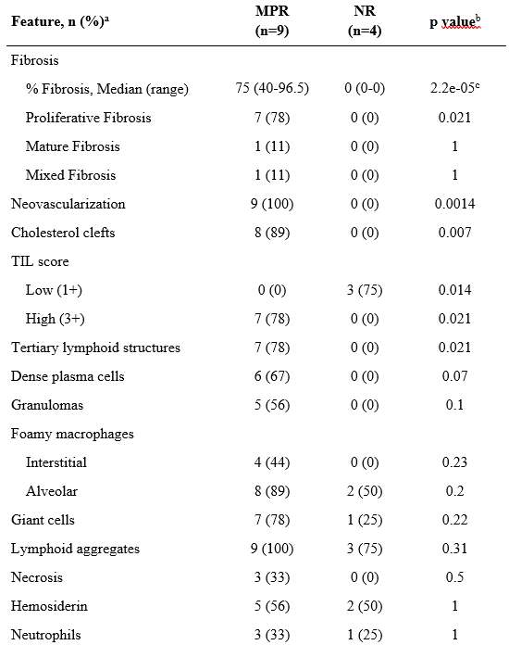
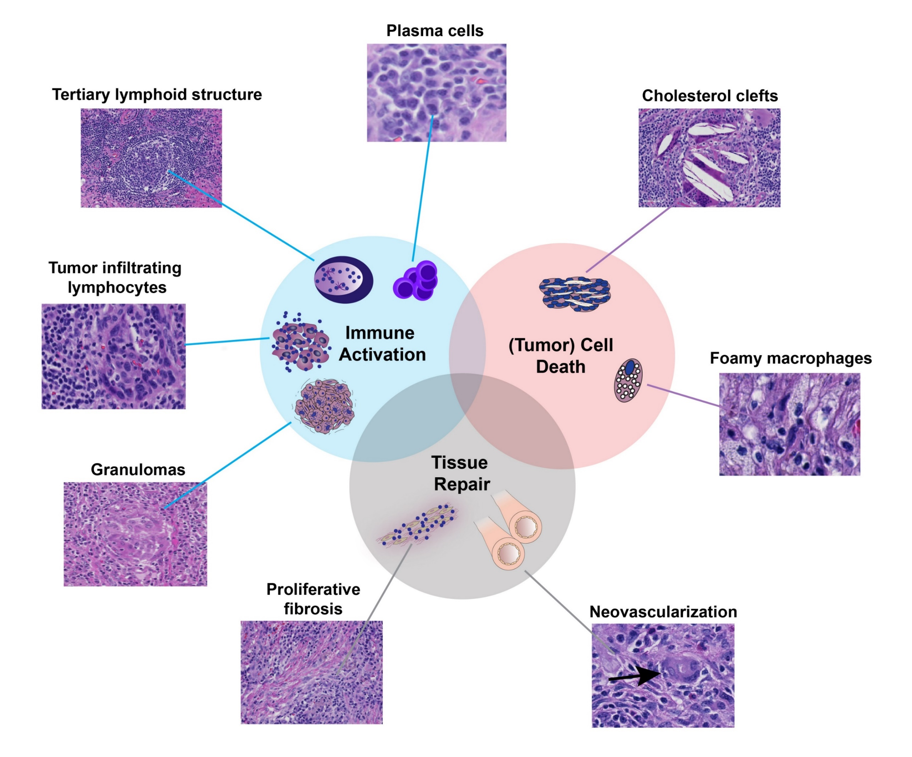
Systematic Identification of Features of Pathologic Response Following Neoadjuvant Immune Checkpoint Blockade

Slide 7
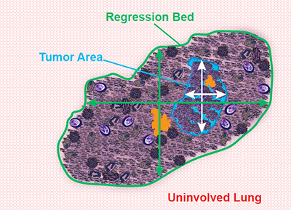
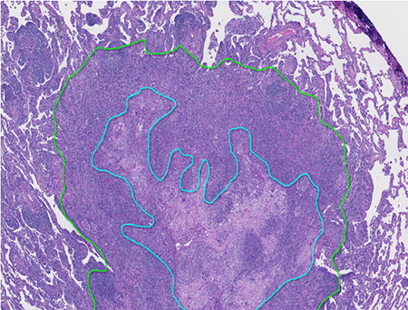
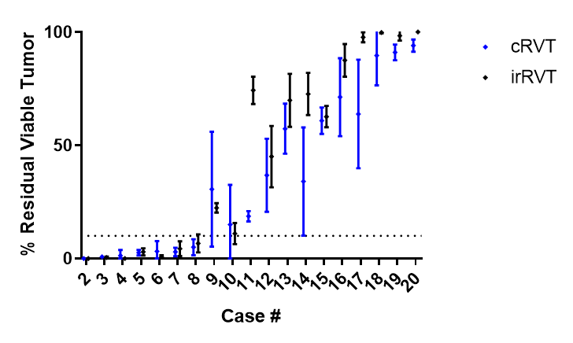
Immune-Related Pathologic Response Criteria (irPRC)
% Residual Viable Tumor
(Mean ± SD)
Patient #
Total area involved by tumor
Total tumor bed area
Define regression bed
Distinct from tumor-associated stroma other forms of fibrosis
Area-based calculation of residual viable tumor (RVT)
Implications for tissue sampling
Reproducibility of blinded pathologist scoring (n=4): chemotherapy vs. immune-related criteria
% irRVT =
x100

Slide 8
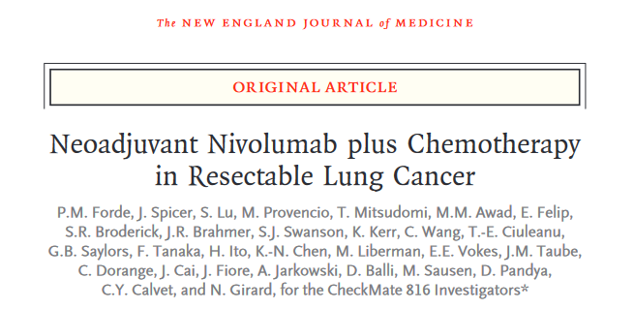
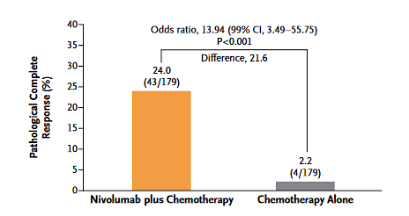
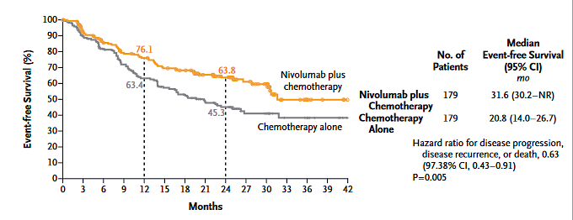
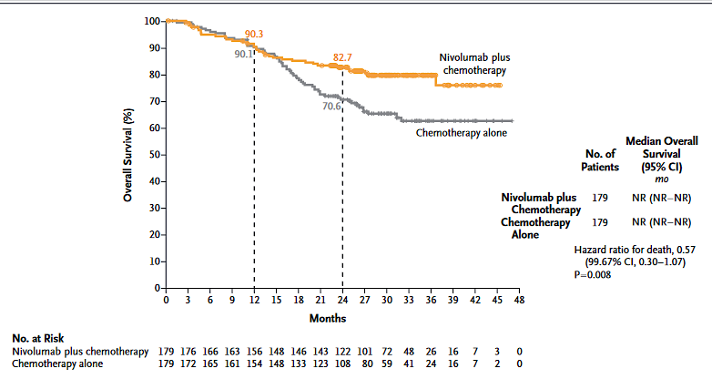
Event-free Survival
Overall Survival

Slide 9
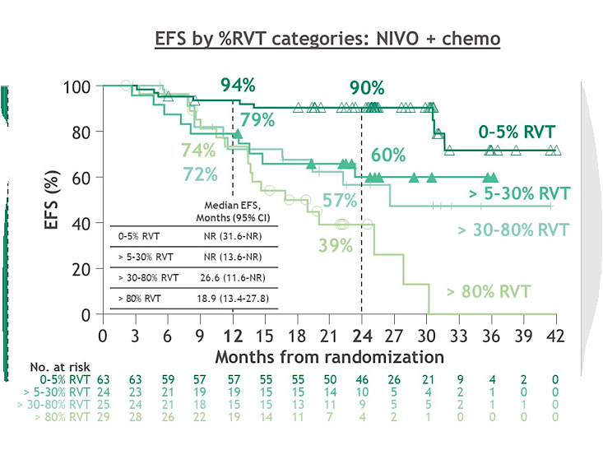
Data For IO/ Combinatorial Therapies Are Needed to Define Meaningful Thresholds of Pathologic Response

Slide 10
Association of % RVT and % Regression in the Primary Tumor With EFSª
NIVO + chemo (n = 141)
Regression
Necrosis
RVT
100
RVT/necrosis/ regression (%)^{b}
50
0
0% RVT
> 0% RVT
ROC curve analysis
2-year EFS by % RVT^{c}
2-year EFS by % regression
100
0
100
90
100
10
5^{d}
70
80
75
20
75
50
60^{d}
30
40
40
50
30
60
20
True positive rate (sensitivity)
True positive rate (sensitivity)
70
50
50
80
10
25
90
25
AUC
0.74
AUC
0.76
0
100
0
0
0
25
50
75
100
0
25
50
75
100
False positivity rate (100-specificity)
False positivity rate (100-specificity)
Similar AUCs for % RVT and % regression were observed with NIVO + chemo in both patients with or without LN involvement^{e}
Notes:
10

Slide 11
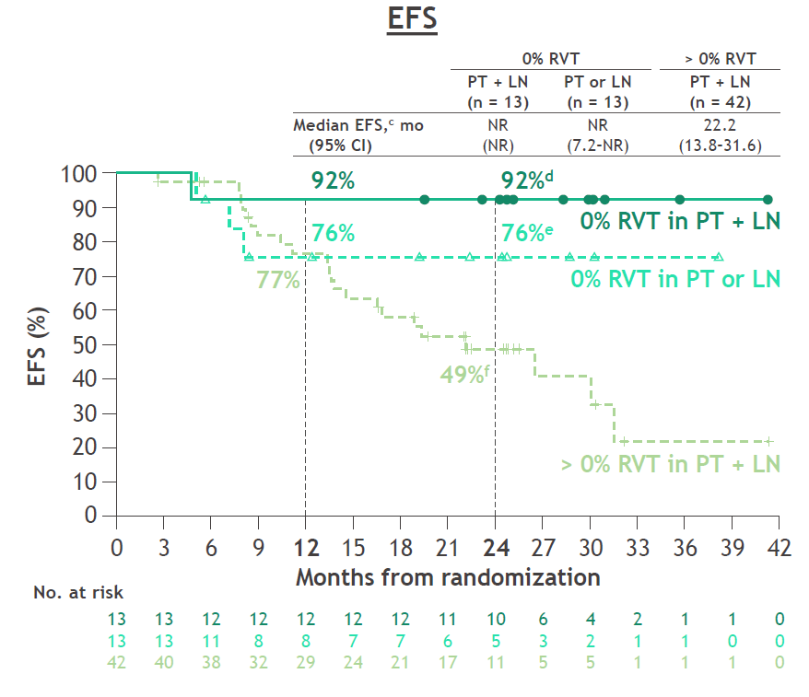
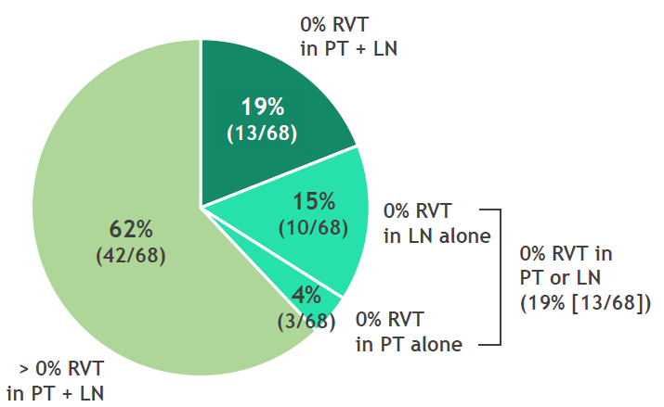
EFS by % RVT in Patients With LN Involvementa: NIVO + Chemo
% RVT (primary tumor [PT] and LN)^{b}

Slide 12
Conclusions
Pathologic response is a valuable clinical trial endpoint that correlates with patient survival, and it can be used to guide adjuvant therapy decisions
Following neoadjuvant immune checkpoint blockade, histologic features of tumor regression reflect immune cell activation, tumor cell death, and tissue repair
Future studies are needed to define the response thresholds which strongly predict distinct survival outcomes, including response assessments in lymph nodes, after neoadjuvant immune checkpoint blockade

