Slide 1
Which Patients Should I Consider For Neoadjuvant or Adjuvant Immunotherapy?
Patrick Forde, MBBCH
Co-Director, Division of Upper Aerodigestive Malignancies
Associate Professor of Oncology
The Johns Hopkins University
Baltimore, MD

Slide 2
Disclaimer
The views and opinions expressed in this educational activity are those of the faculty and do not necessarily represent the views of TotalCME, Inc., the CME providers, or the companies providing educational grants. This presentation is not intended to define an exclusive course of patient management; the participant should use their clinical judgment, knowledge, experience, and diagnostic skills in applying or adopting for professional use any of the information provided herein. Any procedures, medications, or other courses of diagnosis or treatment discussed or suggested in this activity should not be used by clinicians without evaluation of their patient's conditions and possible contraindications or dangers in use, review of any applicable manufacturer’s product information, and comparison with recommendations of other authorities. Links to other sites may be provided as additional sources of information.

Slide 3
Novel Therapy Development for Earlier Stage NSCLC Has Been Slow Despite Unmet Need
AJCC stage | T (Primary tumor) | N (Regional lymph nodes) | M (Distant metastases)
IIA | T2b | N0 | 0
IIB | T1a/T1b/T1c | N1 | 0
 | T2a/T2b | N1 | 0
 | T3 | N0 | 0
IIIA | T1a/T1b/T1c | N2 | 0
 | T2a/T2b | N2 | 0
 | T3 | N1 | 0
 | T4 | N0/N1 | 0
5-year survival
(clinical stage)
Tumors ≥4cm diameter
and/or
Lymph node positive
8th ed stage
II-IIIA
60%
53%
36%
~500,000 people worldwide are diagnosed with potentially curable, surgically resectable lung cancer each year

Slide 4
CheckMate 816 Study Designª
Key eligibility criteria
Newly diagnosed, resectable, stage IB (≥4 cm)–IIIA NSCLC (per AJCC 7th edition^{b})
ECOG PS 0–1
No known sensitizing EGFR mutations or ALK alterations
Stratified by
Stage (IB–II vs IIIA), PD-L1^{c} (≥1% vs <1%^{d}), and sex
NIVO 360 mg Q3W +
chemo^{e} Q3W (3 cycles)
Surgery (within 6 weeks post-treatment)
Optional adjuvant chemo ± RT^{g}
N=358
Radiologic restaging
Follow-up
R
1:1
Chemo^{f} Q3W (3 cycles)
Primary endpoints
pCR by BIPR
EFS^{h} by BICR
Secondary endpoints
MPR by BIPR
OS
Time to death or distant metastases
Key exploratory analysis
EFS by pCR status
Database lock: October 20, 2021​; minimum follow-up: 21 months for NIVO (nivolumab) + chemo and chemo arms; median follow-up, 29.5 months
ªNCT02998528; ^{b}TNM Classification of Malignant Tumors 7th edition; ^{c}Determined by the PD-L1 IHC 28-8 pharmDx assay (Dako); ^{d}Included patients with PD-L1 expression status not evaluable and indeterminate; ^{e}NSQ: pemetrexed + cisplatin or paclitaxel + carboplatin; SQ: gemcitabine + cisplatin or paclitaxel + carboplatin; ^{f}Vinorelbine + cisplatin, docetaxel + cisplatin, gemcitabine + cisplatin (SQ only), pemetrexed + cisplatin (NSQ only), or paclitaxel + carboplatin; ^{g}Per healthcare professional choice; ^{h}EFS defined as the time from randomization to any progression of disease precluding surgery, progression or recurrence of disease after surgery, progression for patients without surgery, or death due to any cause; patients with subsequent therapy were censored at the last evaluable tumor assessment on or prior to the date of subsequent therapy.

Slide 5
CheckMate 816: Baseline Characteristics
 | NIVO + chemo (n=179) | Chemo (n=179)
Age, median (range), years | 64 (41–82) | 65 (34–84)
Age category, % <65 years ≥65 years | 52 48 | 46 54
Male, % | 72 | 71
Region,ª % North America Europe Asia | 23 23 48 | 28 14 51
ECOG PS, % 0 1 | 69 31 | 65 35
Stage,^{b,c} % IB–II IIIA | 36 63 | 35 64
Histology, % Squamous Nonsquamous | 49 51 | 53 47
 | NIVO + chemo (n=179) | Chemo (n=179)
Smoking status,^{d} % Current/former Never | 89 11 | 88 11
Tumor PD-L1 expression,^{e} % Not evaluable <1% ≥1% 1–49% ≥50% | 7 44 50 28 21 | 7 43 50 26 24
TMB,^{f} % Not evaluable/not reported^{g} <12.3 mut/Mb ≥12.3 mut/Mb | 51 27 22 | 50 30 21
Type of platinum therapy, % Cisplatin Carboplatin | 69 22 | 75 18
ªRest of the world: 7% of patients in each of the NIVO + chemo and chemo arm; ^{b}Disease stage by case report form, per AJCC 7th edition; 1 patient in the chemo arm had stage IA disease and 1 patient in each arm had stage IV disease; ^{c}Stage IB, IIA, IIB disease: 6%, 17%, and 14% of patients in the NIVO + chemo arm and 4%, 18%, and 12% in the chemo arm, respectively; ^{d}One patient in the chemo arm had unknown smoking status; ^{e}Percentages are based on the primary analysis population; level of PD-L1 expression was determined using the PD-L1 IHC 28-8 pharmDx assay (Dako); patients with tumor tissue that could not be assessed for PD-L1 (≤10% of all randomized patients) were stratified to the PD-L1 expression <1% subgroup at randomization; ^{f}TMB was evaluated using the Illumina TSO500 assay. A 12.3-mut/Mb cutoff per TSO500 corresponds to 10 mut/Mb per the FoundationOne assay¹; ^{g}TMB was not analyzed for patients in China and these patients are included in the ‘not reported’ category.
1. Baden J, et al. Ann Oncol. 2019;30(suppl 5):v28. doi:10.1093/annonc/mdz239.010

Slide 6
CheckMate 816: EFS Subgroup Analysis
 | Median EFSª, mo |  | Unstratified HR (95% CI) | Unstratified HR
 | NIVO + chemo (n=179) | Chemo (n=179)
Overall (N=358) | 32 | 21 |  | 0.63
<65 years (n=176) ≥65 years (n=182) | NR 30 | 21 18 |  | 0.57 0.70
Male (n=255) Female (n=103) | 31 NR | 17 32 |  | 0.68 0.46
North America (n=91) Europe (n=66) Asia (n=177) | NR 32 NR | NR 21 16 |  | 0.78 0.80 0.45
ECOG PS 0 (n=241) ECOG PS 1 (n=117) | NR 30 | 23 14 |  | 0.61 0.71
Stage IB–II (n=127) Stage IIIA (n=228) | NR 32 | NR 16 |  | 0.87 0.54
Squamous (n=182) Nonsquamous (n=176) | 31 NR | 23 20 |  | 0.77 0.50
Current/former smoker (n=318) Never smoker (n=39) | 32 NR | 22 10 |  | 0.68 0.33
PD-L1 <1% (n=155) PD-L1 ≥1% (n=178) | 25 NR | 18 21 |  | 0.85 0.41
PD-L1 1–49% (n=98) PD-L1 ≥50% (n=80) | NR NR | 27 20 |  | 0.58 0.24
TMB <12.3 mut/Mb (n=102) TMB ≥12.3 mut/Mb (n=76) | 30 NR | 27 22 |  | 0.86 0.69
Cisplatin (n=258) Carboplatin (n=72) | NR NR | 21 11 |  | 0.71 0.31
Favors NIVO + chemo
Favors chemo

Slide 7
IMpower010: Study Design
N=1280
Key eligibility criteria
Completely resected stage
IB (≥4cm)–IIIA NSCLC (per TNM 7th edition)
ECOG performance status 0–1
PD-L1 all-comers
Stratified by
Sex, histology, stage of disease (IB vs II vs IIIA), PD-L1 expression
Up to 4 cycles of:
Cisplatin 75 mg/m²
+
Vinorelbine 30 mg/m²
or
Docetaxel 75 mg/m²
or
Gemcitabine 1250 mg/m²
or
Pemetrexed 500 mg/m²
No crossover permitted
Atezolizumab 1200 mg
Q3W, 16 cycles
N=1005
R
1:1
Best supportive care
Primary endpoints
DFS tested hierarchically
PD-L1 ≥1%, stage II–IIIA population
All-randomized stage II–IIIA population
ITT population IB–IIIA
Secondary endpoints
OS in ITT population
DFS in patients with PD-L1 ≥50% and stage II–IIIA disease
3- and 5-year DFS in all populations

Slide 8
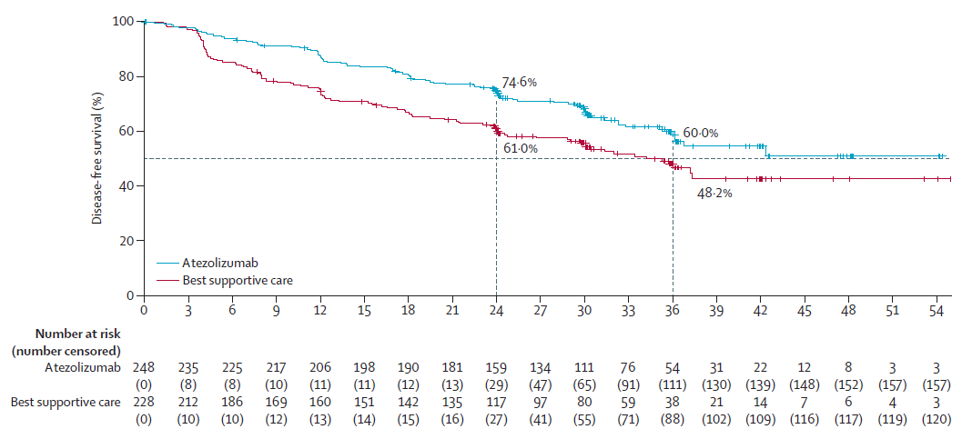
IMpower010: DFS Benefit Observed Among Patients With PD-L1+ Stage II-IIIA Disease
PD-L1 ≥1%*, stage II-IIIA population
 | Atezo (n=248) | BSC (n=228)
Median DFS, mo | NR | 35.3
HR (95% CI), P value | 0.66 (0.50–0.88), 0.004†
Median follow-up: 32.8 mo
Median DFS in the ITT population (IB-IIIA) was not reached with atezolizumab and 37.2 months with BSC (HR: 0.81; 95% CI: 0.67–0.99) after median follow-up of 32.2 months; this endpoint did not cross the significance boundary and analysis is ongoing

Slide 9
IMpower010: Adjuvant Atezolizumab Shows Enriched Benefit With Increased PD-L1 Expression
 |  | HR (95% CI)
Age
<65 years (N=544) |  | 0.79 (0.61-1.03)
≥65 years (N=338) |  | 0.76 (0.54-1.05)
Sex
Male (N=589) |  | 0.76 (0.59-0.99)
Female (N=293) |  | 0.80 (0.57-1.13)
Race
White (N=631) |  | 0.78 (0.61-1.00)
Asian (N=277) |  | 0.82 (0.55-1.22)
Unknown (N=16) |  | 0.27 (0.05-1.50)
Region
Asia-Pacific (N=219) |  | 0.83 (0.55-1.25)
Europe and the Middle East (N=560) |  | 0.73 (0.56-0.94)
North America (N=101) |  | 1.03 (0.57-1.89)
ECOG performance status
0 (N=491) |  | 0.72 (0.55-0.95)
1 (N=388) |  | 0.87 (0.64-1.18)
Tobacco use history
Never (N=196) |  | 1.13 (0.77-1.67)
Previous (N=547) |  | 0.62 (0.47-0.81)
Current (N=139) |  | 1.01 (0.58-1.75)
Histology
Squamous (N=294) |  | 0.80 (0.54-1.18)
Nonsquamous (N=588) |  | 0.78 (0.61-0.99)
Stage
IIA (N=295) |  | 0.68 (0.46-1.00)
IIB (N=174) |  | 0.88 (0.54-1.42)
IIIA (N=413) |  | 0.81 (0.61-1.06)
 |  | HR (95% CI)
Regional lymph node stage (pN)
N0 (N=229) |  | 0.88 (0.57-1.35)
N1 (N=348) |  | 0.67 (0.47-0.95)
N2 (N=305) |  | 0.83 (0.61-1.13)
PD-L1 status by SP263
TC <1% (N=383) |  | 0.97 (0.72-1.31)
TC ≥1% (N=476) |  | 0.66 (0.49-0.87)
TC 1-49% (N=247) |  | 0.87 (0.60-1.26)
TC ≥50% (N=229) |  | 0.43 (0.27-0.68)
Type of surgery
Lobectomy (N=675) |  | 0.77 (0.61-0.97)
Bilobectomy (N=47) |  | 1.02 (0.35-2.98)
Pneumonectomy (N=150) |  | 0.91 (0.56-1.47)
Chemotherapy regimen
Cisplatin plus docetaxel (N=124) |  | 0.72 (0.42-1.23)
Cisplatin plus gemcitabine (N=138) |  | 0.94 (0.56-1.57)
Cisplatin plus pemetrexed (N=349) |  | 0.84 (0.61-1.16)
Cisplatin plus vinorelbine (N=271) |  | 0.67 (0.46-0.99)
EGFR mutation status
Yes (N=109) |  | 0.99 (0.60-1.62)
No (N=463) |  | 0.79 (0.59-1.05)
Unknown (N=310) |  | 0.70 (0.49-1.01)
ALK rearrangement status
Yes (N=31) |  | 1.04 (0.38-2.90)
No (N=507) |  | 0.85 (0.66-1.10)
Unknown (N=344) |  | 0.66 (0.46-0.93)
All patients (N=882) |  | 0.79 (0.64-0.96)
0.1
1.0
10.0
0.1
Favors atezolizumab
1.0
10.0
Favors atezolizumab
Favors best supportive care
Favors best supportive care

Slide 10
Which Patients Should I Consider for Neoadjuvant or Adjuvant Immunotherapy?
Patients with NSCLC measuring 4 cm+ and/or node positive and without EGFR/ALK alterations are potential candidates for neoadjuvant chemotherapy plus nivolumab
Adjuvant atezolizumab is approved for PD-L1 positive NSCLC after adjuvant chemotherapy with the greatest benefit seen in the PD-L1 ≥50% group
Adjuvant pembrolizumab may be a future option

