Slide 1
What Is the Rationale for the Use of Neoadjuvant and Adjuvant Immunotherapy to Treat Patients With Resectable Lung Cancer?
Patrick Forde, MBBCH
Co-Director, Division of Upper Aerodigestive Malignancies
Associate Professor of Oncology
The Johns Hopkins University
Baltimore, MD

Slide 2
Disclaimer
The views and opinions expressed in this educational activity are those of the faculty and do not necessarily represent the views of TotalCME, Inc., the CME providers, or the companies providing educational grants. This presentation is not intended to define an exclusive course of patient management; the participant should use their clinical judgment, knowledge, experience, and diagnostic skills in applying or adopting for professional use any of the information provided herein. Any procedures, medications, or other courses of diagnosis or treatment discussed or suggested in this activity should not be used by clinicians without evaluation of their patient's conditions and possible contraindications or dangers in use, review of any applicable manufacturer’s product information, and comparison with recommendations of other authorities. Links to other sites may be provided as additional sources of information.

Slide 3
US Lung Cancer: Estimated Deaths by Sex
Men
Women
Lung & bronchus | 69,410 | 22%
Prostate | 34,130 | 11%
Colon & rectum | 28,520 | 9%
Pancreas | 25,270 | 8%
Liver & intrahepatic bile duct | 20,300 | 6%
Leukemia | 13,900 | 4%
Esophagus | 12,410 | 4%
Urinary bladder | 12,260 | 4%
Non-Hodgkin lymphoma | 12,170 | 4%
Brain & other nervous system | 10,500 | 3%
All sites | 319,420
Lung & bronchus | 62,470 | 22%
Breast | 43,600 | 15%
Colon & rectum | 24,460 | 8%
Pancreas | 22,950 | 8%
Ovary | 13,770 | 5%
Uterine corpus | 12,940 | 4%
Liver & intrahepatic bile duct | 9,930 | 3%
Leukemia | 9,760 | 3%
Non-Hodgkin lymphoma | 8,550 | 3%
Brain & other nervous system | 8,100 | 3%
All sites | 289,150

Slide 4
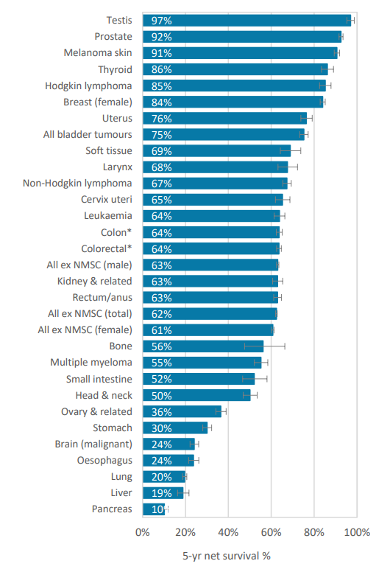
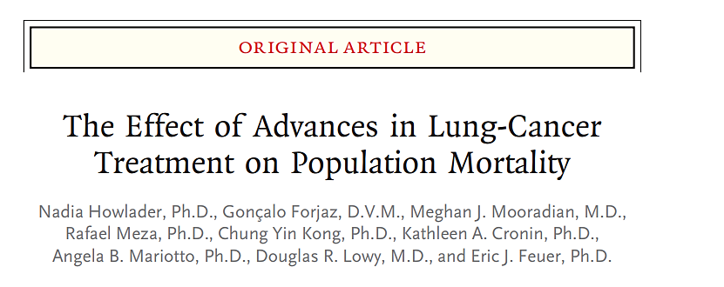
Novel Systemic Therapy Is Impacting Lung Cancer Mortality
Among men, 6.3% reduction in lung cancer mortality each year, 2013 to 2016
3.1% annual reduction in incidence over similar period (2008-2016)
>30 new lung cancer drug approvals or indications in USA from 2015 to 2020

Slide 5
Novel Therapy Development for Earlier Stage NSCLC Has Been Slow Despite Unmet Need
AJCC stage | T (Primary tumor) | N (Regional lymph nodes) | M (Distant metastases)
IIA | T2b | N0 | 0
IIB | T1a/T1b/T1c | N1 | 0
 | T2a/T2b | N1 | 0
 | T3 | N0 | 0
IIIA | T1a/T1b/T1c | N2 | 0
 | T2a/T2b | N2 | 0
 | T3 | N1 | 0
 | T4 | N0/N1 | 0
5-year survival
(clinical stage)
60%
53%
36%

Slide 6
Novel Therapy Development for Earlier Stage NSCLC Has Been Slow Despite Unmet Need
AJCC stage | T (Primary tumor) | N (Regional lymph nodes) | M (Distant metastases)
IIA | T2b | N0 | 0
IIB | T1a/T1b/T1c | N1 | 0
 | T2a/T2b | N1 | 0
 | T3 | N0 | 0
IIIA | T1a/T1b/T1c | N2 | 0
 | T2a/T2b | N2 | 0
 | T3 | N1 | 0
 | T4 | N0/N1 | 0
5-year survival
(clinical stage)
60%
Tumors ≥4cm diameter
and/or
Lymph node positive
53%
36%
~500,000 people worldwide are diagnosed with potentially curable, surgically resectable lung cancer each year

Slide 7
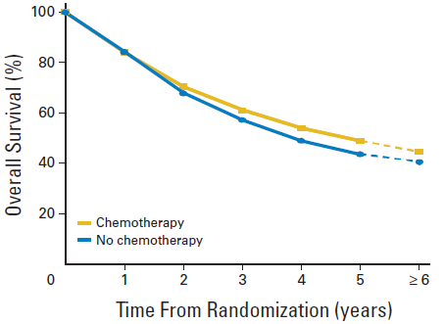
LACE Meta-Analysis of Adjuvant Platinum Chemotherapy Versus No Adjuvant Chemo NSCLC
Standard of care in 2008 was still standard of care in 2020, despite many advances in IO and targeted therapy for advanced lung cancer
HR 0.89 (95% CI 0.82-0.96); P = .005
Absolute benefit 5.4% at 5 years
Pignon et al. J Clin Oncol. 2008;26:3552-3559.

Slide 8
Preoperative (Neoadjuvant) Chemotherapy Plus Surgery Versus Surgery Alone
 | Preoperative chemotherapy | Control | O-E | Variance
France 1990 | 8/13 | 8/13 | 0.32 | 3.97
MD Anderson 1994 | 19/28 | 27/32 | -6.40 | 11.19
Spain 1994 | 19/29 | 27/30 | -8.88 | 9.65
MIP-91 | 137/179 | 146/176 | -12.99 | 70.22
SWOG S9015 | 3/5 | 12/16 | -1.04 | 2.94
JCOG 9209 | 28/31 | 25/31 | 2.25 | 12.97
Netherlands 2000 | 23/39 | 15/40 | 3.86 | 9.36
Finland 2003 | 19/30 | 19/32 | -0.50 | 9.48
MRC BLT | 4/5 | 3/5 | 1.26 | 1.60
MRC LU22 | 151/258 | 158/261 | -2.92 | 77.01
SWOG S9900 | 93/180 | 103/174 | -9.31 | 48.84
China 2002 | 26/32 | 18/23 | 1.42 | 10.78
China 2005 | 8/19 | 14/21 | -3.31 | 5.44
ChEST | 45/129 | 61/141 | -10.27 | 26.39
NATCH | 99/201 | 109/212 | -4.11 | 51.95
Total | 682/1178 | 745/1207 | -50.62 | 351.78
0 0.5 1.0 1.5 2.0
Preoperative chemotherapy better
Nonpreoperative chemotherapy better

Slide 9
Considerations for Timing Immunotherapy Around Surgery
Neoadjuvant
Adjuvant
Provides earliest opportunity to eradicate micrometastatic disease¹
Allows the fastest time to surgery
No risk of presurgery complications from systemic therapy
Enables longer treatment duration for systemic control⁵
More flexible timing as administration postsurgery provides more recovery time for patients⁵
Increased treatment initiation rate and compliance²
97% initiated neoadjuvant vs 66% initiated adjuvant therapy
90% completed neoadjuvant vs 61% completed adjuvant therapy
Pathologic response provides early indicator of response to therapy and can guide future treatment decisions³
Immunotherapy is administered when draining lymph nodes are intact, potentially augmenting response¹
Perioperative treatment

Slide 10
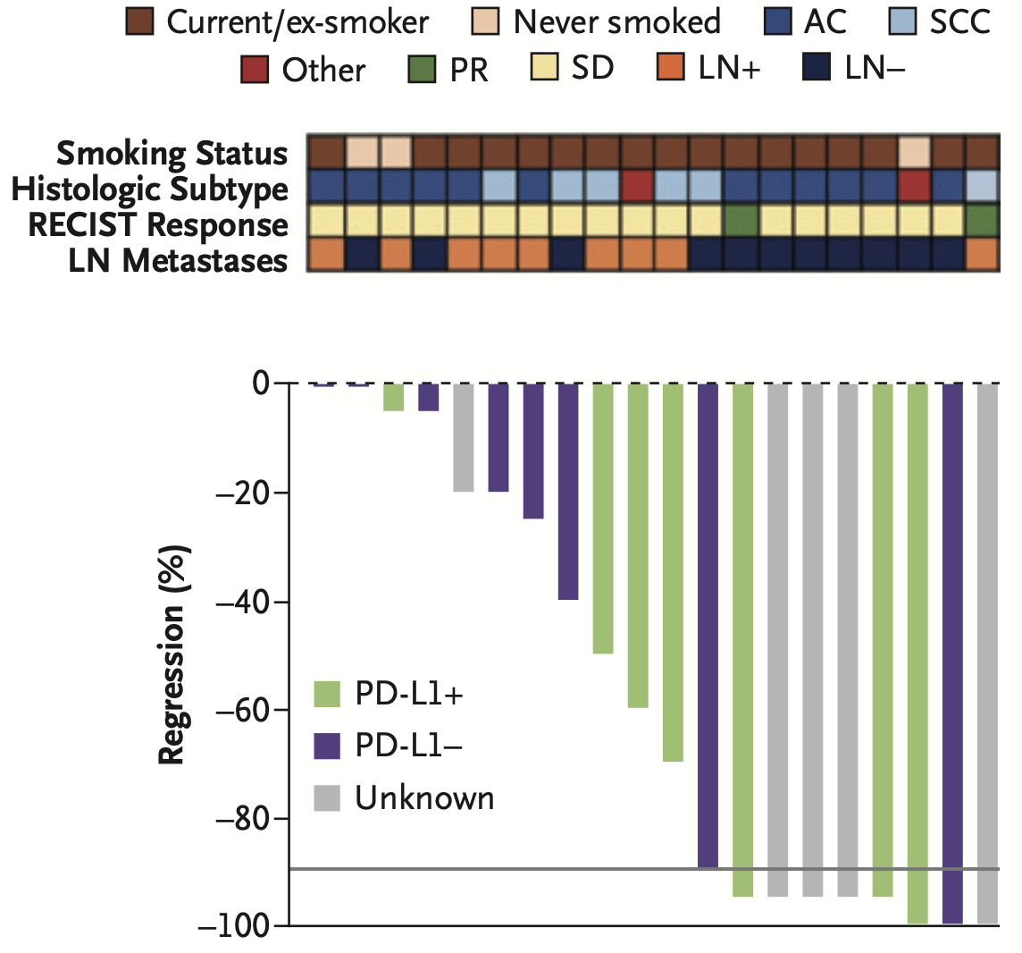
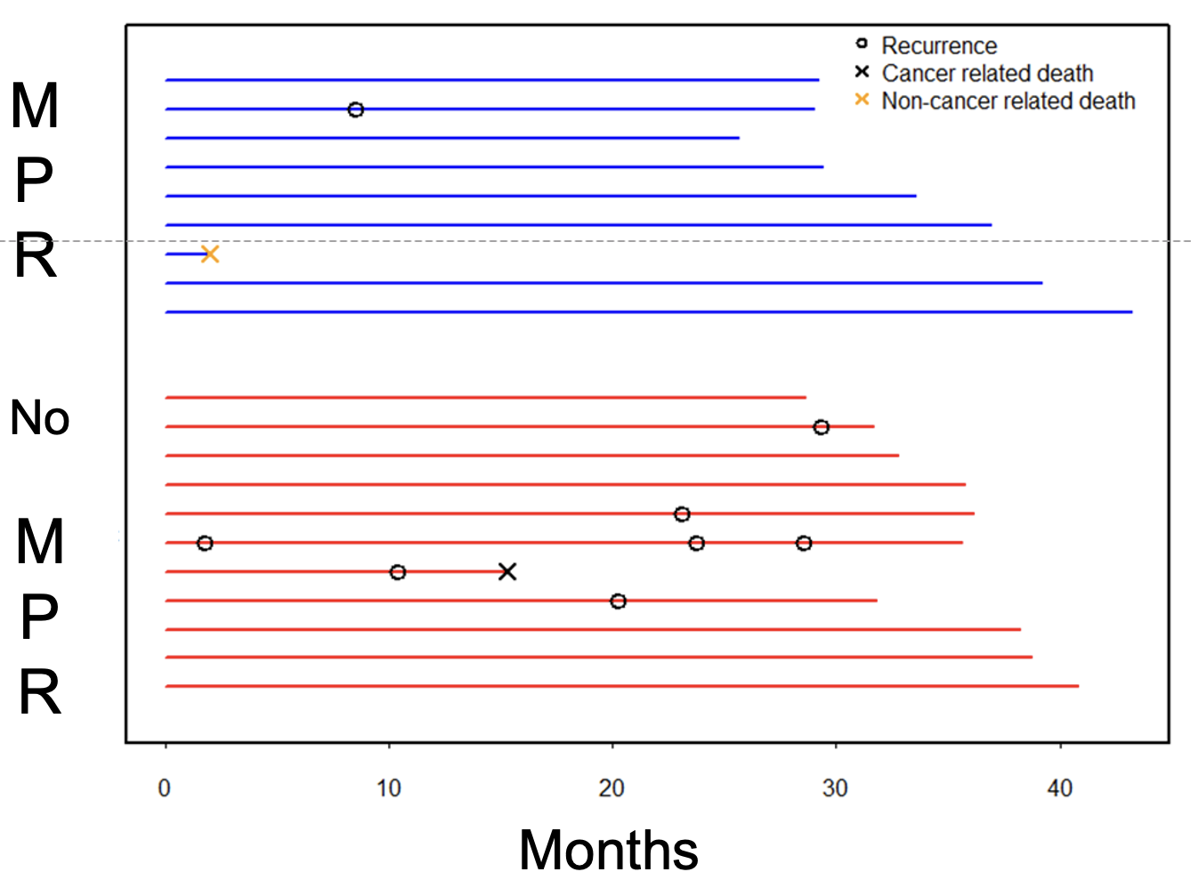
Initial Experience With Neoadjuvant PD-1 Blockade in Resectable Lung Cancer
Percentage of Pathological Regression After Neoadjuvant Nivolumab in 20 Patients Who Underwent Surgical Resection¹
Longer-Term Follow-Up²

Slide 11
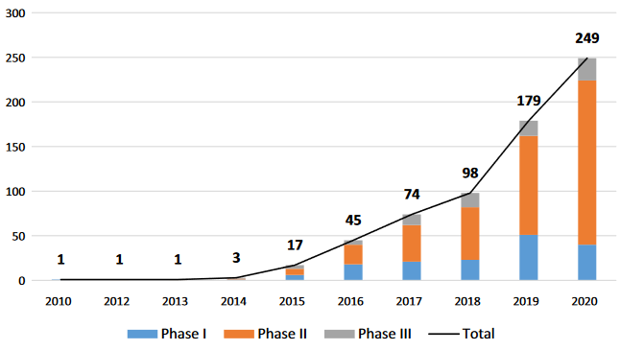
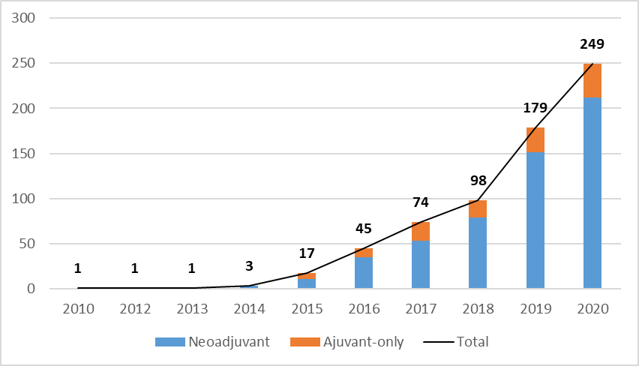
Rapid Increase in Active Neoadjuvant Anti-PD-1/PD-L1 Trials Worldwide
Trial Phase
Neoadjuvant vs. Adjuvant
Adjuvant-only

