Slide 1
Sleep Architecture and Neurotransmitters of Sleep
Michael E. Yurcheshen, MD, FAASM
Associate Professor of Neurology and Medicine
University of Rochester School of Medicine and Dentistry
UR Medicine Sleep Center
Rochester, NY

Slide 2



Resource Information
About This Resource
These slides are one component of a continuing education program available online at MedEd On The Go titled Insomnia Treatment Goals: Restful Nights and Productive Days
Program Learning Objectives:
Explain the importance of improving nighttime sleep difficulties and the positive impact this has on improving daytime function
Describe the role of neurotransmitter systems involved in the sleep-wake cycle
Integrate assessment tools to clinically differentiate insomnia from episodes of poor sleep
Compare current treatment options relative to their clinical impact in the management of both the nighttime and daytime symptoms of insomnia
MedEd On The Go®
www.mededonthego.com
This content or portions thereof may not be published, posted online or used in presentations without permission.
This content can be saved for personal use (non-commercial use only) with credit given to the resource authors.
To contact us regarding inaccuracies, omissions or permissions please email us at support@MedEdOTG.com

Slide 3
Disclaimer
The views and opinions expressed in this educational activity are those of the faculty and do not necessarily represent the views of Total CME, LLC, the CME providers, or the companies providing educational grants. This presentation is not intended to define an exclusive course of patient management; the participant should use their clinical judgment, knowledge, experience, and diagnostic skills in applying or adopting for professional use any of the information provided herein. Any procedures, medications, or other courses of diagnosis or treatment discussed or suggested in this activity should not be used by clinicians without evaluation of their patient's conditions and possible contraindications or dangers in use, review of any applicable manufacturer’s product information, and comparison with recommendations of other authorities. Links to other sites may be provided as additional sources of information.

Slide 4
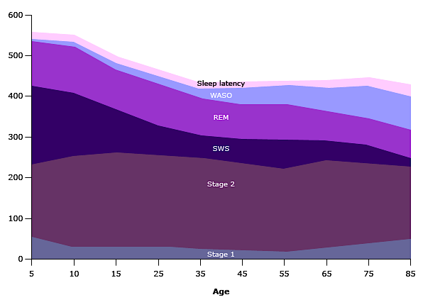
Sleep Macroarchitecture
Ohayon MM, Carskadon MA, Guilleminault C, Vitiello MV. Meta-analysis of quantitative sleep parameters from childhood to old age in healthy individuals: developing normative sleep values across the human lifespan. Sleep. 2004;27(7):1255-1273. doi:10.1093/sleep/27.7.1255

Slide 5
Major Neurotransmitters Regulating Wakefulness
Glutamine
Monoamines
Acetylcholine
Histamine

Slide 6
Major Neurotransmitters Regulating NREM Sleep
Serotonin
GABA
Adenosine

Slide 7
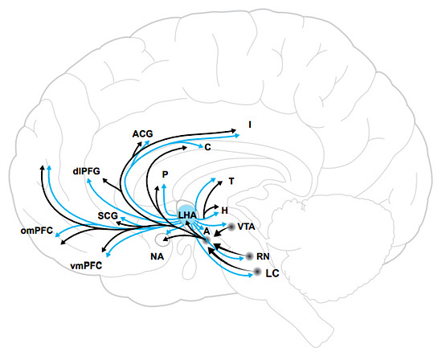
Neurotransmitter Regulating REM Sleep
Orexin
Katzman MA, Katzman MP. Neurobiology of the Orexin System and Its Potential Role in the Regulation of Hedonic Tone. Brain Sciences. 2022; 12(2):150. https://doi.org/10.3390/brainsci12020150

Slide 8



Looking for more resources
on this topic?
CME/CE in minutes
Congress highlights
Late-breaking data
Quizzes
Webinars
In-person events
Slides & resources
www.MedEdOTG.com

