Slide 1
AMKD Disease Burden and Management Strategies: The Need for Small Molecule Treatments
Csaba P. Kovesdy, MD
Fred Hatch Professor of Medicine
Director, Clinical Outcomes and Clinical Trials Program in Nephrology
University of Tennessee Health Science Center
Memphis VA Medical Center
Memphis, TN

Slide 2
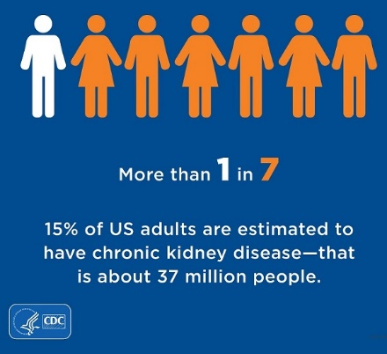
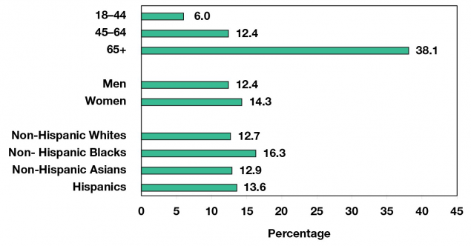
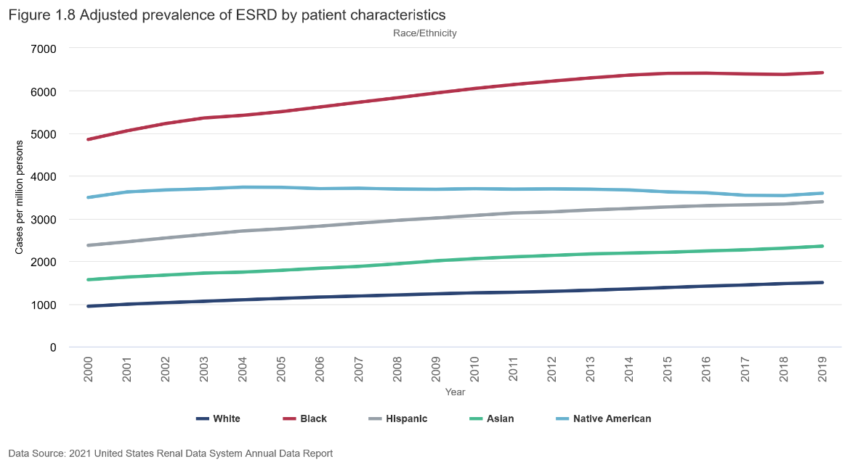
CKD Is More Common in African Americans Than in Other Races
Racial groups in the United States
(2020 Census, including racial identification of Latinos)
White Americans (61.6%)
Black Americans (12.4%)
Two or more races (10.2%)
Some other race (8.4%)
Asian Americans (6.0%)
Native Americans (1.1%)
Pacific Islander Americans (0.2%)

Slide 3
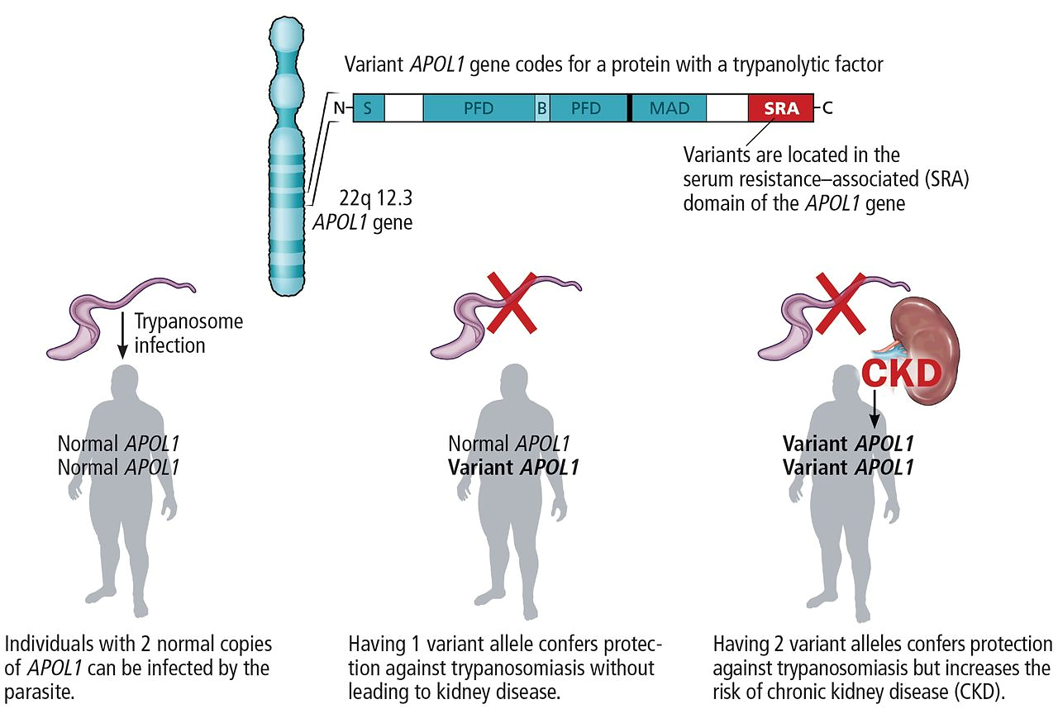
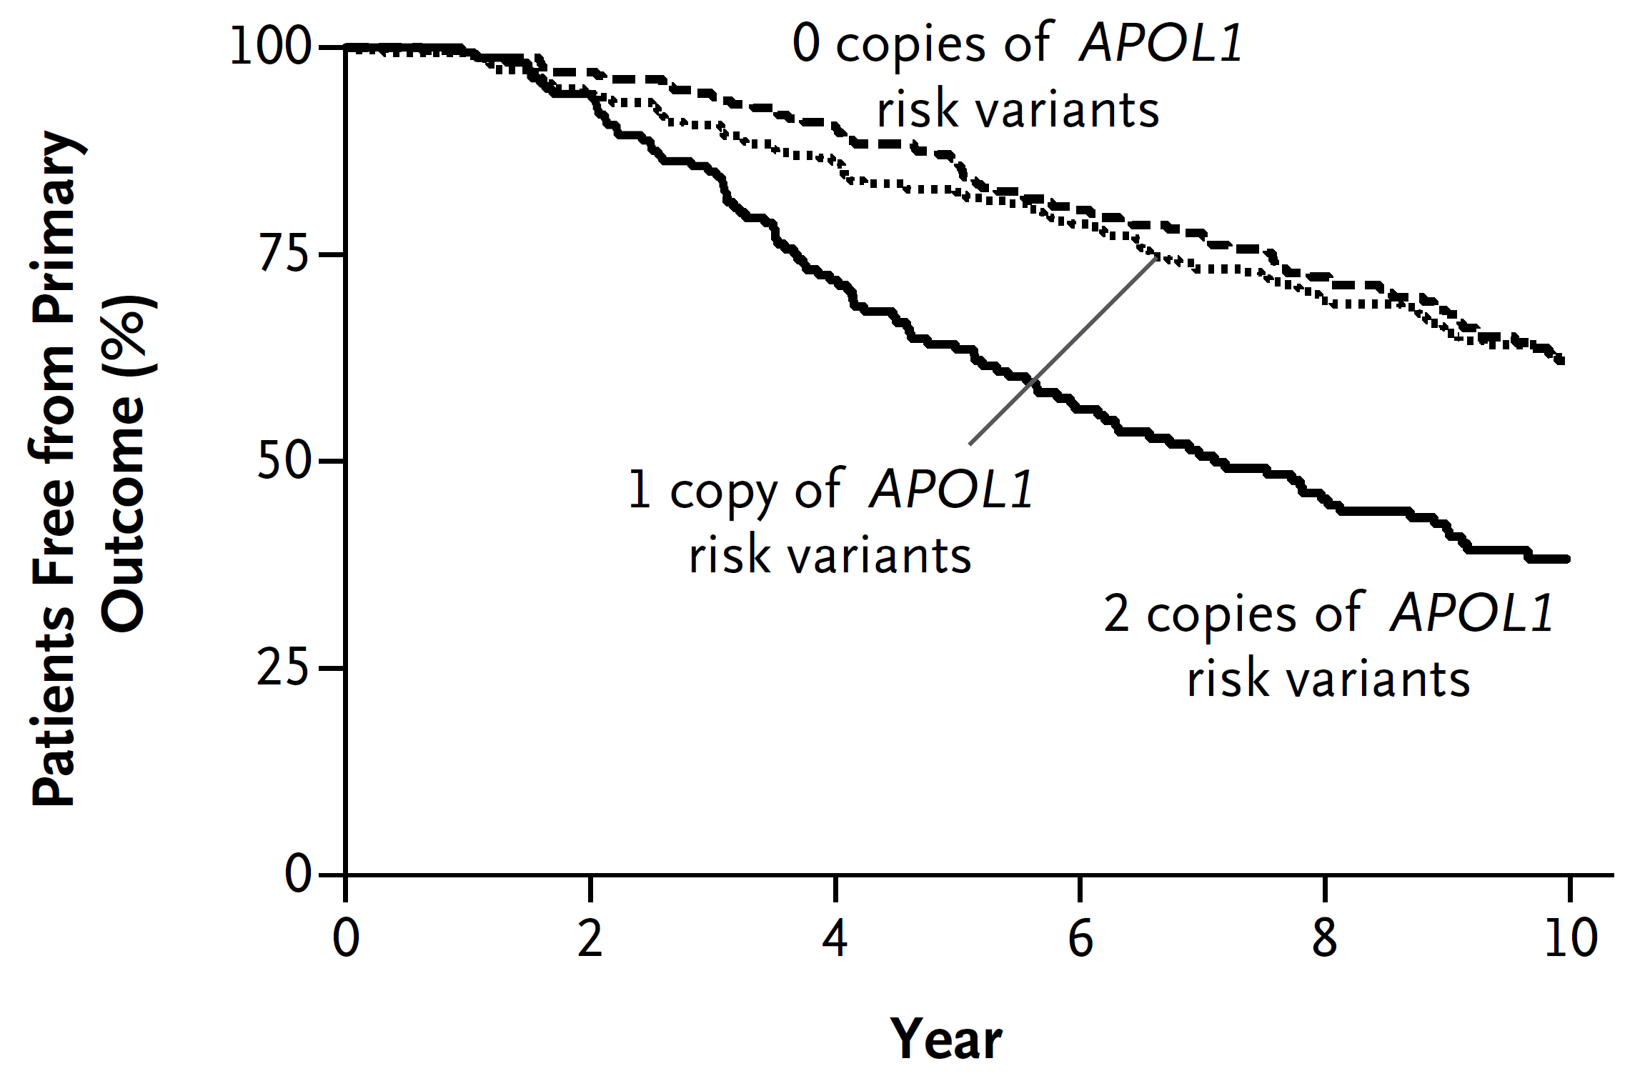
APOL1 Variants Contribute to a Higher Risk of CKD in African Americans

Slide 4
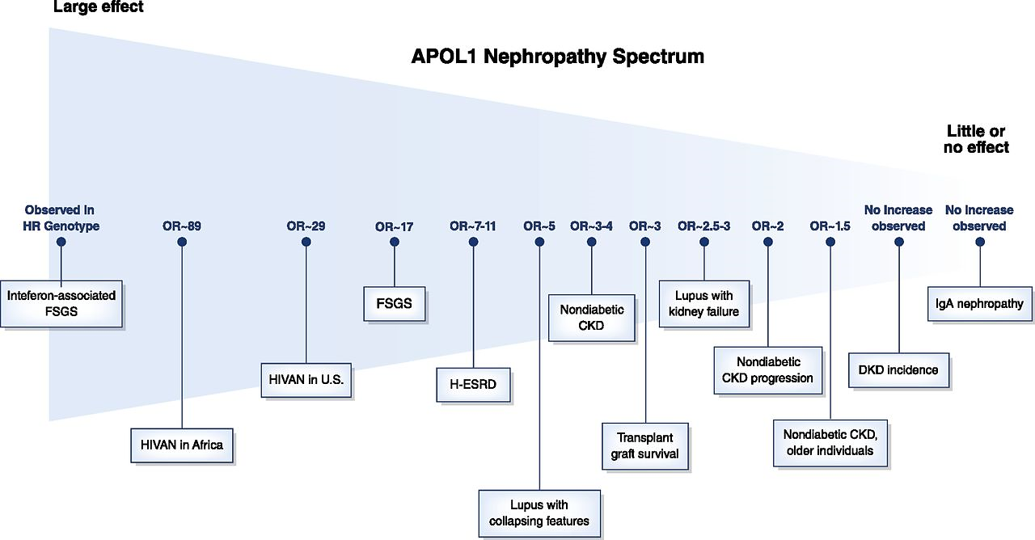
APOL1-Related Kidney Disease Affects a Large Proportion of African American Patients With CKD

Slide 5
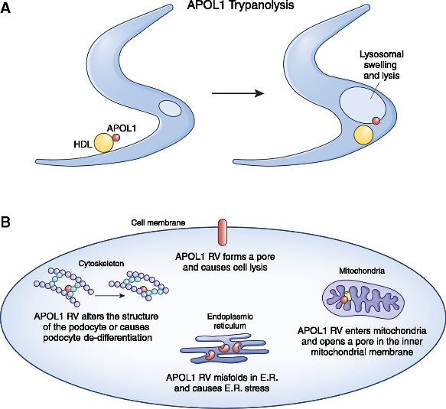
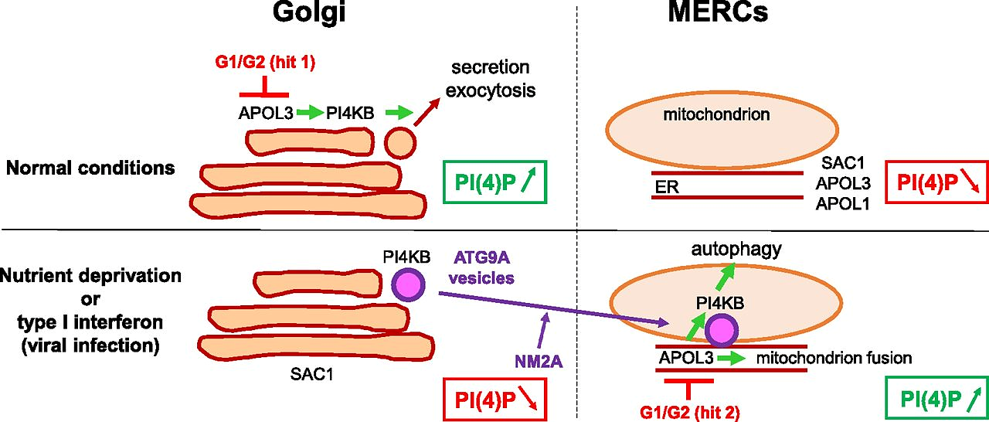
Mechanism of Kidney Injury: APOL1 G1/G2 Are Gain of Function Mutations That Directly Contribute to Kidney Damage

Slide 6
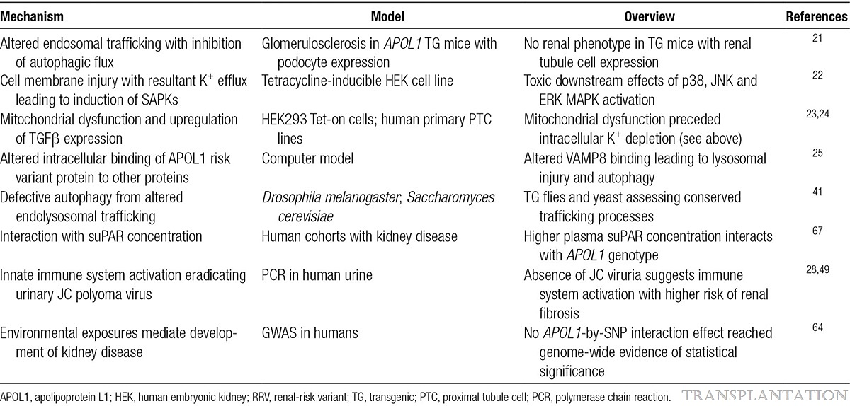

Slide 7
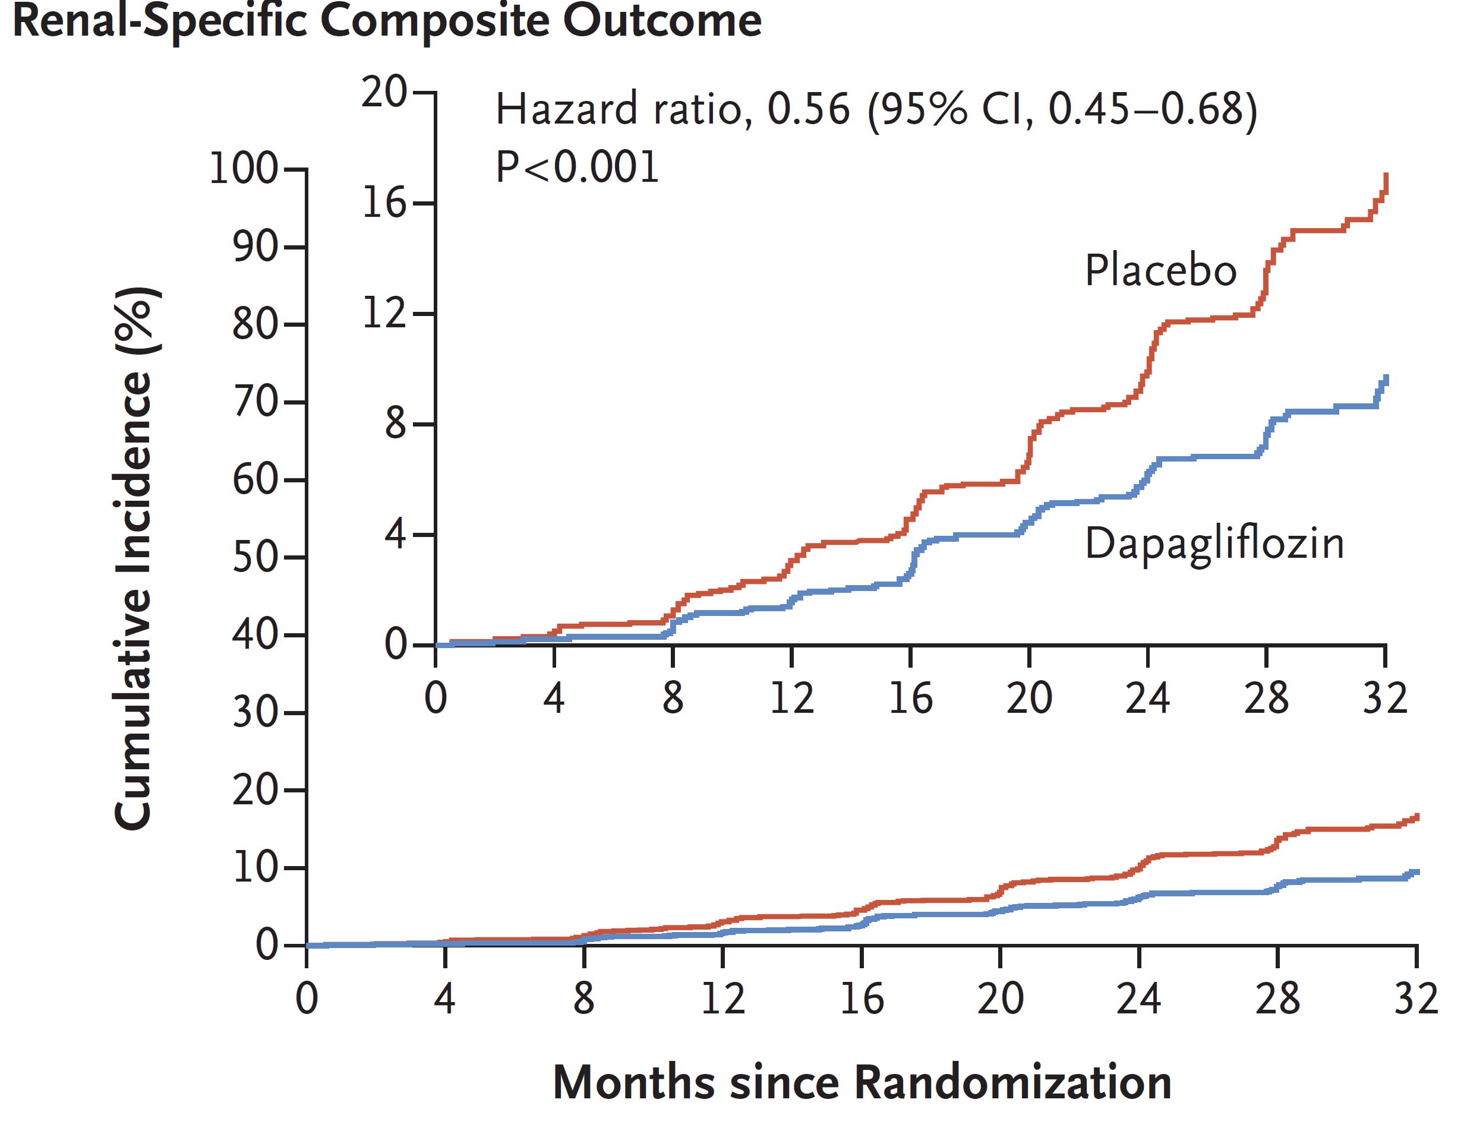
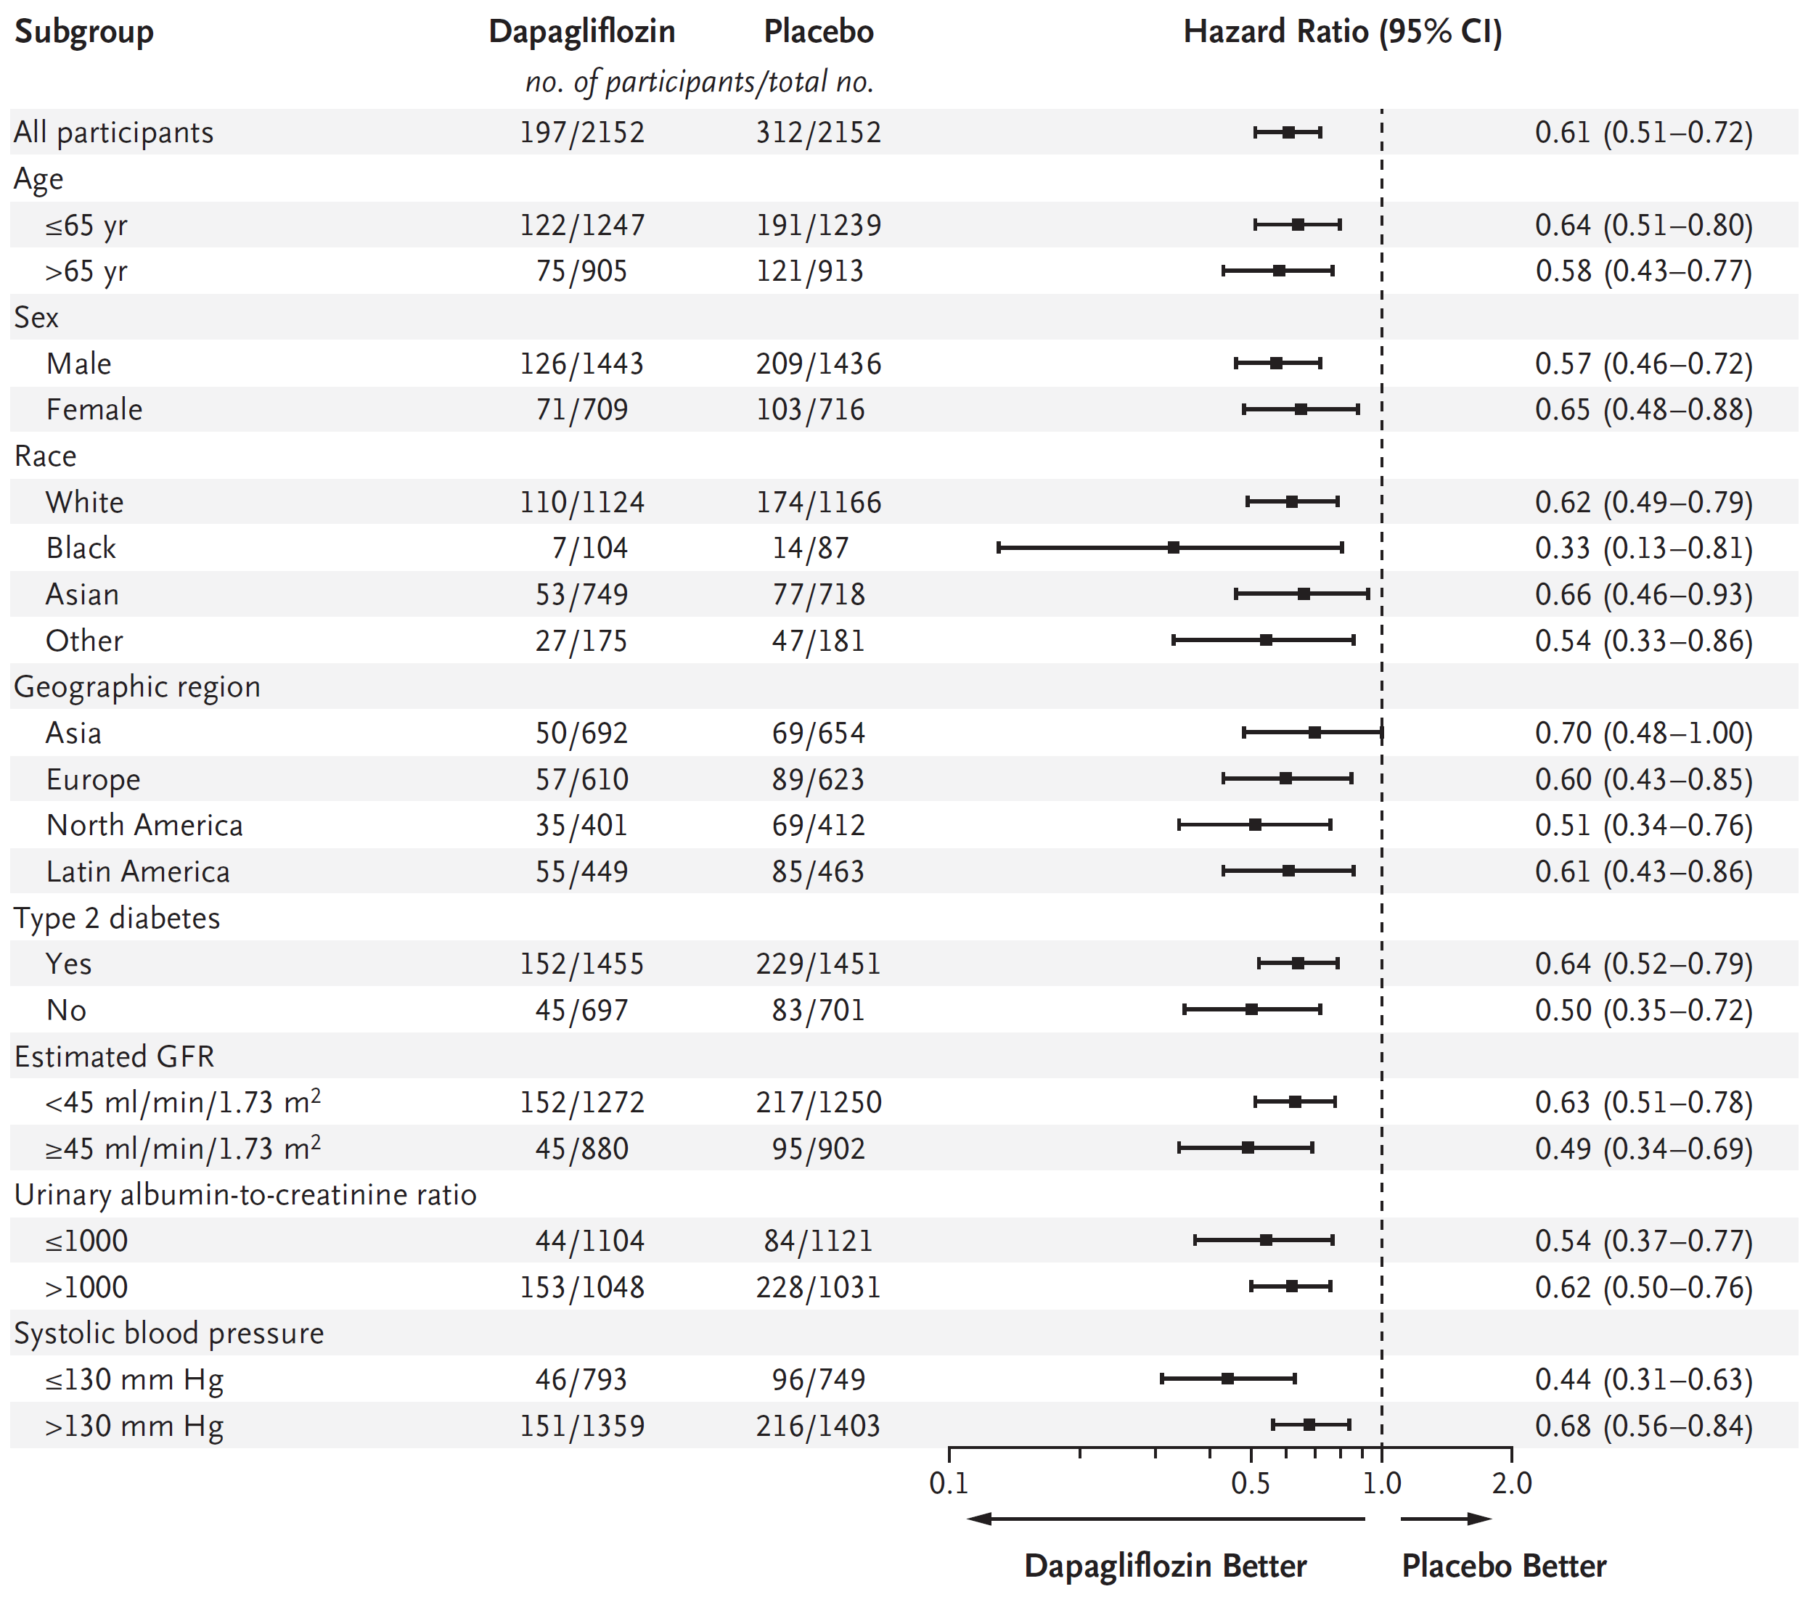
Effect of Existing Therapies on CKD: Despite Efficacy, There Is Still a Large Residual Risk for Progression
Residual Risk

Slide 8
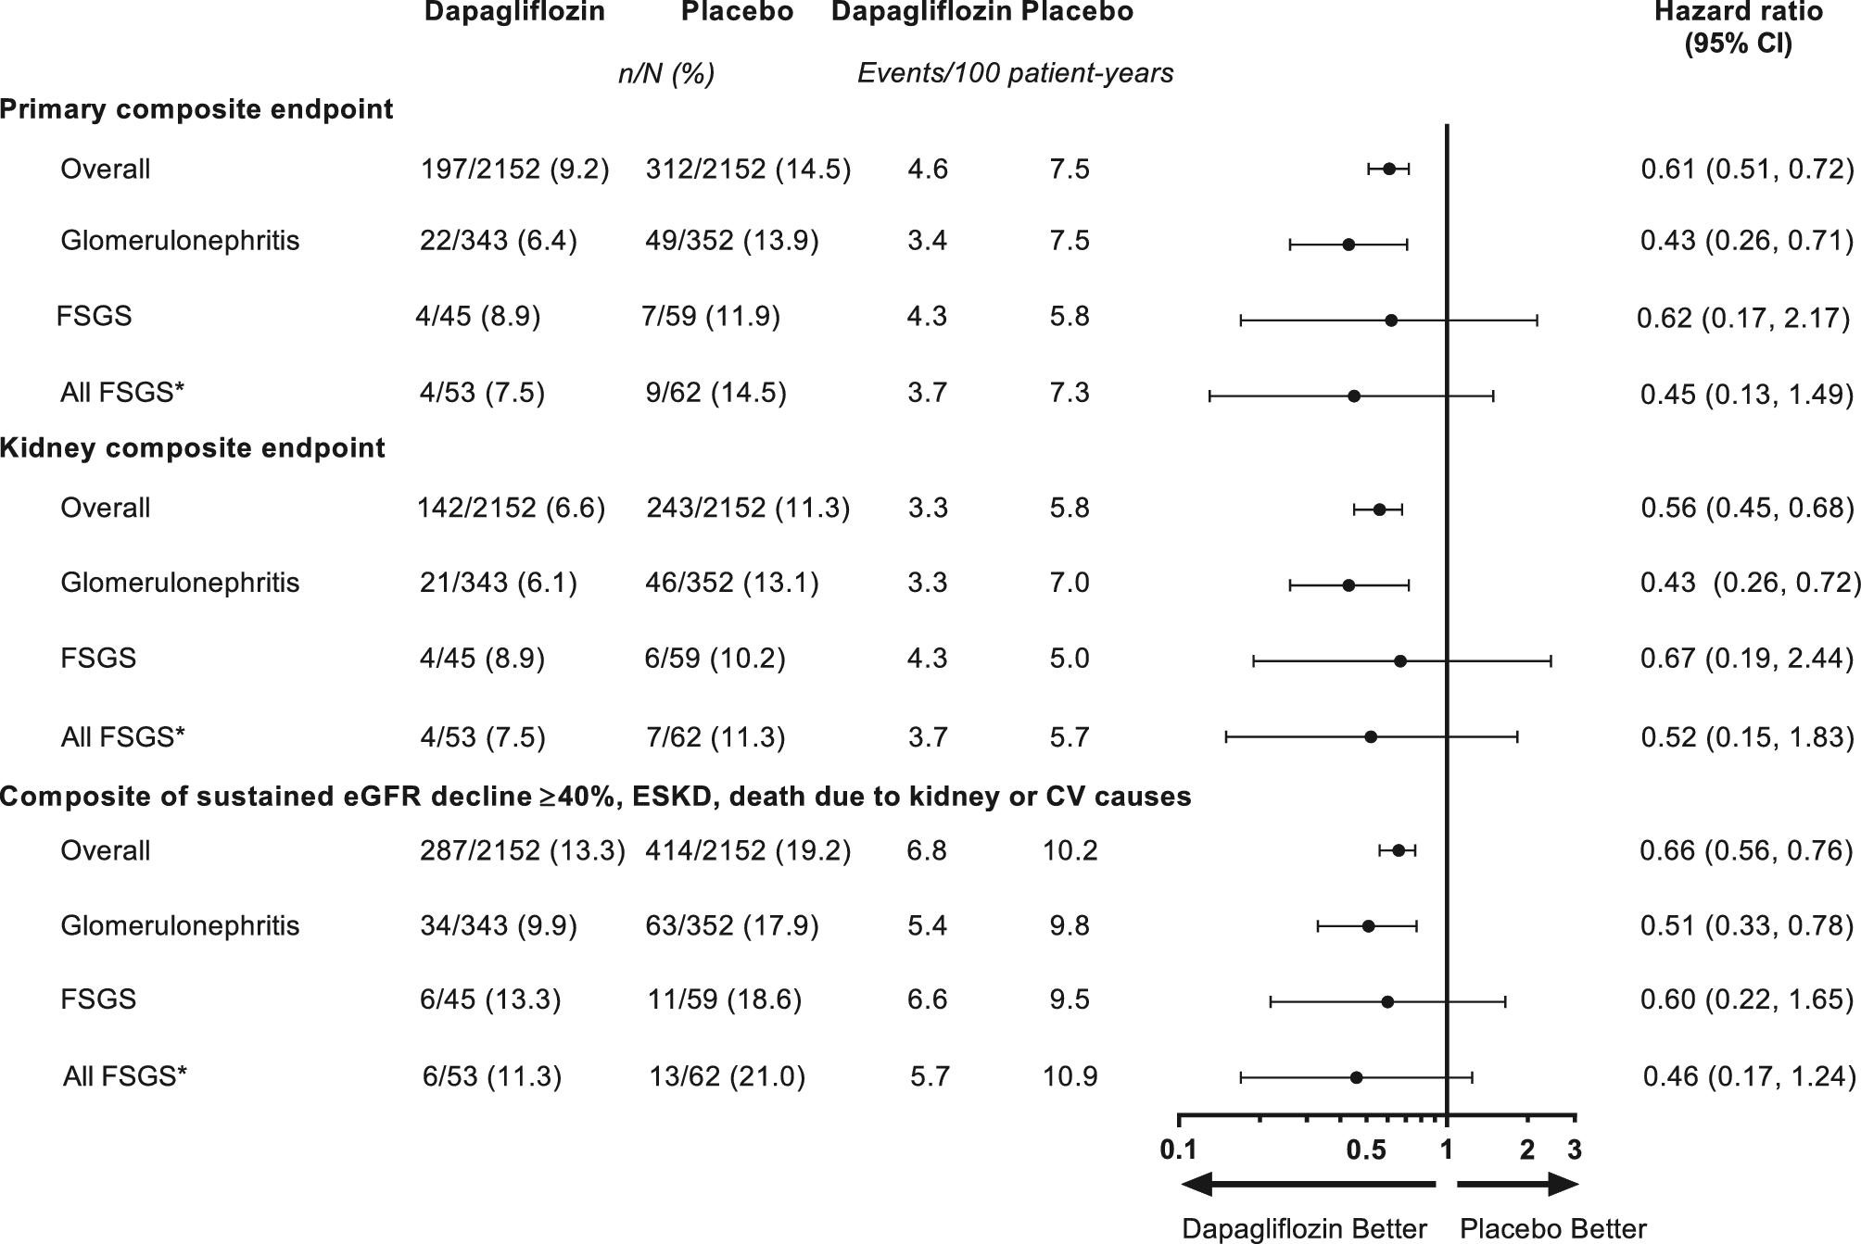
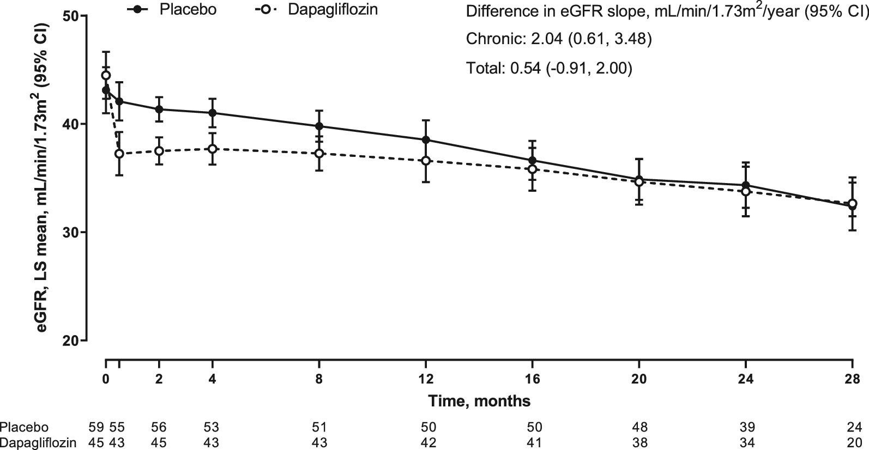
Current Treatment Options: SGLT2i for FSGS

Slide 9
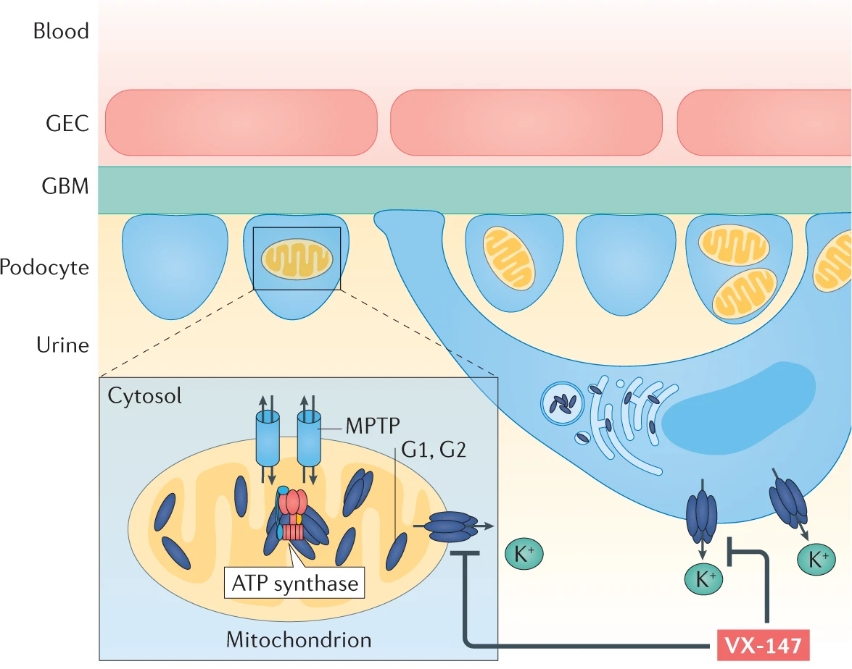
APOL1 Inhibition To Address Podocyte Dysfunction: Drugs in Development

Slide 10
Treatment With the Small Molecule VX-147 Resulted in a 47.6% Reduction of Albuminuria After 13 Weeks in Patients With FSGS
10
 | N = 13
UPCR (gram/gram) at Baseline Mean (SD) | 2.21 (0.95)
UPCR (gram/gram) at Week 13 Mean (SD) | 1.27 (0.73)
Mean percent change (geometric) from baseline at week 13 (95# Confidence Interval) | -47.6 (-60.0, -31.3)
0
-10
-20
Mean percent change in
UPCR from baseline*
-40
-40
-50
-60
Baseline
Week
Day 15
Week
Week 5
Week 9
Week 13
1
3
Visit
*Geometric mean percent change from baseline in UPCR with geometric standard error

Slide 11
Future Studies
Phase 2/3 Adaptive Study of VX-147 in Adults With APOL1-Mediated Proteinuric Kidney Disease (NCT05312879)
A Phase 1 Dose Escalation Study to Evaluate Safety and Pharmacokinetics (PK) of VX-840 in Healthy Participants (NCT05324410)
Janus Kinase-STAT Inhibition to Reduce APOL1 Associated Kidney Disease (JUSTICE) (NCT05237388)

Slide 12
Summary
Given the successful completion of Phase 3 clinical trials, additional therapeutics which benefit kidney-related outcomes will soon become available for patients affected by AMKD

