Slide 1
Communicating Genetic Testing Results to AMKD Patients: The Impact of Early Diagnosis
Adriana Hung, MD, MPH
Associate Professor of Medicine
Medical Director, Nashville VA Dialysis Unit
Vanderbilt University Medical Center
Nashville, TN

Slide 2
Disclaimer
The views and opinions expressed in this educational activity are those of the faculty and do not necessarily represent the views of TotalCME, Inc., the CME providers, or the companies providing educational grants. This presentation is not intended to define an exclusive course of patient management; the participant should use their clinical judgment, knowledge, experience, and diagnostic skills in applying or adopting for professional use any of the information provided herein. Any procedures, medications, or other courses of diagnosis or treatment discussed or suggested in this activity should not be used by clinicians without evaluation of their patient's conditions and possible contraindications or dangers in use, review of any applicable manufacturer’s product information, and comparison with recommendations of other authorities. Links to other sites may be provided as additional sources of information.

Slide 3
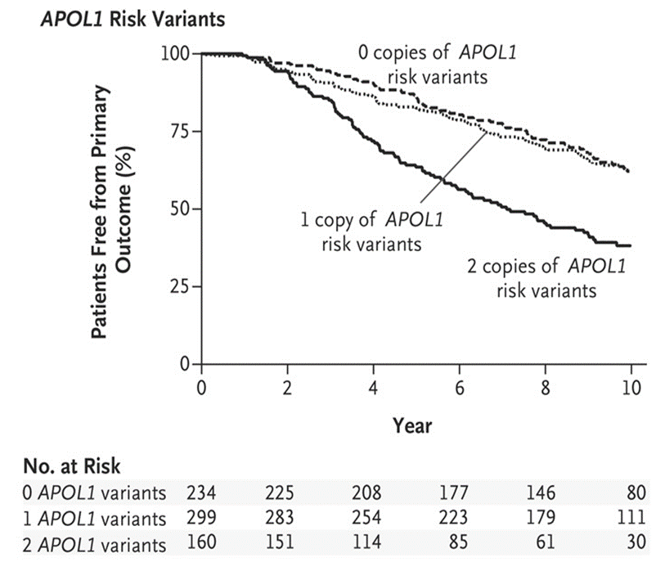
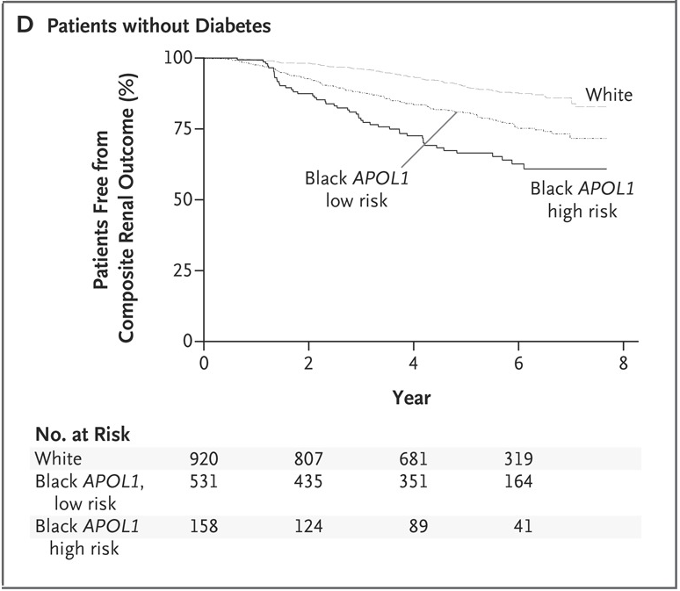
Individuals of African Ancestry with APOL1 High-Risk Variants G1 or G2 Have Increased Risk of Renal Disease Progression and ESRD
Are there other ancestry specific alleles?
AASK
CRIC
?
1.96 (1.44-2.67)
3.05 (2.07-4.48)
1.88 (1.46-2.41)

Slide 4
Not all individuals with G1/G2 develop kidney disease, which is important to inform precision medicine.
“Second hit hypothesis”
gene-environment and gene-gene interactions

Slide 5
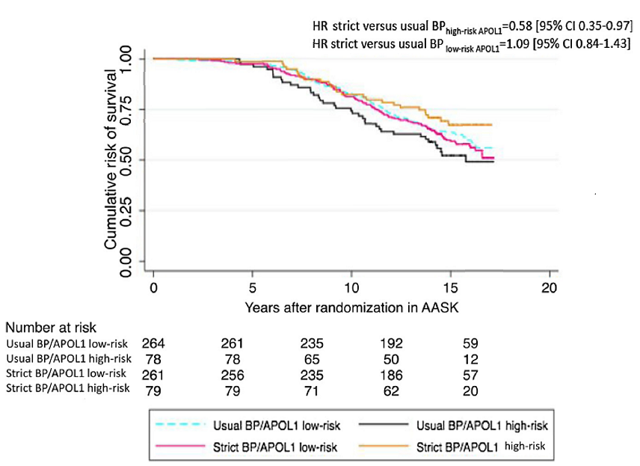
Risk of Death in Strict Versus Usual Blood Pressure Control Arms by APOL1 Status

Slide 6
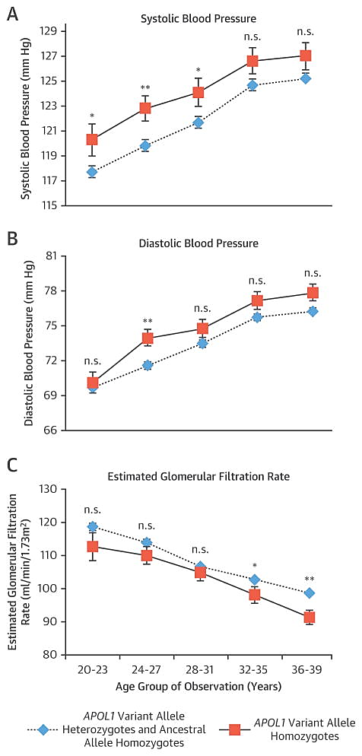
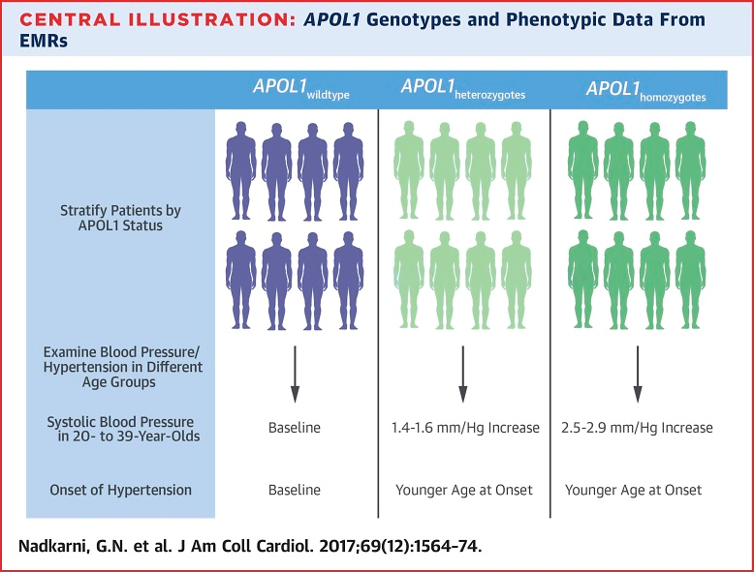
APOL1 Risk Alleles Are Associated With Higher SBP and Earlier Hypertension Diagnosis in Young AAs
The discovery cohort included 5,204 AA participants from Mount Sinai’s BioMe biobank.
Replication additional BioMe (n = 1,623), BioVU (n = 1,809), NUgene (n = 567)
Additive model
SBP (p_{com} = 7.0 × 10⁻⁸)
Additive model
DBP (p_{com} = 2.8 × 10⁻⁴).

Slide 7
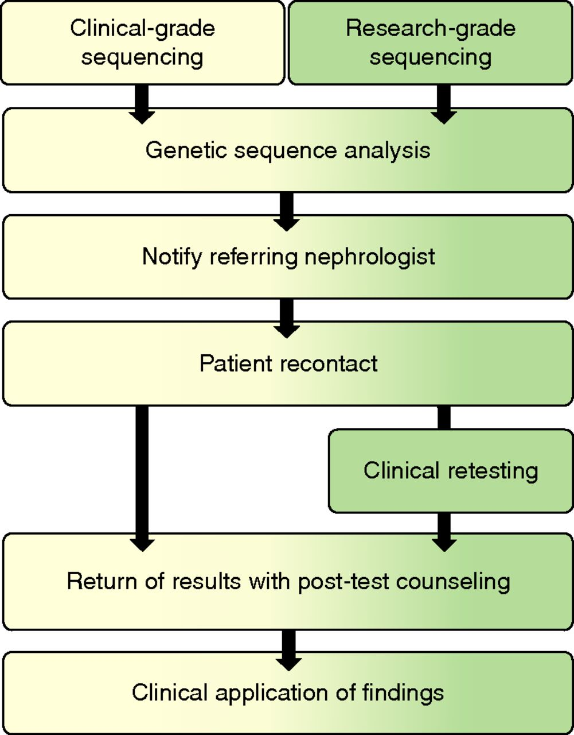
Developing a standardized workflow for return of medically actionable genetic findings to nephrology research participants. Optimization of a workflow for return of results in nephrology: the workflow was iteratively developed on the basis of feasibility an...
©2020 by American Society of Nephrology

Slide 8
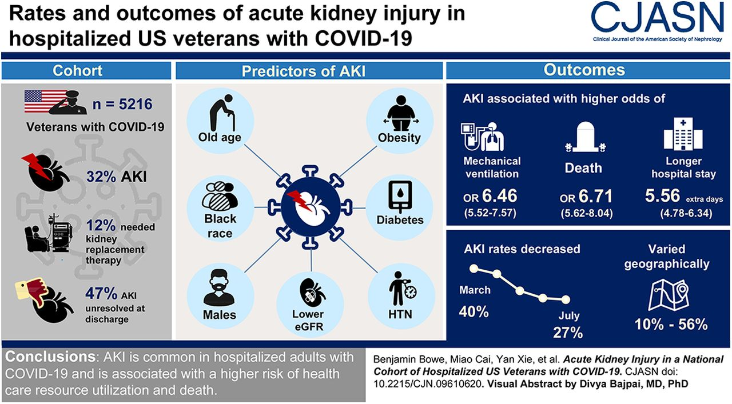

Slide 9
Summary
APOL1 HR genotype is common, affecting ~12-14% of individuals with African ancestry
APOL1 HR variants explain a significant proportion of the excess risk of ESRD in the African American population in the US
Not all individuals with the APOL1 HR genotype will develop kidney disease, substantiating the second hit hypothesis
Precision medicine approaches are needed to tackle this important risk factor, which should include genotyping in specific settings, counseling, and target therapies

