Slide 1
Interpreting Genetic Testing Results for AMKD: How Do We Assess Disease-Causing Variants?
Martin Pollak MD
Professor of Medicine, Harvard Medical School
Chief of Nephrology, Beth Israel Deaconess Medical Center
Boston, MA

Slide 2
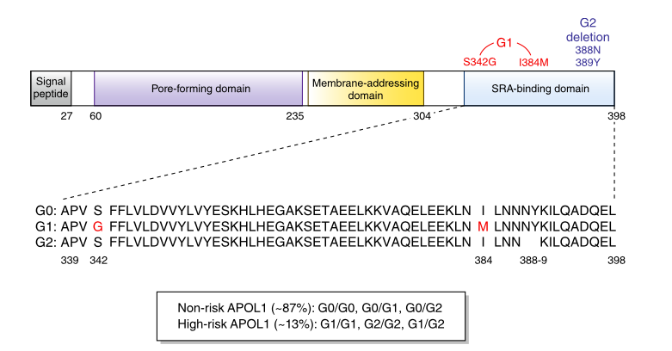
Disease Mechanism(s)
How do these two APOL1 alleles cause increased susceptibility to kidney disease?

Slide 3
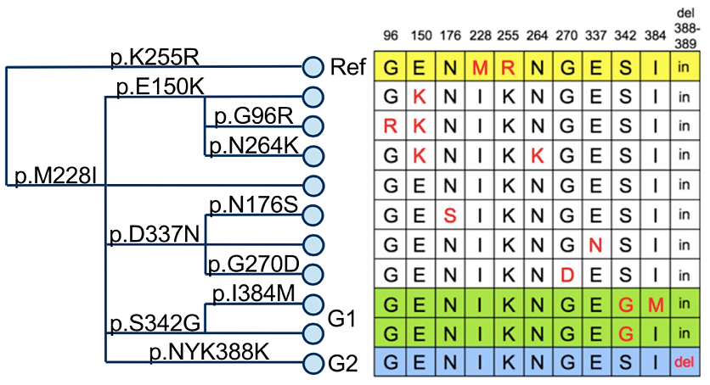
G1 and G2 Are Really Alleles, Not Variants

Slide 4
APOL1 Genotype Frequencies in African Americans
G0 / G0
G0 / G1
G0 / G2
G1 / G1
G2 / G2
G1 / G2
~50-55%
~35%
~13%
Sleeping sickness protective genotypes
Kidney disease
high-risk genotypes

Slide 5
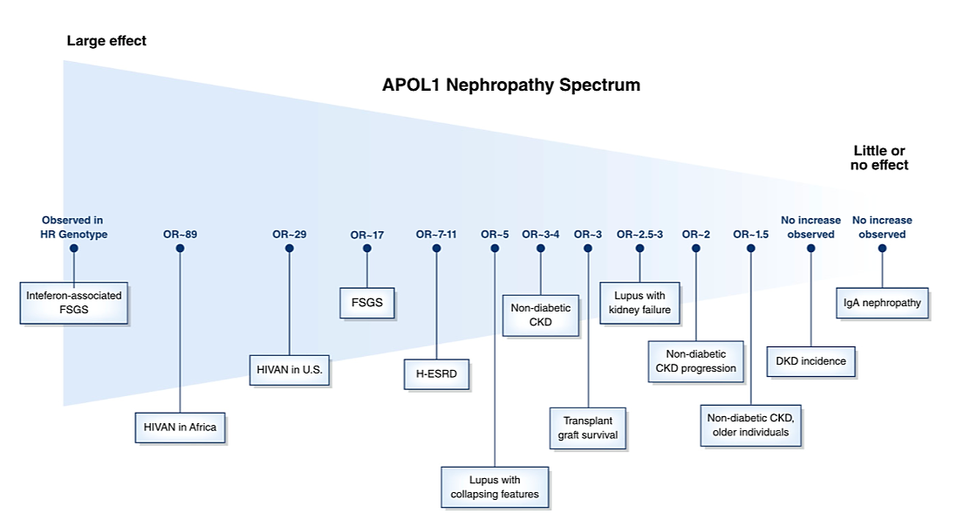
APOL1 Variants Increase the Risk of Several Different Forms of Kidney Disease
COVID-19 associated collapsing GN

Slide 6
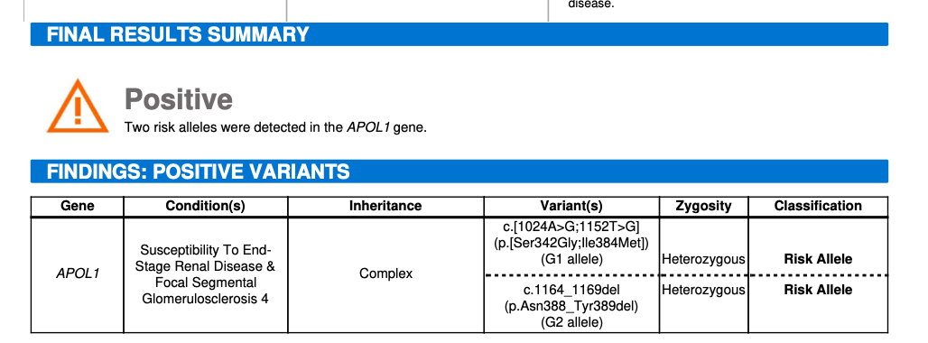
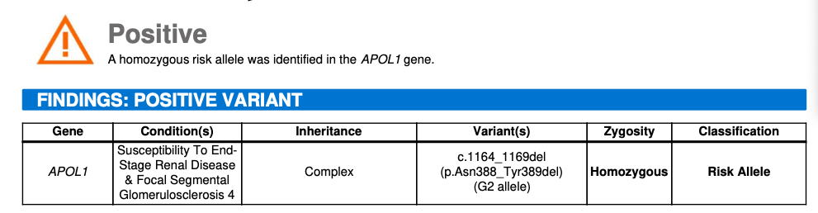
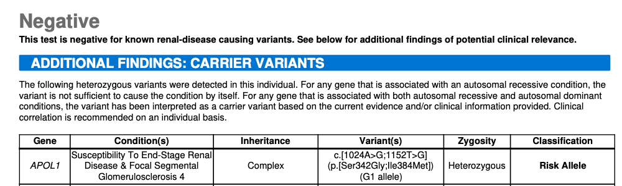
Test Results: Three Examples

