Slide 1
The Genetics of APOL1:
How Does It Cause Disease?
Martin Pollak MD
Professor of Medicine, Harvard Medical School
Chief of Nephrology, Beth Israel Deaconess Medical Center
Boston, MA

Slide 2
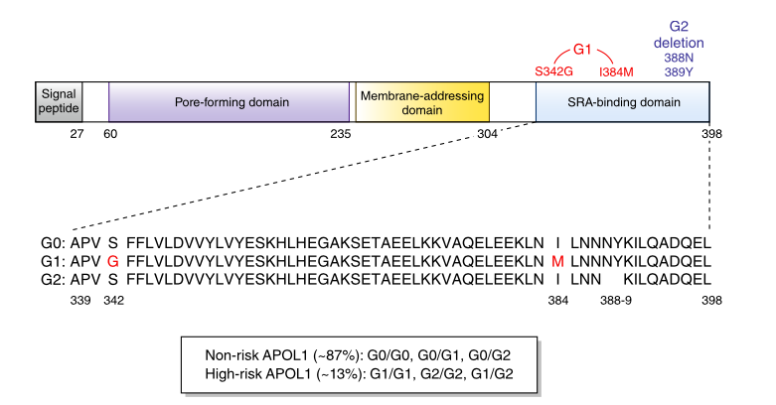
Disease Mechanism(s)
How do these two APOL1 alleles cause increased susceptibility to kidney disease?

Slide 3
Are APOL1 Risk Alleles Loss- or Gain-of-Function?
RV
Cytotoxicity
G0
EV
Overexpression of APOL1 G1, G2 (but not G0) are
toxic in cells, organisms, and mimic FSGS in mice

Slide 4
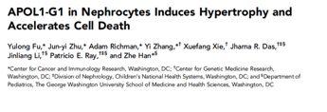
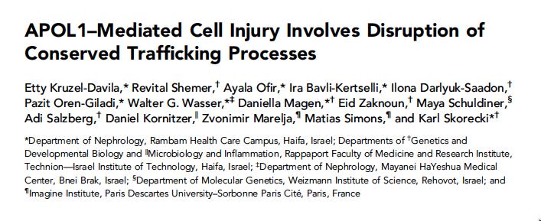
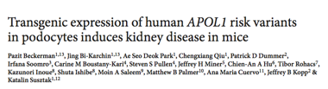
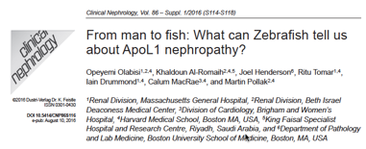
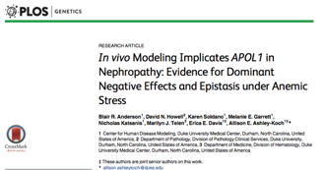
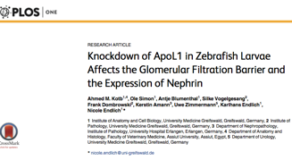
Flies, Fish, Yeast, Mice

Slide 5

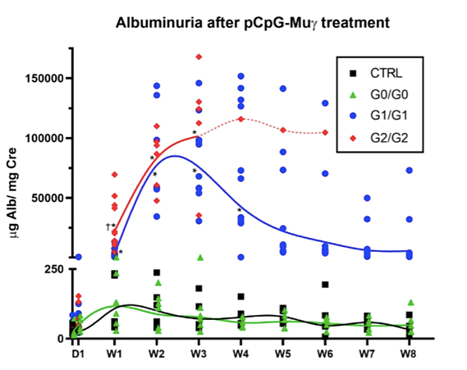
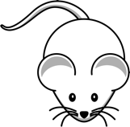
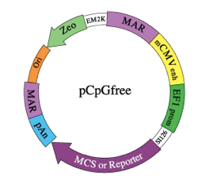
Mouse Model: BAC Transgenic (Human APOL1)

Slide 6
Mouse Model

Slide 7
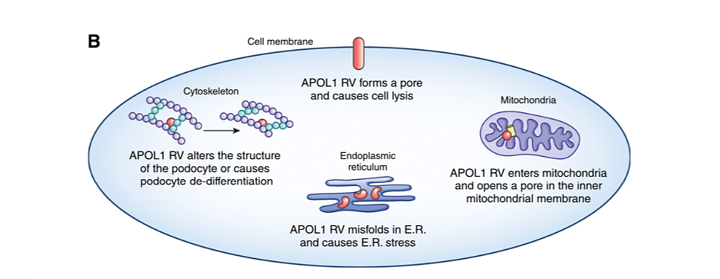
APOL1 as Cause of Disease: Proposed Mechanisms
How do G1 and G2 forms of APOL1 differ from G0?

