Slide 1
AMKD Pathophysiology: What We Currently Know
Adriana Hung, MD, MPH
Associate Professor of Medicine
Medical Director, Nashville VA Dialysis Unit
Vanderbilt University Medical Center
Nashville, TN

Slide 2
Disclaimer
The views and opinions expressed in this educational activity are those of the faculty and do not necessarily represent the views of TotalCME, Inc., the CME providers, or the companies providing educational grants. This presentation is not intended to define an exclusive course of patient management; the participant should use their clinical judgment, knowledge, experience, and diagnostic skills in applying or adopting for professional use any of the information provided herein. Any procedures, medications, or other courses of diagnosis or treatment discussed or suggested in this activity should not be used by clinicians without evaluation of their patient's conditions and possible contraindications or dangers in use, review of any applicable manufacturer’s product information, and comparison with recommendations of other authorities. Links to other sites may be provided as additional sources of information.

Slide 3
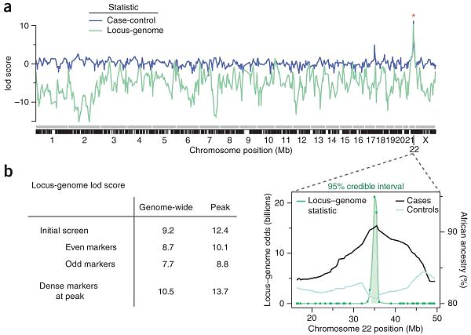
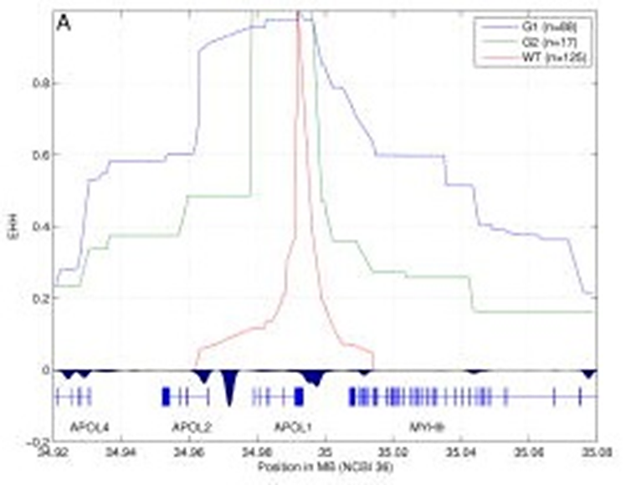
APOL1 Risk Alleles and Risk of FSGS & ESRD Among African Americans
Major-effect risk gene for idiopathic FSGS & HIV associated nephropathy¹
Association of tripanolytic APOL1 variants
with kidney disease in African Americans²
G1: Haplotype: rs73885319/rs60910145 (S342G/I384M).
G2: Haplotype: rs71785313

Slide 4
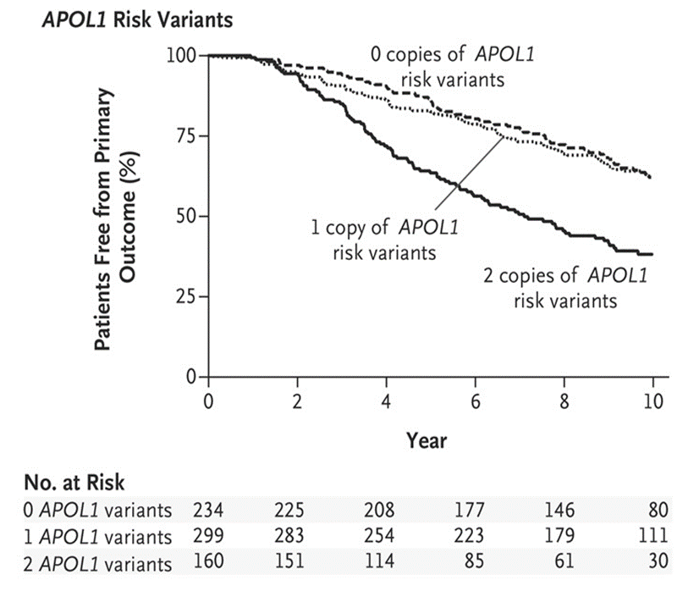
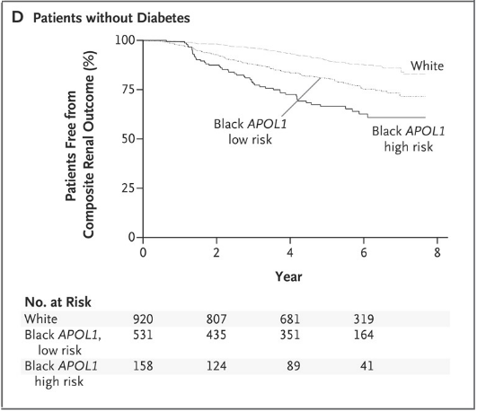
Individuals of African Ancestry with APOL1 High-Risk Variants G1 or G2 Have Increased Risk of Renal Disease Progression and ESRD
Are there other ancestry specific alleles?
AASK
CRIC
?
1.96 (1.44-2.67)
3.05 (2.07-4.48)
1.88 (1.46-2.41)

Slide 5
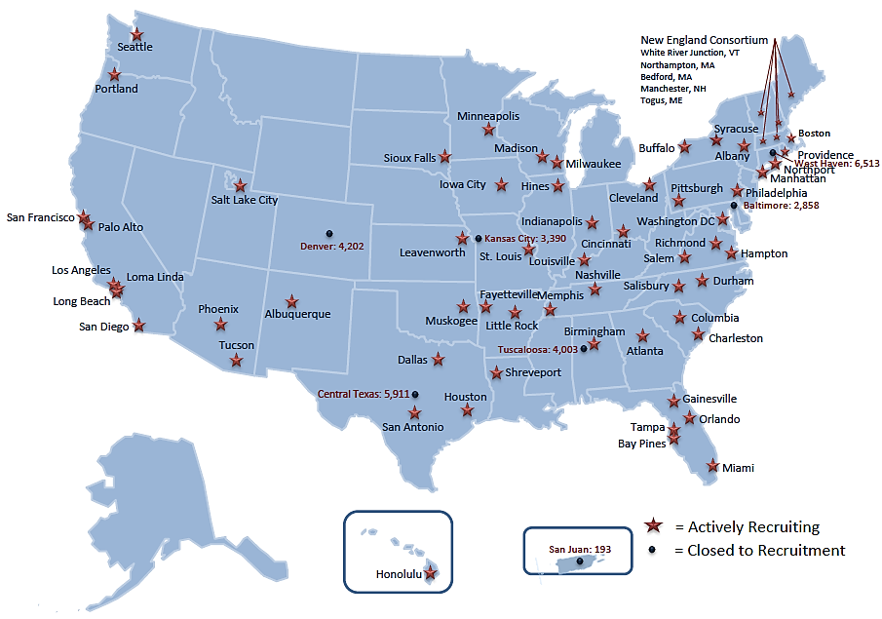
The Million Veteran Program: Diversity in Genetics
Current enrollment=903,341, African ancestry=150,000
Clinical cohort of US military veterans enrolled at 63 VAMCs since 2011
MVP: 12.9% have 2 RVs, 46.2% have 1 risk allele and 40.9% have no risk alleles

Slide 6
Distribution of APOL1 Kidney High-Risk Genotypes in CKD Cohorts
Cohort | Prevalence of APOL1 kidney High-risk genotype , n(%)
African American Study of Kidney Disease and Hypertension | 160/693 (23)¹
Chronic Renal Insufficiency Cohort | 270/1411 (19)¹
Chronic Kidney Disease in Children and Nephrotic Syndrome Study Network (NEPTUNE) | 49/104 (47)²

Slide 7
Not all individuals with G1/G2 develop kidney disease, which is important to inform precision medicine.
“Second hit hypothesis”
gene-environment and gene-gene interactions

Slide 8
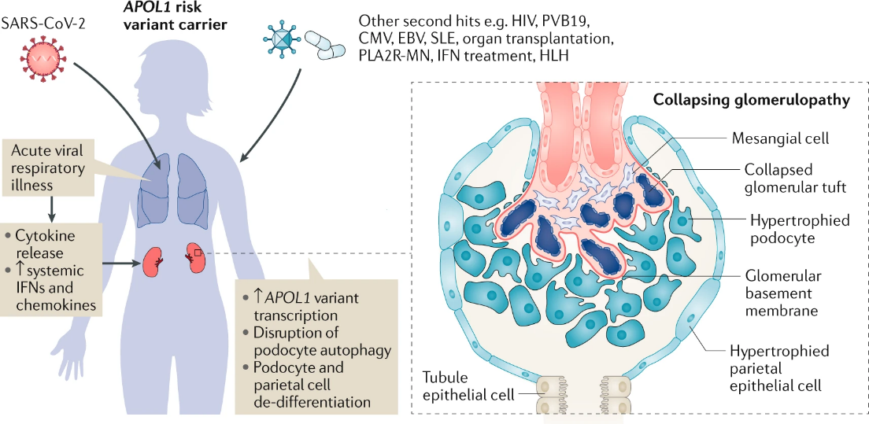

Slide 9
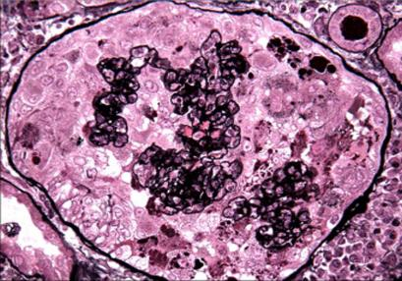
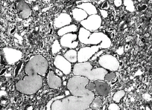
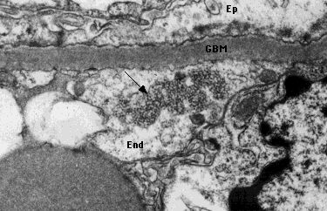
Collapsing FSGS-Pseudocrescent (HIVAN)
Pseudo-crescent collapsing FSGS
Tubulo-reticular inclusions (TRIs)
interferon ‘footprints’

Slide 10
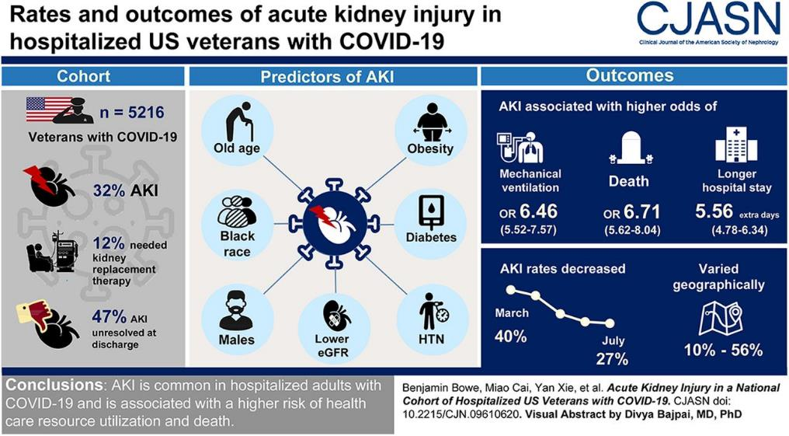

Slide 11
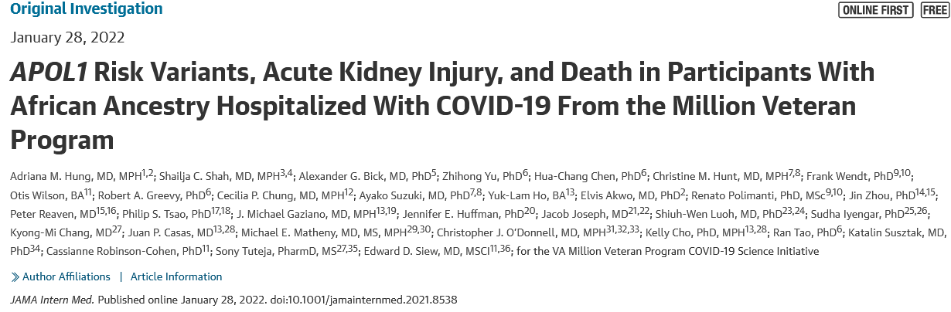
The role of APOL1 RVs in the risk of AKI and death in patients of African Ancestry hospitalized with COVID-19

Slide 12
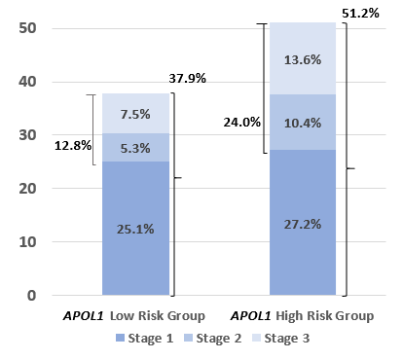
Two-Fold Increases in the Risk of Stage 2 & 3 AKI and Death in Patients with 2 RVs of APOL1 in the High-Risk Group

Slide 13
Summary of the Association Between APOL1 RVs and COVID-19 AKI
The second hit hypothesis model provides important opportunities for precision medicine and targeted therapy:
i.e., no antiviral regimens with interferon should be administered to APOL1 high-risk carriers
Given that the driver of gene expression is the inflammatory response, should we administer anti-cytokine therapy and IL-6 blockers to APOL1 high-risk patients? What about IL1ra since the NLRP3 inflammasome is part of the mechanism?
Can APOL1 blockers and inhibitors can be used in this disease model in the future?
Can we extrapolate these findings to AKI in the ICU setting when there is an extensive inflammatory response i.e., sepsis and other settings?

Slide 14
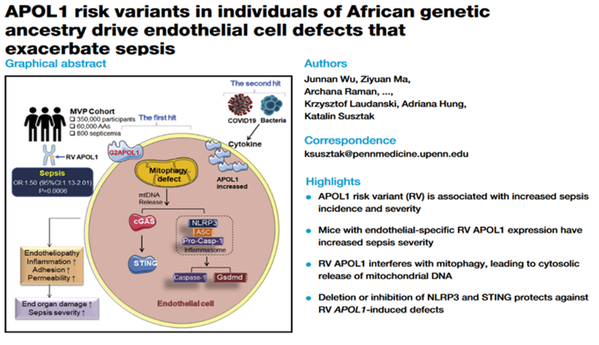
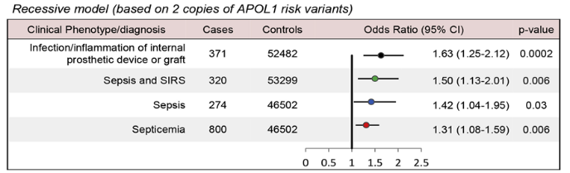
APOL1

Slide 15
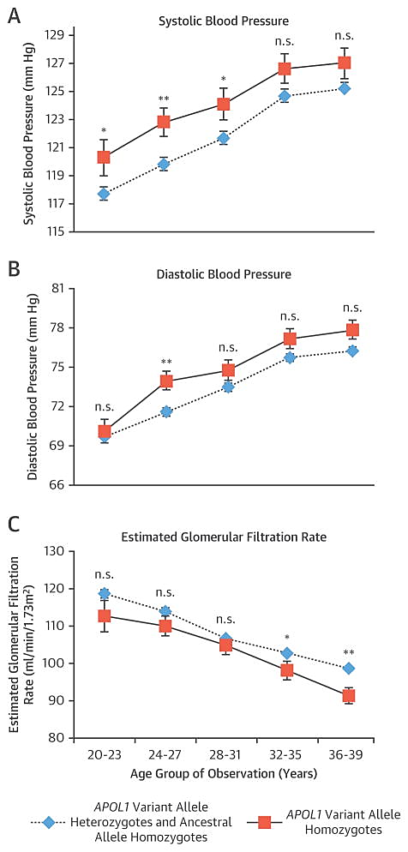
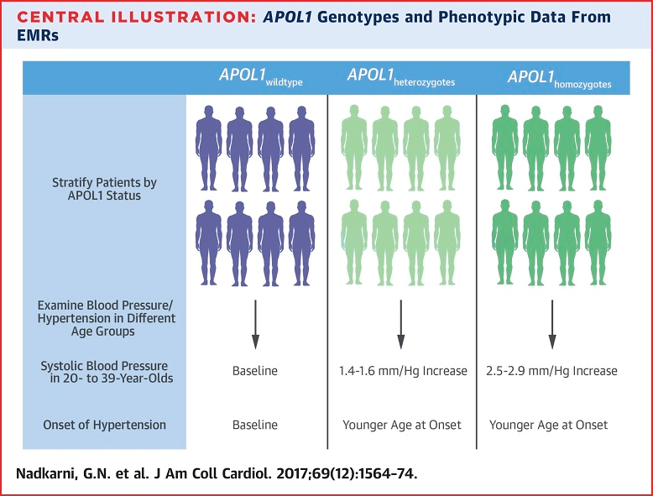
APOL1 Risk Alleles Are Associated With Higher SBP and Earlier Hypertension Diagnosis in Young AAs
The discovery cohort included 5,204 AA participants from Mount Sinai’s BioMe biobank.
Replication additional BioMe (n = 1,623), BioVU (n = 1,809), NUgene (n = 567)
Additive model
SBP (p_{com} = 7.0 × 10⁻⁸)
Additive model
DBP (p_{com} = 2.8 × 10⁻⁴).

Slide 16
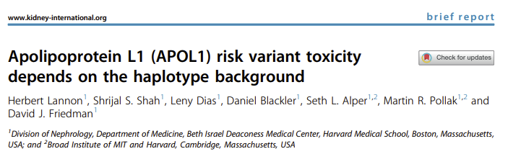
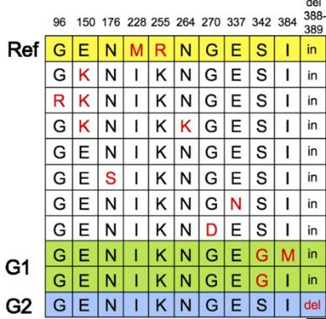
Gene-Gene Interactions: Are There Other APOL1 Protein-Altering Mutations?
G1
G2

Slide 17
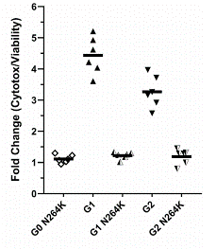
In Vitro Effect of Other APOL1 Variants on Cytotoxicity in Immortalized Human Embryonic Kidney Cells

Slide 18
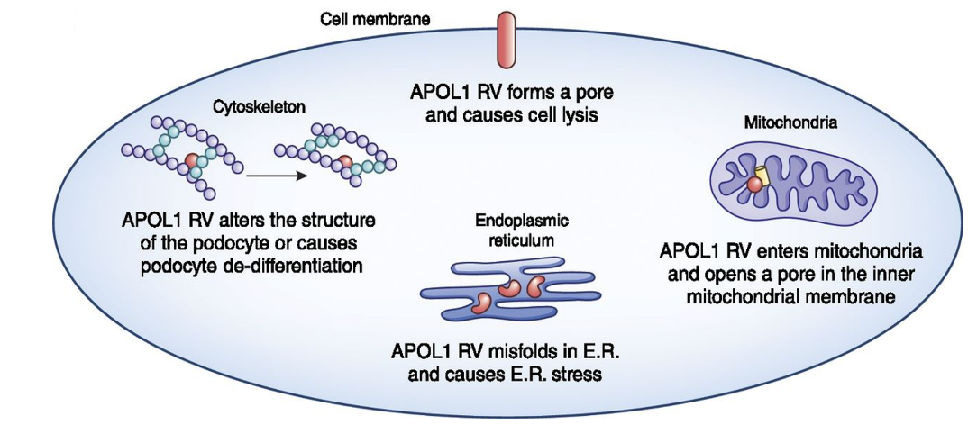
APOL1: Gain of Function Mutation
©2021 by American Society of Nephrology

Slide 19
Summary
APOL1 HR genotype is common, affecting ~12-14% of individuals with African ancestry
APOL1 HR variants explain a significant proportion of the excess risk of ESRD in the African American population in the US
Not all individuals with the APOL1 HR genotype will develop kidney disease, substantiating the second hit hypothesis
Large studies with longitudinal follow up may allow for study of gene-environment and gene-gene interactions, which may inform therapeutic approaches

