Slide 1
Nivolumab and relatlimab Versus nivolumab in Previously Untreated Metastatic or Unresectable Melanoma:
Additional Response Outcomes From RELATIVITY-047
F. Stephen Hodi,¹ Hussein A. Tawbi,² Evan J. Lipson,³ Dirk Schadendorf,⁴ Paolo A. Ascierto,⁵ Luis Matamala,⁶ Pamela Salman,⁶*
Erika Castillo Gutiérrez,⁷ Piotr Rutkowski,⁸ Helen J. Gogas,⁹ Christopher D. Lao,¹⁰ Juliana Janoski De Menezes,¹¹ Stéphane Dalle,¹²
Ana Arance,¹³ Jean-Jacques Grob,¹⁴ Sarah Keidel,¹⁵ Saima Rodriguez,¹⁵ Peter Wang,¹⁵ Sonia Dolfi,¹⁵ Georgina V. Long¹⁶
¹Dana-Farber Cancer Institute, Boston, MA, USA; ²Department of Melanoma Medical Oncology, Division of Cancer Medicine, The University of Texas MD Anderson Cancer Center, Houston, TX, USA; ³Sidney Kimmel Comprehensive Cancer Center, Bloomberg-Kimmel Institute for Cancer Immunotherapy, Johns Hopkins University School of Medicine, Baltimore, MD, USA; ⁴Department of Dermatology, University Hospital Essen, Essen, Germany, and German Cancer Consortium, Partner Site Essen, Essen, Germany; ⁵Istituto Nazionale Tumori IRCCS “Fondazione G. Pascale,” Naples, Italy; ⁶Department of Oncology, Instituto Oncológico Fundación Arturo López Pérez, Santiago, Chile; ⁷FAICIC Clinical Research, Veracruz, Mexico; ⁸Maria Skłodowska-Curie National Research Institute of Oncology, Warsaw, Poland; ⁹Department of Medicine, National and Kapodistrian University of Athens, Athens, Greece; ¹⁰Michigan Medicine, Rogel Cancer Center, University of Michigan, Ann Arbor, MI, USA; ¹¹Hospital Nossa Senhora da Conceição, Porto Alegre, Brazil; ¹²Unit of Dermatology, Hospices Civils de Lyon, Cancer Research Center of Lyon, Pierre-Bénite, France; ¹³Department of Medical Oncology, Hospital Clinic Barcelona and IDIBAPS, Barcelona, Spain; ¹⁴Aix-Marseille University, CHU Timone, Marseille, France; ¹⁵Bristol Myers Squibb, Princeton, NJ, USA; ¹⁶Melanoma Institute Australia, The University of Sydney, Royal North Shore and Mater Hospitals, Sydney, Australia
*Affiliation during the time of the trial
^{Presented by}
^{Jason Luke, MD}
Director of the Cancer Immunotherapeutics Center
Associate Professor of Medicine UPMC Hillman Cancer Center and University of Pittsburgh
^{Pittsburgh, PA}

Slide 2
Disclaimer
The views and opinions expressed in this educational activity are those of the faculty and do not necessarily represent the views of TotalCME, Inc., the CME providers, or the companies providing educational grants. This presentation is not intended to define an exclusive course of patient management; the participant should use their clinical judgment, knowledge, experience, and diagnostic skills in applying or adopting for professional use any of the information provided herein. Any procedures, medications, or other courses of diagnosis or treatment discussed or suggested in this activity should not be used by clinicians without evaluation of their patient's conditions and possible contraindications or dangers in use, review of any applicable manufacturer’s product information, and comparison with recommendations of other authorities. Links to other sites may be provided as additional sources of information.

Slide 3
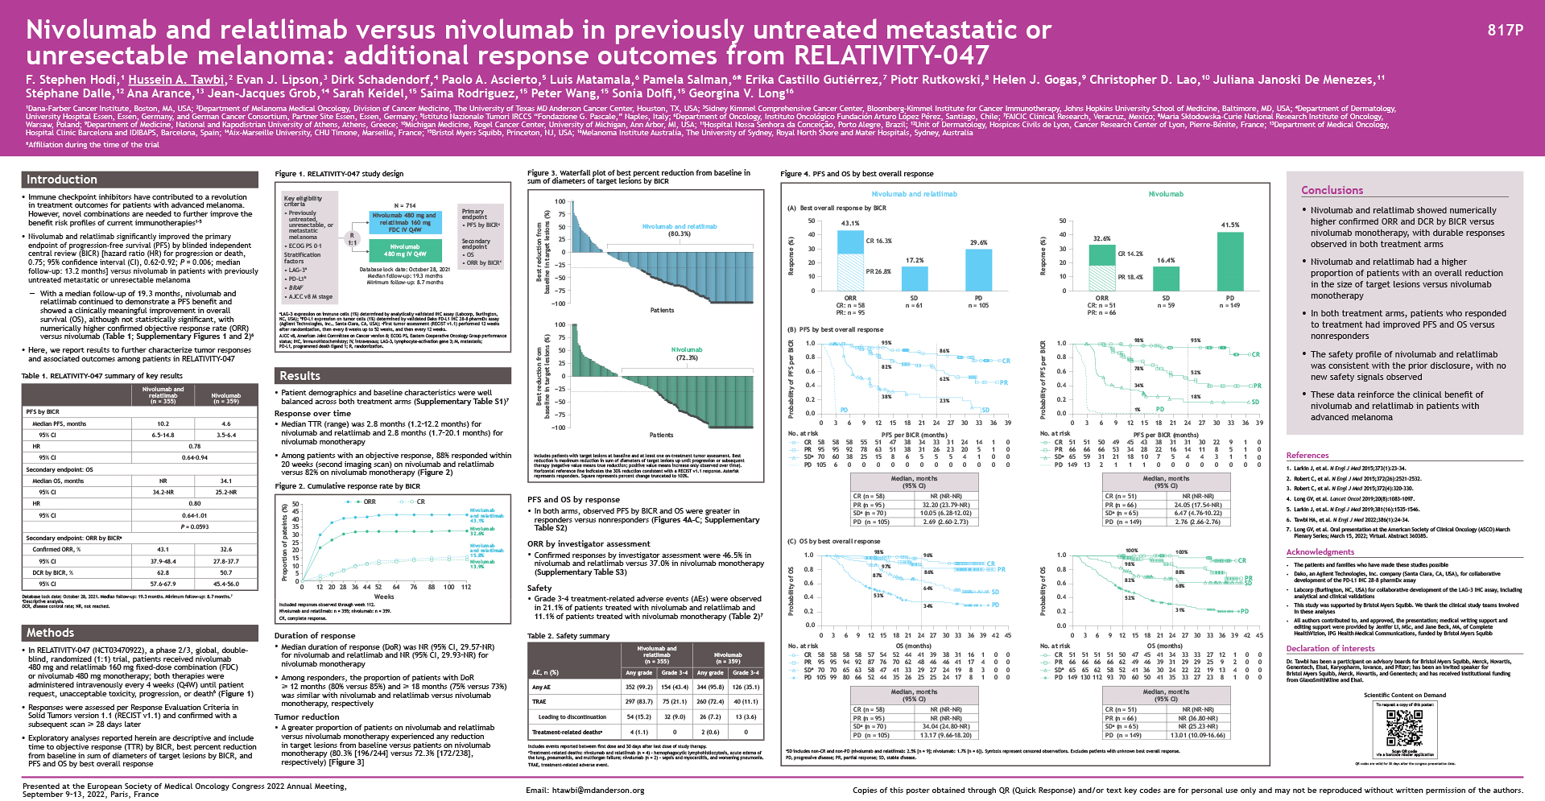

Slide 4
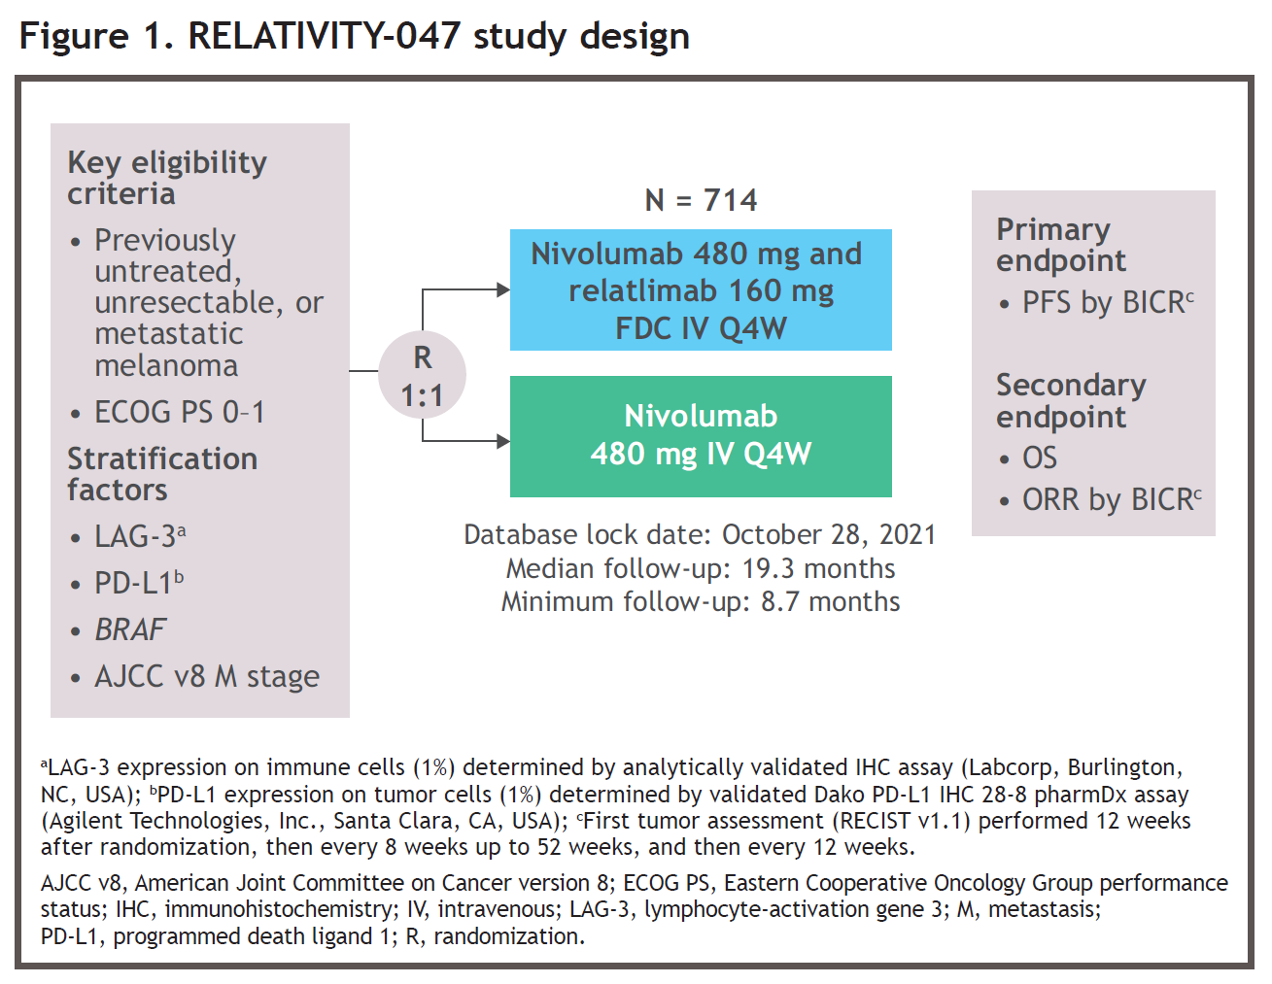

Slide 5
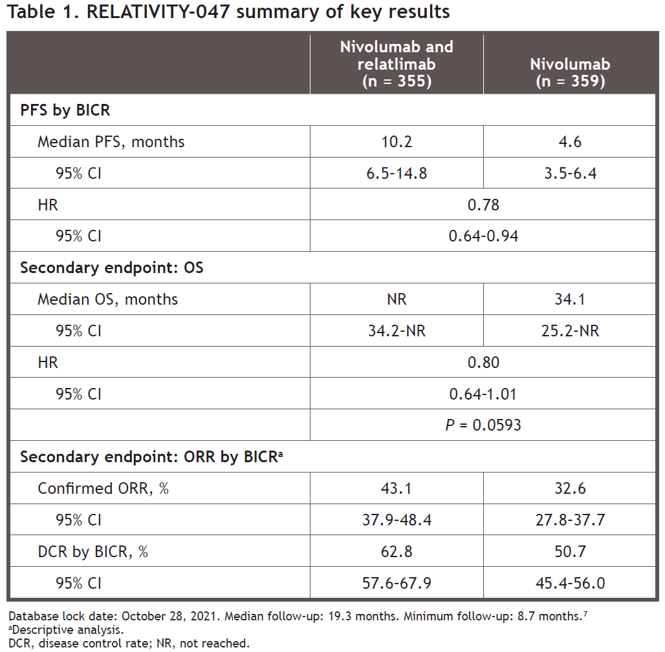

Slide 6
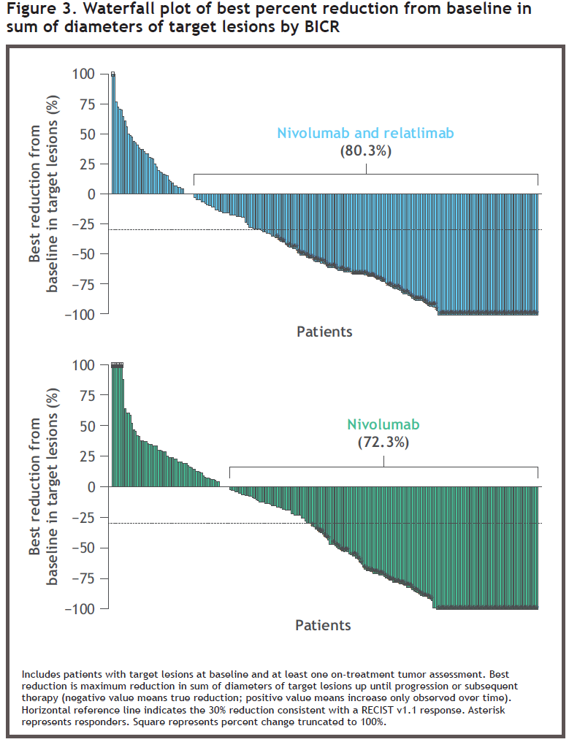

Slide 7
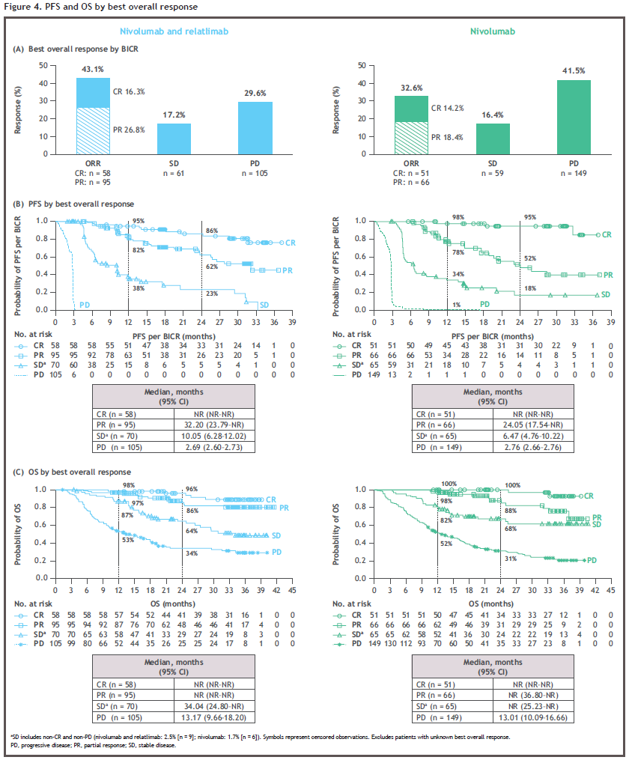

Slide 8
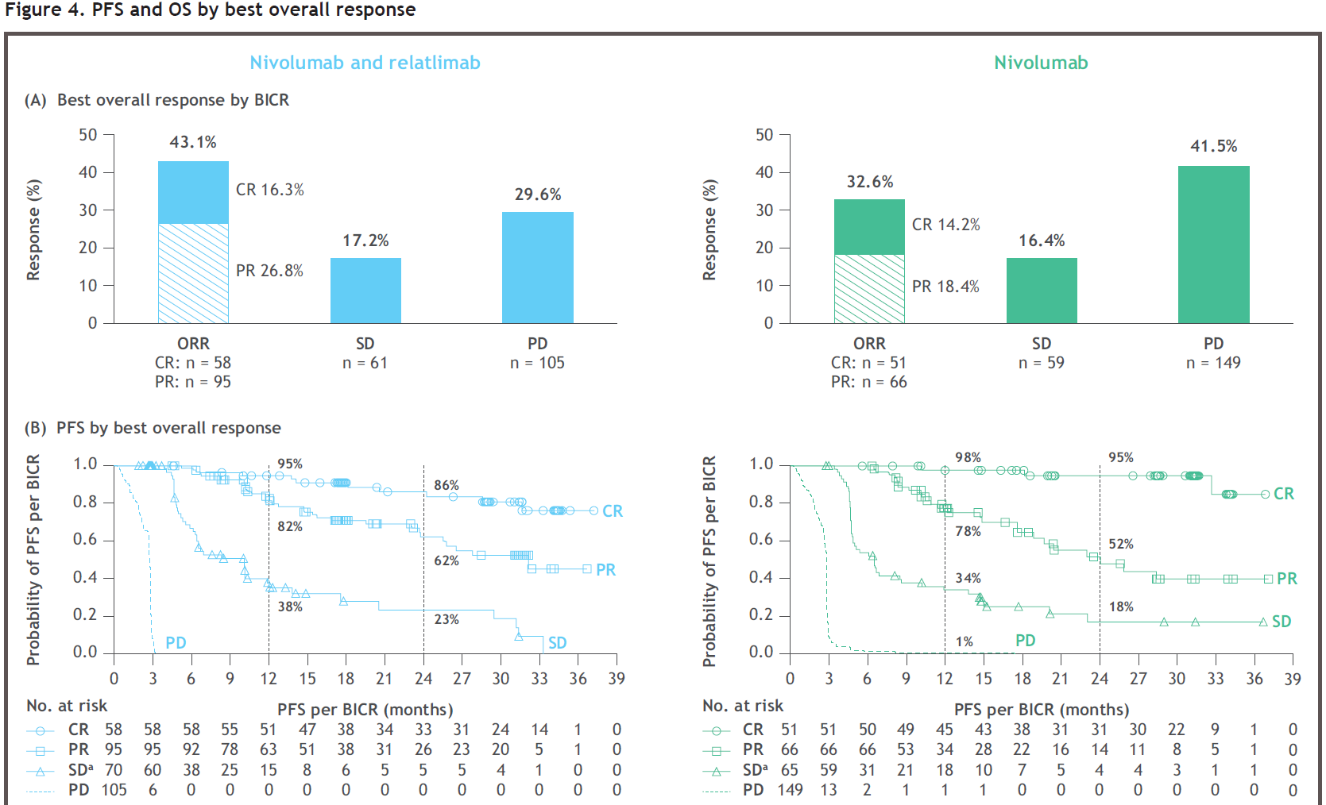

Slide 9
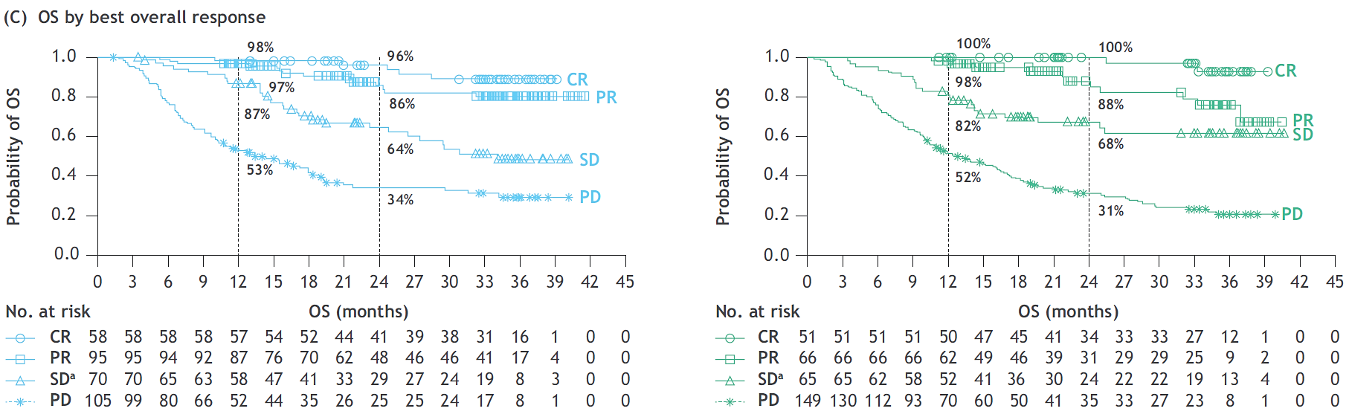

Slide 10
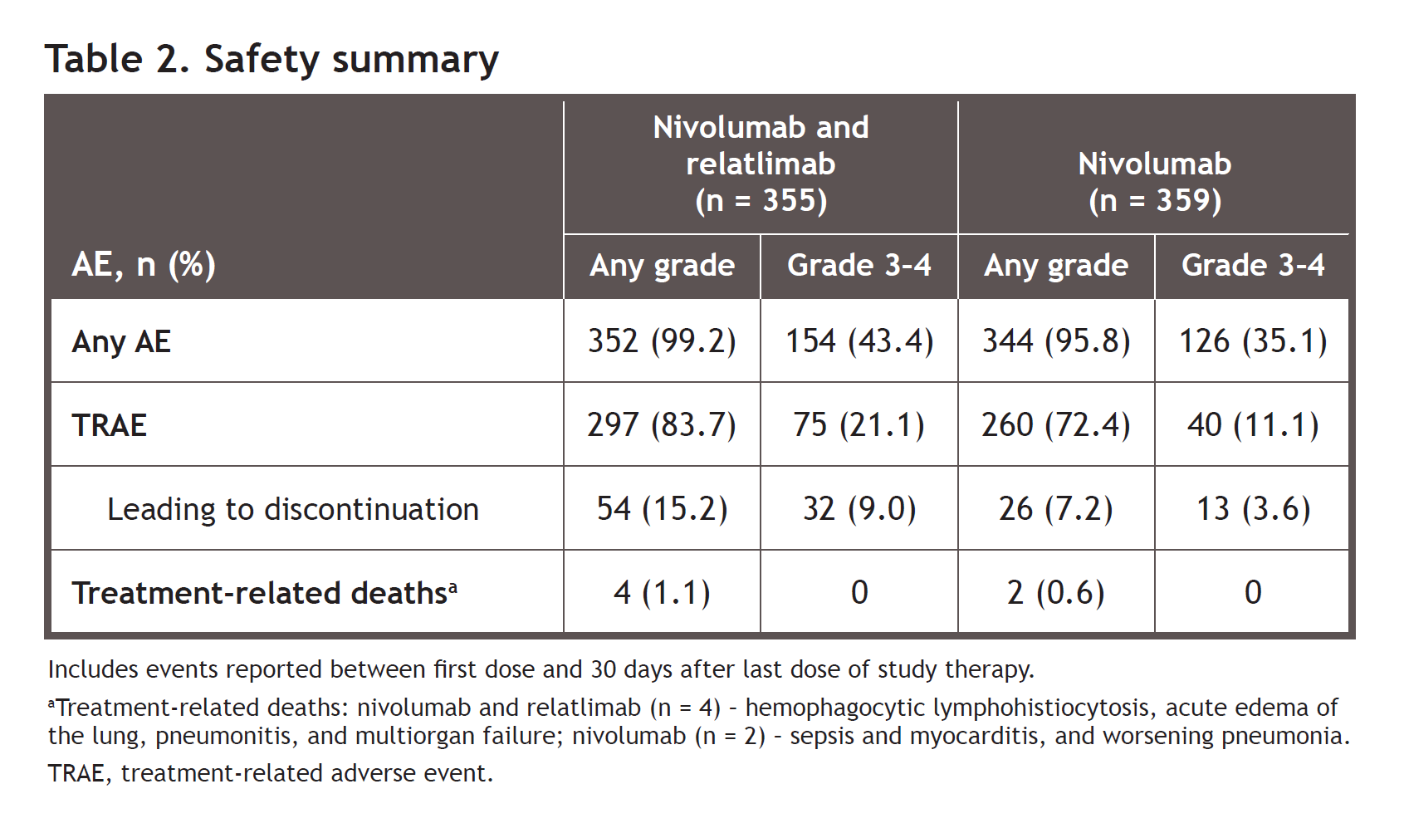

Slide 11
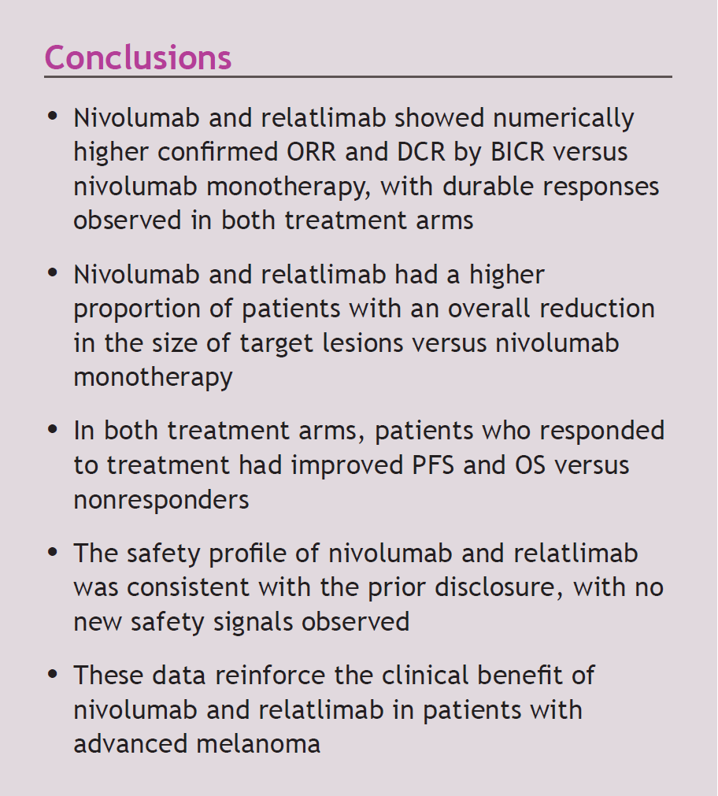

Slide 12
