Slide 1
Phase II Study SECOMBIT (Sequential Combo Immuno- and Target Therapy Study): Four Years OS Data and Preliminary Biomarkers Evaluation
Co-senior authors
Ascierto PA¹, Mandalà M², Ferrucci PF³, Guidoboni M⁴, Rutkowski P⁵, Ferraresi V⁶, Arance AM⁷, Guida M⁸, Maiello E⁹, Gogas H¹⁰, Richtig E¹¹, Fierro MT¹², Lebbé C¹³, Helgadottir H¹⁴, Melero I¹⁵, Palmieri G¹⁶, Giannarelli D¹⁷, Grimaldi AM¹, Dummer R^{18*}, Chiarion-Sileni V^{19*}
¹Melanoma, Cancer Immunotherapy & Developmental Therapeutics, Istituto NazionaleTumori - IRCCS - Fondazione Pascale, Napoli, Italy. ²Department of Medical Oncology, University ofPerugia and Papa Giovanni XXIII Cancer Center Hospital, Perugia, Italy,.³Oncology dept., IEO - IstitutoEuropeo di Oncologia, Milan, Italy. ⁴Oncology, Istituto Scientifico Romagnolo per lo Studio e la Curadei Tumori (IRST) IRCCS S.r.l., Meldola, Italy. ⁵Department of Soft Tissue/Bone Sarcoma andMelanoma, Maria Sklodowska Curie National Research Institute of Oncology, Warsaw, Poland. ⁶Medical Oncology A, IRCCS Istiuto Nazionale Tumori Regina Elena (IRE), Rome, Italy. ⁷MedicalOncology department, Hospital Clinic y Provincial de Barcelona, Barcelona, Spain. ⁸Melanoma and rare tumors Unit, IRCCS Istituto Tumori Giovanni Paolo II, Bari, Italy. ⁹Oncology, IRCCS Fondazione CasaSollievo della Sofferenza, San Giovanni Rotondo, Italy. ¹⁰Oncology, Laiko General Hospital of Athens,Athens, Greece. ¹¹Department of Dermatology, Medical University of Graz,Austria. ¹²Dermatologic Clinic, Oncologia Medica, Torino, Italy. ¹³Dermatology Dept., Hopital SaintLouis AP-HP, Paris, France. ¹⁴Medical Oncology, Karolinska University Hospital, Stockholm, Sweden. ¹⁵Laboratory of immunology, Clinica Universitaria de Navarra, Pamplona, Spain. ¹⁶Immuno-Oncology& Targeted Cancer Biotherapies - Unit of Cancer Genetics, IRGB-CNR, University of Sassari, Sassari,Italy. ¹⁷Biostatistic, Fondazione Policlinico Universitario Agostino Gemelli IRCCS, Rome, Italy. ¹⁸Medical Oncology Unit, A.O.R.N. San Pio, Benevento, Italy. ¹⁹Dermatology Department,Universitätsspital Zürich - Klinik für Dermatologie, Zurich, Switzerland. ²⁰Clinical and ExperimentalOncology dept., IOV - Istituto Oncologico Veneto IRCCS, Padova, Italy
Paolo A. Ascierto, MD Director, Unit of Melanoma, Cancer Immunotherapy and Development Therapeutics Istituto Nazionale Tumori IRCCS Fondazione G. Pascale Napoli, Italy
Paris, 12 September 2022

Slide 2
Disclaimer
The views and opinions expressed in this educational activity are those of the faculty and do not necessarily represent the views of TotalCME, Inc., the CME providers, or the companies providing educational grants. This presentation is not intended to define an exclusive course of patient management; the participant should use their clinical judgment, knowledge, experience, and diagnostic skills in applying or adopting for professional use any of the information provided herein. Any procedures, medications, or other courses of diagnosis or treatment discussed or suggested in this activity should not be used by clinicians without evaluation of their patient's conditions and possible contraindications or dangers in use, review of any applicable manufacturer’s product information, and comparison with recommendations of other authorities. Links to other sites may be provided as additional sources of information.

Slide 3
Sequential Combo Immuno- and Target Therapy (Secombit) Study: Study Design
RANDOM
I
SAT
I
ON
ARM A
Combo T
Encorafenib 450 mg
Binimetinib 45 mg
PD
ipi/nivo
until PD
Primary endpoint:
OS
Secondary endpoints:
PFS
Total PFS
Time to second progression
% patients alive at 2–3 years
Best ORR
DOR
Patients affected by metastatic melanoma BRAF V600 mutated
Sample size 230 pts
ARM B
Combo I
Ipilimumab 3 mg/kg
Nivolumab 1 mg/kg
PD
enco/bini until PD
ECOG PS: 0 or 1
Treatment-naïve
ARM C
Sandwich
Encorafenib 450 mg
Binimetinib 45 mg for 8 weeks
ipi/nivo until PD
enco/bini until PD
Stratification Factors:
IIIb/c – M1a – M1b
M1c with LDH ≤ 2ULN
M1c with LDH > 2 ULN
Current analysis: First patient randomized November 2016. Database lock 31st June 2022: 48 months PFS rate, total PFS at 48 months, OS at 48 months, preliminary biomarkers report. Duration of follow-up: The median follow-up estimated with the reverse Kaplan-Meier method is 43 months (IQR: 37-51).

Slide 4
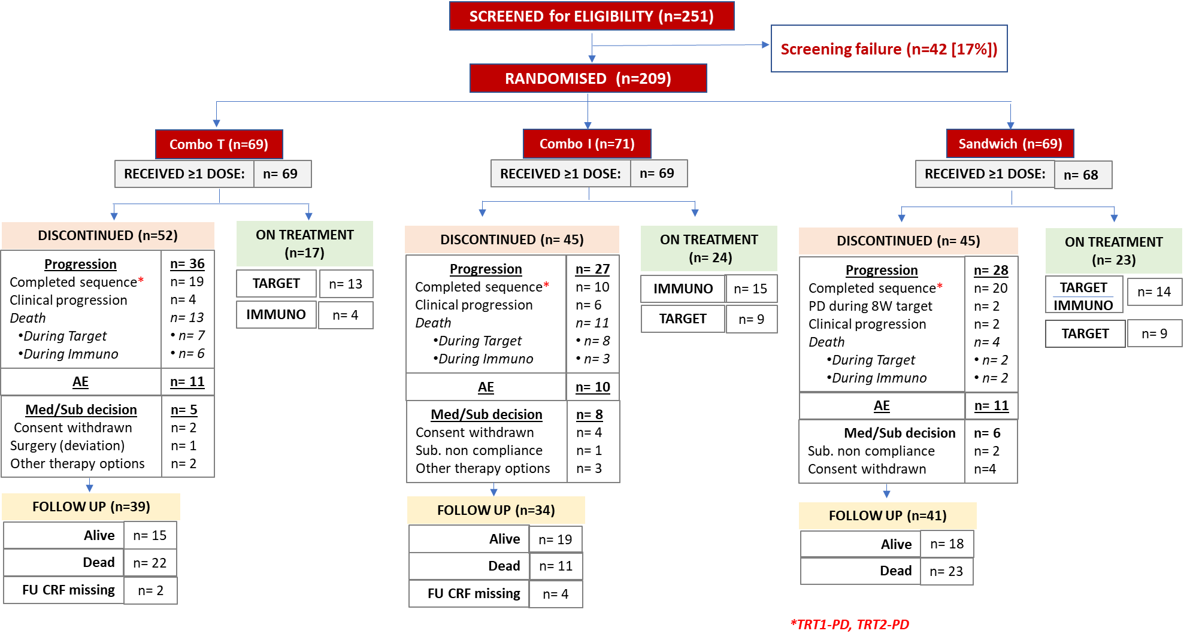
Secombit Study: Consort Diagram and Results

Slide 5
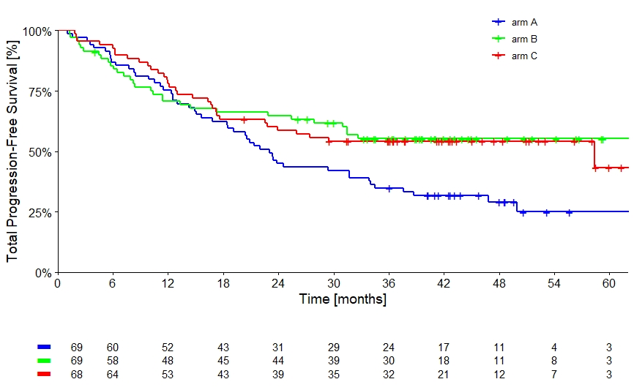
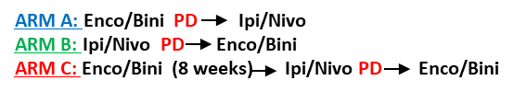
Sequential Combo Immuno- and Target Therapy (Secombit) Study: Total Progression-Free Survival
56%
55%
54%
54%
HR (95% CI) Arm B vs A Exploratory analysis | 0.58 (0.37-0,91) | p= 0,01
HR (95% CI) Arm C vs A Exploratory analysis | 0.60 (0.39-0,94) | p= 0,02
34%
29%

Slide 6
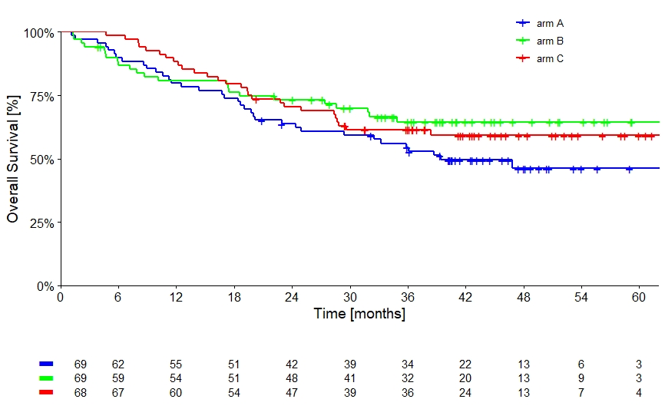
Sequential Combo Immuno- and Target Therapy (Secombit) Study: Overall Survival
64%
63%
60%
59%
53%
46%
HR (95% CI) Arm B vs A Exploratory analysis | 0.66 (0.39-1.12) | p= 0,13
HR (95% CI) Arm C vs A Exploratory analysis | 0.73 (0.44-1.21) | p= 0,22

Slide 7
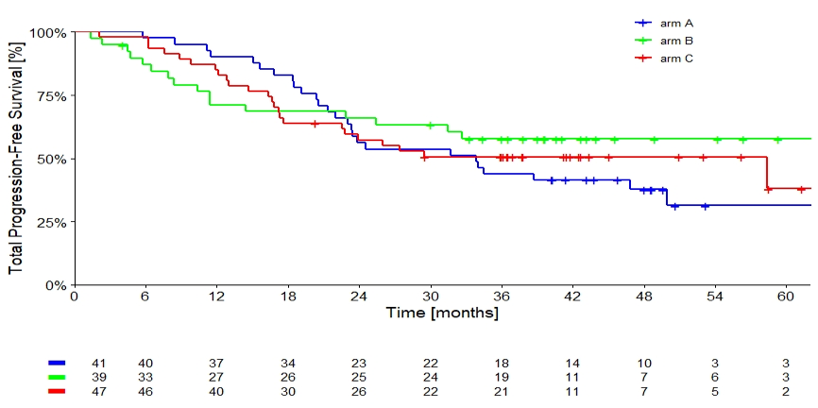
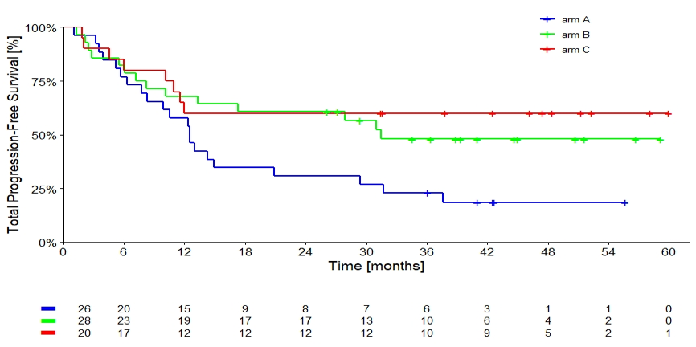
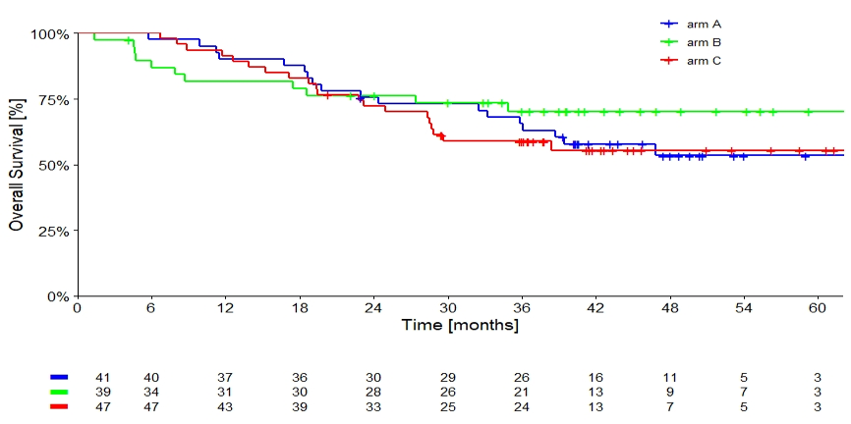
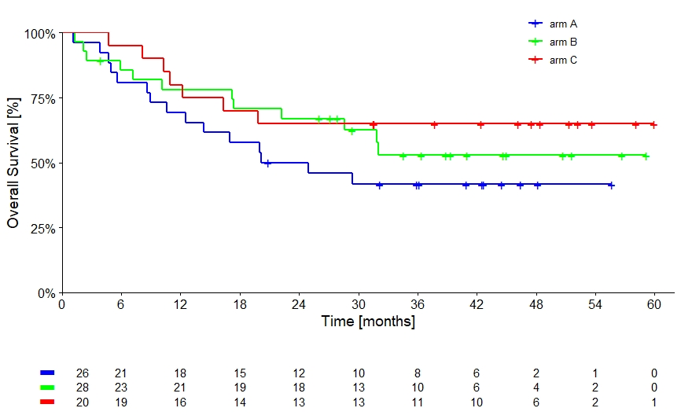
Sequential Combo Immuno- and Target Therapy (Secombit) Study: Subgroups Analysis
nLDH
eLDH
58%
60%
51%
48%
ARM A
ARM B
ARM C
31%
ARM A
ARM B
ARM C
18%
nLDH
eLDH
70%
65%
56%
53%
53%
ARM A
ARM B
ARM C
ARM A
ARM B
ARM C
42%

Slide 8
Sequential Combo Immuno- and Target Therapy (Secombit) Study: Subgroups Analysis
nLDH
eLDH
58%
60%
51%
48%
ARM A
ARM B
ARM C
31%
ARM A
ARM B
ARM C
18%
nLDH
eLDH
70%
65%
56%
53%
53%
ARM A
ARM B
ARM C
ARM A
ARM B
ARM C
42%

Slide 9
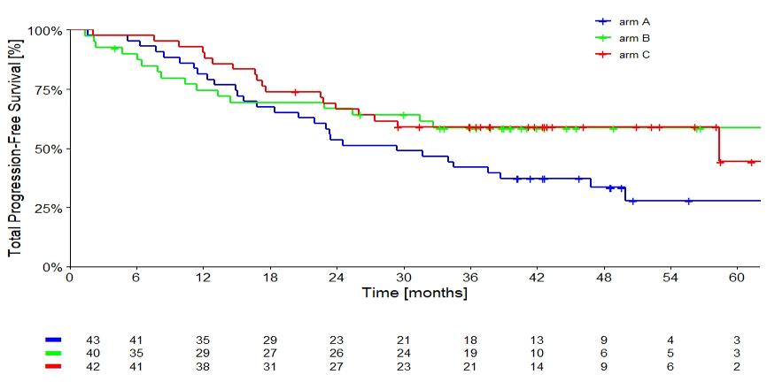
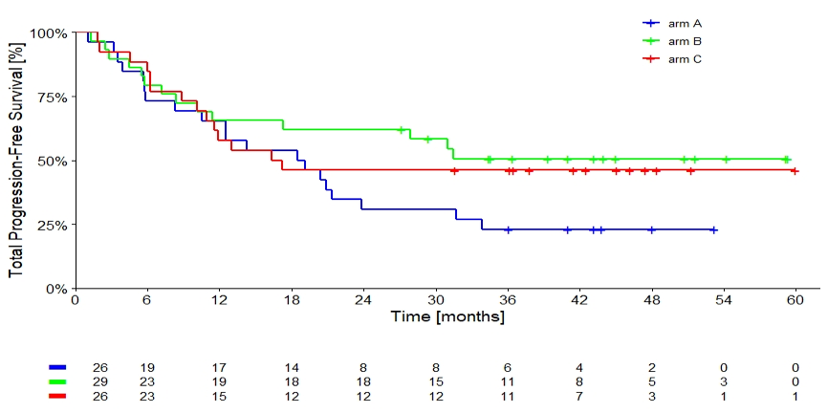
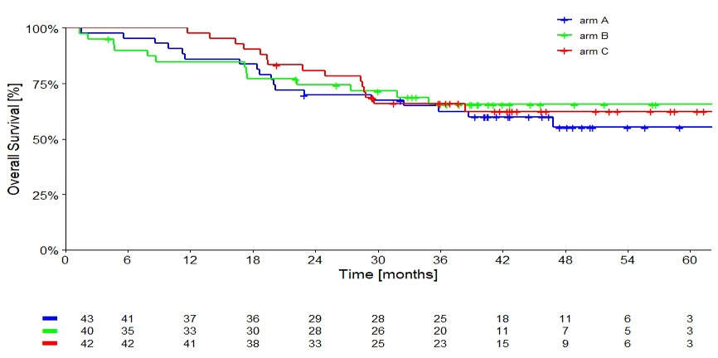
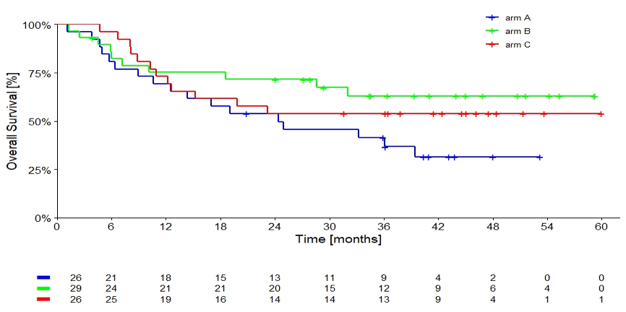
Sequential Combo Immuno- and Target Therapy (Secombit) Study: Subgroups Analysis
< 3 metastatic sites
< 3 metastatic sites
≥ 3 metastatic sites
≥ 3 metastatic sites
59%
59%
51%
46%
ARM A
ARM B
ARM C
33%
ARM A
ARM B
ARM C
23%
65%
63%
62%
55%
54%
ARM A
ARM B
ARM C
ARM A
ARM B
ARM C
32%

Slide 10
Sequential Combo Immuno- and Target Therapy (Secombit) Study: Subgroups Analysis
Baseline Sample Evaluation
A panel of inflammatory cytokines through Luminex assay (IL-6, IL-15, IL-17, PIGF, TNFalfa, INFgamma, Angiopoietin-2, CCL2, CXCL5, CXCL10, FGF2, HB-EGF, VEGF,VEGF-C, MMP9, PDGF) or HS-ELISA (IL-1beta, IL-2, IL-4, IL-10, IL-12), were evaluated at baseline from 93 pts
Target sequencing NGS analysis of about 400 genes involved in oncogenesis was performed on 83 pts
Further biomarker evaluation is ongoing

Slide 11
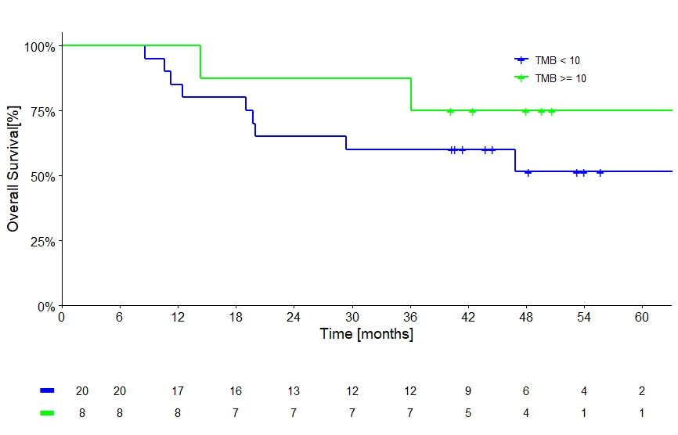
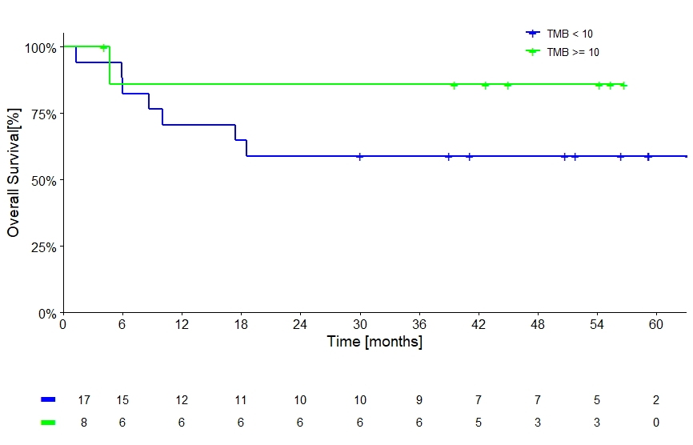
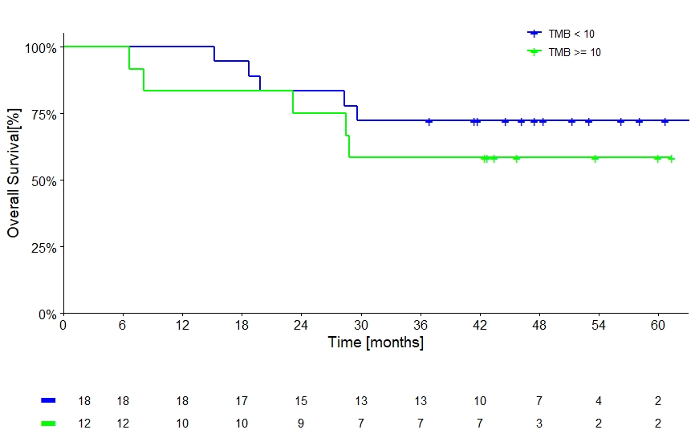
Sequential Combo Immuno- and Target Therapy (Secombit) Study: Biomarkers Ancillary Study – TMB
Arm A
Arm B
Arm C
86%
75%
72%
56%
58%
51%
TMB < 10
TMB >= 10
TMB < 10
TMB >= 10
TMB < 10
TMB >= 10

Slide 12
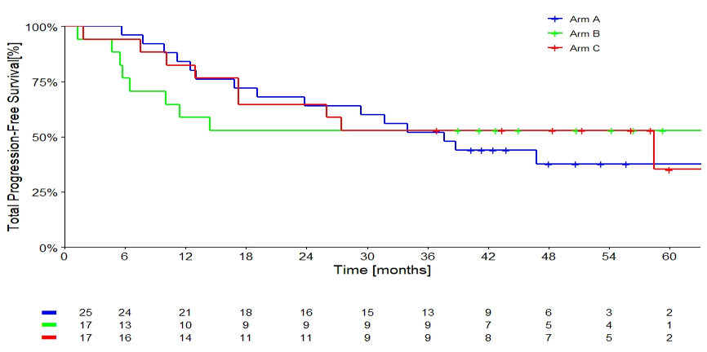
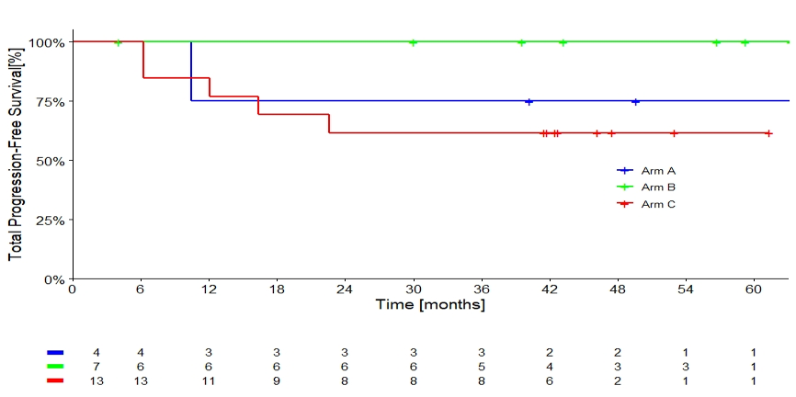
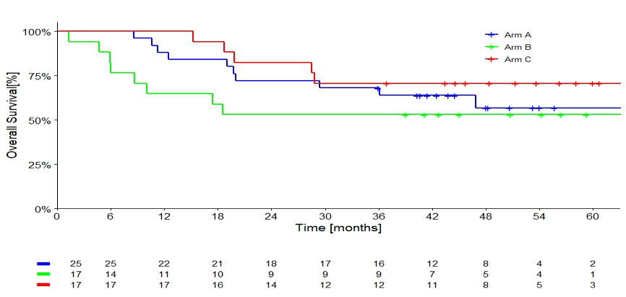
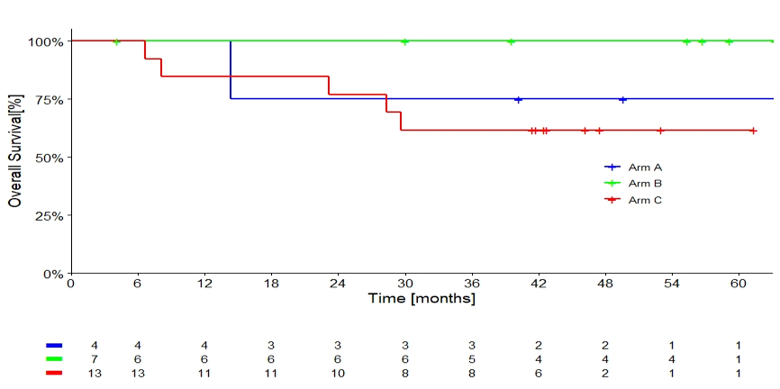
Sequential Combo Immuno- and Target Therapy (Secombit) Study: Biomarkers Ancillary Study – JAK Mutation
JAK wt
JAK wt
JAK mut
JAK mut
100%
75%
53%
53%
62%
ARM A
ARM B
ARM C
38%
ARM A
ARM B
ARM C
100%
71%
75%
57%
62%
53%
ARM A
ARM B
ARM C
ARM A
ARM B
ARM C

Slide 13
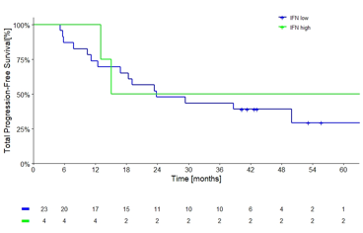
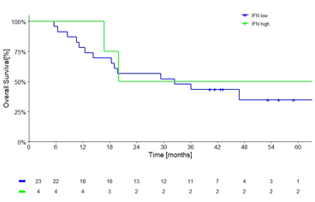
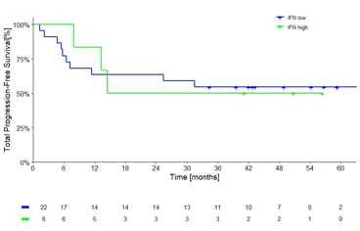
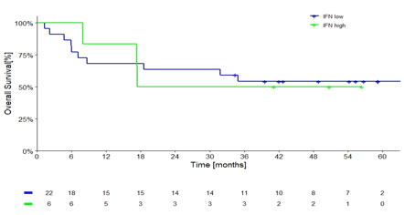
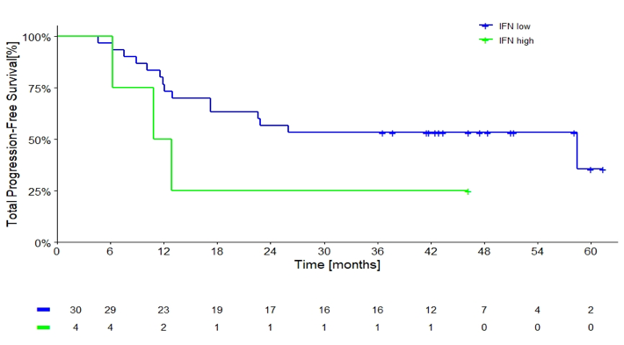
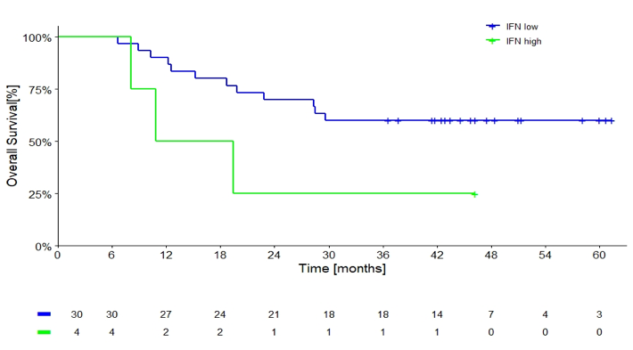
Sequential Combo Immuno- and Target Therapy (Secombit) Study: Biomarkers Ancillary Study – IFN-γ cytokine
Arm A
50%
50%
IFN low
IFN high
35%
IFN low
IFN high
29%
Arm B
55%
55%
IFN low
IFN high
50%
IFN low
IFN high
50%
Arm C
53%
60%
IFN low
IFN high
25%
IFN low
IFN high
25%

Slide 14
Sequential Combo Immuno- and Target Therapy (Secombit) Study: Conclusions
With a median follow-up of 43 months (IQR: 37-51), four-year rate of both Total PFS and OS confirmed better trend for arm B (Combo I) and C (Sandwich)
In the subgroup analysis, patients with elevated LDH or with ≥ 3 metastatic sites showed better trend in arm B (Combo I) and C (Sandwich)
In this preliminary biomarkers analysis (with a limited number of samples), we observed a possible correlation of H-TMB, JAK mutation, and IFN-gamma cytokine with survival
Biomarker studies are still in progress
The study is ongoing to evaluate long term outcomes

Slide 15
Acknowledgments
The patients and families who made this trial possible
The clinical study teams who participated in the trial
The study statistician Diana Giannarelli, study protocol manager Marcello Curvietto, medical monitor Antonio M. Grimaldi, and CRT (Clinical Research Technology-Salerno)
SECOMBIT is registered at ClinicalTrials.gov (NCT02631447)
This study was supported by unconditioned grants from Bristol-Myers Squibb (Princeton, NJ) and Array Biopharma Inc./Pfizer (Boulder, CO)
All authors contributed to the abstract and approved the presentation

Slide 16
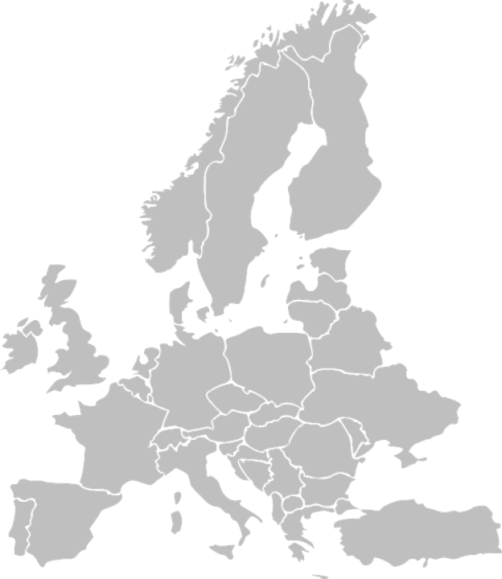



SECOMBIT Investigators
Richtig E, Koelblinger P, Hafner C, Hoeller C
Lebbè C
Weide B
1
1
Gogas H
Ascierto PA, Chiarion Sileni V, Del Vecchio M, De Placido S, Ferrucci PF, Ferraresi V, Fierro MT, Guida M, Guidoboni M, Maiello E, Mandalà M, Marchetti P, Minisini A, Queirolo P, Spagnolo F, Tucci M
2
1
1
1
4
Rutkowski P,
1
Arance AM,, Cao MG, Sanmamed M
3
15
1
Helgadottir H
Dummer R
Larkin J, Lorigan P

