Slide 1
Neoadjuvant Versus Adjuvant Pembrolizumab for Resectable Stage III-IV Melanoma (SWOG S1801)
Sapna P. Patel¹, Megan Othus^{2,3}, Victor G. Prieto¹, Michael C. Lowe⁴, Elizabeth I. Buchbinder⁵, Yuanbin Chen⁶, John Hyngstrom⁷, Christopher Lao⁸, Thach-Giao Truong⁹, Sunandana Chandra¹⁰, Kari Kendra¹¹, Craig Devoe¹², Aparna Hegde¹³, Ankit Mangla¹⁴, Elad Sharon¹⁵, Larissa Korde¹⁵, James Moon^{2,3}, Vernon K. Sondak¹⁶, Antoni Ribas¹⁷
1- University of Texas MD Anderson Cancer Center, Houston, TX; 2-SWOG Statistics and Data Management Center, Seattle, WA; 3-Fred Hutchinson Cancer Research Center, Seattle, WA; 4-Emory University, Atlanta, GA; 5-Dana-Farber Cancer Institute/Harvard Cancer Center, Boston, MA; 6-Cancer and Hematology Centers of Western Michigan/ CRC West MI NCORP, Grand Rapids, MI; 7-University of Utah Huntsman Cancer Institute, Salt Lake City, UT; 8-University of Michigan, Ann Arbor, MI; 9-Kaiser Permanente NCAL, Vallejo, CA; 10-Northwestern University, Chicago, IL; 11-Ohio State University Wexner Medical Center, Columbus, OH; 12-Northwell Health Cancer Institute, Lake Success, NY; 13-University of Alabama, Birmingham, AL; 14-University Hospitals Seidman Cancer Center, Cleveland, OH; 15-National Cancer Institute Cancer Therapy Evaluation Program, Bethesda, MD; 16-Moffitt Cancer Center, Tampa, FL; 17-UCLA/Jonsson Comprehensive Cancer Center, Los Angeles, CA
Presented by
Sapna Patel, MD Associate Professor, Uveal Melanoma Program Director, Melanoma Fellowship Program Chair, SWOG Melanoma Committee University of Texas MD Anderson Cancer Center Houston, Texas

Slide 2
Disclaimer
The views and opinions expressed in this educational activity are those of the faculty and do not necessarily represent the views of TotalCME, Inc., the CME providers, or the companies providing educational grants. This presentation is not intended to define an exclusive course of patient management; the participant should use their clinical judgment, knowledge, experience, and diagnostic skills in applying or adopting for professional use any of the information provided herein. Any procedures, medications, or other courses of diagnosis or treatment discussed or suggested in this activity should not be used by clinicians without evaluation of their patient's conditions and possible contraindications or dangers in use, review of any applicable manufacturer’s product information, and comparison with recommendations of other authorities. Links to other sites may be provided as additional sources of information.

Slide 3
Declaration of Interests
Sapna P. Patel
Institutional clinical trial support: Bristol Myers Squibb, Foghorn Therapeutics, Ideaya, InxMed, Lyvgen Biopharma, Novartis, Provectus Biopharmaceuticals, Seagen, Syntrix Bio, TriSalus Life Sciences
Advisory board, steering committee, data safety monitoring board, consulting: Advance Knowledge in Healthcare, Bristol Myers Squibb, Cardinal Health, Castle Biosciences, Delcath, Immunocore, Novartis, TriSalus Life Sciences
Speaker’s fees: none

Slide 4
S1801 Study Schema
Primary endpoint: Event-free survival
scans
scans
Adjuvant arm Surgery
18 cycles pembrolizumab
200 mg IV q3 wk
Resectable stage IIIB-IV clinically assessable melanoma
1:1 randomization
scans
scans
3 cycles pembrolizumab 200 mg IV q3 wk
scans
15 cycles
pembrolizumab 200
mg IV q3 wk
Neoadjuvant arm
Surgery
Radiographic assessment (scans)
Additional criteria: Strata included AJCC 8th ed. stage and LDH, adjuvant radiation allowed, concomitant radiation and pembrolizumab was not allowed, brain metastasis excluded, uveal melanoma excluded
Surgery type and extent required to be pre-specified and carried out regardless of radiologic response to therapy

Slide 5
Event-Free Survival (EFS) – Primary Endpoint
Measured from the date of randomization to the first of the following events:
Progression or toxicity that rendered a study participant unable to receive surgery
Failure to begin adjuvant therapy within 84 days of surgery
Melanoma recurrence after surgery (local, regional, or distant)
Death from any cause
Study participants who did not register to adjuvant therapy were assigned an EFS of 84 days*
*Exceptions: Participant refusal of surgery in the neoadjuvant arm after complete radiographic response not considered an event. Cancellation of surgery or adjuvant therapy due to site-specific COVID19-related trial limitations not considered an event.

Slide 6
Disposition of Participants
Enrolled, n = 345
Ineligible, n = 32
Randomized, n = 313
Adjuvant arm, n = 159
Neoadjuvant arm, n = 154
Consent withdrawn, n = 7
Consent withdrawn, n = 2
Still on therapy, n = 41
Completed all study therapy, n = 40
Discontinued, n = 71
Still on therapy, n = 43
Completed all study therapy, n = 50
Discontinued, n = 59

Slide 7
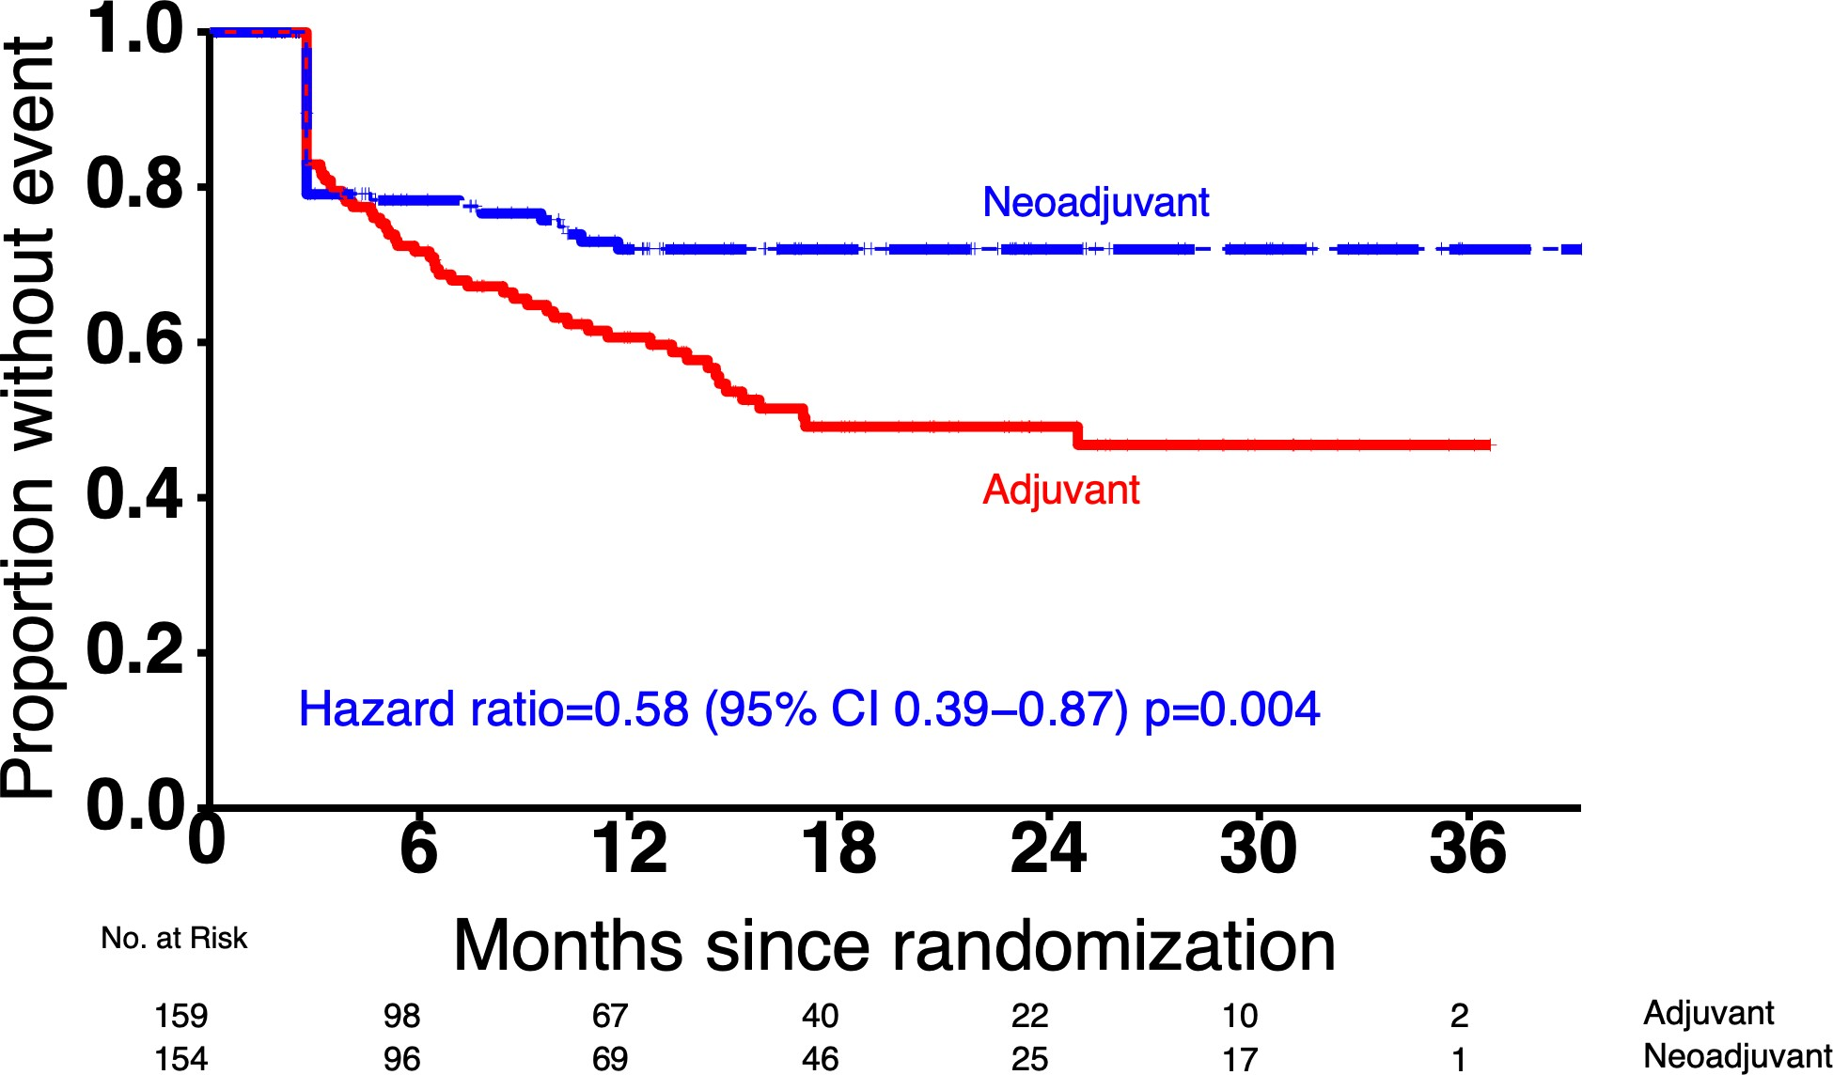
S1801 Primary Endpoint: Event-Free Survival
72%
49%
Landmark 2-year EFS: 72% v. 49%

Slide 8
EFS: Key Subgroups
Adj Neo event/n event/n
HR (95% CI)
Age
Age 65 and younger Age 66 and older Sex
37/92
30/67
23/77
15/77
0.77 (0.46,1.29)
0.4 (0.21,0.74)
Female | 15/48 | 16/62 | 0.89 (0.44,1.81)
Male | 52/111 | 22/92 | 0.48 (0.29,0.8)
erformance status PS 0 49/125 24/113 0.51 (0.32,0.84)
PS 1−2 | 17/33 | 14/40 | 0.74 (0.37,1.51)
DH Low/normal LDH 58/138 34/132 0.6 (0.39,0.92)
High LDH | 9/21 | 4/22 | 0.43 (0.13,1.39)
tage Stage IIIB 24/64 19/62 0.91 (0.5,1.65)
Stage IIIC | 34/74 | 14/69 | 0.4 (0.22,0.75)
Stage IIID/IV | 9/21 | 5/23 | 0.45 (0.15,1.35)
lceration Yes 30/46 16/56 0.4 (0.22,0.74)
No | 22/58 | 11/50 | 0.65 (0.31,1.33)
Unknown | 15/55 | 10/46 | 0.72 (0.32,1.6)
P
L S
U
BRAF
Mutated Wild type Unknown
21/38
25/64
21/57
11/41
16/62
11/50
0.44 (0.21,0.91)
0.72 (0.38,1.35)
0.57 (0.27,1.17)
All patients
67/159
38/154
0.58 (0.39,0.87)
0.5 1 1.5
HR less than 1 favors Neoadjuvant

Slide 9
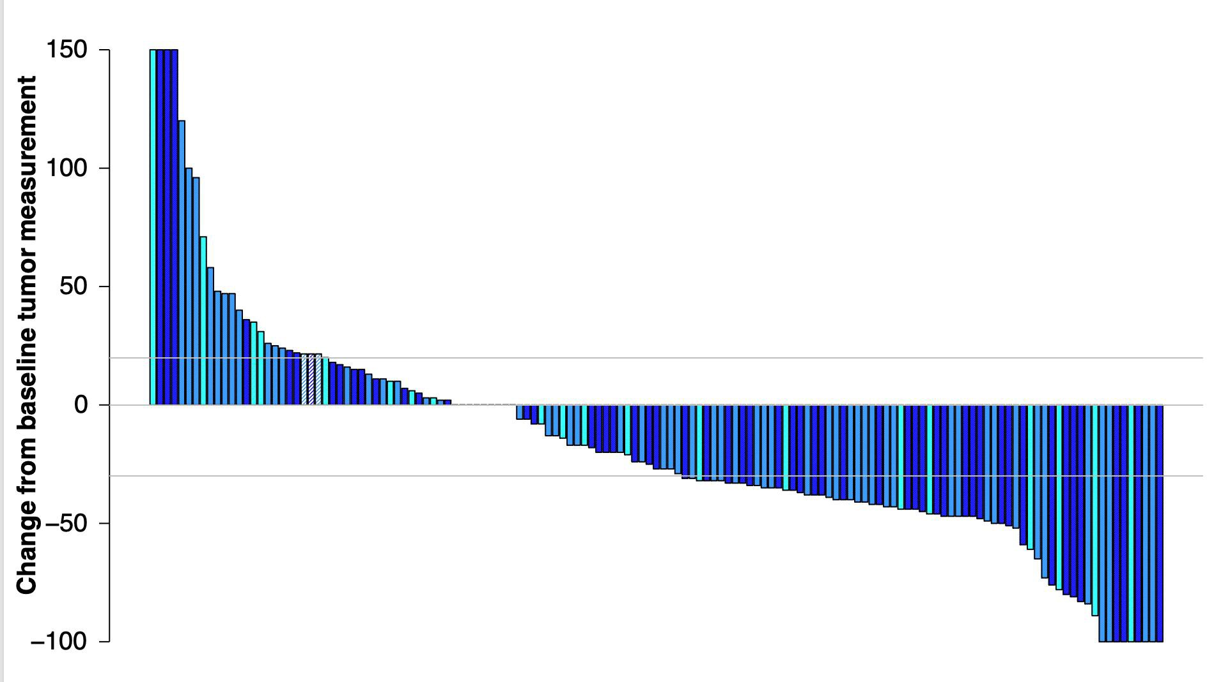
Waterfall Plot: Neoadjuvant Arm
Stage IIIB Stage IIIC Stage IIID/IV
PR
CR
Cross hatches denote participants with clinical disease progression without follow-up scan
42 participants had increase in target lesions; 30 still received surgery
One study participant achieved a CR and refused surgery

Slide 10
Description of Events
 | Event | Adjuvant (n = 67) | Neoadjuvant (n = 38)
 | Unable to receive surgery Toxicity Disease progression Other (co-morbidities, scheduling issue) | 0 0 1 | 1 12 1
 | Unable to start adjuvant therapy Toxicity Unable to resect all disease Disease recurrence (local, regional, distant) Refusal by study participant Adjuvant radiation extended past 84-day window | 0 1 16 2 1 | 3 1 9 1 0
 | Melanoma recurrence after starting adjuvant therapy | 44 | 9
 | Death as first event | 2 | 1
Denotes protocol-defined tumor related events

Slide 11
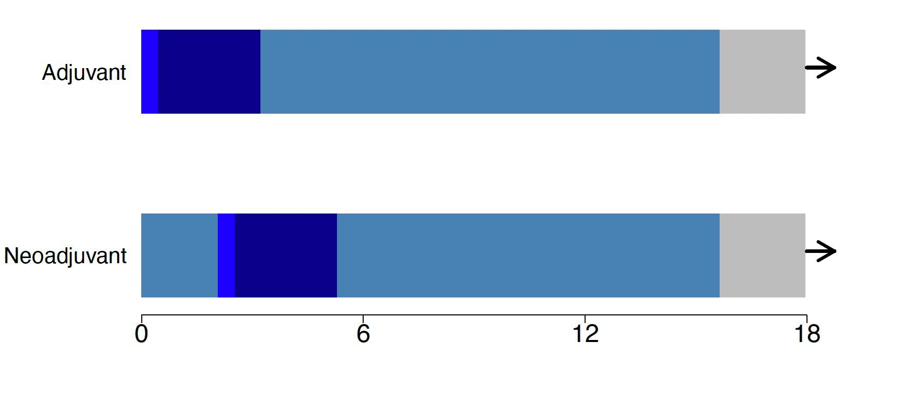
Timing of Events
Surgery Post-surgery
Pembrolizumab Follow-up
(n = 159)
(n = 154)
months from randomization

Slide 12
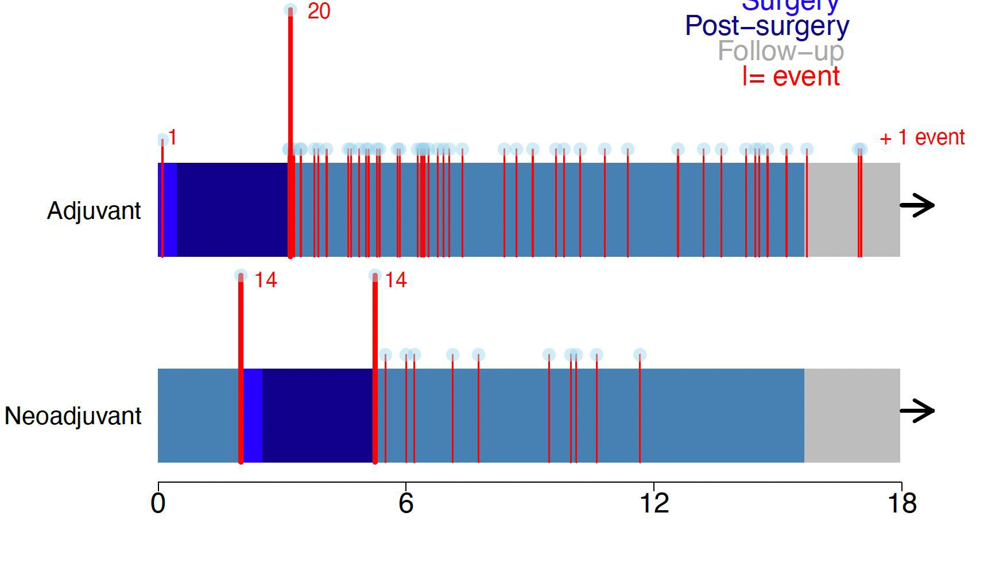
Timing of Events
Surgery
Post-surgery Pembrolizumab Follow-up
I = event
67
events
(n = 159)
38
events
(n = 154)
radiographic assessment (scans)
months from randomization

Slide 13
Treatment-Related Adverse Events
Grade 3/4 rates similar in both study arms
Neoadjuvant period: <2% or less of all study participants in that arm; most common ALT increased (n=3)
Surgery period: most common event was infection (n=3 neoadjuvant arm; n=2 adjuvant arm)
Adjuvant period: most common event was maculopapular rash (n=1 neoadjuvant arm; n=4 adjuvant arm)
Rates of grade 3/4 treatment-related adverse events were similar in both arms
Neoadjuvant pembrolizumab did not increase adverse events in the peri-operative period

Slide 14
Summary
Event-free survival was significantly longer in the neoadjuvant arm than in the adjuvant arm (HR 0.58, 0.39 to 0.87; p=0.004)
2-year event-free survival was 72% in the neoadjuvant arm versus 49% in the adjuvant arm
Events occurring before adjuvant therapy occurred similarly on both arms:
8% of participants in the neoadjuvant arm experienced disease progression that precluded surgery; 6.5% experienced residual disease or developed metastasis prior to the start of adjuvant therapy
11% of participants in the adjuvant arm experienced residual disease or developed metastasis prior to the start of adjuvant therapy
Tumor-related events (disease progression / recurrence) occurred in 20% (n=31) of participants in the neoadjuvant arm versus 40% (n=61) in the adjuvant arm
Events occurring after initiation of adjuvant therapy occurred more frequently in the adjuvant arm
No new safety signals were identified

Slide 15
Conclusion
Compared to the same treatment given entirely in the
adjuvant setting, neoadjuvant pembrolizumab followed
by adjuvant pembrolizumab improves event-free survival
in resectable melanoma

Slide 16
S1801 Accruing Institutions
Cancer Research Consortium of West Michigan NCORP | University of Utah Huntsman Cancer Institute | University of Michigan Comprehensive Cancer Center | Kaiser Permanente NCORP | Northwestern University | Ohio State University Comprehensive Cancer Center
Northwell Health NCORP | University of Alabama at Birmingham / Deep South Research Consortium LAPS | CWRU Case Comprehensive Cancer Center | The University of Texas MD Anderson Cancer Center | Virginia Commonwealth University Massey Cancer Center Minority Underserved NCORP | Wisconsin NCORP
University of Kansas Cancer Center – MCA Rural MU NCORP | USC Norris Comprehensive Cancer Center | Banner University Medical Center – Tucson | National Capital Area Minority Underserved NCORP | University of Oklahoma Health Sciences Center | UCLA / Jonsson Comprehensive Cancer Center
City of Hope Comprehensive Cancer Center | Heartland Cancer Research NCORP | Edward Hospital / Cancer Center | Emory University – Winship Cancer Institute | Washington University – Siteman Cancer Center | Massachusetts Veterans Epidemiology Research and Information Center
Michigan Cancer Research Consortium NCORP | Wake Forest University Health Sciences | East Carolina University | Sanford NCORP of the North Central Plains | University of South Alabama Mitchell Cancer Institute | Aurora NCORP
University of Kentucky / Markey Cancer Center | University of Rochester | MedStar Franklin Square Medical Center / Weinberg Cancer Institute | Metro Minnesota Community Oncology Research Consortium | Montana Cancer Consortium NCORP | University of Tennessee – Knoxville
Banner MD Anderson Cancer Center | UC Irvine Health / Chao Family Comprehensive Cancer Center | Stanford Cancer Institute Palo Alto | Cancer Research of Wisconsin and Northern Michigan Consortium | Dartmouth College – Norris Cotton Cancer Center | Hackensack University Medical Center
Pacific Cancer Research Consortium NCORP | The Don and Sybil Harrington Cancer Center | Loma Linda University Medical Center | Geisinger Cancer Institute NCORP | Hawaii Minority Underserved NCORP | Rush University Medical Center
Franciscan Health Indianapolis | Ascension Via Christi Hospitals Wichita | Atlantic Health Cancer Consortium Community Oncology Research Program | Baptist Memorial Health care / Mid South Minority Underserved NCORP | Saint Joseph Hospital – Orange | Carle Cancer Center NCORP
Columbus NCORP | University of Miami Miller School of Medicine – Sylvester Cancer Center | Gulf South Minority Underserved NCORP | University of Nebraska Medical Center | New Mexico Minority Underserved NCORP | University of Cincinnati Cancer Center – UC Medical Center

