Slide 1
Case: Using the 2022 ESC/ERS Treatment Algorithm in Older Male Patient with Cardiopulmonary Comorbidities
Richard Channick, MD
Saul Brandman Endowed Chair in Pulmonary Arterial Hypertension
Co-Director, Pulmonary Vascular Disease Program
Director, Acute and Chronic Thromboembolic Disease Program
Professor of Medicine
Pulmonary and Critical Care Division
David Geffen School of Medicine at UCLA
Los Angeles, CA

Slide 2
Resource Information
About This Resource
These slides are one component of a continuing education program available online at MedEd On The Go titled Implementing Aggressive Treatment to Improve Risk Profiles for PH Patients
Program Learning Objectives:
Gain an understanding of the 2022 ERS/ES guidelines and algorithms developed to detect PH early in the community
Identify appropriate circumstances to implement 3 or 4 strata risk assessments
Demonstrate best practices amongst MDs on how to impact diagnosis screening for at-risk patients subject to economic disparity, lack of access to referral centers, or understudied subtypes for the disease
Enable early recognition of sub-populations of patients who are at high risk and identify appropriate screening candidates
MedEd On The Go®
www.mededonthego.com
This content or portions thereof may not be published, posted online or used in presentations without permission.
This content can be saved for personal use (non-commercial use only) with credit given to the resource authors.
To contact us regarding inaccuracies, omissions or permissions please email us at support@MedEdOTG.com

Slide 3
Disclaimer
The views and opinions expressed in this educational activity are those of the faculty and do not necessarily represent the views of Total CME, LLC, the CME providers, or the companies providing educational grants. This presentation is not intended to define an exclusive course of patient management; the participant should use their clinical judgment, knowledge, experience, and diagnostic skills in applying or adopting for professional use any of the information provided herein. Any procedures, medications, or other courses of diagnosis or treatment discussed or suggested in this activity should not be used by clinicians without evaluation of their patient's conditions and possible contraindications or dangers in use, review of any applicable manufacturer’s product information, and comparison with recommendations of other authorities. Links to other sites may be provided as additional sources of information.

Slide 4
Our Patient
66 y/o male with history of methamphetamine use (none in 15 years), hypertension, and DM who noted onset of dyspnea with exertion 7 months ago
He was forced to stop working and currently gets short of breath and tired when working around his house
Past smoker 1 ppd x 30 years, quit 10 years ago
No other risk factors for PH

Slide 5
Exam
110/72, HR 68, O₂ sat 91% on room air. BMI 35
No JVD
Lungs: Crackles at lung bases
Heart: Regular, prominent P2, II/VI HSM LLSB
Trace pedal edema

Slide 6
Workup
6MWD: 320m
V/Q: Normal
PFTs: Normal spirometry, reduced DLCO
NT-proBNP: 500 ng/ml

Slide 7
Echocardiogram
ECHO:
Normal LV
Moderate to severe RV enlargement with decreased function
RVSP estimate 64 + CVP
TAPSE 1.6

Slide 8
RHC
RAP 8
PAP 70/45 (mean 53)
PCWP 8
CO/CI 4.5/2.8
PVR 10
In response to iNO
PAPmean 48, PCWP 10, CO 4.7, PVR 8

Slide 9
What Risk Category Is this Patient?
FC III
6MWD 320 meters
NT-proBNP 500 ng/ml
RAP 8
PAP 70/45 (mean 53)
PCWP 8
CO/CI 4.5/2.8
PVR 10

Slide 10
What is your initial treatment for this patient?
ERA monotherapy
sGCs or PDE5i monotherapy
PGI-2 monotherapy
Combination therapy

Slide 11
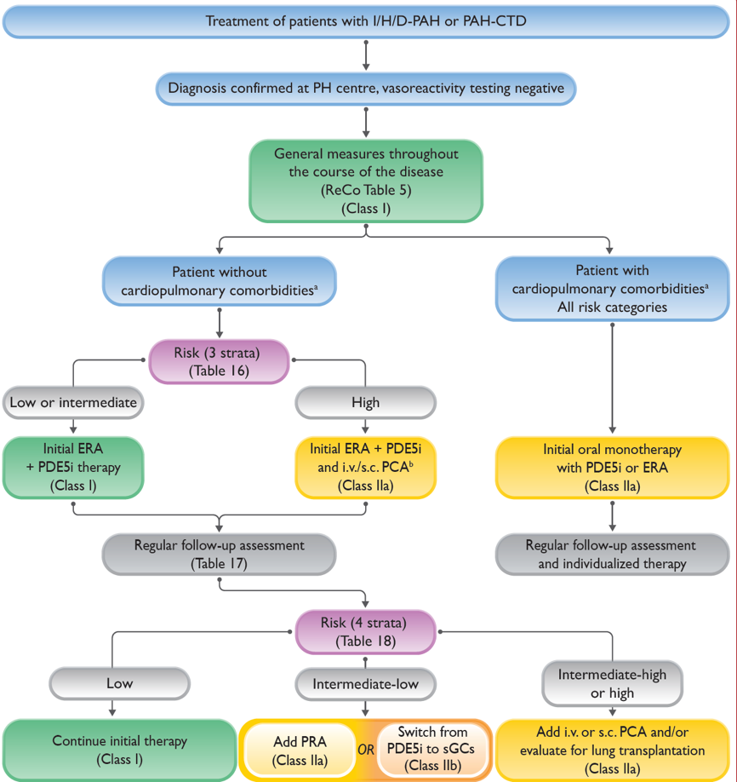
The 2022 ESC/ERS Treatment Algorithm Is Risk-based
Treatment algorithm divides management approach based on presence of cardiopulmonary comorbidities
Risk assessment and combination therapy recommended for those without comorbidities
Monotherapy recommended for those with cardiopulmonary comorbidities
This recommendation should not be applied
to all patients

Slide 12
Our Patient
Group 1
Intermediate risk
Poor RV function
CV comorbidities not prominent and likely not driving disease
Treat this patient same as other PAH patients without comorbidities:
Combination Therapy

Slide 13
Looking for more resources on this topic?
CME/CE in minutes
Congress highlights
Late-breaking data
Quizzes
Webinars
In-person events
Slides & resources
www.MedEdOTG.com

