Slide 1
Essential Aspects of the New ERS/ESC Treatment Guidelines: Patients with Comorbidities
Richard Channick, MD
Saul Brandman Endowed Chair in Pulmonary Arterial Hypertension
Co-Director, Pulmonary Vascular Disease Program
Director, Acute and Chronic Thromboembolic Disease Program
Professor of Medicine
Pulmonary and Critical Care Division
David Geffen School of Medicine at UCLA
Los Angeles, CA

Slide 2



Resource Information
About This Resource
These slides are one component of a continuing education program available online at MedEd On The Go titled Implementing Aggressive Treatment to Improve Risk Profiles for PH Patients
Program Learning Objectives:
Gain an understanding of the 2022 ERS/ES guidelines and algorithms developed to detect PH early in the community
Identify appropriate circumstances to implement 3 or 4 strata risk assessments
Demonstrate best practices amongst MDs on how to impact diagnosis screening for at-risk patients subject to economic disparity, lack of access to referral centers, or understudied subtypes for the disease
Enable early recognition of sub-populations of patients who are at high risk and identify appropriate screening candidates
MedEd On The Go®
www.mededonthego.com
This content or portions thereof may not be published, posted online or used in presentations without permission.
This content can be saved for personal use (non-commercial use only) with credit given to the resource authors.
To contact us regarding inaccuracies, omissions or permissions please email us at support@MedEdOTG.com

Slide 3
Disclaimer
The views and opinions expressed in this educational activity are those of the faculty and do not necessarily represent the views of Total CME, LLC, the CME providers, or the companies providing educational grants. This presentation is not intended to define an exclusive course of patient management; the participant should use their clinical judgment, knowledge, experience, and diagnostic skills in applying or adopting for professional use any of the information provided herein. Any procedures, medications, or other courses of diagnosis or treatment discussed or suggested in this activity should not be used by clinicians without evaluation of their patient's conditions and possible contraindications or dangers in use, review of any applicable manufacturer’s product information, and comparison with recommendations of other authorities. Links to other sites may be provided as additional sources of information.

Slide 4
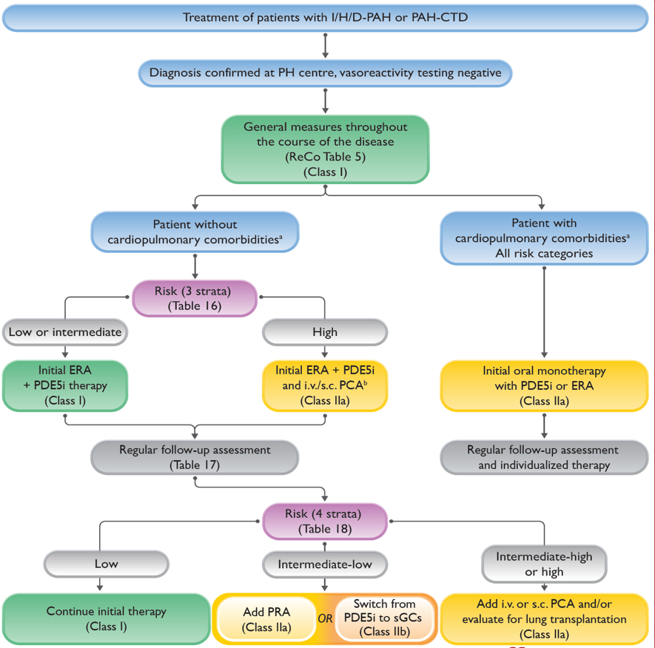
The 2022 ESC/ERS Treatment Algorithm Is Risk-based
Treatment algorithm divides management approach based on presence of cardiopulmonary comorbidities
Risk assessment and combination therapy recommended for those without comorbidities
Monotherapy recommended for those with cardiopulmonary comorbidities

Slide 5
Comorbidities in PAH
Patients diagnosed with PAH are typically older (average age 60y) in modern day registries
Two described phenotypes:
  Left heart phenotype: elderly, mostly female patients with risk factors for HFpEF (e.g., hypertension, obesity, diabetes, or coronary heart disease) but have pre-capillary PH rather than post-capillary PH. 30% have atrial fibrillation
  Cardiopulmonary phenotype: elderly, predominantly male patients who have a low DLCO (less than 45% of the predicted value), are often hypoxemic, have a significant smoking history, and have risk factors for LHD
  COMPERA Registry: Of 841 IPAH patients, 12.6% were young, mostly female patients without cardiopulmonary comorbidities presenting with a classic phenotype, while 35.8% presented with a left heart phenotype and 51.6% had a cardiopulmonary phenotype

Slide 6
Response to Therapy in PAH Patients with Left Heart or Cardiopulmonary Phenotype May Be Different
Patients with a left heart phenotype:
More likely to have edema, higher discontinuation rates, and are less likely to respond to combination therapy
Patients with a cardiopulmonary phenotype:
Do not respond as well; they have more side effects and higher discontinuation rates

Slide 7
Evidence-based Treatment Recommendations for PAH Patients with Comorbidities
Recommendations for the treatment of non-vasoreactive patients with idiopathic, heritable, or drug-associated pulmonary arterial hypertension who present with cardiopulmonary comorbiditiesª
Recommendations | Class^{b} | Level^{c}
Recommendations for initial therapy
In patients with IPAH/HPAH/DPAH and cardiopulmonary comorbidities, initial monotherapy with a PDE5i or an ERA should be considered | IIa | C
Recommendations for treatment decisions during follow-up
In patients with IPAH/HPAH/DPAH with cardiopulmonary comorbidities who have an intermediate or high risk of death while receiving PDE5i or ERA monotherapy, additional PAH medications may be considered on an individual basis | IIb | C

Slide 8
Comorbidities in PAH: Individualize Treatment Decisions
Although older patients with left heart and pulmonary disease features should be treated cautiously, possibly with initial monotherapy as per guidelines, one should not extrapolate to all PAH patients with comorbidities
Example:
45-year-old woman with scleroderma and PAH who also has well controlled hypertension and DM
This patient should be treated the same as a PAH patient without comorbidities!

Slide 9



Looking for more resources
on this topic?
CME/CE in minutes
Congress highlights
Late-breaking data
Quizzes
Webinars
In-person events
Slides & resources
www.MedEdOTG.com

