Slide 1
Essential Aspects of the New ERS/ESC Treatment Guidelines: Patients Without Comorbidities
Richard Channick, MD
Saul Brandman Endowed Chair in Pulmonary Arterial Hypertension
Co-Director, Pulmonary Vascular Disease Program
Director, Acute and Chronic Thromboembolic Disease Program
Professor of Medicine
Pulmonary and Critical Care Division
David Geffen School of Medicine at UCLA
Los Angeles, CA

Slide 2



Resource Information
About This Resource
These slides are one component of a continuing education program available online at MedEd On The Go titled Implementing Aggressive Treatment to Improve Risk Profiles for PH Patients
Program Learning Objectives:
Gain an understanding of the 2022 ERS/ES guidelines and algorithms developed to detect PH early in the community
Identify appropriate circumstances to implement 3 or 4 strata risk assessments
Demonstrate best practices amongst MDs on how to impact diagnosis screening for at-risk patients subject to economic disparity, lack of access to referral centers, or understudied subtypes for the disease
Enable early recognition of sub-populations of patients who are at high risk and identify appropriate screening candidates
MedEd On The Go®
www.mededonthego.com
This content or portions thereof may not be published, posted online or used in presentations without permission.
This content can be saved for personal use (non-commercial use only) with credit given to the resource authors.
To contact us regarding inaccuracies, omissions or permissions please email us at support@MedEdOTG.com

Slide 3
Disclaimer
The views and opinions expressed in this educational activity are those of the faculty and do not necessarily represent the views of Total CME, LLC, the CME providers, or the companies providing educational grants. This presentation is not intended to define an exclusive course of patient management; the participant should use their clinical judgment, knowledge, experience, and diagnostic skills in applying or adopting for professional use any of the information provided herein. Any procedures, medications, or other courses of diagnosis or treatment discussed or suggested in this activity should not be used by clinicians without evaluation of their patient's conditions and possible contraindications or dangers in use, review of any applicable manufacturer’s product information, and comparison with recommendations of other authorities. Links to other sites may be provided as additional sources of information.

Slide 4
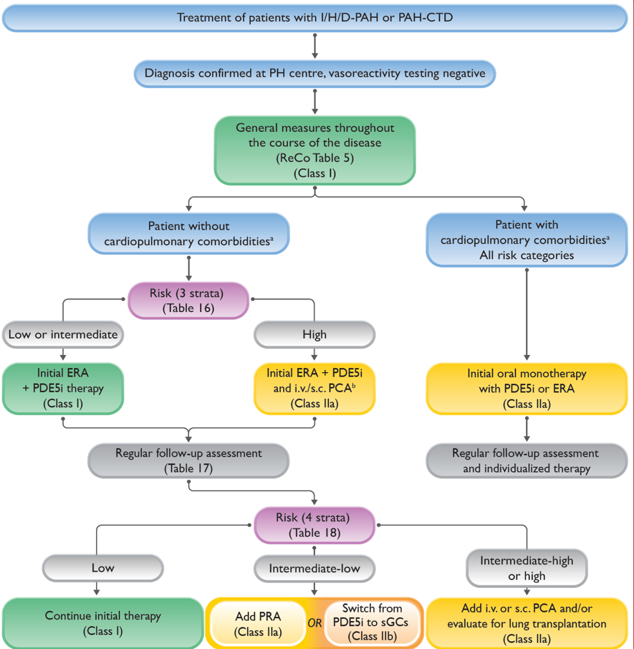
ESC/ERS Treatment Algorithm: Notable Changes
Treatment algorithm divides management approach based on presence of cardiopulmonary comorbidities
Risk assessment and combination therapy recommended for those without comorbidities
Monotherapy recommended for those with cardiopulmonary comorbidities

Slide 5
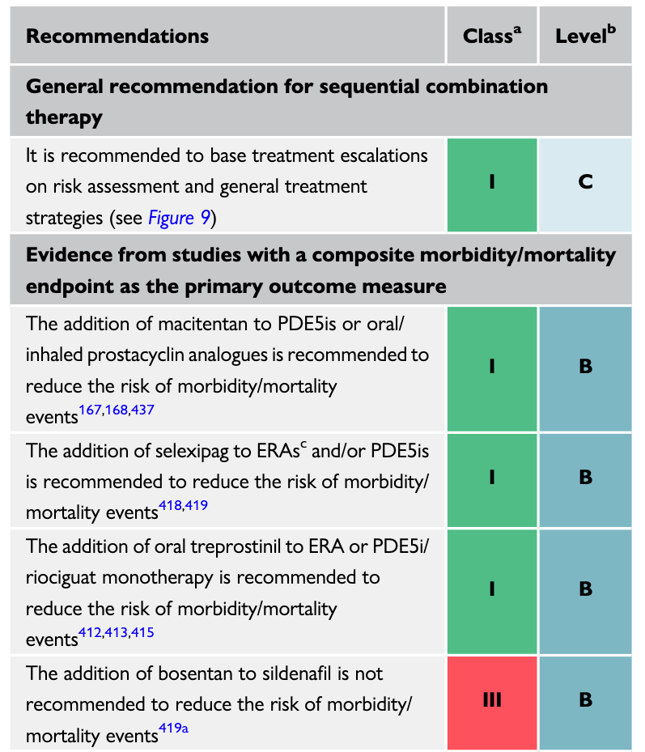
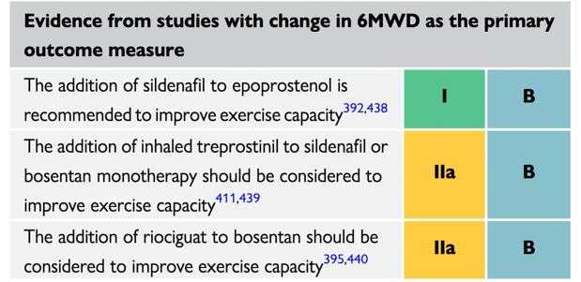
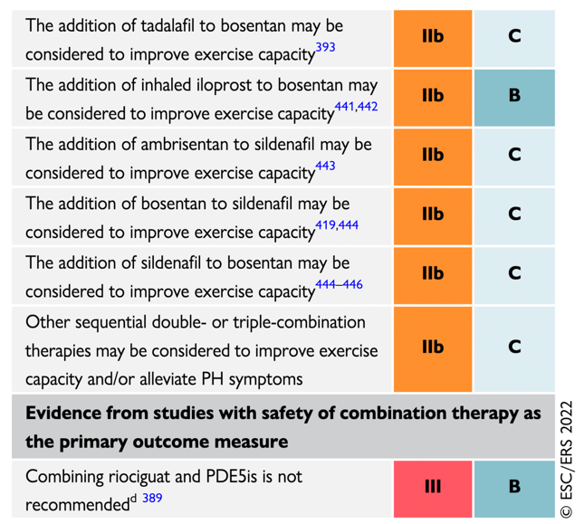
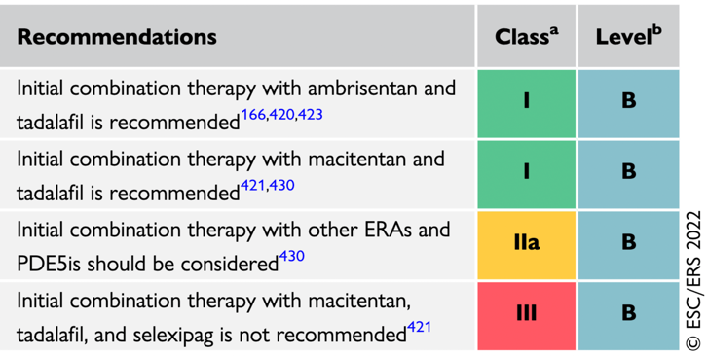
Levels of Evidence for Initial Combination and Sequential Therapy
Recommendation Table 10 — Recommendations for sequential drug combination therapy for patients with idiopathic, heritable, or drug-associated pulmonary
arterial hypertension
Recommendation Table 9 — Recommendations for initial oral drug combination therapy for patients with idiopathic, heritable, or drug-associated pulmonary arterial hypertension without cardiopulmonary comorbidities

Slide 6
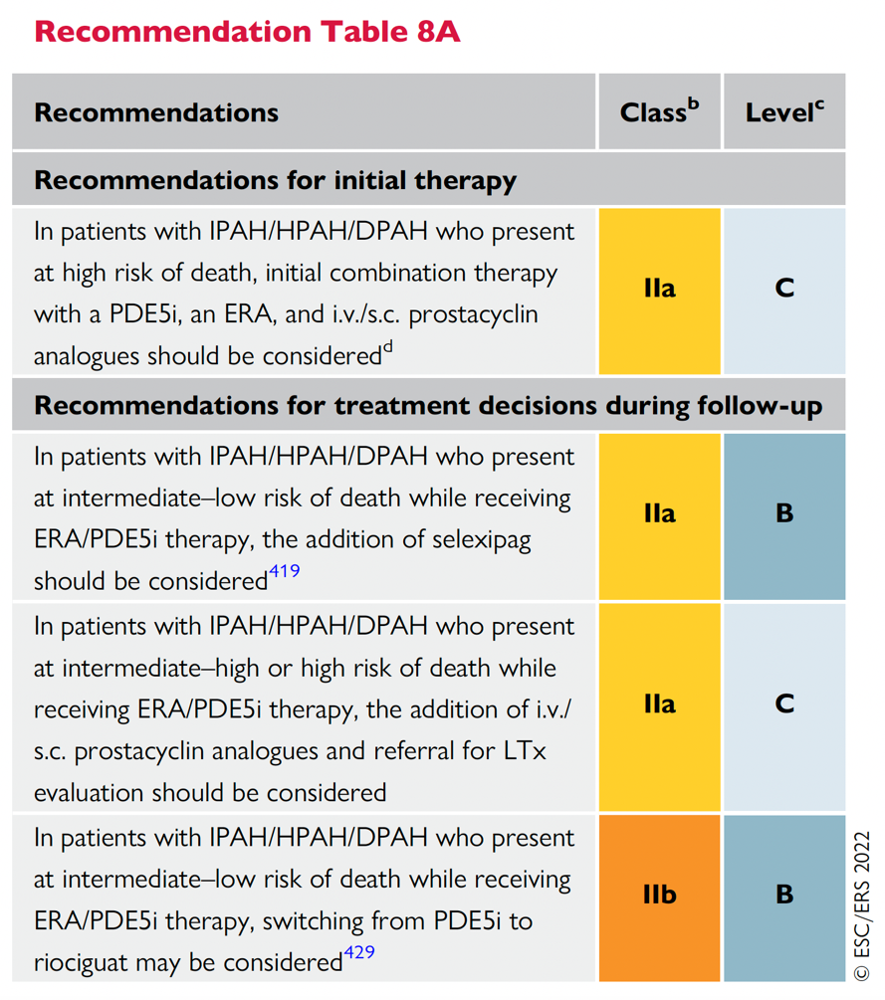
High-risk PAH Patients
Parenteral prostacyclins have consistent, rapid effect.
Limited randomized controlled trials in high-risk patients, but extensive experience (epoprostenol approved in 1996)
Benefit of combining parenteral therapy with PDE5i and ERA

Slide 7



Looking for more resources
on this topic?
CME/CE in minutes
Congress highlights
Late-breaking data
Quizzes
Webinars
In-person events
Slides & resources
www.MedEdOTG.com

