Slide 1
2022 ERS/ESC PAH Guidelines on Treatment
Jean Elwing, MD
Professor of Medicine
Director, Pulmonary Hypertension Program
Division of Pulmonary, Critical Care and Sleep Medicine
University of Cincinnati
Cincinnati, OH

Slide 2



Resource Information
About This Resource
These slides are one component of a continuing education program available online at MedEd On The Go titled Implementing Aggressive Treatment to Improve Risk Profiles for PH Patients
Program Learning Objectives:
Gain an understanding of the 2022 ERS/ES guidelines and algorithms developed to detect PH early in the community
Identify appropriate circumstances to implement 3 or 4 strata risk assessments
Demonstrate best practices amongst MDs on how to impact diagnosis screening for at-risk patients subject to economic disparity, lack of access to referral centers, or understudied subtypes for the disease
Enable early recognition of sub-populations of patients who are at high risk and identify appropriate screening candidates
MedEd On The Go®
www.mededonthego.com
This content or portions thereof may not be published, posted online or used in presentations without permission.
This content can be saved for personal use (non-commercial use only) with credit given to the resource authors.
To contact us regarding inaccuracies, omissions or permissions please email us at support@MedEdOTG.com

Slide 3
Disclaimer
The views and opinions expressed in this educational activity are those of the faculty and do not necessarily represent the views of Total CME, LLC, the CME providers, or the companies providing educational grants. This presentation is not intended to define an exclusive course of patient management; the participant should use their clinical judgment, knowledge, experience, and diagnostic skills in applying or adopting for professional use any of the information provided herein. Any procedures, medications, or other courses of diagnosis or treatment discussed or suggested in this activity should not be used by clinicians without evaluation of their patient's conditions and possible contraindications or dangers in use, review of any applicable manufacturer’s product information, and comparison with recommendations of other authorities. Links to other sites may be provided as additional sources of information.

Slide 4
2022 ERS/ESC PAH Treatment Guidelines: General Measures
General Measures
Supervised exercise training is recommended in patients with PAH under medical therapy | I
Psychosocial support is recommended in patients with PAH | I
Immunization of patients with PAH against SARS-CoV-2, influenza, and Streptococcus pneumoniae is recommended | I
Diuretic treatment is recommended in patients with PAH with signs of RV failure and fluid retention | I
Long-term oxygen therapy is recommended in patients with PAH whose arterial blood oxygen pressure is <8 kPa (60 mmHg) | I
In the presence of iron-deficiency anemia, correction of iron status is recommended in patients with PAH | I
In the absence of anemia, iron repletion may be considered in patients with PAH with iron deficiency | IIb
Anticoagulation is not generally recommended in patients with PAH but may be considered on an individual basis | IIb
The use of ACEis, ARBs, ARNIs, SGLT-2is, beta-blockers, or ivabradine is not recommended in patients with PAH unless required by comorbidities (i.e. high blood pressure, coronary artery disease, left HF, or arrhythmias) | III
Special Circumstances
In-flight oxygen administration is recommended for patients using oxygen or whose arterial blood oxygen pressure is <8 kPa (60 mmHg) at sea level
For interventions requiring anesthesia, multidisciplinary consultation at a PH center to assess risk and benefit should be considered | IIa

Slide 5
2022 ERS/ESC PAH Treatment Guidelines: General Measures
Recommendations
It is recommended that women of childbearing potential with PAH are counselled at the time of diagnosis about the risks and uncertainties associated with becoming pregnant; this should include advice against becoming pregnant, and referral for psychological support where needed
It is recommended to provide women of childbearing potential with PAH with clear contraceptive advice, considering the individual needs of the woman while recognizing that the implications of contraceptive failure are significant in PAH
It is recommended that women with PAH who are considering pregnancy or who become pregnant receive prompt counselling in an experienced PH center to facilitate genetic counselling and shared decision-making as well as to provide psychological support to the patients and their families where needed
For women with PAH having a termination of pregnancy, it is recommended that this be performed in PH centers, with psychological support provided to the patients and their families
For women with PAH who desire to have children, where available, adoption and surrogacy with pre-conception genetic counselling may be considered
As teratogenic potential has been reported in pre-clinical models for endothelin receptor antagonists and riociguat, these drugs are not recommended during pregnancy

Slide 6
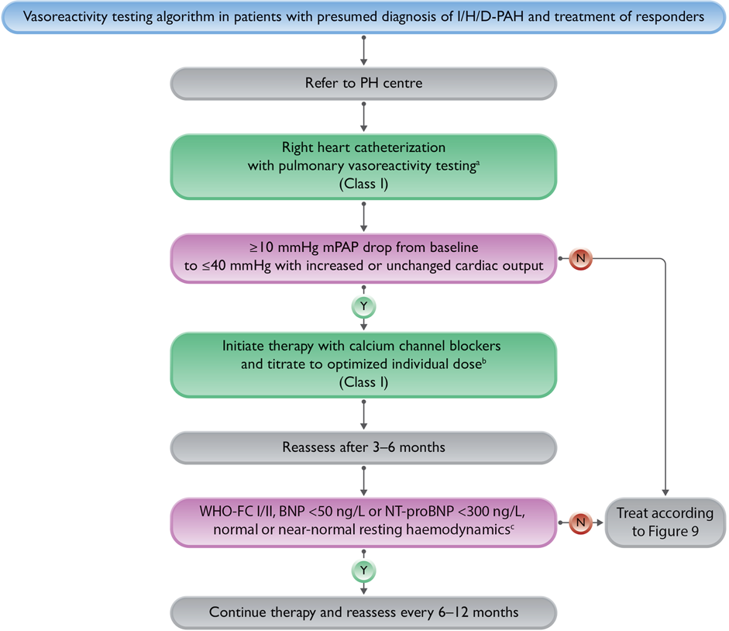
2022 ERS/ESC PAH Guidelines: Vasoreactive I/H/D PAH
Vasoreactivity Testing Algorithm of Patients With Presumed Diagnosis of Idiopathic, Heritable, or Drug-Induced (I/H/D) Associated Pulmonary Arterial Hypertension
Compound | Route | Half-life | Dosage | Duration
Nitric oxide | inh | 15–30 s | 10–20 p.p.m. | 5–10 min
Iloprost | inh | 30 min | 5–10 µg | 10–15 min
Epoprostenol | IV | 3 min | 2–12 ng/kg/min | 10 min
CCB Initial dose Dose range
Amlodipine 5 mg QD 15–30 mg QD
Diltiazem 60 mg BID 120–360 mg BID
Felodipine 5 mg QD 15–30 mg QD
Nifedipine 10 mg TID 20–60 mg BID or TID

Slide 7
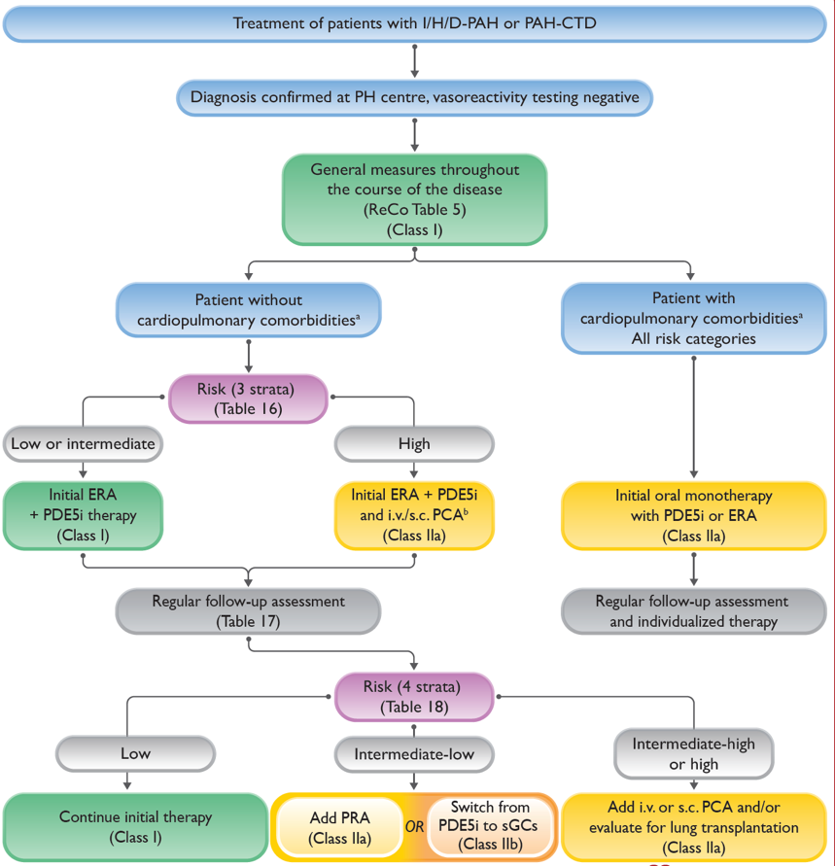
2022 ERS/ESC PAH Guidelines: Non-vasoreactive PAH
Treatment algorithm divides management approach based on presence of cardiopulmonary comorbidities
Risk assessment and combination therapy recommended for those without comorbidities
Monotherapy recommended for those with cardiopulmonary comorbidities

Slide 8
2022 ERS/ESC PAH Guidelines: Non-vasoreactive PAH with Comorbidities
Patients with cardiopulmonary comorbidities were under-represented in or excluded from PAH trials
Registry data suggest that most physicians use PDE5is as primary treatment for these patients
Endothelin receptor antagonists or PDE5i/ERA combinations are occasionally used but the drug discontinuation rate is higher in patients with non-vasoreactive PAH with comorbidities than in patients with classic PAH
A subgroup analysis from AMBITION with left heart phenotype (105 patients) showed less clinical improvement and a higher likelihood of drug discontinuations due to safety and tolerability with both monotherapy and initial combination therapy
Data from the ASPIRE registry demonstrated that patients with IPAH and a cardiopulmonary phenotype had less improvement in exercise capacity and patient-reported outcome measures (PROMs) compared with IPAH
In patients with a left heart phenotype:
ERA therapy is associated with an elevated risk of fluid retention
PAH medication may cause a decline in the peripheral oxygen saturation
There is little published experience on the use of prostacyclin analogues or prostacyclin receptor agonists
The lack of solid evidence for treating elderly patients with PAH who have cardiopulmonary comorbidities makes treatment recommendations challenging

Slide 9

2022 ERS/ESC PAH Guidelines: Non-vasoreactive Without Comorbidities
Determinants of prognosis (estimated 1-year mortality) | Low risk (<5%) | Intermediate risk (5–20%) | High risk (>20%)
Clinical observations and modifiable variables
Signs of right HF | Absent | Absent | Present
Progression of symptoms and clinical manifestations | No | Slow | Rapid
Syncope | No | Occasional syncopeª | Repeated syncope^{b}
WHO-FC | I, II | III | IV
6MWD^{c} | >440 m | 165–440 m | <165 m
CPET | Peak VO₂ >15 mL/min/kg (>65% pred.) VE/VCO₂ slope <36 | Peak VO₂ 11–15 mL/min/kg (35–65% pred.) VE/VCO₂ slope 36–44 | Peak VO₂ <11 mL/min/kg (<35% pred.) VE/VCO₂ slope >44
Biomarkers: BNP or NT-proBNP^{d} | BNP <50 ng/L NT-proBNP <300 ng/L | BNP 50–800 ng/L NT-proBNP 300–1100 ng/L | BNP >800 ng/L NT-proBNP >1100 ng/L
Echocardiography | RA area <18 cm² TAPSE/sPAP >0.32 mm/mmHg No pericardial effusion | RA area 18–26 cm² TAPSE/sPAP 0.19–0.32 mm/mmHg Minimal pericardial effusion | RA area >26 cm² TAPSE/sPAP <0.19 mm/mmHg Moderate or large pericardial effusion
cMRIe | RVEF >54% SVI >40 mL/m² RVESVI <42 mL/m² | RVEF 37–54% SVI 26–40 mL/m² RVESVI 42–54 mL/m² | RVEF <37% SVI <26 mL/m² RVESVI >54 mL/m²
Hemodynamics | RAP <8 mmHg CI ≥2.5 L/min/m² SVI >38 mL/m² SvO₂ >65% | RAP 8–14 mmHg CI 2.0–2.4 L/min/m² SVI 31–38 mL/m² SvO₂ 60–65% | RAP >14 mmHg CI <2.0 L/min/m² SVI <31 mL/m² SvO₂ <60%

Slide 10
2022 ERS/ESC PAH Guidelines: Non-vasoreactive Without Comorbidities
Endothelin receptor antagonists (oral administration)
Ambrisentan | 5 mg OD |  | 10 mg OD
Bosentan | 62.5 mg BID |  | 125 mg BID
Macitentan | 10 mg OD |  | 10 mg OD
Phosphodiesterase 5 inhibitors (oral administration)
Sildenafil | 20 mg TID |  | 20 mg TID^{c}
Tadalafil | 20 or 40 mg OD |  | 40 mg OD
Prostacyclin analogues (oral administration)
Beraprost sodium | 20 µg TID |  | Maximum tolerated dose up to 40 µg TID
Beraprost extended release | 60 µg BID |  | Maximum tolerated dose up to 180 µg BID
Treprostinil | 0.25 mg BID or 0.125 mg TID |  | Maximum tolerated dose
Prostacyclin receptor agonist (oral administration)
Selexipag | 200 µg BID |  | Maximum tolerated dose up to 1600 µg BID
Soluble guanylate cyclase stimulator (oral administration)
Riociguat^{d} | 1 mg TID |  | 2.5 mg TID
Prostacyclin analogues (inhaled administration)
Iloprost^{e} | 2.5 µg 6–9 times per day |  | 5.0 µg 6–9 times per day
Treprostinil^{e} | 18 µg 4 times per day |  | 54–72 µg 4 times per day
Prostacyclin analogues (i.v. or s.c. administration)
Epoprostenol i.v. | 2 ng/kg/min | Determined by tolerability and effectiveness; typical dose range at 1 year is 16–30 ng/kg/min, with wide individual variability | Determined by tolerability and effectiveness; typical dose range at 1 year is 16–30 ng/kg/min, with wide individual variability
Treprostinil s.c. or i.v. | 1.25 ng/kg/min | Determined by tolerability and effectiveness; typical dose range at 1 year is 25–60 ng/kg/min, with wide individual variability | Determined by tolerability and effectiveness; typical dose range at 1 year is 25–60 ng/kg/min, with wide individual variability

Slide 11
2022 ERS/ESC PAH Guidelines: Non-vasoreactive Without Comorbidities
Determinants of prognosis | Low risk | Intermediate–low risk | Intermediate–high risk | High risk
Points assigned | 1 | 2 | 3 | 4
WHO-FC | I or II | - | III | IV
6MWD, m | >440 | 320–440 | 165–319 | <165
BNP or NT-proBNP, ng/L | <50 <300 | 50–199 300–649 | 200–800 650–1100 | >800 >1100
Risk is calculated by dividing the sum of all grades by the number of variables and rounding to the next integer
Change in therapy based on results of follow up risk assessment

Slide 12
Summary
General measures should be implemented to optimize health status in all PAH patients
Pregnancy should be avoided in patients with PAH due to the risk of cardiovascular compromise
Vasoreactivity testing algorithm should be followed for idiopathic, heritable, or drug- (I/H/D) associated pulmonary arterial hypertension
Calcium channel blocker therapy should be considered for I/H/D associated PAH with a positive vasodilator challenge
PAH monotherapy can be considered in patients with non-vasoreactive PAH with significant comorbidities
PAH combination therapy should be used in patients with non-vasoreactive PAH without comorbidities and medication choices are driven by risk assessment

Slide 13



Looking for more resources on this topic?
CME/CE in minutes
Congress highlights
Late-breaking data
Quizzes
Webinars
In-person events
Slides & resources
www.MedEdOTG.com

