Slide 1
2022 ERS/ESC PH Guidelines on Diagnosis
Jean Elwing, MD
Professor of Medicine
Director, Pulmonary Hypertension Program
Division of Pulmonary, Critical Care and Sleep Medicine
University of Cincinnati
Cincinnati, OH

Slide 2
Resource Information
About This Resource
These slides are one component of a continuing education program available online at MedEd On The Go titled Implementing Aggressive Treatment to Improve Risk Profiles for PH Patients
Program Learning Objectives:
Gain an understanding of the 2022 ERS/ES guidelines and algorithms developed to detect PH early in the community
Identify appropriate circumstances to implement 3 or 4 strata risk assessments
Demonstrate best practices amongst MDs on how to impact diagnosis screening for at-risk patients subject to economic disparity, lack of access to referral centers, or understudied subtypes for the disease
Enable early recognition of sub-populations of patients who are at high risk and identify appropriate screening candidates
MedEd On The Go®
www.mededonthego.com
This content or portions thereof may not be published, posted online or used in presentations without permission.
This content can be saved for personal use (non-commercial use only) with credit given to the resource authors.
To contact us regarding inaccuracies, omissions or permissions please email us at support@MedEdOTG.com

Slide 3
Disclaimer
The views and opinions expressed in this educational activity are those of the faculty and do not necessarily represent the views of Total CME, LLC, the CME providers, or the companies providing educational grants. This presentation is not intended to define an exclusive course of patient management; the participant should use their clinical judgment, knowledge, experience, and diagnostic skills in applying or adopting for professional use any of the information provided herein. Any procedures, medications, or other courses of diagnosis or treatment discussed or suggested in this activity should not be used by clinicians without evaluation of their patient's conditions and possible contraindications or dangers in use, review of any applicable manufacturer’s product information, and comparison with recommendations of other authorities. Links to other sites may be provided as additional sources of information.

Slide 4
Do you know the new hemodynamic cutoff values for PH as proposed by the ERS/ESC?

Slide 5
2022 ESC/ERS Guidelines: New PH Definitions
New definitions of PH have been endorsed and expanded in the 2022 ESC/ERS guidelines
Definitions for PH are based on hemodynamic assessment by right heart catheterization (RHC)
Hemodynamics represent the central element of characterizing PH but the final diagnosis and classification should reflect the entire clinical context and results of all investigations
Endorsed the pulmonary pressure of > 20 mPAP as proposed by 6th World Symposium on Pulmonary Hypertension (WSPH)
Revised the cut-off level for pulmonary vascular resistance (PVR) to > 2.0
Proposed a definition of exercise induced pulmonary hypertension (PH)

Slide 6
The 2022 Definitions of Pulmonary Hypertension
Definition | Hemodynamic Characteristics
Pulmonary Hypertension | mPAP > 20 mmHg
Pre-capillary Pulmonary Hypertension | mPAP > 20 mmHg PAWP ≤ 15 mmHg PVR > 2 WU
Isolated Post-capillary Pulmonary Hypertension (IpcPH) | mPAP > 20 mmHg PAWP > 15 mmHg PVR ≤ 2 WU
Combined Pre- and Post-capillary Pulmonary Hypertension (CpcPH) | mPAP > 20 mmHg PAWP > 15 mmHg PVR > 2 WU
Exercise Pulmonary Hypertension | mPAP/CO Slope between rests and exercise >3mmHg/L/min
Some patients present with elevated mPAP (>20 mmHg) but low PVR (≤2 WU) and low PAWP (≤15 mmHg)
This hemodynamic condition may be described by the term ‘unclassified PH’ (see text for further details)

Slide 7
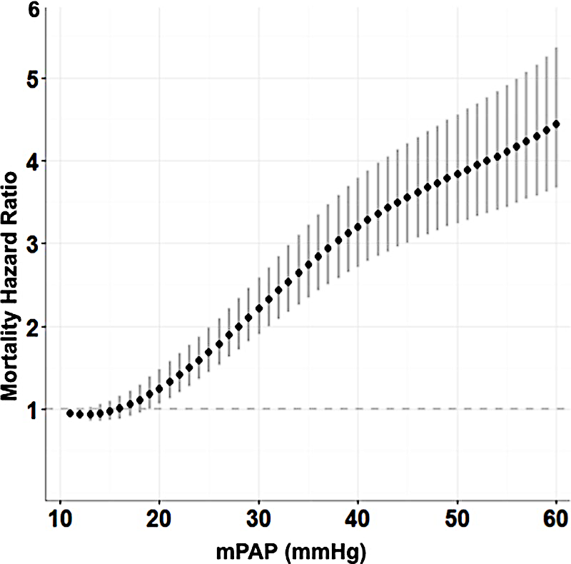
Hemodynamic Definition Changes: Pulmonary Pressure
Comprehensive, systematic, literature review
Analyzed hemodynamic data obtained by RHC
1187 healthy individuals from 47 studies
Supine position at rest the normal mPAP: 14.0+3.3 mmHg¹
Definition | Hemodynamic characteristics
PH³ | mPAP >20 mmHg
Several studies have shown increased risk mortality in patients with mPAP > 20 mmHg
Retrospective analysis of US Veterans’ RHC
21,727 from 2007-2012
908-day median follow-up
Mortality hazard increased² with mPAP as a continuous variable beginning at 19 mmHg

Slide 8
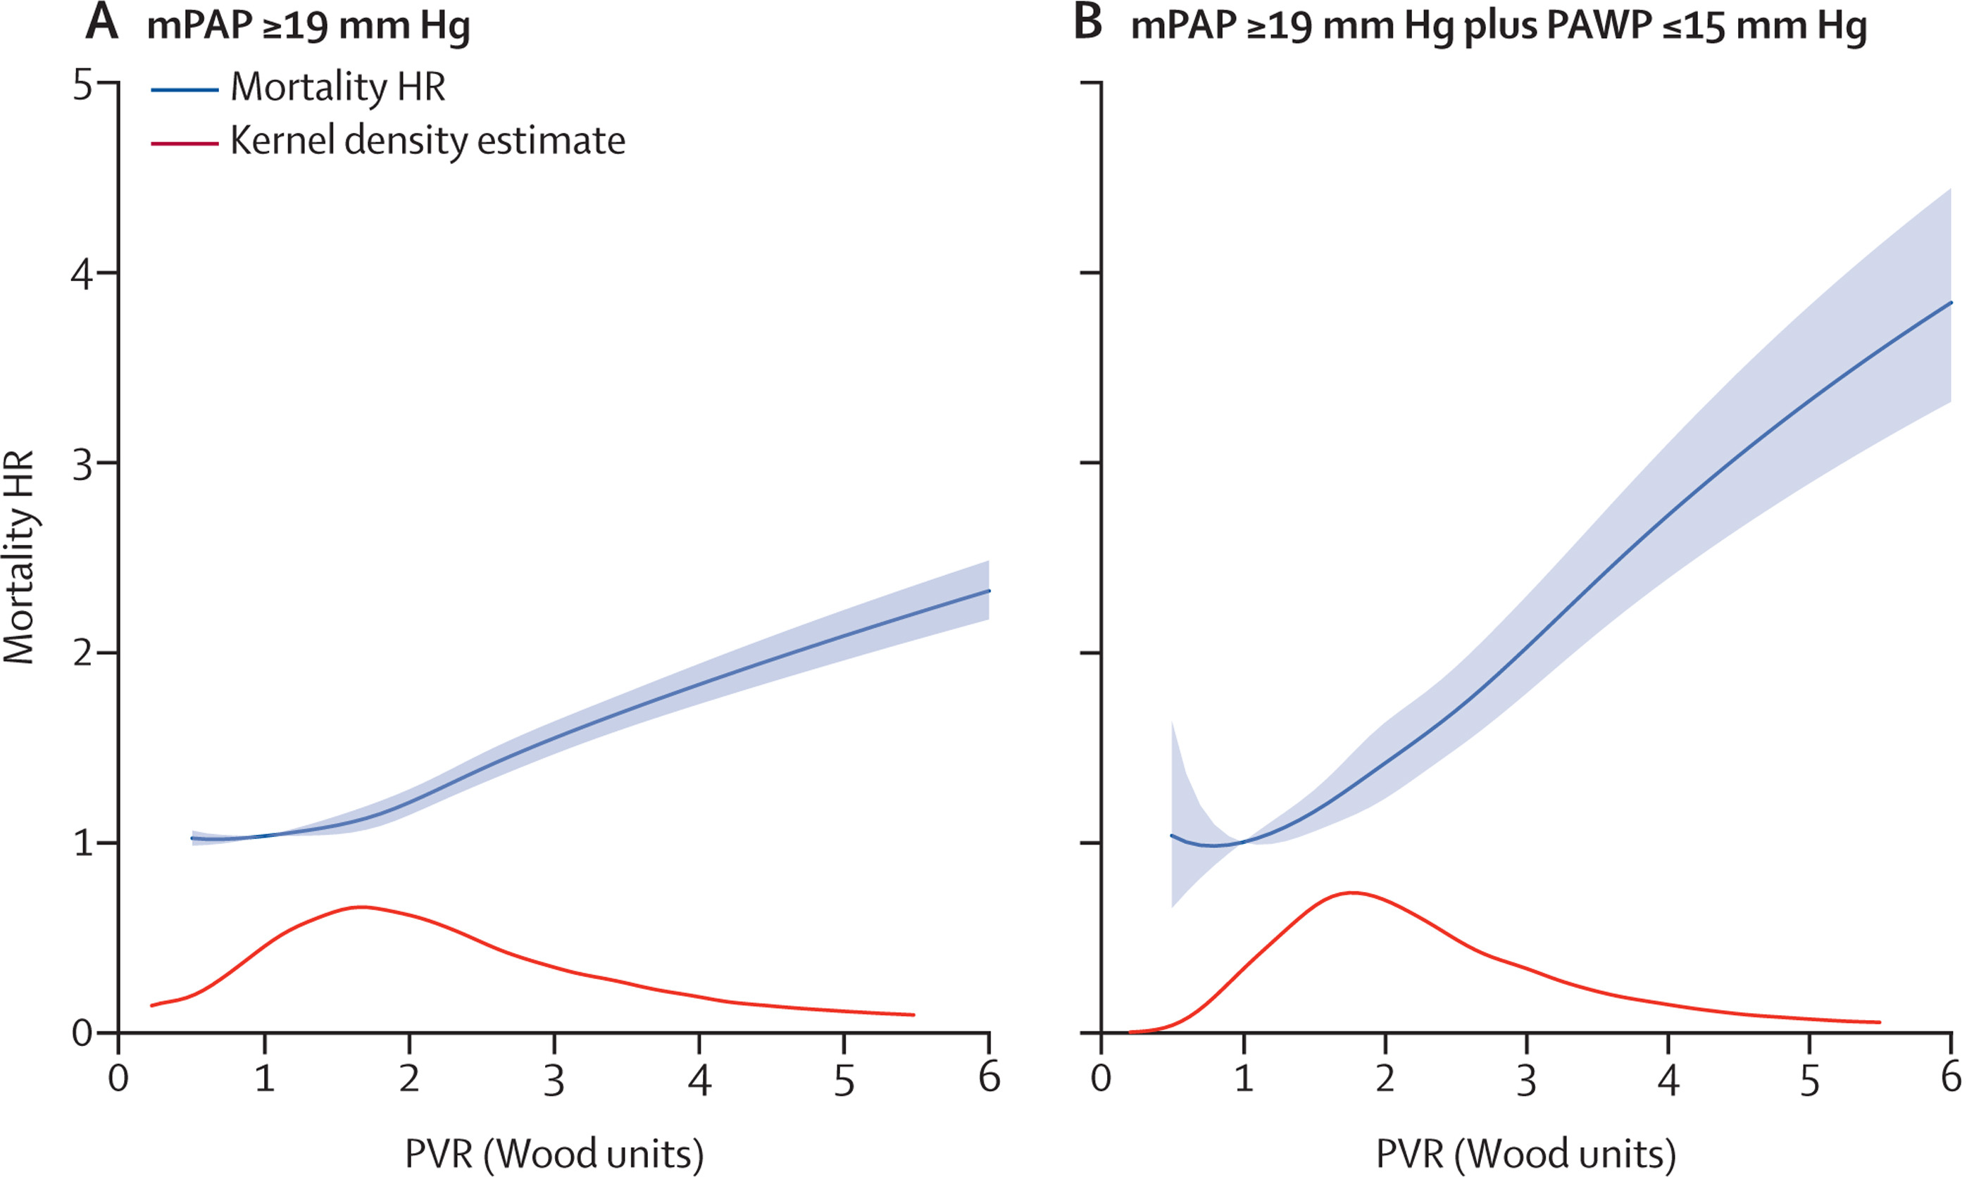
Hemodynamic Definition Changes: Pulmonary Vascular Resistance
Definition | Hemodynamic characteristics
Precapillary PH² | mPAP > 20 mmHg PAWP ≤15 mmHg PVR > 2 WU
Retrospective analysis of US Veterans’ RHC
40,082 from 2007-2016
1,153-day follow-up
The adjusted HR for all-cause mortality was stratified by PVR
All-cause adjusted mortality HR increased progressively increasing PVR >2.2²
Based on the available data, PVR of ~ 2 Wood units (WU) is the upper limit of normal and the lowest prognostically relevant threshold¹

Slide 9
Hemodynamic Definition Changes: Exercise Pulmonary Pressures
Definition | Hemodynamic characteristics
Exercise PH¹ | mPAP/CO slope between rest and exercise >3 mmHg/L/min
mPAP/CO slope is age dependent and upper limit of normal ranges from 1.6–3.3 mmHg/L/min in the supine position
mPAP/CO slope >3 mmHg/L/min is not physiological in subjects < 60 years and may rarely be present in healthy subjects > 60 years
Systematic literature review
45 eligible studies with a total of 5,598 subjects
Increased mPAP/CO slope during exercise is associated with impaired survival
Independent, prognostically relevant cut-off >3 WU has been validated²
mPAP/CO slope
50
40
Age (years)
30
60
50
40
30
mPAP
20
10
0
0
5
10
15
20
CO
Normal ≤1.6-3.3 WU,
dependent on age
>3 WU
Survival ↓
Heart failure-related
hospitalization ↑

Slide 10
Looking for more resources on this topic?
CME/CE in minutes
Congress highlights
Late-breaking data
Quizzes
Webinars
In-person events
Slides & resources
www.MedEdOTG.com

