Slide 1
2022 ERS/ESC PAH Guidelines on Echocardiography
Jean Elwing, MD
Professor of Medicine
Director, Pulmonary Hypertension Program
Division of Pulmonary, Critical Care and Sleep Medicine
University of Cincinnati
Cincinnati, OH

Slide 2



Resource Information
About This Resource
These slides are one component of a continuing education program available online at MedEd On The Go titled Implementing Aggressive Treatment to Improve Risk Profiles for PH Patients
Program Learning Objectives:
Gain an understanding of the 2022 ERS/ES guidelines and algorithms developed to detect PH early in the community
Identify appropriate circumstances to implement 3 or 4 strata risk assessments
Demonstrate best practices amongst MDs on how to impact diagnosis screening for at-risk patients subject to economic disparity, lack of access to referral centers, or understudied subtypes for the disease
Enable early recognition of sub-populations of patients who are at high risk and identify appropriate screening candidates
MedEd On The Go®
www.mededonthego.com
This content or portions thereof may not be published, posted online or used in presentations without permission.
This content can be saved for personal use (non-commercial use only) with credit given to the resource authors.
To contact us regarding inaccuracies, omissions or permissions please email us at support@MedEdOTG.com

Slide 3
Disclaimer
The views and opinions expressed in this educational activity are those of the faculty and do not necessarily represent the views of Total CME, LLC, the CME providers, or the companies providing educational grants. This presentation is not intended to define an exclusive course of patient management; the participant should use their clinical judgment, knowledge, experience, and diagnostic skills in applying or adopting for professional use any of the information provided herein. Any procedures, medications, or other courses of diagnosis or treatment discussed or suggested in this activity should not be used by clinicians without evaluation of their patient's conditions and possible contraindications or dangers in use, review of any applicable manufacturer’s product information, and comparison with recommendations of other authorities. Links to other sites may be provided as additional sources of information.

Slide 4
What echo values indicate the patient must be referred for RHC?

Slide 5
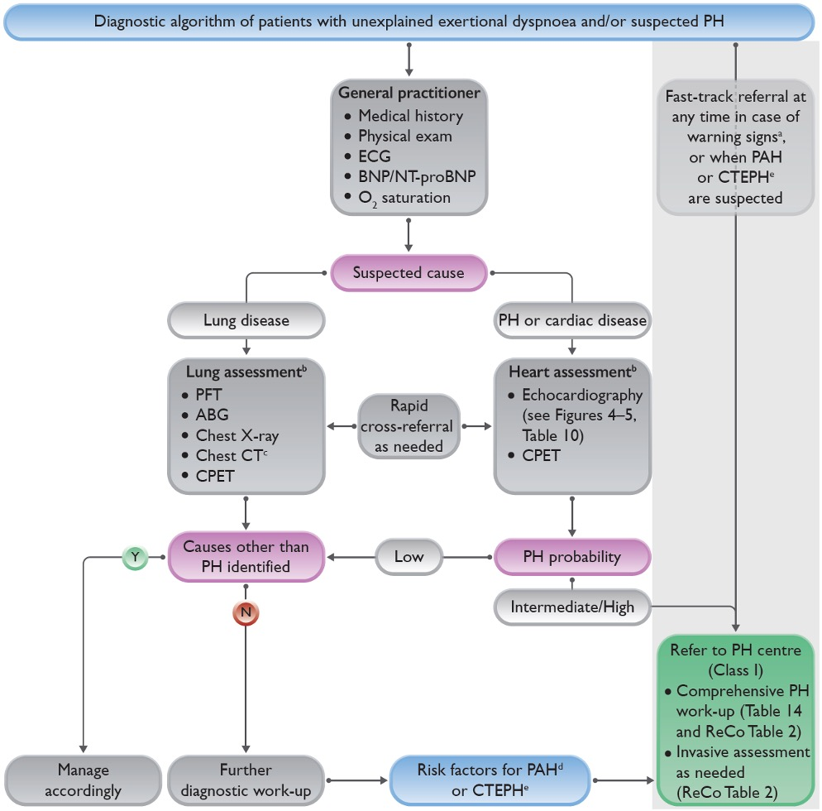
Echocardiography in the Evaluation of Dyspnea and Suspected PH
Legend
Warning signs include rapid progression of symptoms, severely reduced exercise capacity, pre-syncope or syncope on mild exertion, signs of right heart failure
Lung and heart assessment by specialist as per local practice
As indicated; CT pulmonary angiography recommended if PH suspected
Includes connective tissue disease (especially systemic sclerosis), portal hypertension, HIV infection, and family history of PAH
History of PE, permanent intravascular devices, inflammatory bowel diseases, essential thrombocythemia, splenectomy, high-dose thyroid hormone replacement, and malignancy

Slide 6
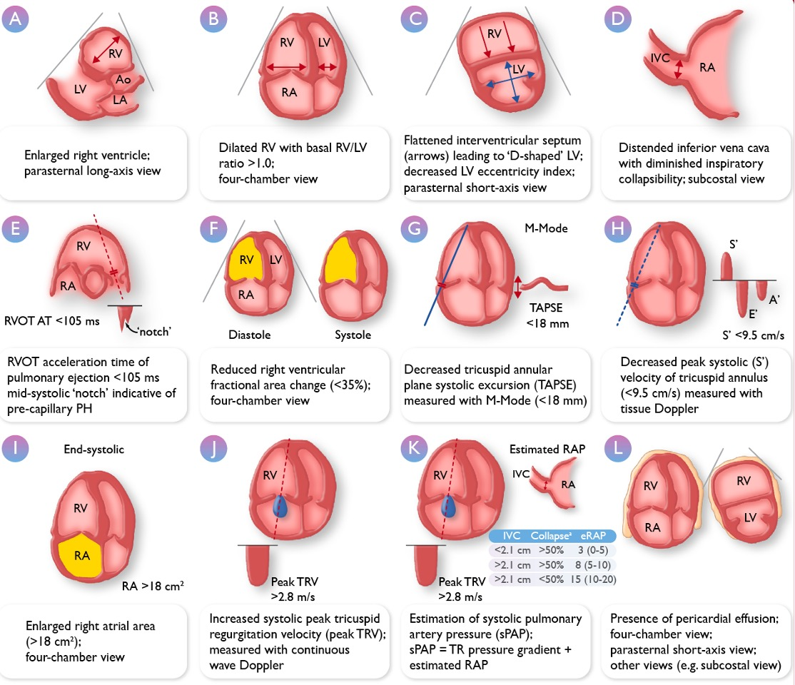
ERS/ESC 2022: Echo Parameters for Assessing PH
Echocardiography is an essential tool for assessing patients at risk for PH
Echocardiographic evidence of PH is useful to help determine when to proceed to RHC

Slide 7
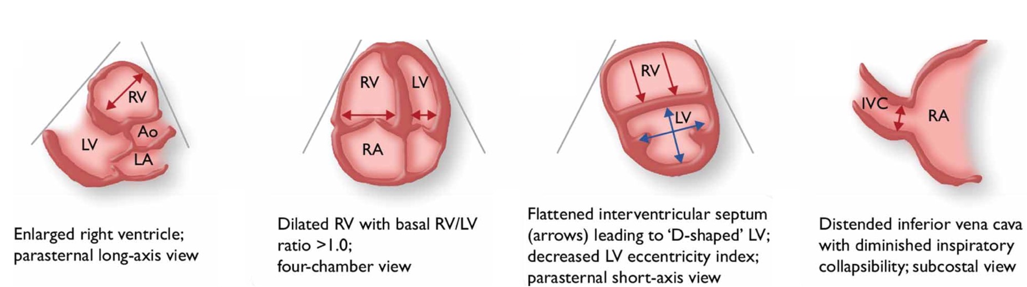
ERS/ESC 2022: Echo Parameters for Assessing PH
Echocardiography is an essential tool for assessing patients at risk for PH
Echocardiographic evidence of PH is useful to help determine when to proceed to RHC
Important Echo Measurements
Apical 4-chamber
Parasternal short axis
Tricuspid annular plane systolic excursion (TAPSE)
TR jet-based estimation of systolic pulmonary arterial pressure,

Slide 8
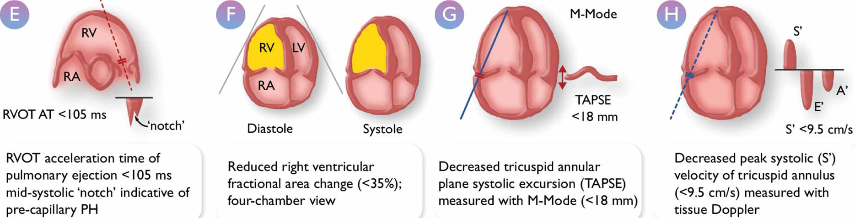
ERS/ESC 2022: Echo Parameters for Assessing PH
Important Echo Measurements
Apical 4-chamber
Parasternal short axis
Tricuspid annular plane systolic excursion (TAPSE)
TR jet-based estimation of systolic pulmonary arterial pressure

Slide 9
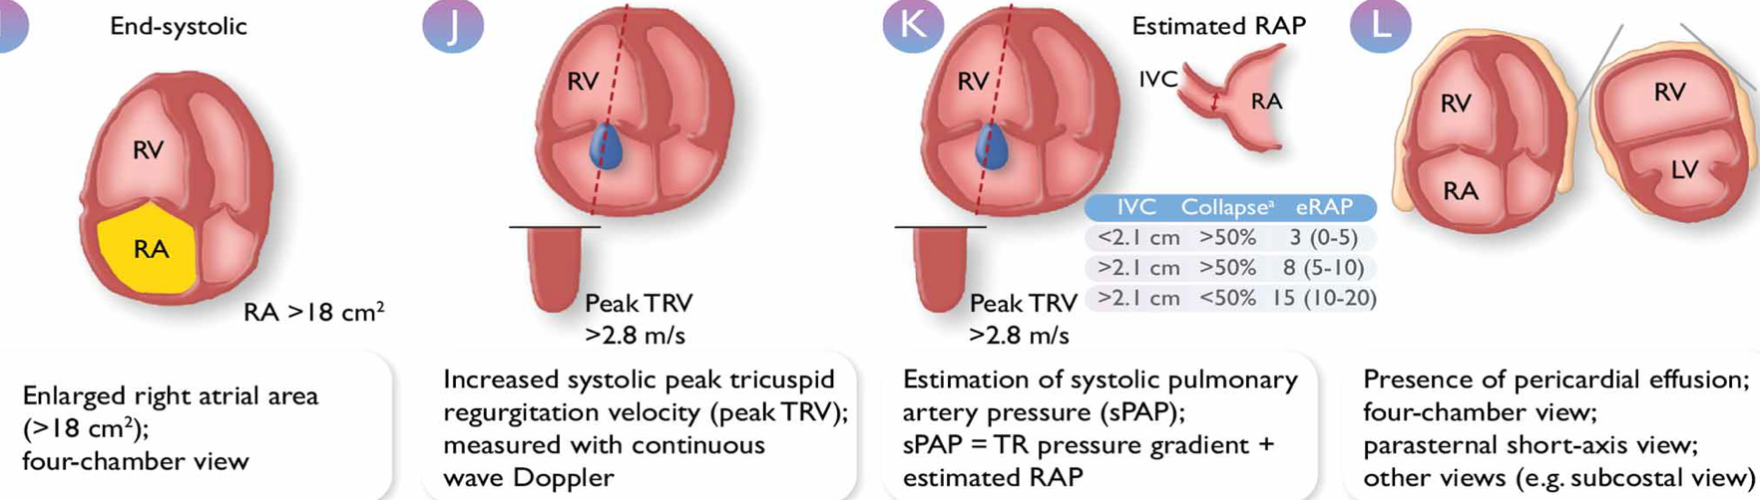
ERS/ESC 2022: Echo Parameters for Assessing PH
Important Echo Measurements
Apical 4-chamber
Parasternal short axis
Tricuspid annular plane systolic excursion (TAPSE)
TR jet-based estimation of systolic pulmonary arterial pressure

Slide 10
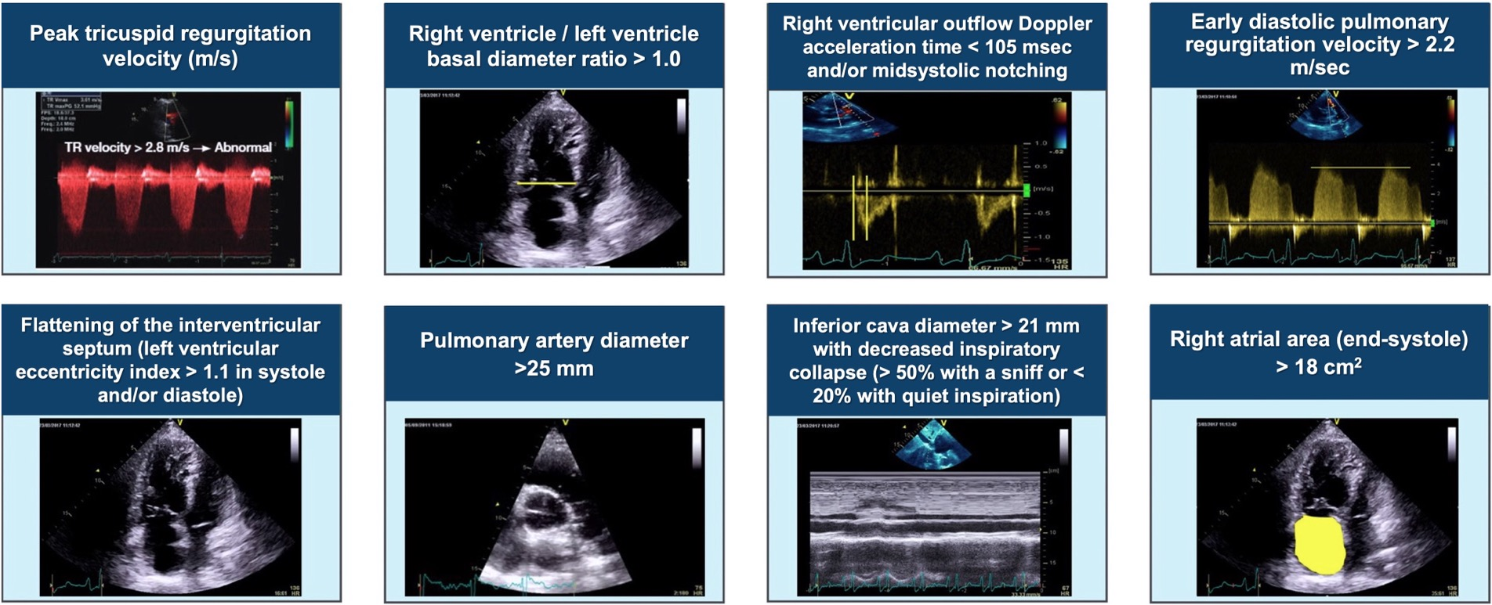
The Eight Signs of Pulmonary Hypertension

Slide 11
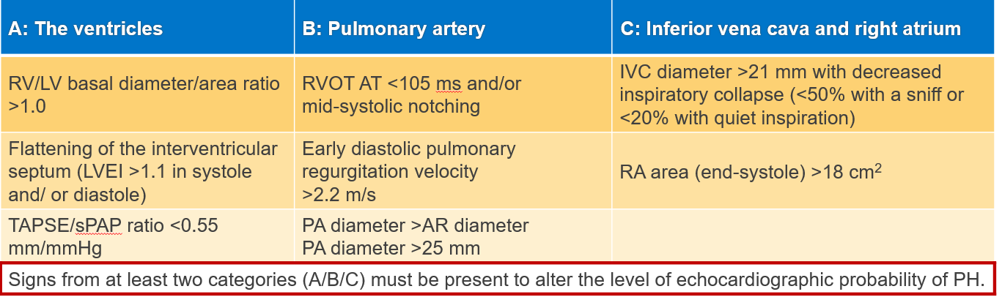
Key Features for the Diagnosis of PH/Pulmonary Vascular Disease
Peak tricuspid regurgitation velocity m・sec⁻¹ | Presence of other echocardiographic PH signs | Echocardiographic probability of PH
≤2.8 or not measurable | No | Low
≤2.8 or not measurable 2.9-3.4 | Yes No | Intermediate
2.9-3.4 >3.4 | Yes Not required | High
Central role hemodynamic measures (TRV)
Supportive signs

Slide 12
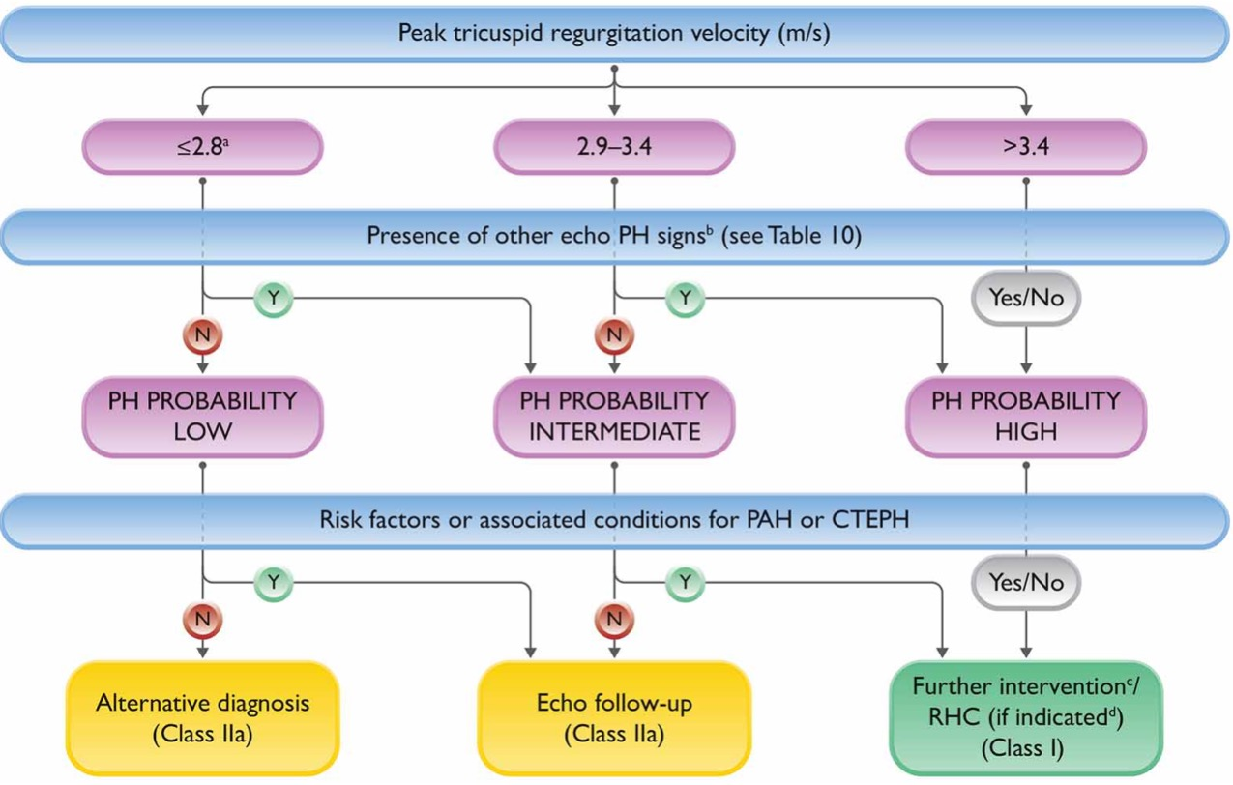
Echocardiographic Probability of PH and Recommendations for Further Assessment

Slide 13
Summary
Echocardiography is essential in the evaluation of dyspnea and suspected PH
Echocardiographic evidence of PH is useful to help determine when to proceed to RHC
Multiple echocardiographic parameters are assessed in addition to TR jet to help determine likelihood of PH
Echocardiographic parameters are employed in the current ERS/ESC PH Guidelines to trigger further assessment of PH with invasive RHC

Slide 14


Looking for more resources
on this topic?
CME/CE in minutes
Congress highlights
Late-breaking data
Quizzes
Webinars
In-person events
Slides & resources
www.MedEdOTG.com

