Slide 1
Essential Aspects of the New ERS/ESC Guidelines on PH Treatment: An Overview
Richard Channick, MD
Saul Brandman Endowed Chair in Pulmonary Arterial Hypertension
Co-Director, Pulmonary Vascular Disease Program
Director, Acute and Chronic Thromboembolic Disease Program
Professor of Medicine
Pulmonary and Critical Care Division
David Geffen School of Medicine at UCLA
Los Angeles, CA

Slide 2
Resource Information
About This Resource
These slides are one component of a continuing education program available online at MedEd On The Go titled Implementing Aggressive Treatment to Improve Risk Profiles for PH Patients
Program Learning Objectives:
Gain an understanding of the 2022 ERS/ES guidelines and algorithms developed to detect PH early in the community
Identify appropriate circumstances to implement 3 or 4 strata risk assessments
Demonstrate best practices amongst MDs on how to impact diagnosis screening for at-risk patients subject to economic disparity, lack of access to referral centers, or understudied subtypes for the disease
Enable early recognition of sub-populations of patients who are at high risk and identify appropriate screening candidates
MedEd On The Go®
www.mededonthego.com
This content or portions thereof may not be published, posted online or used in presentations without permission.
This content can be saved for personal use (non-commercial use only) with credit given to the resource authors.
To contact us regarding inaccuracies, omissions or permissions please email us at support@MedEdOTG.com

Slide 3
Disclaimer
The views and opinions expressed in this educational activity are those of the faculty and do not necessarily represent the views of Total CME, LLC, the CME providers, or the companies providing educational grants. This presentation is not intended to define an exclusive course of patient management; the participant should use their clinical judgment, knowledge, experience, and diagnostic skills in applying or adopting for professional use any of the information provided herein. Any procedures, medications, or other courses of diagnosis or treatment discussed or suggested in this activity should not be used by clinicians without evaluation of their patient's conditions and possible contraindications or dangers in use, review of any applicable manufacturer’s product information, and comparison with recommendations of other authorities. Links to other sites may be provided as additional sources of information.

Slide 4
Treatment: The Overall Strategy Is Clear
Basic principles:
Proper diagnosis: Make sure it’s PAH!
Risk assessment
Close follow-up
Combination therapy is now proven
Focus on treatment strategy: Treat to achieve low risk status

Slide 5
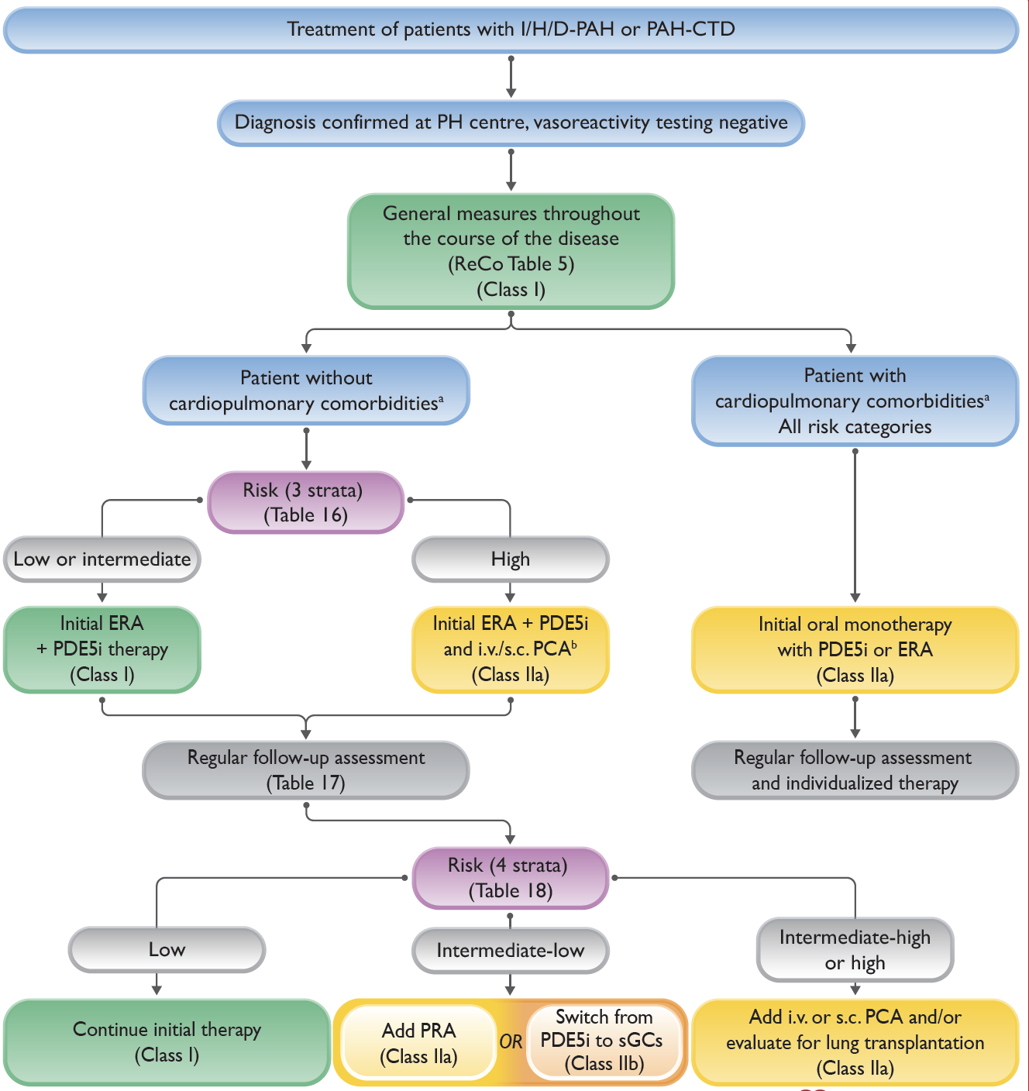
The 2022 ESC/ERS Treatment Algorithm Is Risk-based
Treatment algorithm divides management approach based on presence of cardiopulmonary comorbidities
Risk assessment and combination therapy recommended for those without comorbidities
Initial oral monotherapy recommended for those with cardiopulmonary comorbidities

Slide 6
Risk Stratification: 3 Strata For Diagnosis; 4 Strata for Management
For Diagnosis
Determinants of prognosis (estimated 1-year mortality) | Low risk (<5%) | Intermediate risk (5–20%) | High risk (>20%)
Clinical observations and modifiable variables
Signs of right HF | Absent | Absent | Present
Progression of symptoms and clinical manifestations | No | Slow | Rapid
Syncope | No | Occasional syncope | Repeated syncope
WHO-FC | I, II | III | IV
6MWD | >440 m | 165–440 m | <165 m
CPET | Peak VO₂ >15 mL/min/kg (>65% pred.) VE/VCO₂ slope <36 | Peak VO₂ 11–15 mL/min/kg (35–65% pred.) VE/VCO₂ slope 36–44 | Peak VO₂ <11 mL/min/kg (<35% pred.) VE/VCO₂ slope >44
Biomarkers: BNP or NT-proBNP | BNP <50 ng/L NT-proBNP <300 ng/L | BNP 50–800 ng/L NT-proBNP 300–1100 ng/L | BNP >800 ng/L NT-proBNP >1100 ng/L
Echocardiography | RA area <18 cm² TAPSE/sPAP >0.32 mm/mmHg No pericardial effusion | RA area 18–26 cm² TAPSE/sPAP 0.19–0.32 mm/mmHg Minimal pericardial effusion | RA area >26 cm² TAPSE/sPAP <0.19 mm/mmHg Moderate or large pericardial effusion
cMRI | RVEF >54% SVI >40 mL/m² RVESVI <42 mL/m² | RVEF 37–54% SVI 26–40 mL/m² RVESVI 42–54 mL/m² | RVEF <37% SVI <26 mL/m² RVESVI >54 mL/m²
Hemodynamics | RAP <8 mmHg CI ≥2.5 L/min/m² SVI >38 mL/m² SvO₂ >65% | RAP 8–14 mmHg CI 2.0–2.4 L/min/m² SVI 31–38 mL/m² SvO₂ 60–65% | RAP >14 mmHg CI <2.0 L/min/m² SVI <31 mL/m² SvO₂ <60%
For Management
Determinants of Prognosis | Low Risk | Intermediate-Low Risk | Intermediate-High Risk | High Risk
Points Assigned | 1 | 2 | 3 | 4
WHO-FC | I or II | --- | III | IV
6MWD, m | > 440 | 320 - 440 | 165 - 319 | < 165
BNP or NT-proBNP, ng/L | < 50 < 300 | 50 – 199 300 - 649 | 200 – 800 650 - 1100 | > 800 > 1100

Slide 7
2022 ESC/ERS Treatment Algorithm: Notable Changes
Different recommendations for PAH with comorbidities
Addition of 4 strata risk assessment on follow-up
Option of switch from PDE5i to sGCs

Slide 8
Looking for more resources on this topic?
CME/CE in minutes
Congress highlights
Late-breaking data
Quizzes
Webinars
In-person events
Slides & resources
www.MedEdOTG.com

