Slide 1
Patient Case: 65-Year-Old Man
Comes to clinic after 1 year of completion of concurrent therapy for HPV-related disease
Enrolled on clinical trial; randomized to the control arm of single-agent pembrolizumab
2 weeks after initiation of therapy, he presents with shortness of breath and clinical picture of diabetic ketoacidosis
Cardiac evaluation shows evidence of acute infarct, elevated troponins, but no evidence of coronary obstructive disease
Pembrolizumab was discontinued; he was started on steroids after which troponins normalized

Slide 2
ICI-Related Cardiotoxicities
ICI-related myocarditis and cardiac vasculitis are extremely rare complications
Cardiac MRI should be used as a diagnostic tool; monitor patients during tapering-off period from steroids or other immunosuppressive regimens
Obtain cardiogram and baseline troponin levels as a comparator should a cardiotoxic event occur

Slide 3
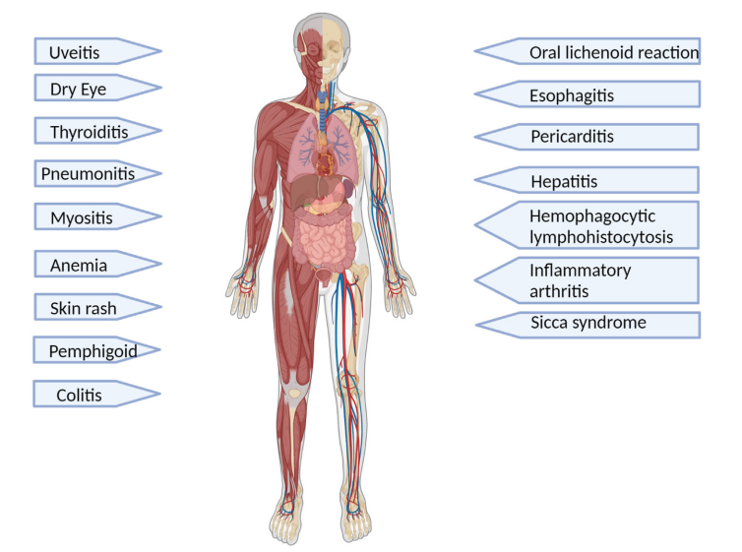
Immune-Related Adverse Events in HNSCC
Commonly reported AEs include fatigue, low-grade rash
Rare AEs include pneumonitis, diarrhea, rheumatologic complications
High-grade toxicities leading to treatment discontinuation, steroids use, or hospitalization occur in ~17% of patients

Slide 4
Management of irAEs
Educate patients and their caregivers on irAEs
If imaging or lab work show an anomaly but the patient is asymptomatic → continue pembrolizumab
For mild symptoms that do not require intervention and are not life-threatening → withhold pembrolizumab and observe
For grade 3 toxicity requiring oxygen, transfusions, etc. → withhold pembrolizumab, initiate steroids, monitor closely, and consider admitting patient
If no response to steroids within 7 days: consider mycophenolate or infliximab
If response to steroids: start tapering after 1 week and continue tapering over 1 month

Slide 5
Familiarity with irAEs is very important in the management of HNSCC

