Slide 1
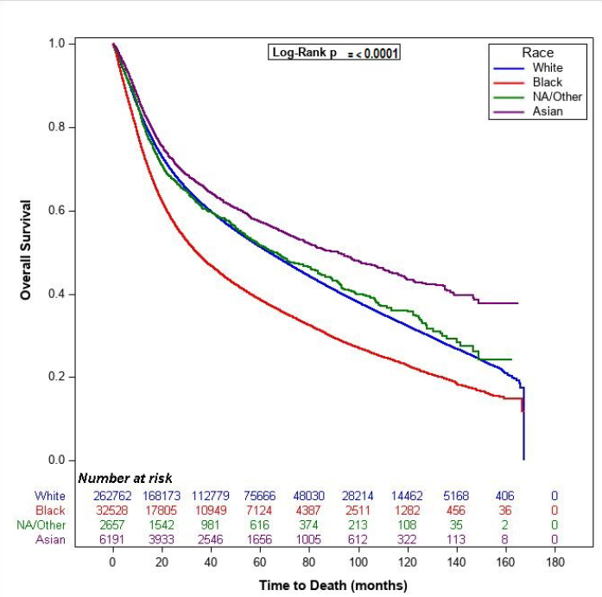
Racial/Ethnic Disparities in HNSCC
OS by Race/Ethnicity, Entire Cohort and All Sites
Population-based retrospective cohort study that analyzed patients with HNSCC using the NCDB from 2000-2016 (N = 304,138)
Patient outcomes were stratified by R/E groups including White, Black, Hispanic, Native American/Other, and Asian
Primary outcome: OS

Slide 2
Impact of SES Factors on HPV Status and OS on OPSCC
Analysis of patients diagnosed with OPSCC from 2010-2014 (N = 18,164) identified from the NCDB to assess the influence of SES factors on the relationship between HPV status and OS
Findings:
HPV+ patients with private insurance had improved OS vs uninsured HPV+ patients (HR, 0.51, 95% CI, 0.41 to 0.63, P < 0.001)
HPV- patients with private insurance had improved OS vs uninsured HPV- patients (HR, 0.62, 95% CI, 0.53 to 0.73, P < 0.001)
HPV+ patients living in the south had improved OS vs HPV+ patients living in the west (HR, 0.83, 95% CI, 0.72 to 0.96, P = 0.013)
Relationships between survival and insurance (P = 0.004), rural-urban status (P = 0.009), and facility location (P = 0.021) statistically differed between HPV+ and HPV- patients
HPV, human papillomavirus; NCDB, National Cancer Database; OPSCC, oropharyngeal squamous cell carcinoma; OS, overall survival; SES, socioeconomic status. Marks JA, et al. JCO Oncol Pract. 2021;17(3):e313-e322.

Slide 3
The Role of Patient Navigation (PN) in Cancer Care
PN is an individualized intervention designed to address barriers and facilitate timely access to healthcare services, diagnosis, treatments, and care
Characteristics:
Identifies barriers to accessing care experienced by individuals
Overcomes barriers (eg, health system, literacy, language, cultural, social, financial, logistical) experienced by individuals
Addresses disparities from contextual barriers (eg, geographical, racial/ethnic, financial, socioeconomic)
Can occur anywhere along the cancer care continuum, from early detection to end of life
Can be delivered by various personnel (including, but not limited to, the following), with or without a third-party facilitator (eg, digital technology or AI): Clinical navigators: nurses and oncology social workers Nonclinical navigators: case managers, outreach workers, community health workers/aides/representatives/ volunteers, counselors, educators, health coaches, peers, cancer survivors, and lay personnel

Slide 4
Alcohol and tobacco cessation services are an integral part of HNSCC care

Slide 5
Patient Advocacy Organizations for Head and Neck Cancer
https://spohnc.org/
https://rarediseases.org/organizations/support-for-people-with-oral-and-head-and-neck-cancer-inc/
https://www.headandneck.org/

Slide 6
Our efforts need to focus on identifying socioeconomic factors that impact outcome of patients and try to address them through focus research along those lines...
...designing clinical trials that target these specific populations and relying on, also, real-world data…
Nabil Saba, MD

