Slide 1
KEYNOTE-048 Results
OS
PD-L1 CPS ≥1
PD-L1 CPS ≥20
PD-L1 CPS ≥20
PFS
PD-L1 CPS ≥1

Slide 2
KEYNOTE-048 Subset Analyses
Unplanned subset analyses showed compared with chemotherapy + cetuximab, pembrolizumab monotherapy was:
Superior in CPS 1-19
Numerically inferior in CPS ≤1
Response rates were higher with the addition of chemotherapy vs pembrolizumab monotherapy

Slide 3
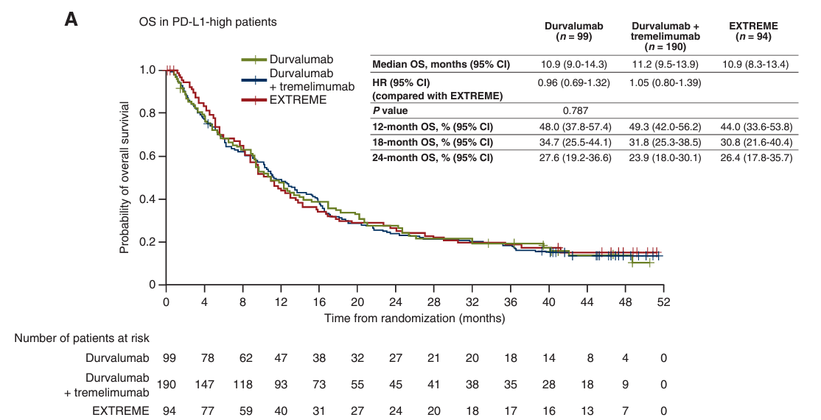
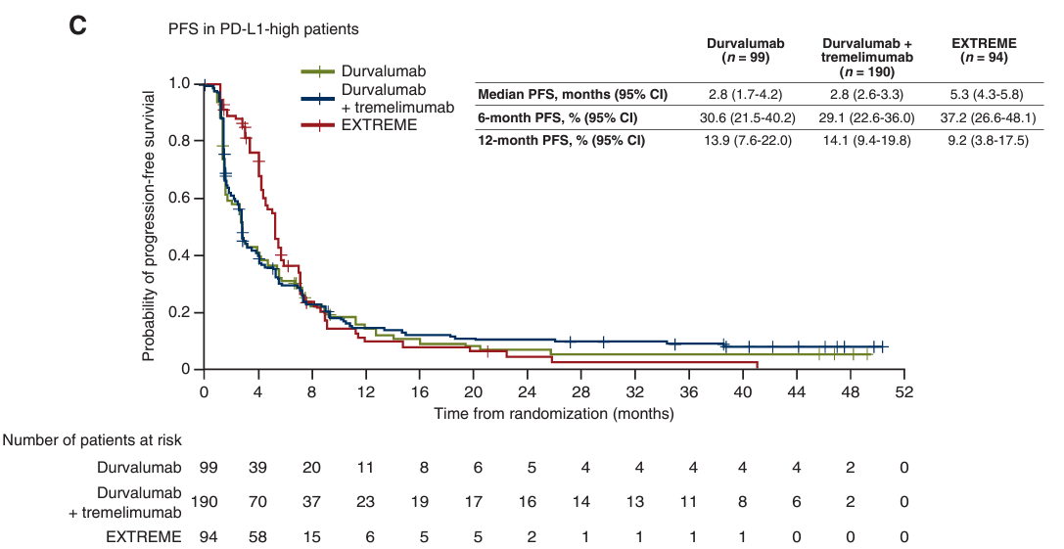
KESTREL: Durvalumab ± Tremelimumab vs EXTREME
Randomized, open-label, phase 3 study
Primary objective: To assess the OS of durvalumab monotherapy vs the EXTREME regimen in R/M HSNCC with high PD-L1 (PD-L1 TC 50% or IC 25%)
OS in PD-L1-high patients
PFS in PD-L1-high patients
OS in PD-L1-high patients

Slide 4
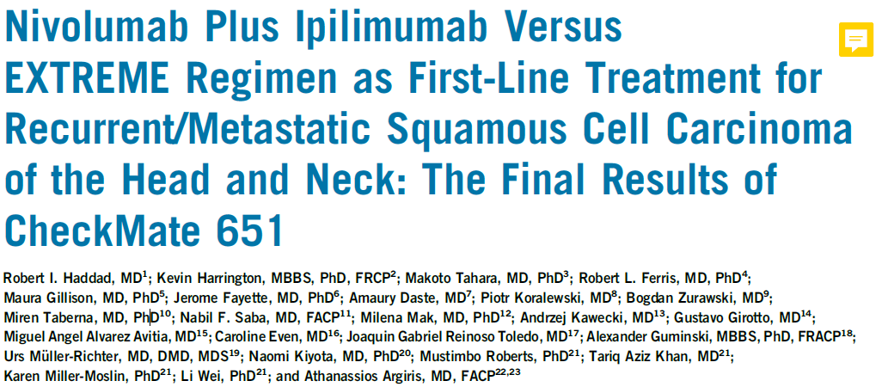

Slide 5
KEYNOTE-B10
Measure | Patients, N = 101
ORR by BICR, n (% [95% CI]) | 49 (48.5 [38.4-58.7])
CR by BICR, n (%) | 7 (6.9)
PR by BICR, n (%) | 42 (41.6)
PD-L1 CPD ≥1, n | 81
ORR by BICR, n (% [95% CI]) | 36 (44.4 [33.4-55.9])
PD-L1 CPS ≥20, n | 41
ORR by BICR, n (% [95% CI]) | 18 (43.9 [28.5-60.3])
DCR, n (% [95% CI]) | 76 (75.2 [65.7-83.3])
DOR, median (95% CI), mo | 5.5 (4.2-6.7)
PFS, median (95% CI), mo | 5.6 (5.1-6.7)
OS, median (95% CI), mo | 13.1 (9.6-15.2)
12-mo OS rate, % (95% CI) | 52.3 (42.1-61.5)
18-mo OS rate, % (95% CI) | 37.8 (27.6-47.9)
Intervention:
Pembrolizumab 200 mg IV Q3W, carboplatin AUC 5 mg/mL/min IV Q3W, and paclitaxel 175 mg/m² IV Q3W
or
100 mg/m² IV Q1W on days 1 and 8, for ≤35 cycles of pembrolizumab, ≤6 cycles of carboplatin and paclitaxel

Slide 6
FRAIL-IMMUNE
Intervention:
4 cycles of CT (carboplatin AUC2; paclitaxel 80 mg/m² both at day 1, day 8, day 15) and durvalumab 1500 mg repeated every 4 weeks for a maximum of 12 months
Measure | Patients, N = 64
Median OS, mo (95% CI) | 18.0 (11.9-NR)
24-mo rate, % (range) | 45 (32-57)
Median PFS, mo (95% CI) | 7.0 (5.4-9.9)
Median TTF, mo (95% CI) | 6.0 (4.7-9.0)
Objective response, % | 71
CR | 11.3
PR | 59.7
Median DOR, mo (95% CI) | 5.9 (3.4-9.6)

Slide 7
Investigational Regimens Without Chemotherapy
LEAP-010¹
Cabozantinib + pembrolizumab²
STELLAR-305 (zanzalintinib + pembrolizumab; phase 2/3 trial)³

Slide 8
Immunotherapy has clearly transformed the landscape and therapy in recurrent metastatic disease. And we expect this field to continue evolving rapidly, hopefully with novel combinations.
Nabil Saba, MD

