Slide 1
Biologics for the Management of IBD
Ayanna Lewis, MD
Director, Inflammatory Bowel Disease Program
Assistant Professor of Medicine, Icahn School of Medicine at Mount Sinai
Department of Medicine, Division of Gastroenterology & Hepatology
Mount Sinai West & Mount Sinai Morningside Hospitals
New York, NY

Slide 2
Resource Information
About This Resource
These slides are one component of a continuing education program available online at MedEd On The Go titled IBD: Insights for Better Decisions
Program Learning Objectives:
Identify the benefits, risks, and clinical utility of current and emerging drug therapies for patients with IBD
Discuss the implementation of IBD treatment strategies for gastroenterologists
Interpret and apply the latest guidelines for patients with IBD to improve clinical outcomes
MedEd On The Go®
www.mededonthego.com
This content or portions thereof may not be published, posted online or used in presentations without permission.
This content can be saved for personal use (non-commercial use only) with credit given to the resource authors.
To contact us regarding inaccuracies, omissions or permissions please email us at support@MedEdOTG.com

Slide 3
Disclaimer
The views and opinions expressed in this educational activity are those of the faculty and do not necessarily represent the views of Total CME, LLC, the CME providers, or the companies providing educational grants. This presentation is not intended to define an exclusive course of patient management; the participant should use their clinical judgment, knowledge, experience, and diagnostic skills in applying or adopting for professional use any of the information provided herein. Any procedures, medications, or other courses of diagnosis or treatment discussed or suggested in this activity should not be used by clinicians without evaluation of their patient's conditions and possible contraindications or dangers in use, review of any applicable manufacturer’s product information, and comparison with recommendations of other authorities. Links to other sites may be provided as additional sources of information.

Slide 4
Learning Objectives
Review available biologics for the treatment of IBD
Review mechanisms of action of biologics

Slide 5
Mechanisms of Action
The biologic mechanisms of action available for treatment of inflammatory bowel disease (IBD) include:
Anti- Integrin
Anti- Interleukin
Anti- Tumor Necrosis Factor

Slide 6
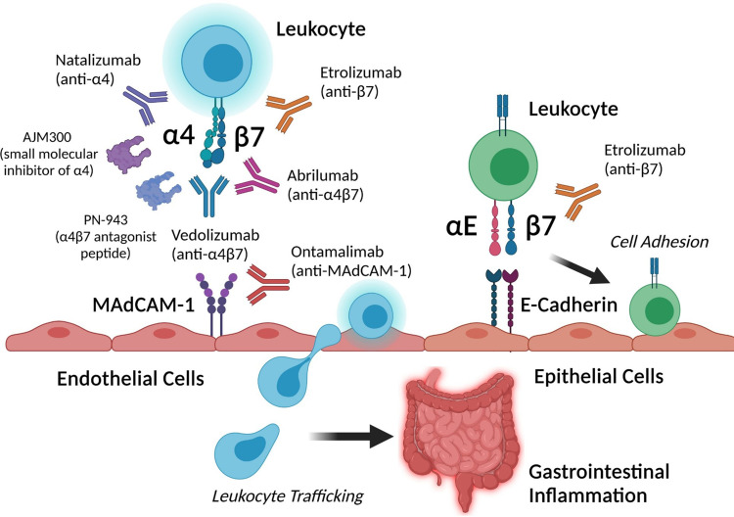
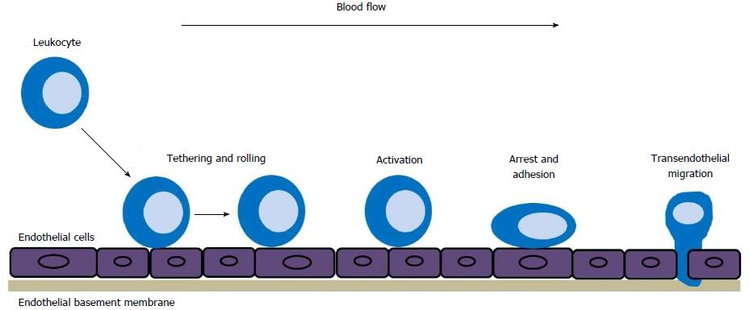
Anti- Integrin
Natalizumab (Historically)
Vedolizumab

Slide 7
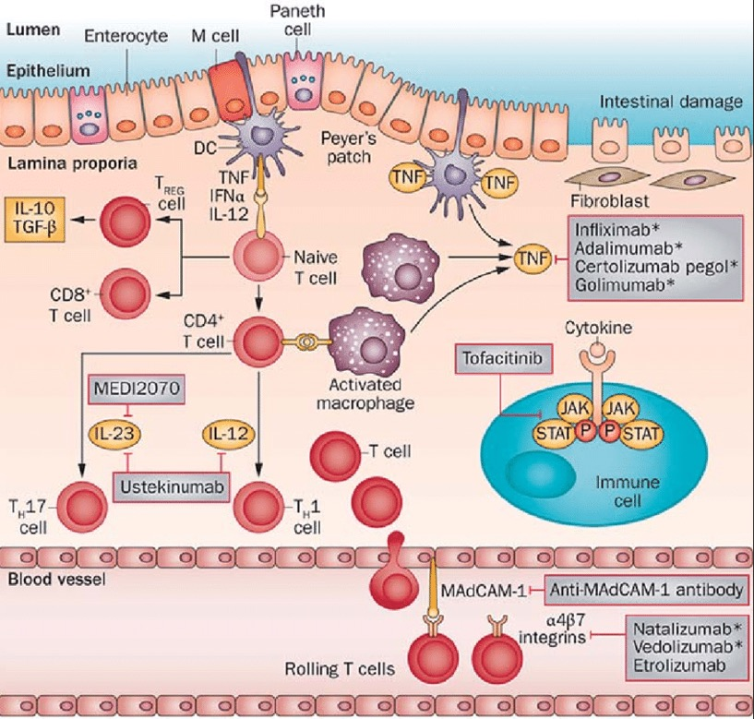
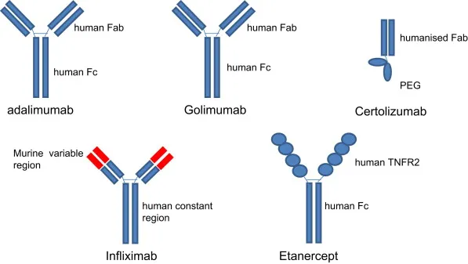
Anti- Tumor Necrosis Factor
Infliximab
Adalimumab
Golimumab
Certolizumab

Slide 8
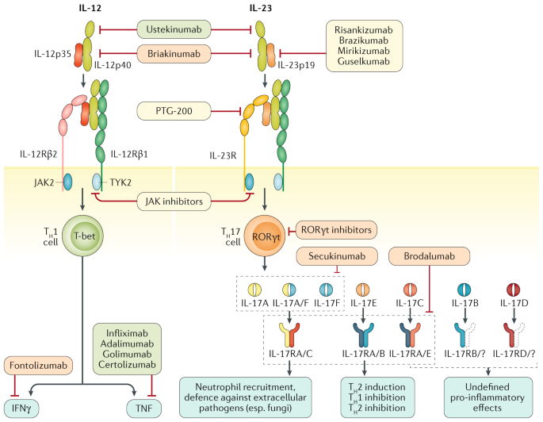
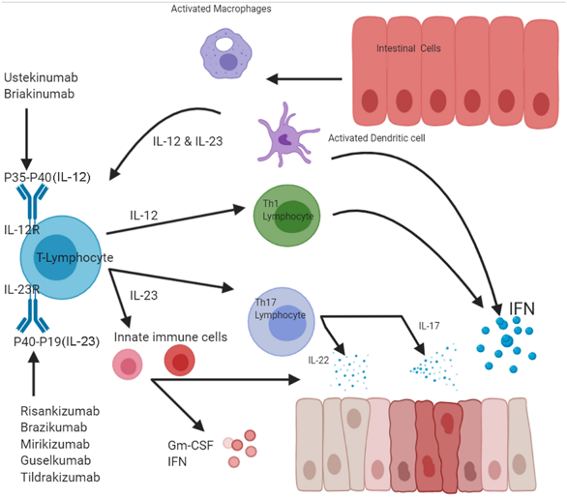
Anti- Interleukin
Ustekinumab
Rizankizumab
Mirikizumab

Slide 9
Summary
Three major biologic mechanisms of action can be utilized for the treatment of inflammatory bowel disease
The available therapies for the treatment of patients with ulcerative colitis and Crohn’s disease continue to expand

Slide 10
References
Raad, Mohamad & Chams, Nour & Sharara, Ala. (2016). New and Evolving Immunotherapy in Inflammatory Bowel Disease. Inflammatory Intestinal Diseases. 1. 10.1159/000445986.
Gubatan J, Keyashian K, Rubin SJS, Wang J, Buckman CA, Sinha S. Anti-Integrins for the Treatment of Inflammatory Bowel Disease: Current Evidence and Perspectives. Clin Exp Gastroenterol. 2021 Aug 24;14:333-342. doi: 10.2147/CEG.S293272. PMID: 34466013; PMCID: PMC8402953
Moschen, A.R., Tilg, H. & Raine, T. IL-12, IL-23 and IL-17 in IBD: immunobiology and therapeutic targeting. Nat Rev Gastroenterol Hepatol 16, 185–196 (2019). https://doi.org/10.1038/s41575-018-0084-8

Slide 11
Looking for more resources on this topic?
CME/CE in minutes
Congress highlights
Late-breaking data
Quizzes
Webinars
In-person events
Slides & resources
www.MedEdOTG.com

