Slide 1
STRIDE II Guidelines & Updates
Ayanna Lewis, MD
Director, Inflammatory Bowel Disease Program
Assistant Professor of Medicine, Icahn School of Medicine at Mount Sinai
Department of Medicine, Division of Gastroenterology & Hepatology
Mount Sinai West & Mount Sinai Morningside Hospitals
New York, NY

Slide 2
Resource Information
About This Resource
These slides are one component of a continuing education program available online at MedEd On The Go titled IBD: Insights for Better Decisions
Program Learning Objectives:
Identify the benefits, risks, and clinical utility of current and emerging drug therapies for patients with inflammatory bowel disease
Discuss the implementation of IBD treatment strategies for gastroenterologists
Interpret and apply the latest guidelines for patients with IBD to improve clinical outcomes
MedEd On The Go®
www.mededonthego.com
This content or portions thereof may not be published, posted online or used in presentations without permission.
This content can be saved for personal use (non-commercial use only) with credit given to the resource authors.
To contact us regarding inaccuracies, omissions or permissions please email us at support@MedEdOTG.com

Slide 3
Disclaimer
The views and opinions expressed in this educational activity are those of the faculty and do not necessarily represent the views of Total CME, LLC, the CME providers, or the companies providing educational grants. This presentation is not intended to define an exclusive course of patient management; the participant should use their clinical judgment, knowledge, experience, and diagnostic skills in applying or adopting for professional use any of the information provided herein. Any procedures, medications, or other courses of diagnosis or treatment discussed or suggested in this activity should not be used by clinicians without evaluation of their patient's conditions and possible contraindications or dangers in use, review of any applicable manufacturer’s product information, and comparison with recommendations of other authorities. Links to other sites may be provided as additional sources of information.

Slide 4
Learning Objectives
Discuss the updates to the 2015 STRIDE Guidelines made in 2021
Review 13 new recommendations across 4 target domains
Clinical Assessment
Endoscopic and Transmural Assessment
Biomarkers
Quality of Life and Disability
Consideration should be given for a change in therapy if the treatment targets are not met

Slide 5
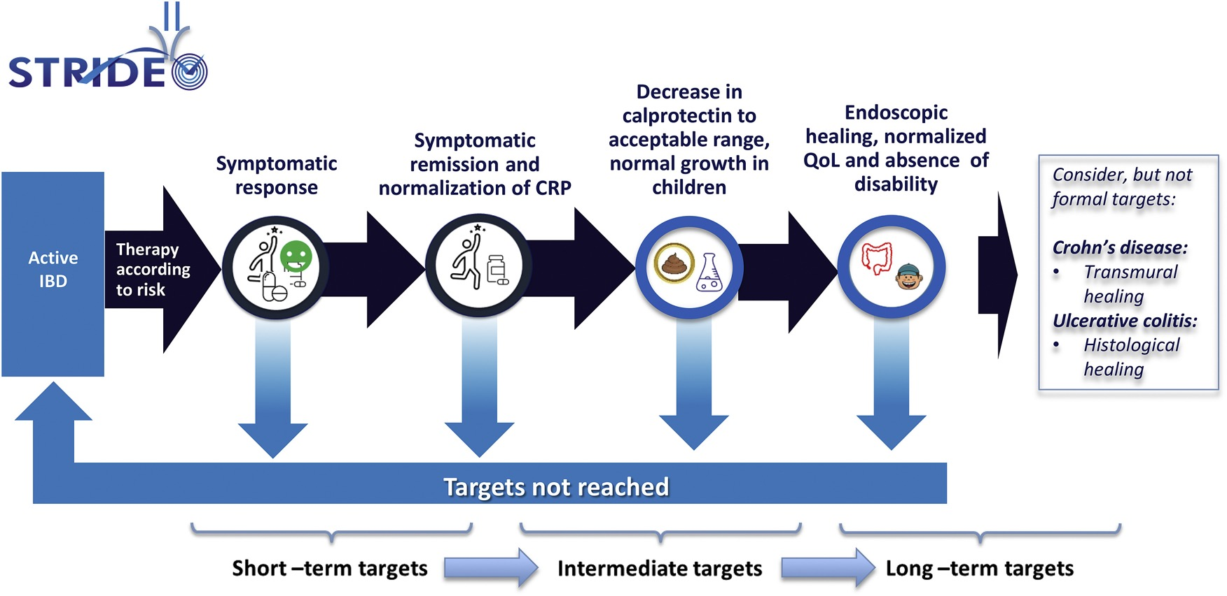

Slide 6
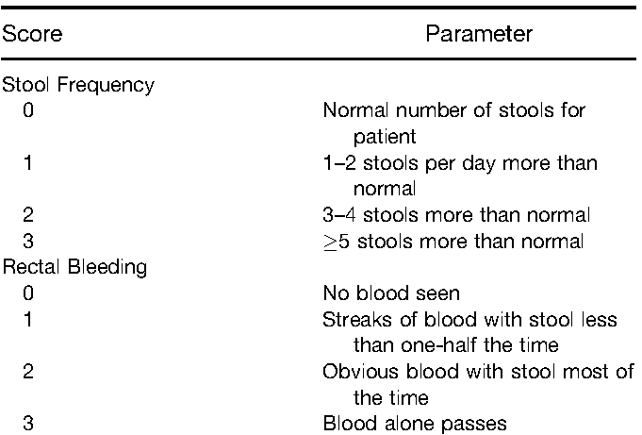
Clinical Assessment: Disease Activity Scores
Crohn’s Disease Activity Index (CDAI)
Two-Item Patient Reported Outcomes for Ulcerative Colitis (PRO2)

Slide 7
Clinical Assessment
Clinical response should be defined as:
Crohn’s Disease (CD):
In adults:
decrease of at least 50% in two-item Patient Reported Outcomes (PRO2): abdominal pain and stool frequency
In children:
decrease in the Pediatric Crohn’s Disease Activity Index (PCDAI) of at least 12.5 points
decrease in weighted Pediatric Crohn’s Disease Activity Index (wPCDAI) of at least 17.5 points
Ulcerative Colitis (UC):
In adults:
decrease of at least 50% in PRO2: rectal bleeding and stool frequency
In children:
decrease in Pediatric Ulcerative Colitis Activity Index (PUCAI) of at least 20 points

Slide 8
Clinical Assessment
Clinical remission should be defined as:
CD:
In adults
PRO2 (abdominal pain ≤1 and stool frequency ≤3) or HBI <5
In children
PCDAI (<10 points or <7.5 excluding the height item) or wPCDAI (<12.5 points)
UC:
In adults
PRO2 (rectal bleeding=0 and stool frequency=0) or partial Mayo (<3 and no score >1)
In children
PUCAI <10 points

Slide 9
Clinical Assessment
Clinical response is an immediate treatment target
Clinical remission is an intermediate treatment target
In children, restoration of normal growth is a long-term treatment target
Clinical response or remission are insufficient to be used as long-term treatment targets

Slide 10
Endoscopic and Transmural Assessment
Endoscopic healing should be measured by:
CD:
SES-CD <3 points or absence of ulcerations (e.g. SES-CD ulceration subscores = 0)
UC:
Mayo endoscopic subscore = 0 points, or UCEIS ≤1 points
Endoscopic healing is a long-term target
Assessment of endoscopic healing can be achieved by sigmoidoscopy or colonoscopy. When not feasible, alternatives in CD can be capsule endoscopy or balloon enteroscopy

Slide 11
Endoscopic and Transmural Assessment
Histologic remission is not a treatment-target in either CD or UC. Nonetheless, in UC it could be used as an adjunct to endoscopic remission to represent a deeper level of healing
Transmural healing (assessed by CTE, MRE, or bowel ultrasound) is not a treatment-target in either CD or UC. Nonetheless, in CD it should be used as an adjunct to endoscopic remission to represent a deeper level of healing

Slide 12
Biomarkers
Normalization of biomarkers is an is an intermediate treatment target in UC and CD.
These include:
C Reactive Protein (CRP) to values under the upper limit of normal
Fecal Calprotectin (to 100–250 μg/g)
Turner D, et al. Gastroenterology. 2021; 160(5):1570-83.

Slide 13
Quality of Life and Disability
Absence of disability is a long-term treatment target
Normalized health-related quality of life is a long-term treatment target

Slide 14
Summary
A Treat to target approach should be employed across the domains of:
Clinical Assessment
Endoscopic and Transmural Assessment
Biomarkers
Quality of Life and Disability
Consideration should be given for changes in therapy if targets are not met in short-term, intermediate or long-term assessments of inflammatory bowel disease response

Slide 15
Looking for more resources on this topic?
CME/CE in minutes
Congress highlights
Late-breaking data
Quizzes
Webinars
In-person events
Slides & resources
www.MedEdOTG.com

