Slide 1
IBD & The Evolution of Targeted Therapies – How Far Have We Come?
Ugo Iroku, MD, MHS
Clinical Assistant Professor
Mount Sinai Hospital
New York, NY

Slide 2
Resource Information
About This Resource
These slides are one component of a continuing education program available online at MedEd On The Go titled IBD: Insights for Better Decisions
Program Learning Objectives:
Identify the benefits, risks, and clinical utility of current and emerging drug therapies for patients with inflammatory bowel disease
Discuss the implementation of IBD treatment strategies for gastroenterologists
Interpret and apply the latest guidelines for patients with IBD to improve clinical outcomes
MedEd On The Go®
www.mededonthego.com
This content or portions thereof may not be published, posted online or used in presentations without permission.
This content can be saved for personal use (non-commercial use only) with credit given to the resource authors.
To contact us regarding inaccuracies, omissions or permissions please email us at support@MedEdOTG.com

Slide 3
Disclaimer
The views and opinions expressed in this educational activity are those of the faculty and do not necessarily represent the views of Total CME, LLC, the CME providers, or the companies providing educational grants. This presentation is not intended to define an exclusive course of patient management; the participant should use their clinical judgment, knowledge, experience, and diagnostic skills in applying or adopting for professional use any of the information provided herein. Any procedures, medications, or other courses of diagnosis or treatment discussed or suggested in this activity should not be used by clinicians without evaluation of their patient's conditions and possible contraindications or dangers in use, review of any applicable manufacturer’s product information, and comparison with recommendations of other authorities. Links to other sites may be provided as additional sources of information.

Slide 4
Learning Objectives
Identify the benefits, risks, and clinical utility of current and emerging drug therapies for patients with inflammatory bowel disease

Slide 5
Inflammatory Bowel Disease (IBD) Therapies Timeline (1)

Slide 6
IBD Therapies Timeline (2)

Slide 7
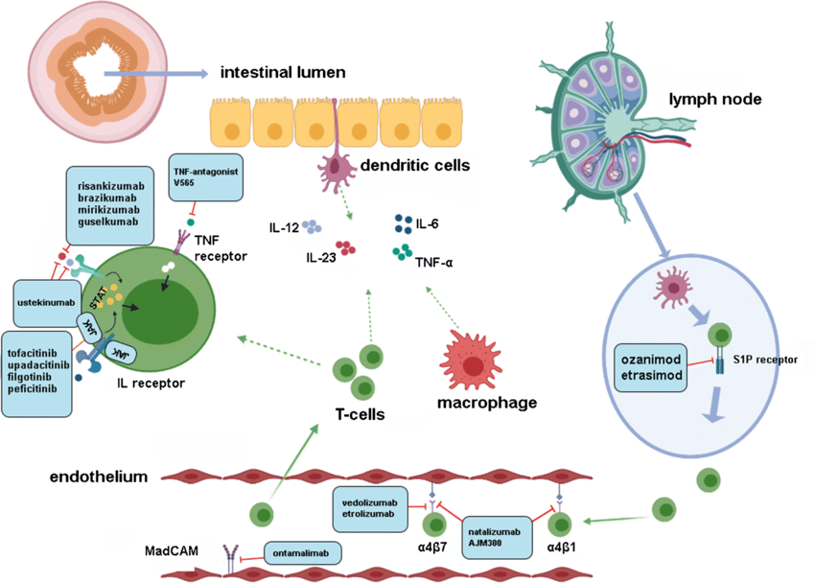
Broad & Targeted IBD Therapy Mechanisms of Action

Slide 8
Broad & Targeted IBD Therapy Mechanisms of Action

Slide 9
FDA Approved Therapies for IBD
Anti-TNF’s
S1P Receptor Modulators
JAK-STAT inhibitors
IL23 Selective Inhibitors
Infliximab
Adalimumab
Certolizumab
Golimumab
Ozanimod
Etrasimod
Upadacitnib
Tofacitinib
Risankizumab
Mirikizumab

Slide 10
Anti-TNF Broad Mechanism of Action

Slide 11
Broad & Targeted IBD Therapy Mechanisms of Action

Slide 12
Broad & Targeted IBD Therapy Mechanisms of Action

Slide 13
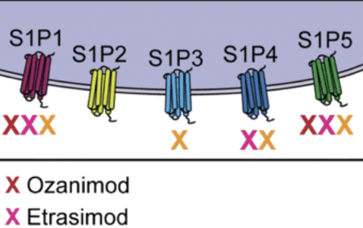
Slide 5 – S1P Receptor Modulators

Slide 14
FDA Approved S1P Receptor Modulators
Anti-TNF’s
S1P Receptor Modulators
JAK-STAT inhibitors
IL23 Selective Inhibitors
Infliximab
Adalimumab
Certolizumab
Golimumab
Ozanimod
Etrasimod
Upadacitnib
Tofacitinib
Risankizumab
Mirikizumab

Slide 15
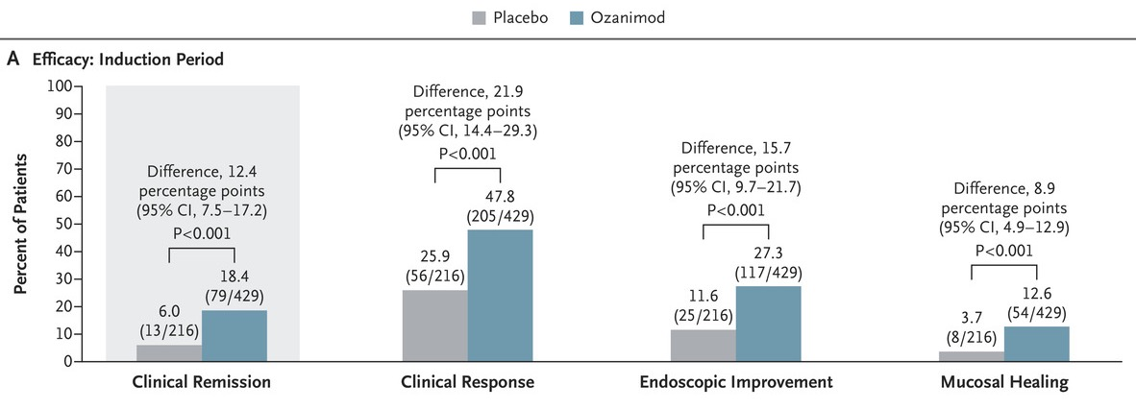
Ozanimod in UC: True North Study

Slide 16
Etrasimod in UC: ELEVATE Study

Slide 17
Broad & Targeted IBD Therapy Mechanisms of Action

Slide 18
Broad & Targeted IBD Therapy Mechanisms of Action

Slide 19
FDA Approved JAK-STAT inhibitors
Anti-TNF’s
S1P Receptor Modulators
JAK-STAT inhibitors
IL23 Selective Inhibitors
Infliximab
Adalimumab
Certolizumab
Golimumab
Ozanimod
Etrasimod
Upadacitnib
Tofacitinib
Risankizumab
Mirikizumab

Slide 20
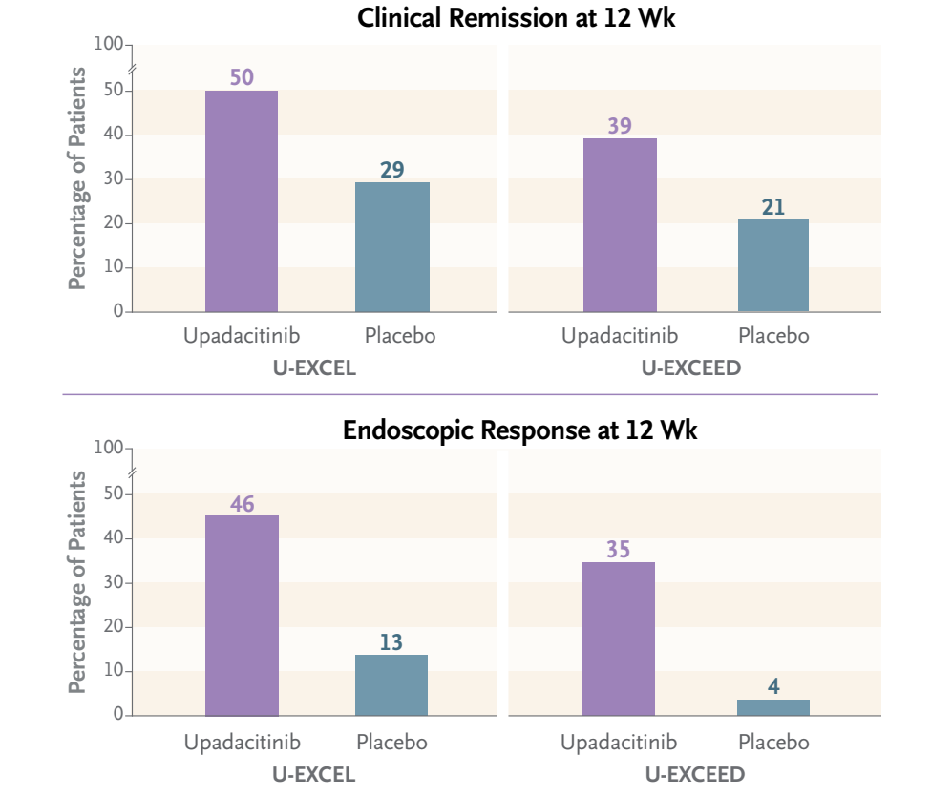
Upadacitinib in Crohn’s Disease

Slide 21
Upadacitinib – JAK Kinase Inhibitor

Slide 22
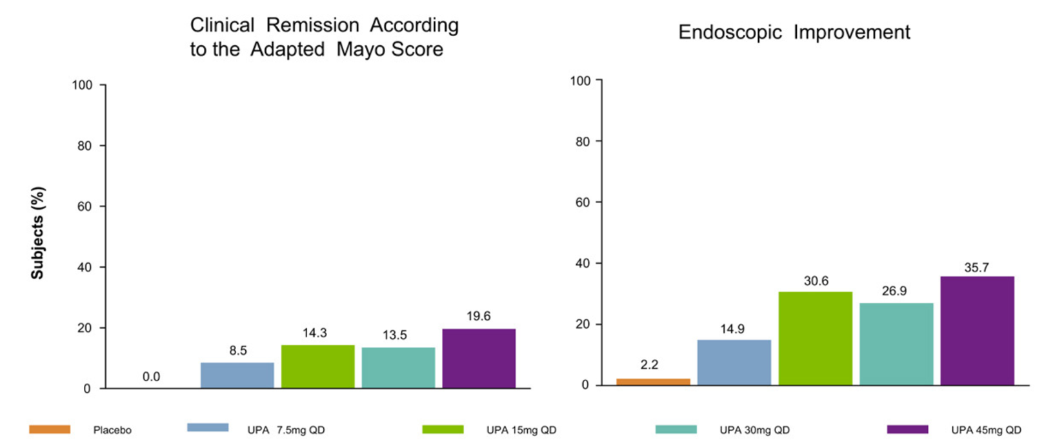
Upadacitinib in Ulcerative Colitis

Slide 23
Broad & Targeted IBD Therapy Mechanisms of Action

Slide 24
Broad & Targeted IBD Therapy Mechanisms of Action

Slide 25
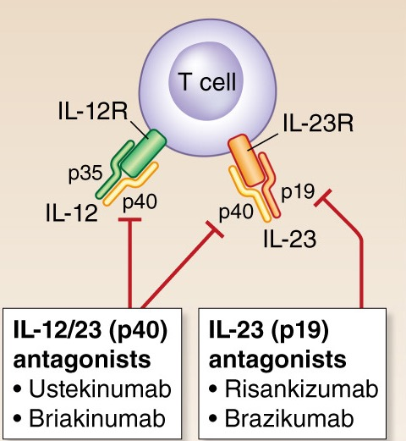
Risankizumab Mechanism of Action

Slide 26
Risankizumab – IL23 Inhibitor

Slide 27
FDA Approved IL23 Selective Inhibitors
Anti-TNF’s
S1P Receptor Modulators
JAK-STAT inhibitors
IL23 Selective Inhibitors
Infliximab
Adalimumab
Certolizumab
Golimumab
Ozanimod
Etrasimod
Upadacitnib
Tofacitinib
Risankizumab
Mirikizumab

Slide 28
Risankizumab in Crohn’s Disease

Slide 29
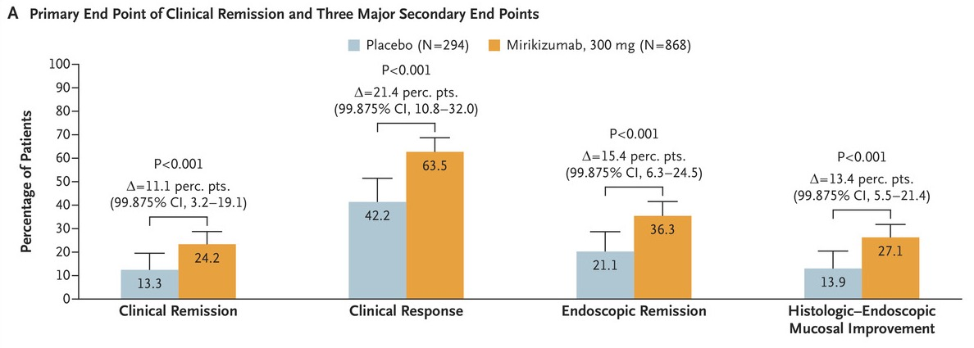
Mirakizumab in Ulcerative Colitis

Slide 30
Summary
New treatment mechanisms of actions are now available for treating Crohn’s and ulcerative colitis
These include increasingly targeted biological therapies such as IL-23 specific blockers
New and effective oral small molecule treatments are available for both ulcerative colitis and Crohn’s

Slide 31
Looking for more resources on this topic?
CME/CE in minutes
Congress highlights
Late-breaking data
Quizzes
Webinars
In-person events
Slides & resources
www.MedEdOTG.com

