Slide 1

Holding Court in Pulmonary Hypertension:
Should All Adult Fontan Patients Be Placed on PAH Group 1 Therapy?
Richard Krasuski, MD (Presiding Judge) Professor of Medicine and Pediatrics Director, Adult Congenital Heart Disease Center Director, Hemodynamic Research Director, Interventional CTEPH Program Duke University Medical Center Durham, NC | Jamil A. Aboulhosn, MD (Prosecuting Attorney) Director, Ahmanson/UCLA Adult Congenital Heart Disease Center University of California Los Angeles Los Angeles, CA | Joseph Kay, MD (Defense Attorney) Professor of Pediatrics and Internal Medicine Colorado’s Adult and Teen Congenital Heart (CATCH) Program Director Children’s Hospital Colorado Aurora, CO
Alexander Opotowsky, MD, MMSc (Prosecution Witness) Director, Adult Congenital Heart Disease Program Co-Director, Exercise Laboratory Co-Director, The Heart Institute Research Core Professor, UC Department of Pediatrics Cincinnati Children’s Hospital Medical Center Cincinnati, OH | Wayne J. Franklin, MD, FACC (Defense Witness) Co-Director, Center for Heart Care Associate Director, Adult Congenital Heart Disease Program Robinson Family Endowed Chair, Center for Heart Care Phoenix Children's Hospital Phoenix, AZ | Jean Elwing, MD (Bailiff) Professor of Medicine Director, Pulmonary Hypertension Program Division of Pulmonary, Critical Care and Sleep Medicine University of Cincinnati Cincinnati, OH

Slide 2
Disclaimer
The views and opinions expressed in this educational activity are those of the faculty and do not necessarily represent the views of TotalCME, Inc., the CME providers, or the companies providing educational grants. This presentation is not intended to define an exclusive course of patient management; the participant should use their clinical judgment, knowledge, experience, and diagnostic skills in applying or adopting for professional use any of the information provided herein. Any procedures, medications, or other courses of diagnosis or treatment discussed or suggested in this activity should not be used by clinicians without evaluation of their patient's conditions and possible contraindications or dangers in use, review of any applicable manufacturer’s product information, and comparison with recommendations of other authorities. Links to other sites may be provided as additional sources of information.

Slide 3
Learning Objectives
Understand the fundamental aspects of adult congenital heart disease with univentricular physiology
Debate the hemodynamic aspects of Fontan physiology and its failure
Review current information on the use of Group 1 vasodilator therapies in the adult Fontan patient
Discuss the negative aspects of Group 1 vasodilator therapy in the adult Fontan patient

Slide 4
Judge’s Opening Remarks
Should All Adult Fontan Patients Be Placed on PAH Group 1 Therapy?

Slide 5
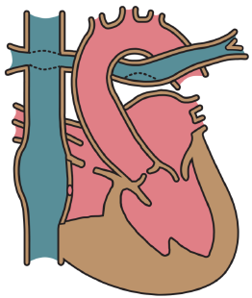
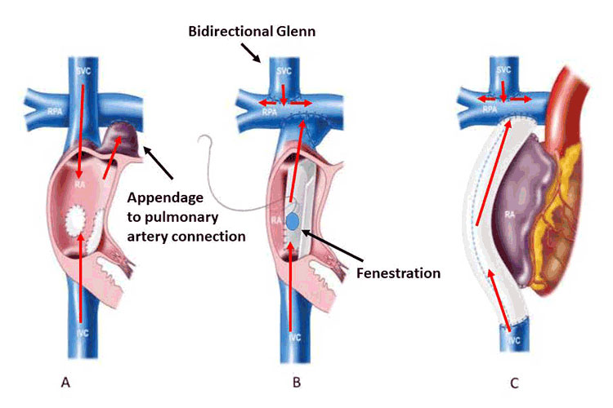
Fontan Circulation and Risks for PAH
Fontan Operation & Pulmonary Vascular Disease (PVD without PAH)
Fontan operation: For patients with complex CHD unsuitable for biventricular repair, separates the systemic from pulmonary circulation by directing systemic venous return to the pulmonary artery, without an interposed subpulmonary ventricle
Radical but palliative procedure associated with many late complications and limited surgical alternatives
Pulmonary blood flow and cardiac output are dependent on low PVR, especially because there is no subpulmonary ventricle
Lacking an effective ventricle, even a slight increase in PVR could result in low cardiac output with extravascular fluid accumulation and hepatic congestion associated with increased mortality

Slide 6
Witness for the Prosecution
Should All Adult Fontan Patients Be Placed on PAH Group 1 Therapy?

Slide 7
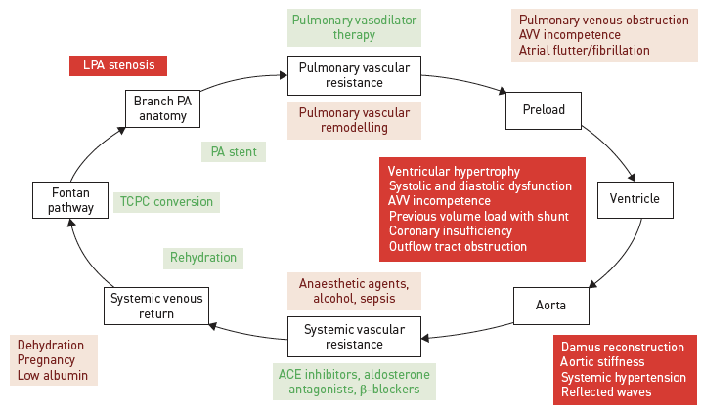
Challenges and Management Strategies in the Fontan Circulation
LPA: left pulmonary artery
PA: pulmonary artery
AVV: atrioventricular valve
ACE: angiotensin-converting enzyme
TCPC: total cavopulmonary connection

Slide 8
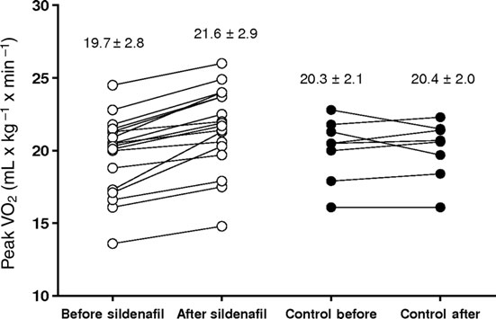
Sildenafil Effects on Hemodynamic Response to Exercise and Exercise Capacity in Fontan Patients
Patients underwent a baseline exercise test with noninvasive measurement of cardiac index (CI) and pulmonary blood flow (PBF) index, and peak exercise oxygen uptake (VO₂)
After the baseline test, patients were randomly assigned to receive either a single 0.7 mg/kg body weight oral dose of sildenafil citrate (n=18) or no treatment (control group, n=9)
After 1 hour of rest, all patients performed a second exercise test
In Fontan patients, a single oral dose of the PDE-5 inhibitor sildenafil might acutely improve exercise capacity and increase pulmonary blood flow and CI, both at rest and during exercise

Slide 9
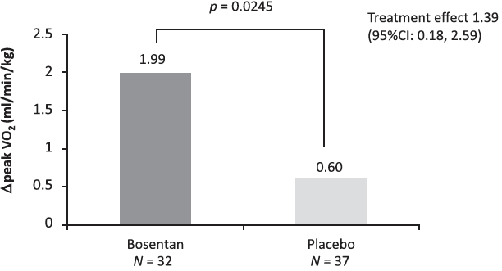
Bosentan Improves Exercise Capacity in Adolescents and
Adults After Fontan Operation (TEMPO)
Scandinavian study of 75 adolescents and adults randomized 1:1 to 14 weeks of treatment with bosentan (62.5 mg bid/2 weeks, followed by 125 mg bid/12 weeks) or placebo
Peak oxygen consumption increased significantly by 2.0 mL·kg⁻¹·min⁻¹ (from 28.7 to 30.7 mL·kg⁻¹·min⁻¹) in the bosentan group compared with 0.6 mL·kg⁻¹·min⁻¹ (from 28.4 to 29.0 mL·kg⁻¹·min⁻¹) in the placebo group (P=0.02)
Cardiopulmonary exercise test time also increased by 0.48 minute (from 6.79 to 7.27 minutes) versus 0.08 minute (from 6.94 to 7.02 minutes; P=0.04)
Nine bosentan-treated patients improved 1 functional class, whereas none improved in the placebo group (P=0.0085)

Slide 10
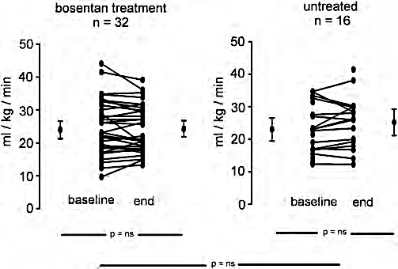
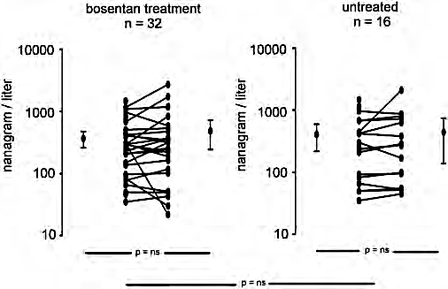
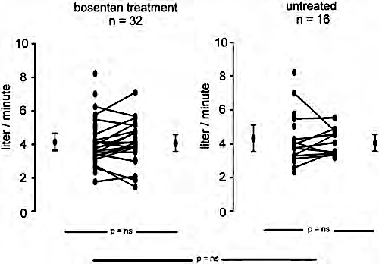
Bosentan Shows No Efficacy on O₂ Consumption in Fontan Patients
O₂ Consumption
NT-proBNP
Cardiac Output
bosentan treatment
n = 32
untreated
n = 16
bosentan treatment
n = 32
untreated
n =16
bosentan treatment
n = 32
untreated
n = 16
50
50
10000
10000
10
10
40
40
8
8
30
1000
1000
30
ml / kg / min
6
6
ml / kg / min
nanagram / liter
nanagram / liter
liter / minute
liter / minute
20
20
4
4
10
100
100
10
2
2
0
baseline
end
0
baseline
end
10
10
0
0
p = ns
p = ns
p = ns
p = ns
p = ns
p = ns
p = ns
p = ns
p = ns
Prospective, multicenter randomized open label trial in 42 Fontan patients
One group received bosentan for 6 months
Other group did not receive study medication for the first 3 months, followed by bosentan for 6 months
Primary endpoint was exercise capacity; primary endpoint was not met
Secondary endpoints: NT-proBNP level, cardiac output, SF-36 (Short Form-36) quality of life (QoL), and NYHA class

Slide 11
Witness for the Defense
Should All Adult Fontan Patients Be Placed on PAH Group 1 Therapy?

Slide 12
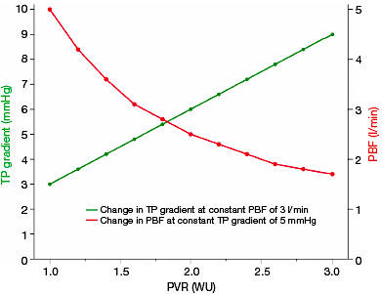
Relation Between Pulmonary Blood Flow (PBF), Pulmonary Vascular Resistance (PVR) and Central Venous Pressure (CVP)
In theory, there is a strong linear relationship between CVP and transpulmonary gradient (TP)
If PVR increases in Fontan patients, the TP will increase if pulmonary blood flow is constant (green line)
Changes of CVP in relation to PVR are dependent on PBF
Small increments in PVR can result in a significant reduction of PBF (red line)
In extreme cases, CVP can be in a normal range for Fontan patients with low cardiac output despite elevated PVRi

Slide 13
PVR: Does It Rise After Fontan, or Not?
PVRI Plotted Against Time After Operation Shows No Correlation¹
Pretransplantation and posttransplantation pulmonary hemodynamics²
 | Early Fontan |  | Late Fontan |  | All Patients
 | n | Mean ± SD | n | Mean ± SD | n | Mean ± SD
Mean PAP (mm Hg)
Pretransplantation | 4 | 17.0 ± 5.0 | 11 | 16.7 ± 3.3 | 15 | 16.8 ± 3.6
Posttransplantation | 4 | 17.8 ± 4.0 | 10 | 20.8 ± 2.4 | 14 | 19.9 ± 3.3
Mean TPG (mm Hg)
Pretransplantation | 4 | 6.0 ± 2.0 | 10 | 4.5 ± 2.8 | 14 | 4.9 ± 2.8
Posttransplantation | 4 | 10.5 ± 1.7 | 10 | 12.8 ± 2.0 | 14 | 12.1 ± 1.4
Mean PVR (Wood units · m²)
Pretransplantation | 4 | 2.1 ± 1.4 | 5 | 1.5 ± 0.7 | 8 | 1.7 ± 0.6
Posttransplantation | 4 | 2.0 ± 0.4 | 10 | 3.8 ± 0.8 | 14 | 3.3 ± 1.7
5
4
3
PVRI Wu.m2
2
1
0
0
2
4
6
8
10
12
14
16
Time after operation (yrs)
Patient age and postoperative follow-up duration had no correlation with PVRI
Mild-to-moderate pulmonary vascular disease was evident after heart transplantation for late failure

Slide 14
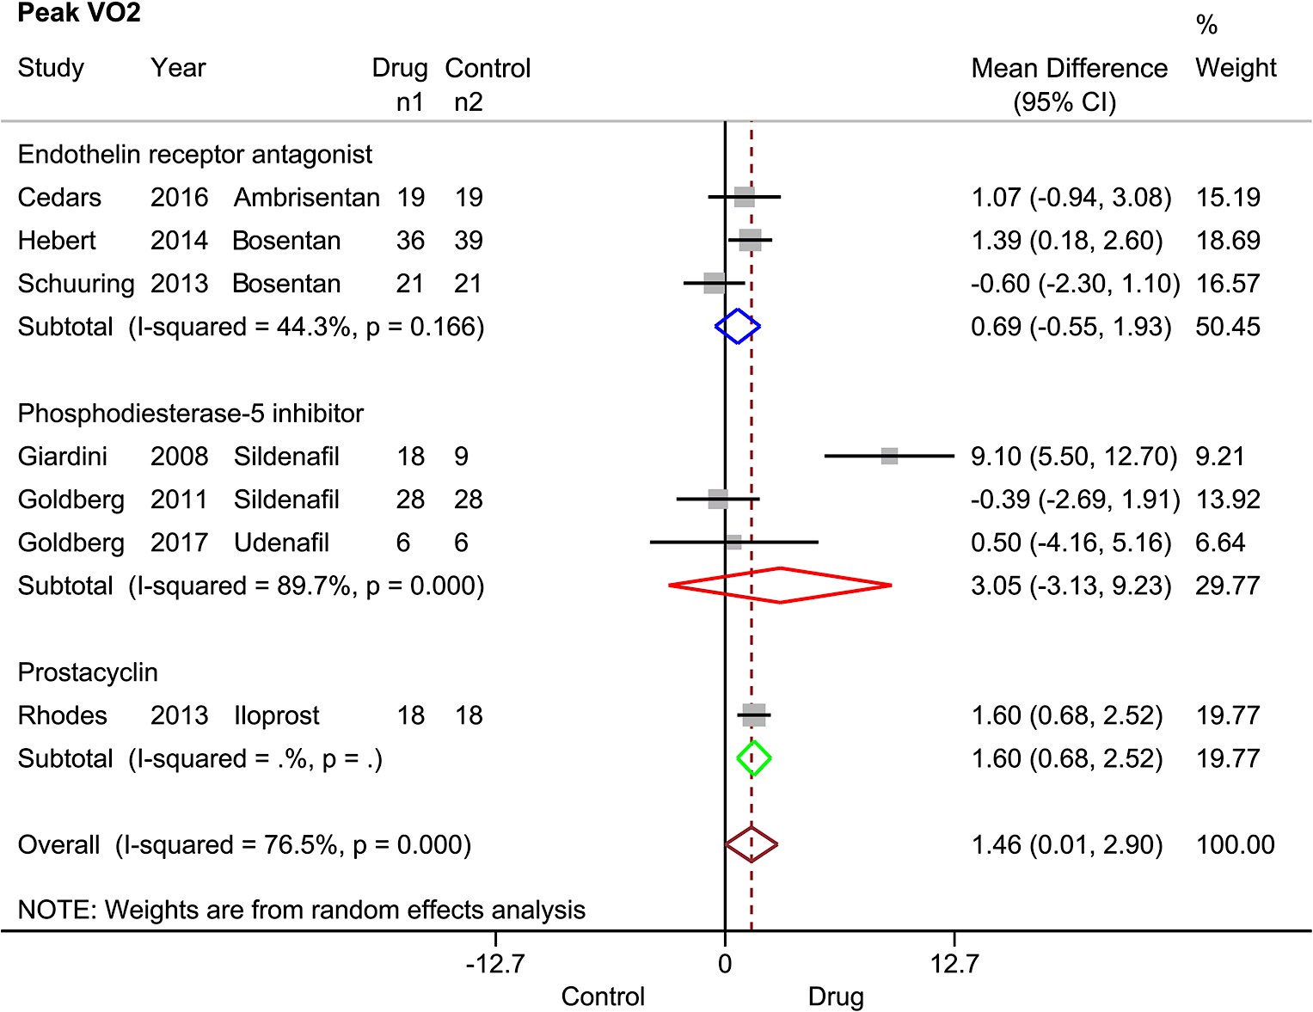
Meta-Analysis: Vasodilators Do Not Provide Clinical Benefit in Fontan Patients – Peak VO₂
Comparisons of the Changes Before and After Administration Between the Drug and Control Groups
The total pooled estimates of peak VO₂ showed marginal changes between the drug and control groups
However, except for prostacyclin (iloprost), no significant changes were noted in the other two drug subgroups (PDE-5 inhibitors and ERAs)
Although safe and well-tolerated, pulmonary vasodilator therapy does not appear to be beneficial in patients after the Fontan procedure in regard to pulmonary resistance, heart function, or quality of life
With the exception of iloprost, no significant evidence could confirm that other pulmonary vasodilators could improve exercise capacity in Fontan patients
Peak VO₂

Slide 15
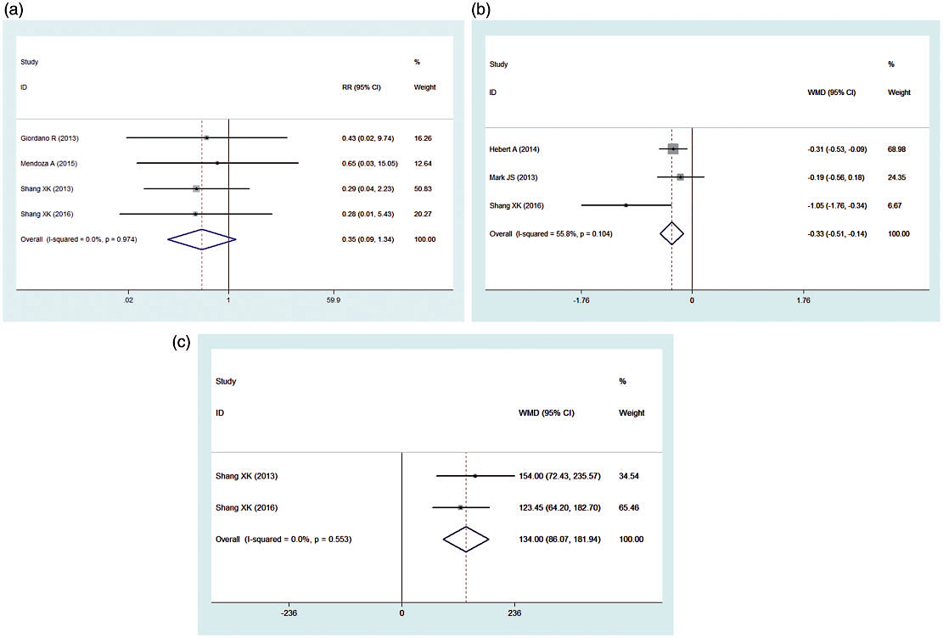
Wang, et al Meta-Analysis: Vasodilators Do Provide Benefit in Fontan
Forest plot of mortality
Forest plot of the NYHA class
Forest plot of the 6MWD
Plots are based on 9 RCTs of 381 patients.
Peak VO₂ was significantly improved (mean difference 1.42 ml (kg・min)⁻¹, 95% CI: [0.21, 2.63])
mPAP was significantly reduced (mean difference = -2.25 mmHg, 95% CI:
[-3.00, -1.50])
No significant change was found in mortality or in BNP) or NT-proBNP
Squares indicate risk ratio (RR). Horizontal lines indicate the 95% confidence interval (CI) for each included trial
The statistical weight of a trial in the meta-analysis was proportional to the size of each square
Diamonds indicate the pooled risk ratio and 95% confidence interval, with the center indicating the point estimate, and the left and right ends indicating the 95% CIs
Forest plot of mortality
Forest plot of the NYHA class
(c) Forest plot of the 6MWD

Slide 16
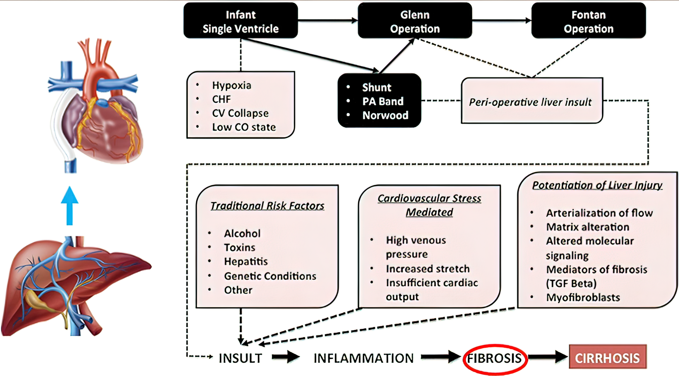
Heart–Liver Interaction in Single Ventricle and Potential Factors Influencing Development of “Fontan-Associated Liver Disease”
Liver is universally affected in individuals with a Fontan circulation
Inherent differences in hepatic substrate in association with single-ventricle congenital heart disease, injury related to alterations in perfusion along the path of surgical treatment, cyanosis, and congestive hepatopathy as a consequence of chronic venous hypertension due to the Fontan circulatory state may all contribute to what is now referred to as “Fontan associated liver disease” (FALD)

Slide 17
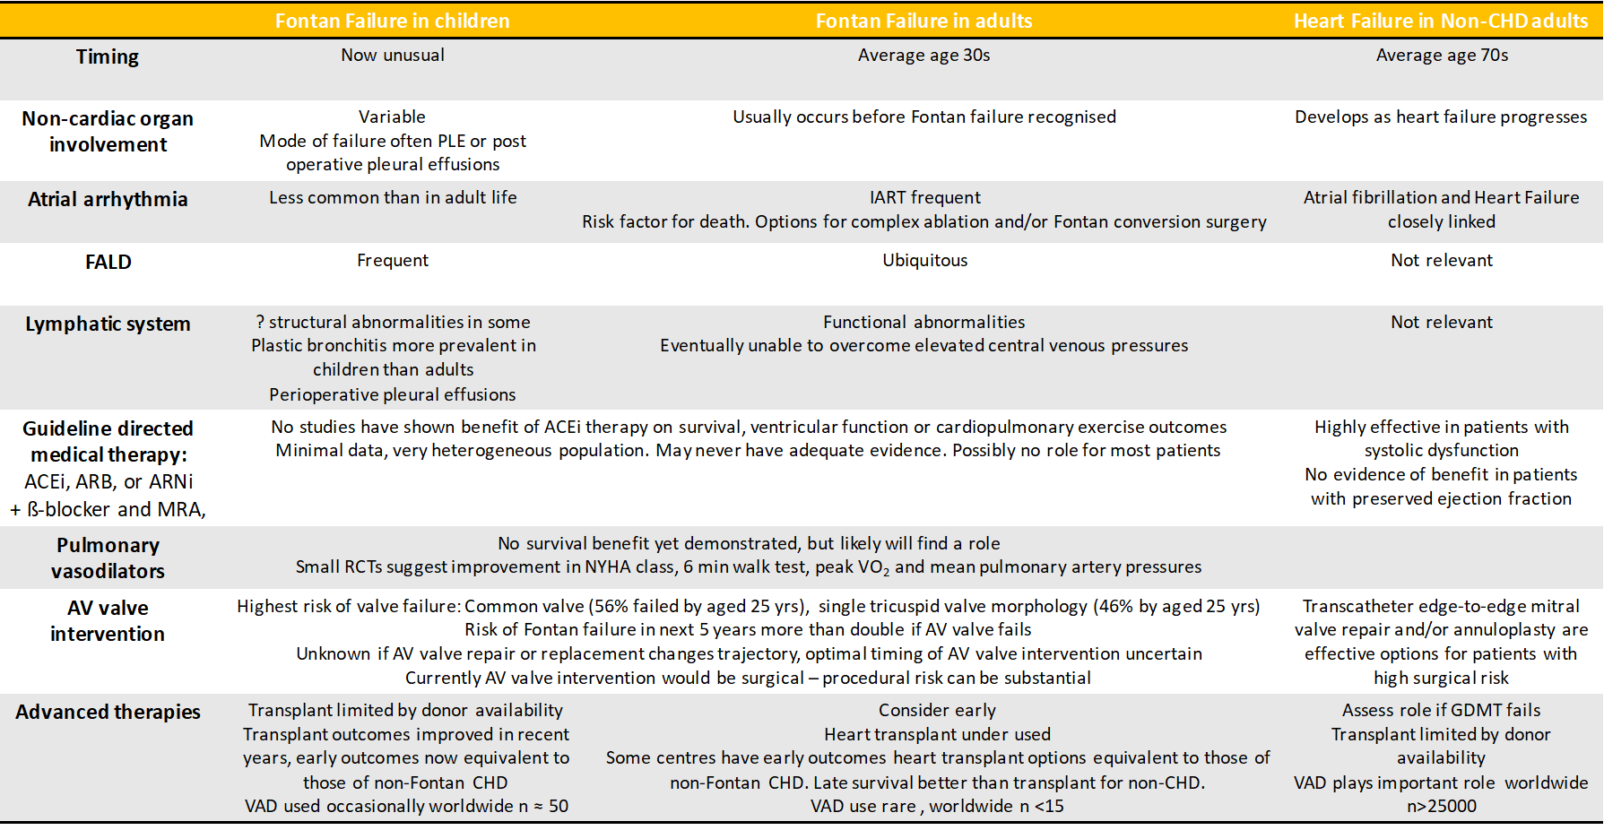
Similarities and Differences Between Fontan Failure in Children and Adults and Heart Failure in Adults Without CHD

