Slide 1

Choosing the Optimal Adjuvant Treatment Approach for Stage III BRAF-Mutant Melanoma

Slide 2



Resource Information
About This Resource
These slides are one component of a continuing education program available online at MedEd On The Go titled Holding Court in Melanoma: Choosing the Optimal Adjuvant Treatment Approach for Stage III BRAF-Mutant Melanoma
Program Learning Objective:
Understand the nuances of adjuvant regimens in stage III melanoma which guides treatment choice
MedEd On The Go®
www.mededonthego.com
This content or portions thereof may not be published, posted online or used in presentations without permission.
This content can be saved for personal use (non-commercial use only) with credit given to the resource authors.
To contact us regarding inaccuracies, omissions or permissions please email us at support@MedEdOTG.com

Slide 3
Disclaimer
The views and opinions expressed in this educational activity are those of the faculty and do not necessarily represent the views of Total CME, LLC, the CME providers, or the companies providing educational grants. This presentation is not intended to define an exclusive course of patient management; the participant should use their clinical judgment, knowledge, experience, and diagnostic skills in applying or adopting for professional use any of the information provided herein. Any procedures, medications, or other courses of diagnosis or treatment discussed or suggested in this activity should not be used by clinicians without evaluation of their patient's conditions and possible contraindications or dangers in use, review of any applicable manufacturer’s product information, and comparison with recommendations of other authorities. Links to other sites may be provided as additional sources of information.

Slide 4
Targeted Versus ICI Adjuvant Treatment of Stage III Melanoma
A recurrence-free survival benefit has been demonstrated with:
While both treatment modalities are appropriate, clinically what is the optimal adjuvant treatment option for a completely resected, BRAF-mutant stage III melanoma?
Adjuvant treatment of resected stage II, III, and IV melanoma with single-agent anti-PD-1 therapy
Adjuvant therapy with combined dabrafenib and trametinib in resected stage III and IV BRAF-mutated melanoma
Neoadjuvant/adjuvant immune checkpoint inhibitor (ICI) therapy for stage III and IV melanoma
Single agent ICI
BRAF/MEK-targeted therapy

Slide 5
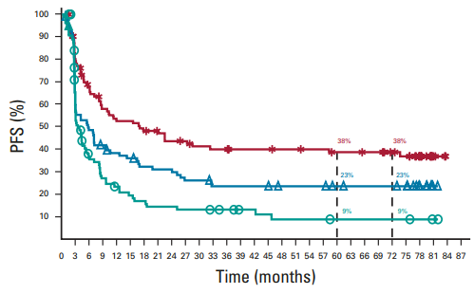
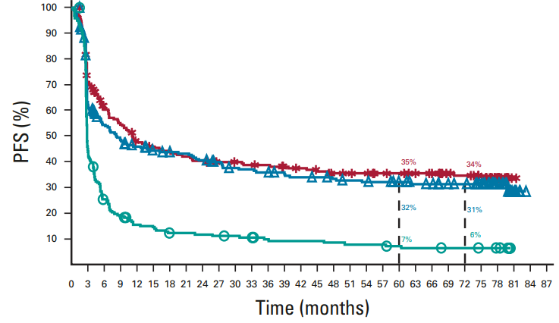
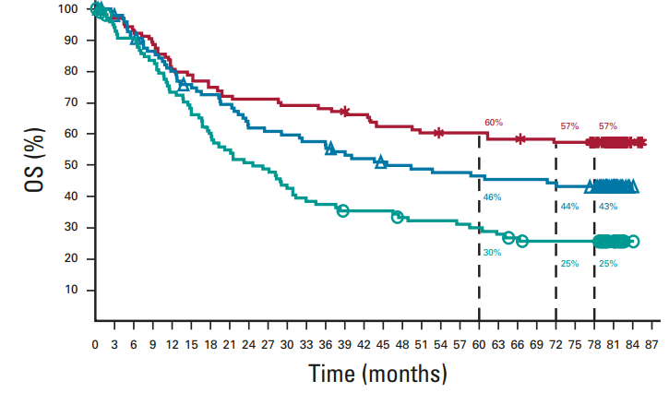
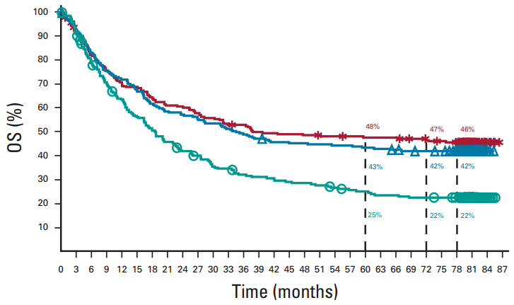
Survival Curves for Single Versus Dual ICI in BRAF-Mutant Versus Wild-Type Unresectable Stage III/IV Melanoma
PFS in BRAF-Mutant Patients
PFS in BRAF-Wild-Type Patients
NIVO/IPI
NIVO
IPI
NIVO/IPI
NIVO
IPI
OS in BRAF-Mutant Patients
OS in BRAF-Wild-Type Patients
NIVO/IPI
NIVO
IPI
NIVO/IPI
NIVO
IPI

Slide 6
Survival Benefit of Adjuvant Therapy in Resected Stage III Melanoma
Trial | Control | Experimental | RFS HR | DMFS HR | OS HR
KEYNOTE-054¹ | Placebo | Pembrolizumab | 0.59* | 0.60* | NR
CheckMate 238² | Ipilimumab | Nivolumab | 0.72* | 0.79* | 0.86
COMBI-AD³ | Placebo | Dabrafenib + Trametinib | 0.51* | 0.55* | 0.57
*significant P value

Slide 7
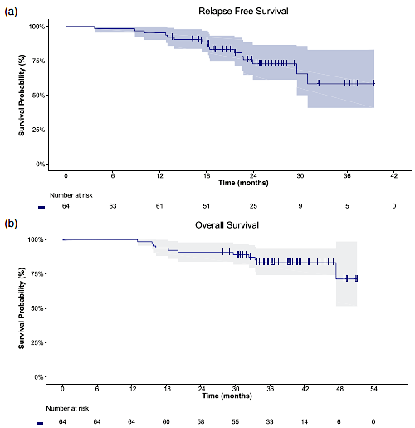
DESCRIBE-AD: Real-World Retrospective Study of Adjuvant BRAF-Targeted Therapy for Resected Melanoma
Relapse Free Survival
Patients: 65 patients
Median follow-up of 20 months
  Disease progression: 9%
  12-month RFS: 95.3%
  12-month OS: 100%
Overall Survival
Grade 3/4 TRAEs: 21.5%
  Pyrexia (3%)
  Asthenia (3%)
  Diarrhea (3%)

Slide 8
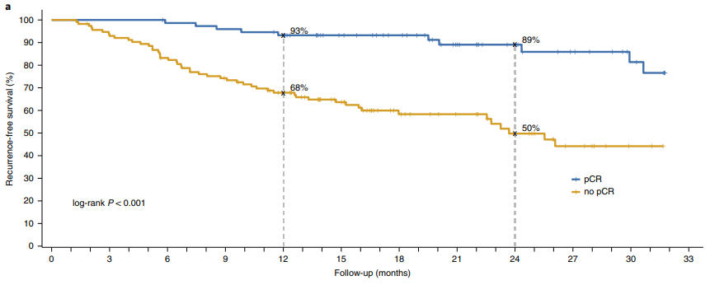
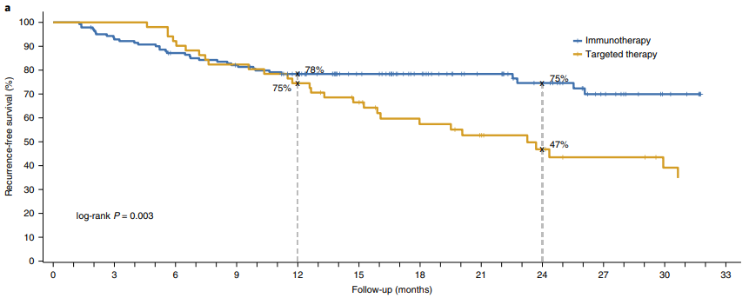
RFS with Neoadjuvant Immunotherapy Versus BRAF-Targeted Therapy
RFS Estimate by Pathological Response
Pathological Response by Treatment Cohort
Pathological response | Targeted therapy (n = 51) n (%, 95% CI) | Immunotherapy (n = 138) n (%, 95% CI) | P value*
pCR | 24 (47%, 33-61) | 51 (37%, 29-46) | 0.017
Near pCR | 0 (0%, 0-7) | 21 (15.2%, 10-22)
pPR | 10 (20%, 10-33%) | 17 (12.3%, 7-19)
pNR | 17 (33%, 21-48) | 49 ( 35.5%, 24-40)
RFS Estimate by Treatment Regimen
*Comparing immunotherapy to targeted therapy groups

Slide 9
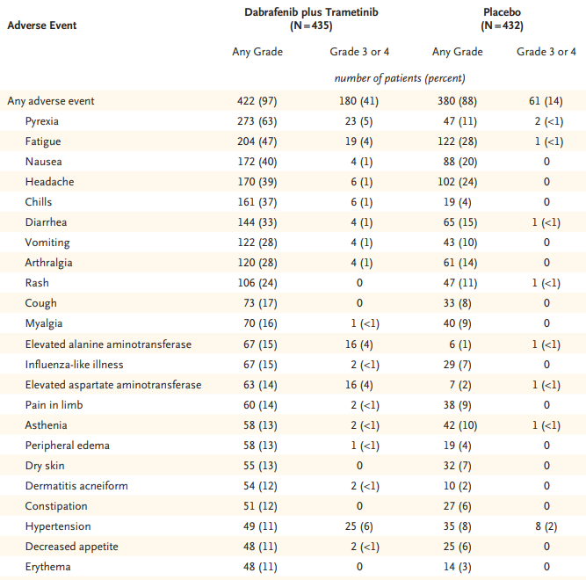
Dabrafenib + Trametinib Treatment-Related Adverse Events
COMBI-AD¹
Cardiovascular Toxicity in Clinical Trials²
Reference | Regimen | Cardiac events | Incidence (%) | Subjects treated
Lancet Oncol. 2012;13(8):782-789. | Trametinib | Decreased EF | 7 | 97
J Clin Oncol. 2013;31(4):482-489. | Trametinib | Decreased EF | 3 | 97
N Engl J Med. 2012;367(2):107-114. | Trametinib | Decreased EF | 7 | 214
N Engl J Med. 2015;372(1):30-39. | Trametinib + dabrafenib | Decreased EF | 8 | 350
Lancet. 2015;386(9992):444-451. | Trametinib + dabrafenib | Decreased EF | 4 | 209
N Engl J Med. 2012;367(2):107-114. | Trametinib | HTN | 15 | 214
N Engl J Med. 2015;372(1):30-39. | Trametinib + dabrafenib | HTN | 26 | 350
Lancet. 2015;386(9992):444-451. | Trametinib + dabrafenib | HTN | 22 | 209
Ocular Toxicity in Clinical Trials³
Drug(s) | Adverse effects: All grades | Adverse effects: Grade 3+ | Adverse effects
Dabrafenib + trametinib | 0%-2% | 2% | Chorioretinopathy
Trametinib | <1%-1.5% | NR | Retinal vein occlusion, chorioretinopathy

Slide 10
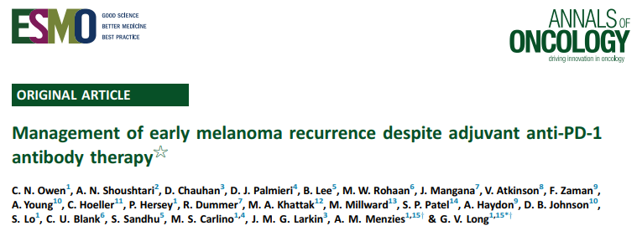
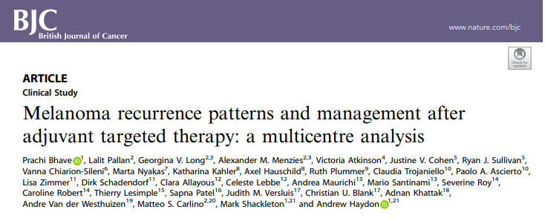
Real-World Data Series: Time to Recurrence After Adjuvant Therapy
Adjuvant anti-PD-1 therapy¹
Median time to recurrence: 4.6 months
Recurrence during therapy: 104/147 (76%)
Adjuvant targeted therapy²
Median time to recurrence: 18 months
Recurrence during therapy: 19/85 (22%)

Slide 11
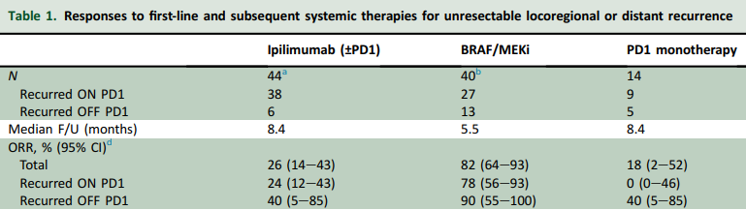
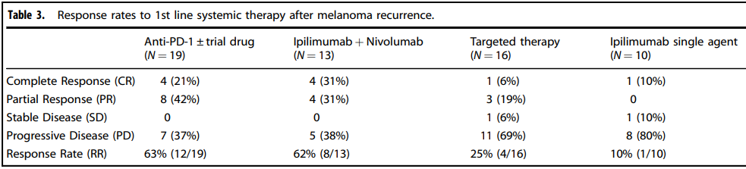
Real-World Data Series: Response Rates to 1L Systemic Therapy After Melanoma Recurrence
Adjuvant Anti-PD-1 Therapy¹
Adjuvant Targeted Therapy²

Slide 12
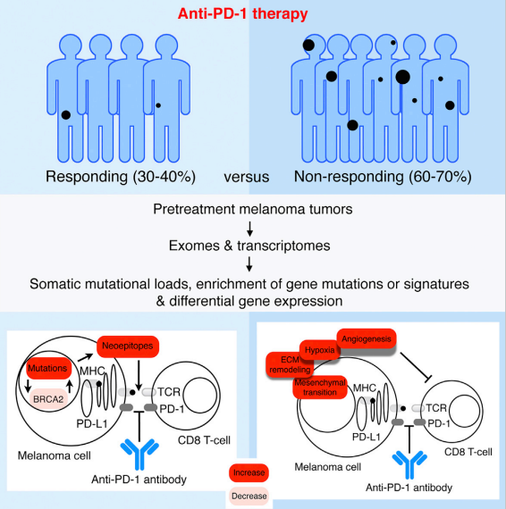
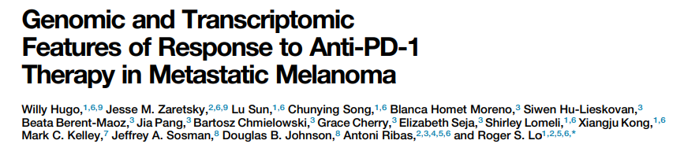
BRAF Therapy and Immune Insensitivity
High mutational load predictive of improved survival in melanoma patients, but not response to anti-PD-1
Other genomic and non-genomic features also contribute to anti-PD-1 response patterns
A transcriptional signature is related to innate anti-PD-1 resistance (IPRES)
A non-genomic form of MAP kinase inhibitor resistance mediates cross-resistance to anti-PD-1 therapy

Slide 13
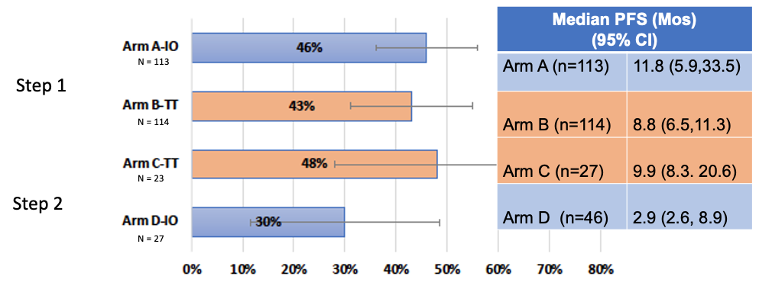
DREAMSeq Immunotherapy Response Rate Post BRAF-Targeted Therapy
ORR by Treatment Arm*
Data missing on ~15% of patients
*Bars represent 95% confidence interval

Slide 14
Response Rate with Fianlimab and Cemiplimab in Advanced Melanoma
Post-Adjuvant PD-1 Analysis
Response endpoints | PD-1 experienced cohort: MM3# (n=18)*
Median follow-up (IQR), months | 9.7 (4.8-14.1)
Treatment exposure, median (IQR), weeks | 23 (12-37)
ORR, (n) | 56% (10)
95% CI for ORR | (31-79)
DoR, median (95% CI), months | NR (6-NE)
DCR, (n) | 67% (12)
95% CI for DCR | (41-87)
Best overall response, (n)
CR | 6% (1)
PR | 50% (9)
SD | 11% (2)
PD | 28% (5)
NE | 6% (1)
KM-estimated PFS, median (95% CI), months | 12 (1-NE)

Slide 15
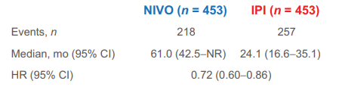
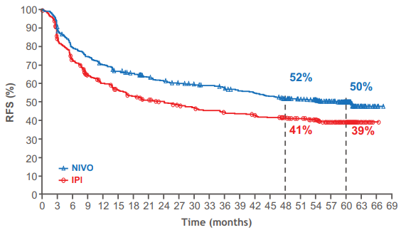
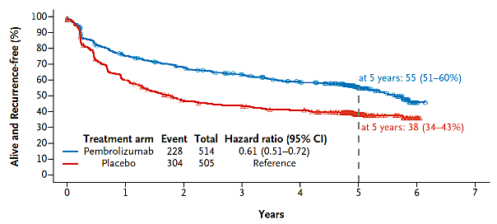
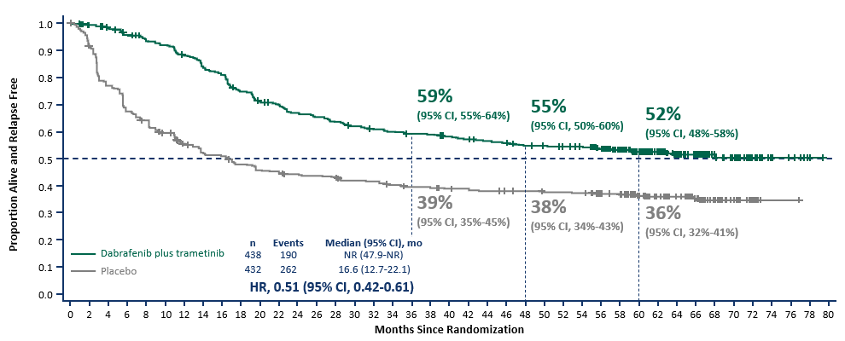
Relapse-Free Survival with Adjuvant Therapy for Resected Melanoma
CheckMate 238²
KEYNOTE-054¹
COMBI-AD³

Slide 16
Targeted Versus ICI Adjuvant Treatment of Resected Stage III BRAF-Mutant Melanoma
Anti-PD-1 therapy
BRAF-targeted therapy
  Risk of severe, potentially life-threatening toxicities
  High rates of chronic adverse effects
  No increase of efficacy versus alternative agents
  Superior efficacy versus anti-PD-1 therapy in retrospective studies, real-world analyses, and cross-trial comparison
  Manageable, reversible adverse effects

Slide 17
Targeted Versus ICI Adjuvant Treatment of Resected Stage III BRAF-Mutant Melanoma
Anti-PD-1 therapy
BRAF-targeted therapy
  Superiority in multiple settings
  Does not require molecular testing
  Single doses drive efficacy, allowing for hold and monitor
  High response rate with dual ICI regimens in the post-adjuvant anti-PD-1 therapy setting, if needed
  Toxicity leads to dose modifications, reducing efficacy
  Initial BRAF-targeted therapy may result in innate anti-PD- resistance

Slide 18



Targeted Versus ICI Adjuvant Treatment of Resected Stage III BRAF-Mutant Melanoma
Adjuvant ICI provides a RFS and DMFS benefit compared to no therapy or ipilimumab
Adjuvant BRAF/MEK inhibition provides a similar RFS benefit versus ICI therapy
Toxicity profiles differ between drug classes

Slide 19



Looking for more resources
on this topic?
CME/CE in minutes
Congress highlights
Late-breaking data
Quizzes
Webinars
In-person events
Slides & resources
www.MedEdOTG.com

