Slide 1
Addressing Gaps in the Care of HFrEF Now What?
Javed Butler, MD, MPH, MBA
President
Baylor Scott and White Research Institute
Distinguished Professor of Medicine
University of Mississippi
Jackson, MS

Slide 2
Disclaimer
The views and opinions expressed in this educational activity are those of the faculty and do not necessarily represent the views of TotalCME, Inc., the CME providers, or the companies providing educational grants. This presentation is not intended to define an exclusive course of patient management; the participant should use their clinical judgment, knowledge, experience, and diagnostic skills in applying or adopting for professional use any of the information provided herein. Any procedures, medications, or other courses of diagnosis or treatment discussed or suggested in this activity should not be used by clinicians without evaluation of their patient's conditions and possible contraindications or dangers in use, review of any applicable manufacturer’s product information, and comparison with recommendations of other authorities. Links to other sites may be provided as additional sources of information.

Slide 3
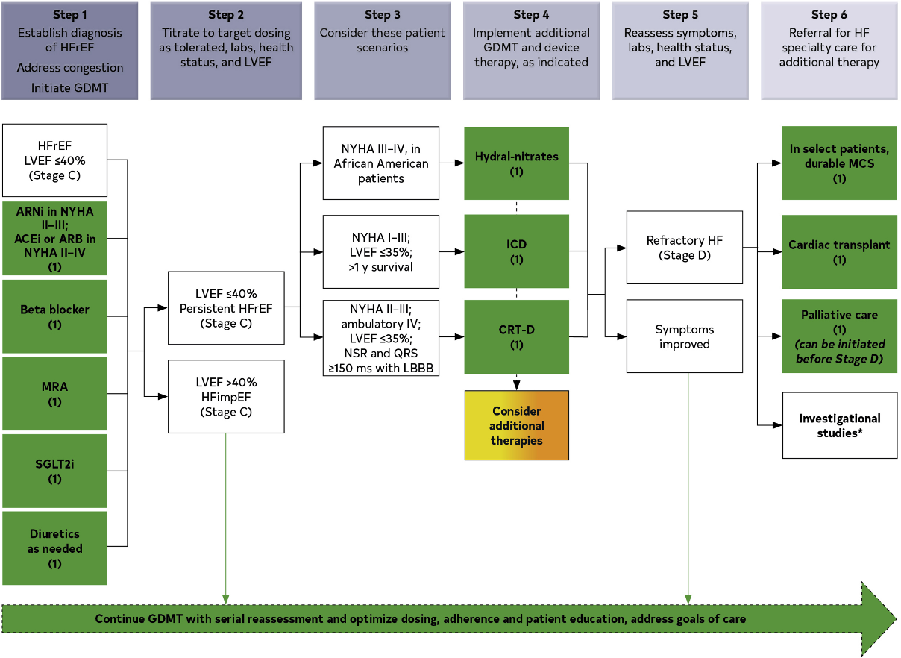
Treatment of HFrEF Stages C and D
Guideline-directed medical therapy (GDMT) for heart failure (HF) with reduced ejection fraction (HFrEF) now includes 4 medication classes that include sodium-glucose cotransporter-2 inhibitors (SGLT2i).
If patients have chronic symptomatic HFrEF with NYHA class II or III symptoms and they tolerate an ACEi or ARB, they should be switched to an ARNi because of improvement in morbidity and mortality

Slide 4
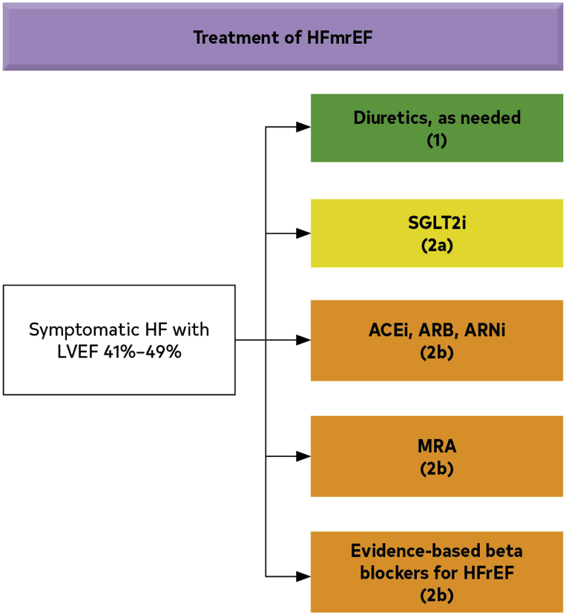
Recommendations for Patients with HFmrEF
Continuation of GDMT for patients with improved HFrEF and HFmrEF is important to reduce risk of recrudescent HF
Patients with HFmrEF should have repeat evaluation of LVEF to determine the trajectory of their disease process and should undergo testing as clinically indicated to diagnose conditions warranting disease-specific therapy (e.g., CAD, sarcoidosis, amyloidosis)

Slide 5
What is at Stake? Cumulative Impact of Evidence-based HFrEF Medical Therapies on All-Cause Mortality
 | Relative-risk reduction | 2 yr Mortality
None | -- | 35.0%
ARNI (vs imputed placebo) | 28% | 25.2%
Beta Blocker | 35% | 16.4%
Aldosterone Ant | 30% | 11.5%
SGLT2 inhibitor | 17% | 9.5%
Cumulative risk reduction if all evidence-based medical therapies are used:
Relative risk reduction 72.9%, Absolute risk reduction: 25.5%, NNT = 4

Slide 6
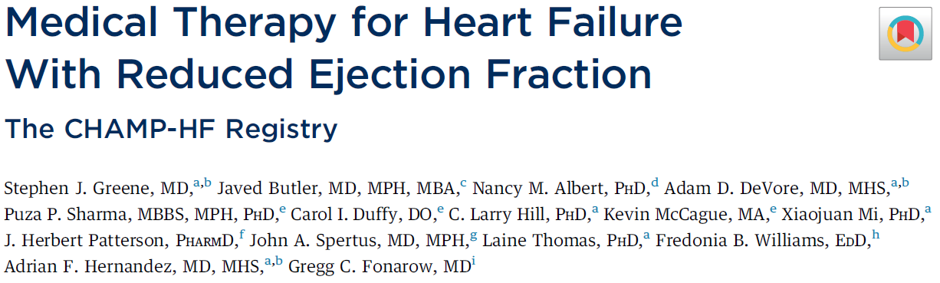
The CHAMP-HF Registry
Prospective, observational, non-interventional registry
Adult outpatients with chronic HFrEF ≤40%
Enrolled December 2015 - October 2017 across the US
Baseline data for 3,518 patients across 150 US sites
Greene SJ et al. JACC 2018
Greene SJ et al. JACC 2019

Slide 7
Gaps in GDMT Use in the United States
% Eligible Patients NOT Receiving Therapy:
ACEI/ARB/ARNI – 27%
Beta-blocker – 33%
MRA – 67%
<25% of eligible patients receive “triple therapy” (ACEI/ARB/ARNI + BB + MRA)

Slide 8
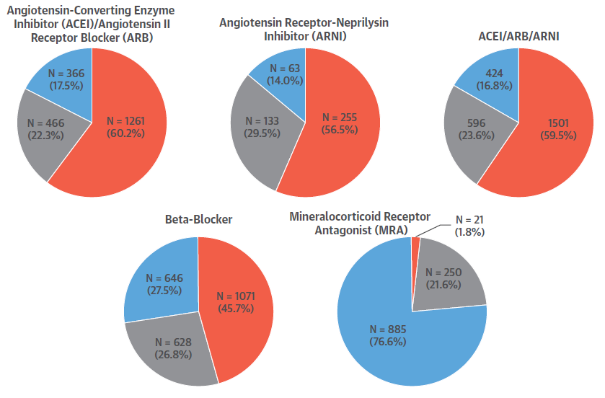
When Medications Are Prescribed, Most Receive Low or Sub-Target Doses
<50% target
50 to <100% target
≥ 100% target dose
1% receive “triple therapy” at target doses

Slide 9
The Case for a New Approach: A Summary
The efficacy of each foundational drug class is independent of treatment with the other drug classes. Historical sequencing does not matter.
Background therapy can influence the tolerability of other foundational agents. Proper sequencing should account for this.
Low starting doses of foundational drugs have important therapeutic benefits. Starting all foundational drugs should be prioritized over up-titration to target doses.
Treatments reduce morbidity and mortality within 4 weeks of initiating therapy. Time is of the essence.

Slide 10
The Case for a New Approach: A Summary
The efficacy of each foundational drug class is independent of treatment with the other drug classes. Historical sequencing does not matter.
Background therapy can influence the tolerability of other foundational agents. Proper sequencing should account for this.
Low starting doses of foundational drugs have important therapeutic benefits. Starting all foundational drugs should be prioritized over up-titration to target doses.
Treatments reduce morbidity and mortality within 4 weeks of initiating therapy. Time is of the essence.

Slide 11
The Case for a New Approach: A Summary
The efficacy of each foundational drug class is independent of treatment with the other drug classes. Historical sequencing does not matter.
Background therapy can influence the tolerability of other foundational agents. Proper sequencing should account for this.
Low starting doses of foundational drugs have important therapeutic benefits. Starting all foundational drugs should be prioritized over up-titration to target doses.
Treatments reduce morbidity and mortality within 4 weeks of initiating therapy. Time is of the essence.

Slide 12
The Case for a New Approach: A Summary
The efficacy of each foundational drug class is independent of treatment with the other drug classes. Historical sequencing does not matter.
Background therapy can influence the tolerability of other foundational agents. Proper sequencing should account for this.
Low starting doses of foundational drugs have important therapeutic benefits. Starting all foundational drugs should be prioritized over up-titration to target doses.
Treatments reduce morbidity and mortality within 4 weeks of initiating therapy. Time is of the essence.

Slide 13
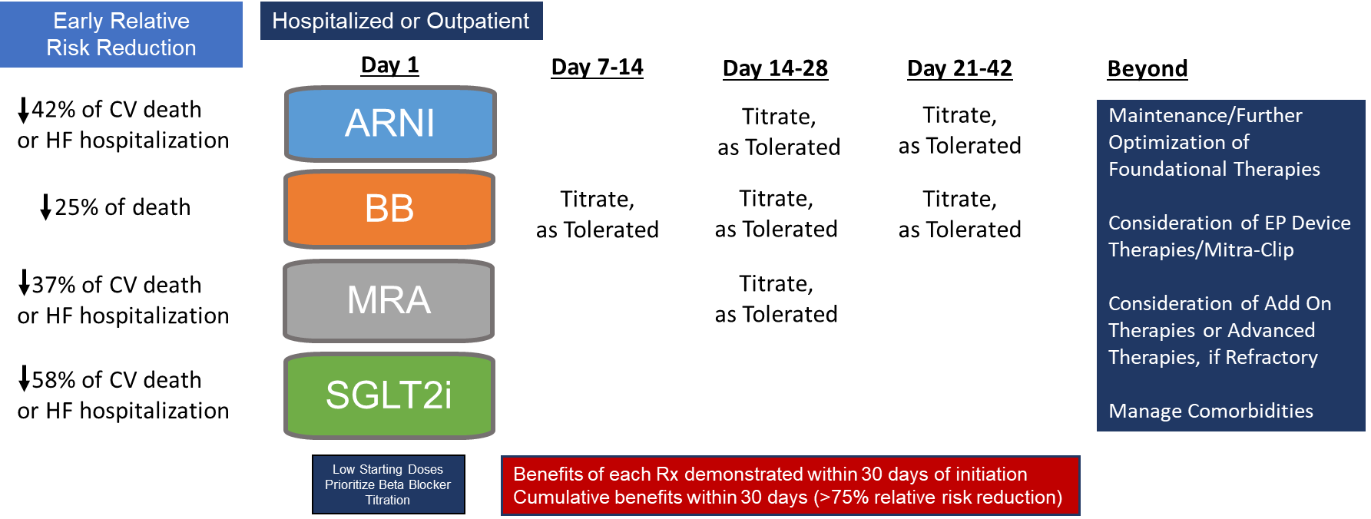
Simultaneous or Rapid Sequence Initiation of Quadruple Medical Therapy for Heart Failure - Optimizing Therapy With the Need for Speed

Slide 14
Strategies to Help Facilitate GDMT Initiation
Start all 4 classes of medication at diagnosis¹
In-hospital initiation for hospitalized patients¹
Performance improvement systems (GWTG-HF, IMPROVE-HF)²
Multidisciplinary heart failure disease management programs³
Navigators or pharmacists to guide GDMT³
Telehealth GDMT optimization program⁵
Digital health tools and apps focused on GDMT⁶
Patient activation program (EPIC-HF)³
GDMT clinics⁴

Slide 15







Benefits of Simultaneous or Rapid Initiation of ARNi, BB, MRA, and SGLT2i for HFrEF are Multifaceted
Benefits of Initiating ARNi+BB+MRA+SGLT2i as First-line Treatment
for HFrEF Versus Drawn-out Historical Sequencing
Rapid improvement in health status (within 1 to 8 weeks)^{1,}*
Rapid improvement in LVEF (within 12 weeks)²
Rapid reduction in HF hospitalizations (within 2 to 4 weeks)*
Rapid reduction in HF rehospitalizations (within 2 to 4 weeks)³
Rapid reduction in mortality (within 2 to 4 weeks)*
Improved use, tolerability, adherence, persistence, overcoming inertia^{4,}*

Slide 16
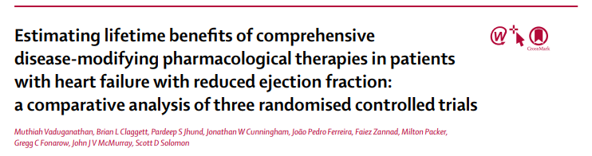
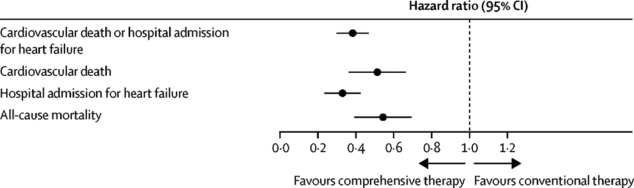
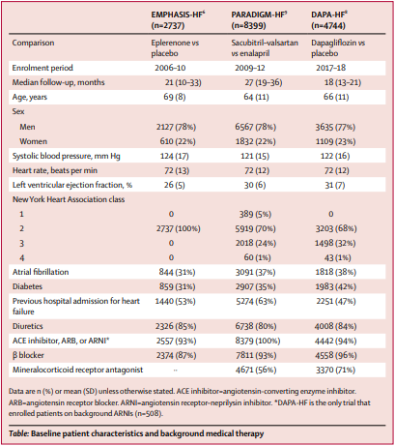
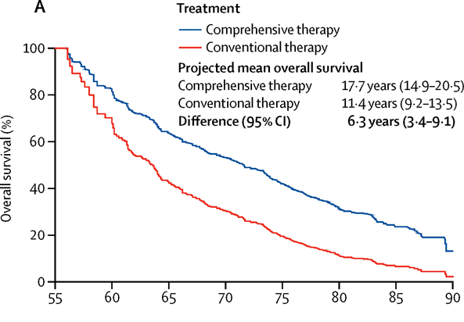
Compared to ACEI/ARB + BB:
1. Switch to ARNI
2. Start MRA
3. Start SGLT2i
Compared to ACEI/ARB+BB: Comprehensive Rx including ARNI+BB+MRA+SGLT2i
HR 0.38 CV Death/HF Hospitalization
HR 0.50 CV Death
HR 0.32 HF Hospitalization
HR 0.53 Mortality
Survival-free from All-Cause Mortality
Extend Your HFrEF Patient’s Life by 6.3 Years

