Slide 1
What are the Keys to Post-discharge Care for Patients Hospitalized for HFrEF?
Javed Butler, MD, MPH, MBA
President
Baylor Scott and White Research Institute
Distinguished Professor of Medicine
University of Mississippi
Jackson, MS

Slide 2
Disclaimer
The views and opinions expressed in this educational activity are those of the faculty and do not necessarily represent the views of TotalCME, Inc., the CME providers, or the companies providing educational grants. This presentation is not intended to define an exclusive course of patient management; the participant should use their clinical judgment, knowledge, experience, and diagnostic skills in applying or adopting for professional use any of the information provided herein. Any procedures, medications, or other courses of diagnosis or treatment discussed or suggested in this activity should not be used by clinicians without evaluation of their patient's conditions and possible contraindications or dangers in use, review of any applicable manufacturer’s product information, and comparison with recommendations of other authorities. Links to other sites may be provided as additional sources of information.

Slide 3
HF Burden of Disease
HOSPITALIZATIONS AND READMISSIONS |  | COSTS
> 1,100,000 hospitalizations for HF¹ | > 3,000,000 hospitalizations include HF as a contributor² | Total medical costs for HF are projected to increase to $70B by 2030, a 2x increase from 2013* | 50% of the costs are attributed to hospitalization⁶
~5 days average length of hospital stay³ | ~25% all-cause readmission within 30 days; ~50% within 6 months^{4,5}

Slide 4
Hospital Discharge
Recommendation or Indication | COR | LOE
Before hospital discharge, at the first post-discharge visit, and in subsequent follow-up visits, the following should be addressed: a) initiation of GDMT if not done or contraindicated b) causes of HF, barriers to care, and limitations in support c) assessment of volume status/blood pressure with adjustment of therapy d) optimization of chronic oral HF therapy e) renal function and electrolytes f) management of comorbid conditions g) HF education, self-care, emergency plans, and adherence h) palliative or hospice care | I | B
Multidisciplinary HF disease-management programs for patients at high risk for hospital readmission are recommended | I | B
A follow-up visit within 7 to 14 days and/or a telephone follow-up within 3 days of hospital discharge is reasonable | IIa | B
Use of clinical risk-prediction tools and/or biomarkers to identify higher-risk patients is reasonable | IIa | B

Slide 5


HF Clinical Practice Guidelines
Indication | Class | LOE
NPs for diagnosis¹⁻³ | I | A
NPs for prognosis¹⁻³ | I | A
NPs for predischarge risk assessment¹⁻³ | IIa | B-NR
NPs to prevent HF onset¹⁻³ | IIa | B-R
NPs to guide HF therapy⁴ | IIa | B

Slide 6
Individualized Care Based on Discharge NT-proBNP
Discharge NT-proBNP concentration

Slide 7
Individualized Care Based on Discharge NT-proBNP
Discharge NT-proBNP concentration
Low
Routine follow up

Slide 8
Individualized Care Based on Discharge NT-proBNP
Discharge NT-proBNP concentration
Low
Medium
Early follow up
Home nursing
Routine follow up

Slide 9
Individualized Care Based on Discharge NT-proBNP
Discharge NT-proBNP concentration
Low
Medium
High
Rehab stay
Early follow up
Home nursing
Telemonitoring
Early follow up
Home nursing
Routine follow up

Slide 10
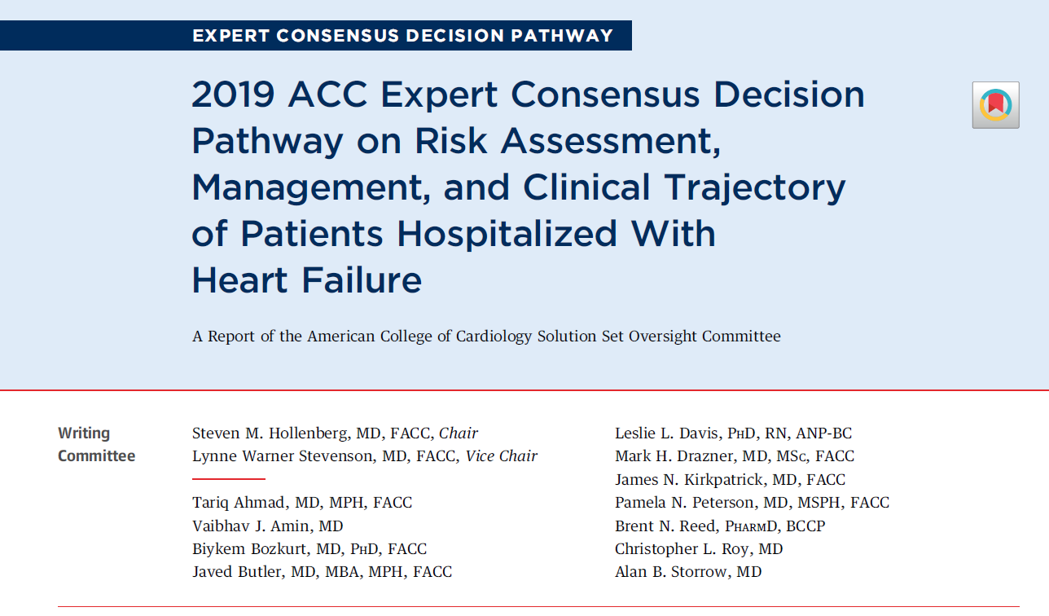

Slide 11
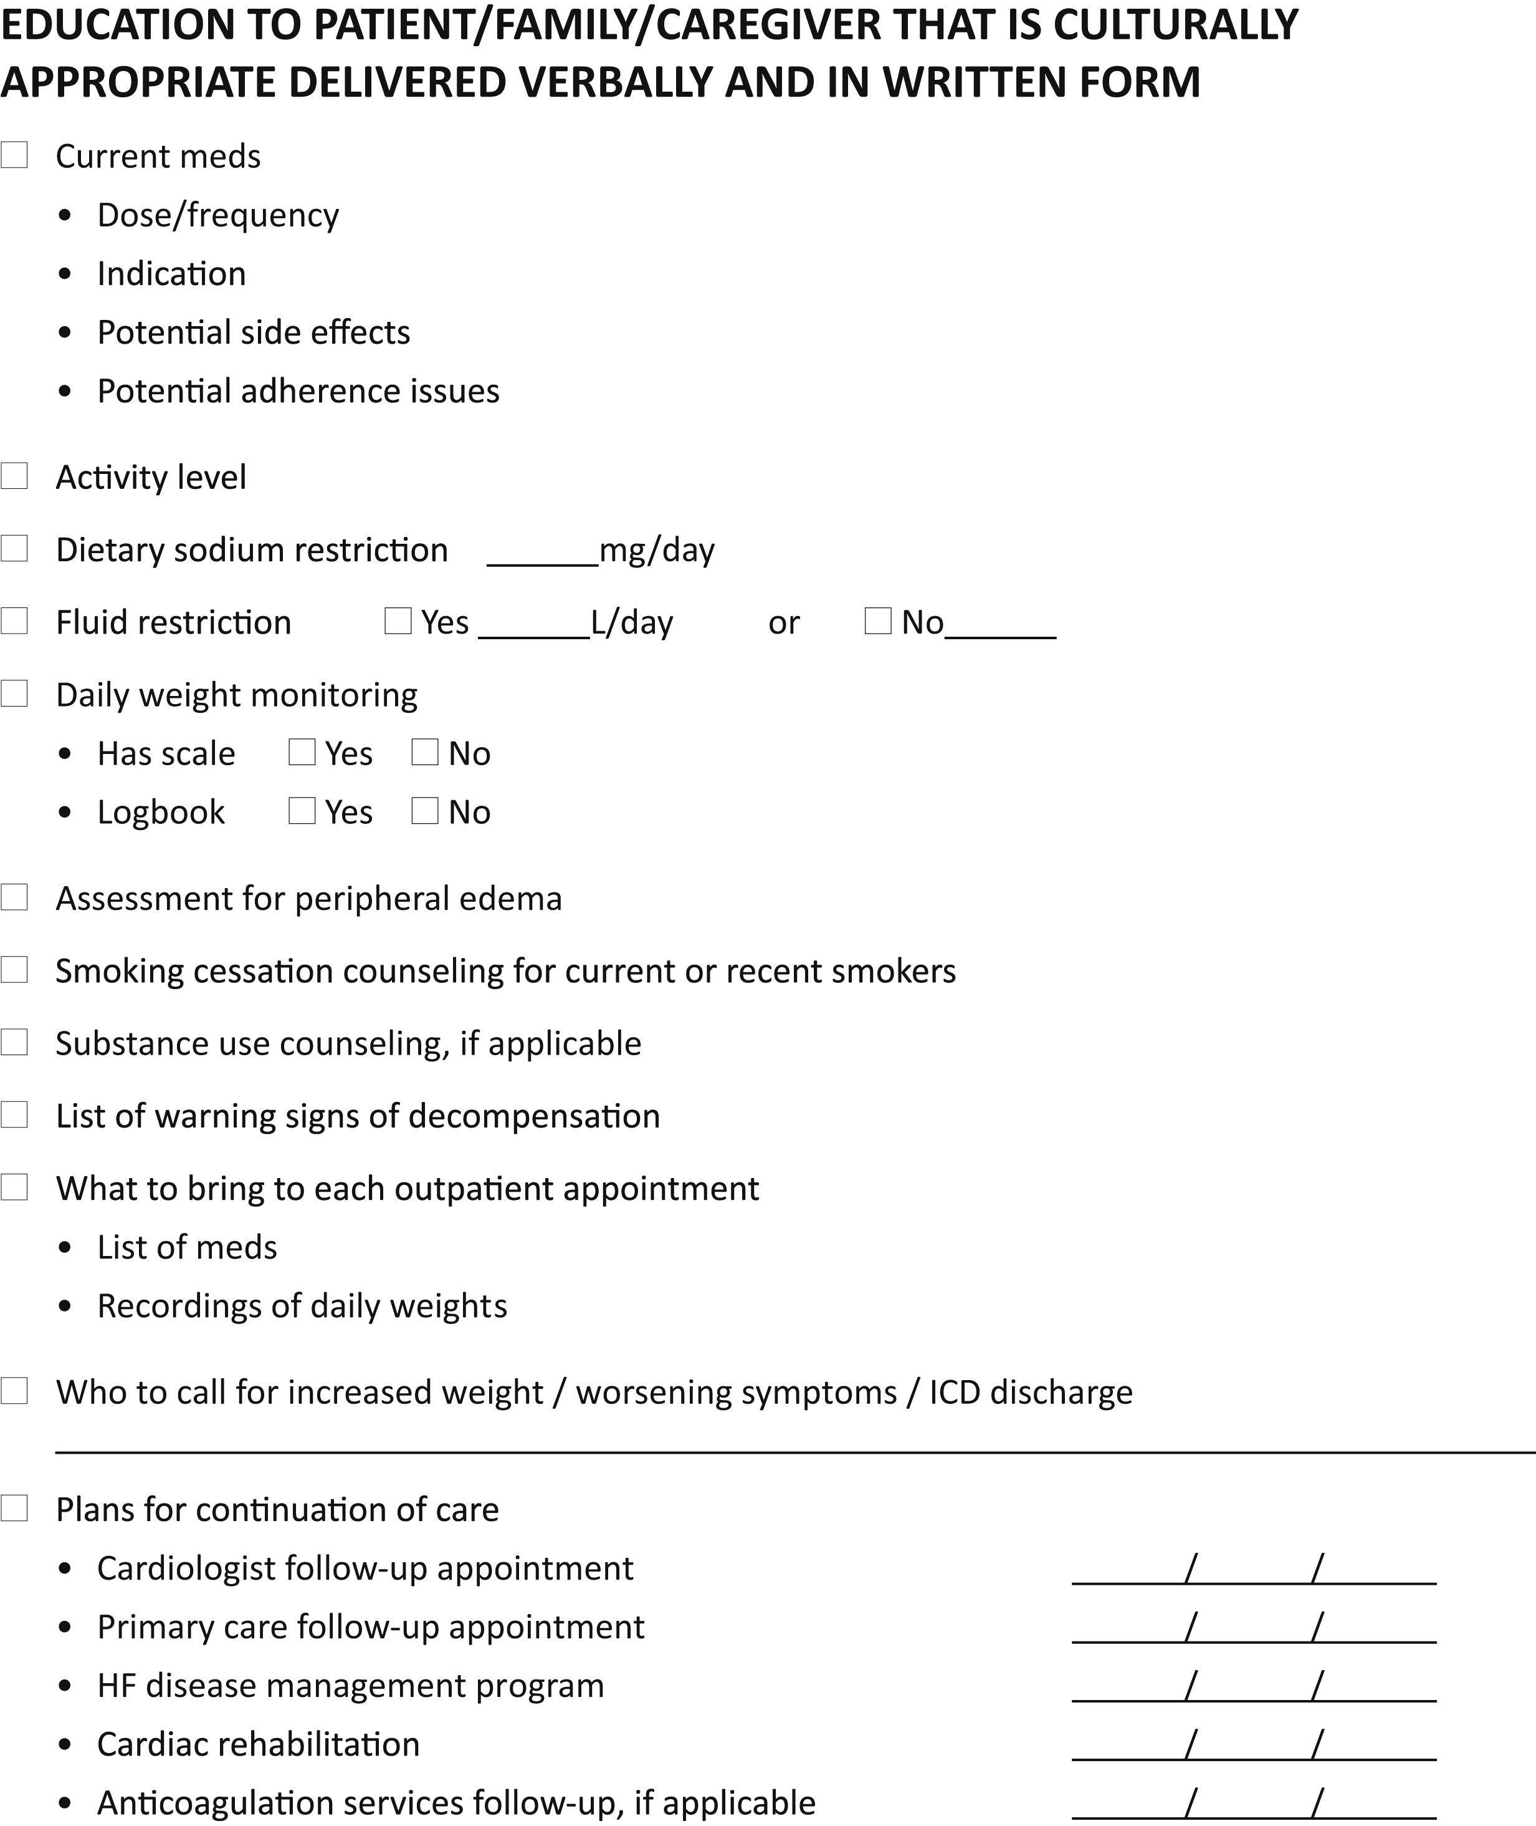
Patient Education

Slide 12
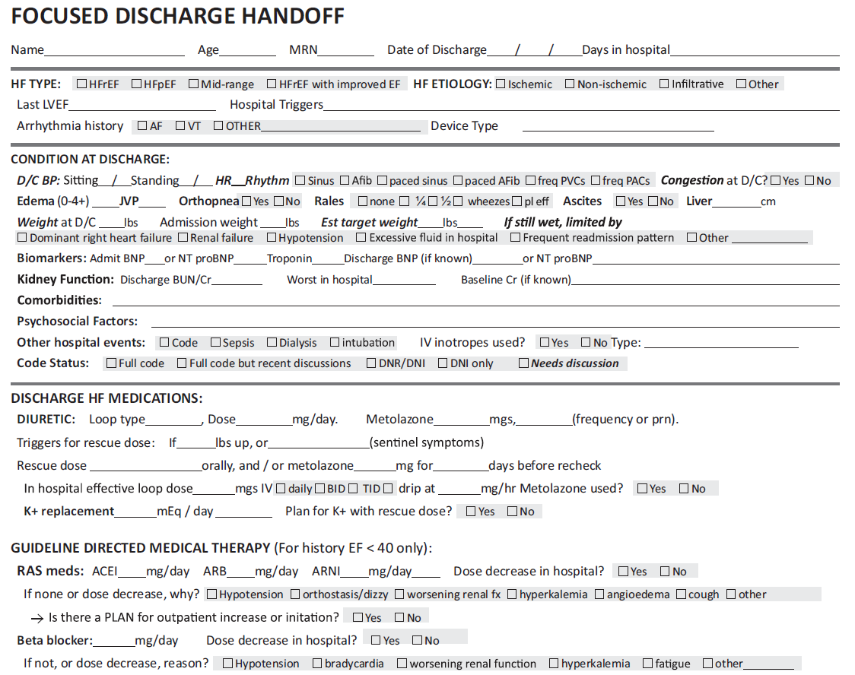
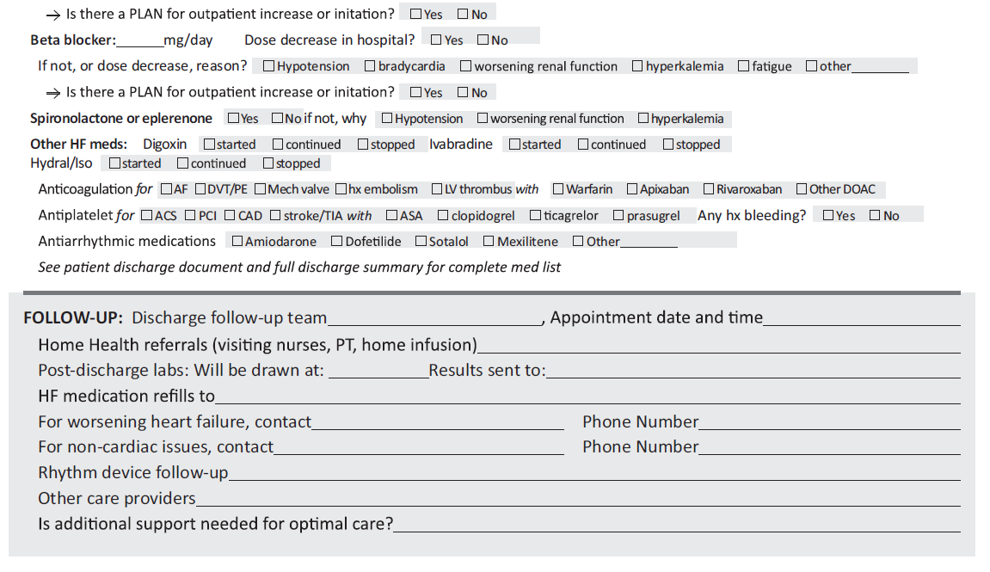
Focused Discharge Handoff

Slide 13
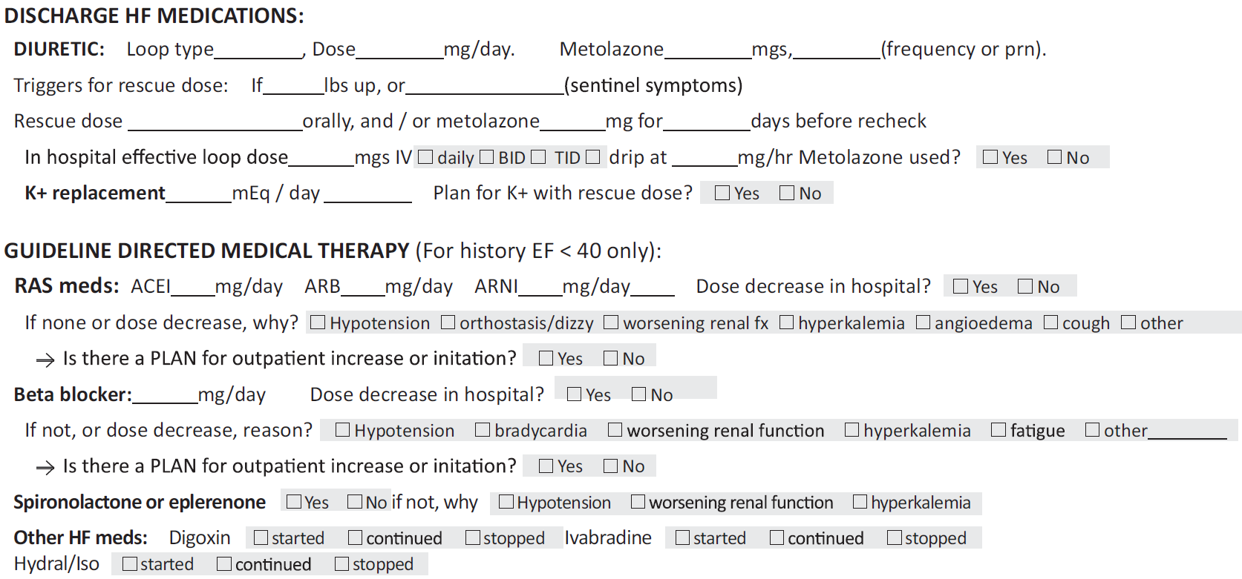

Slide 14
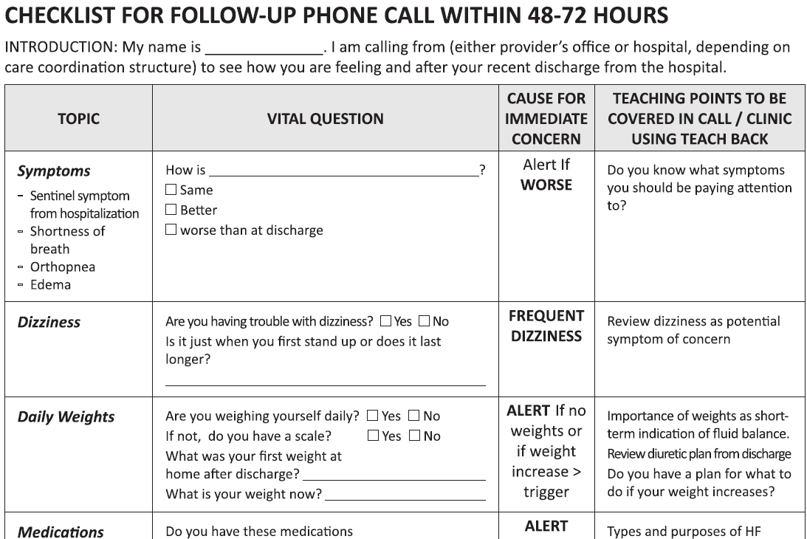
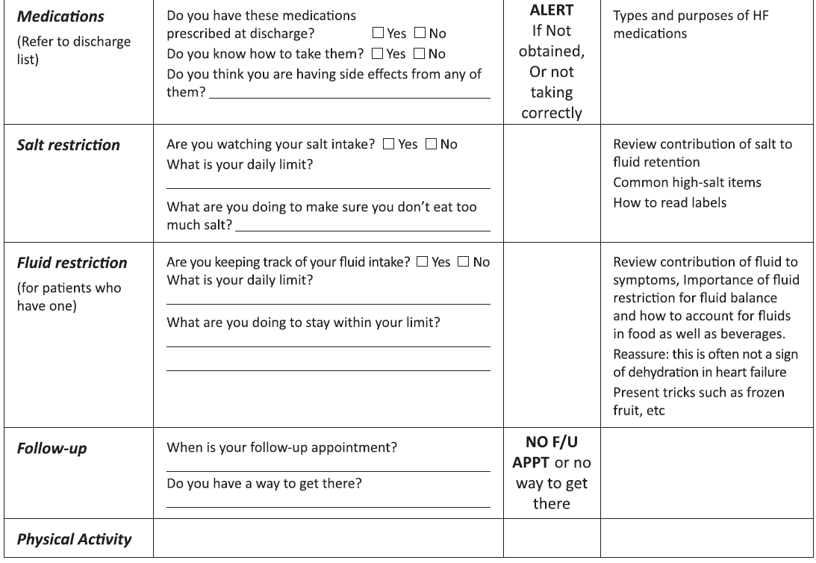
Follow-Up Phone Call

Slide 15
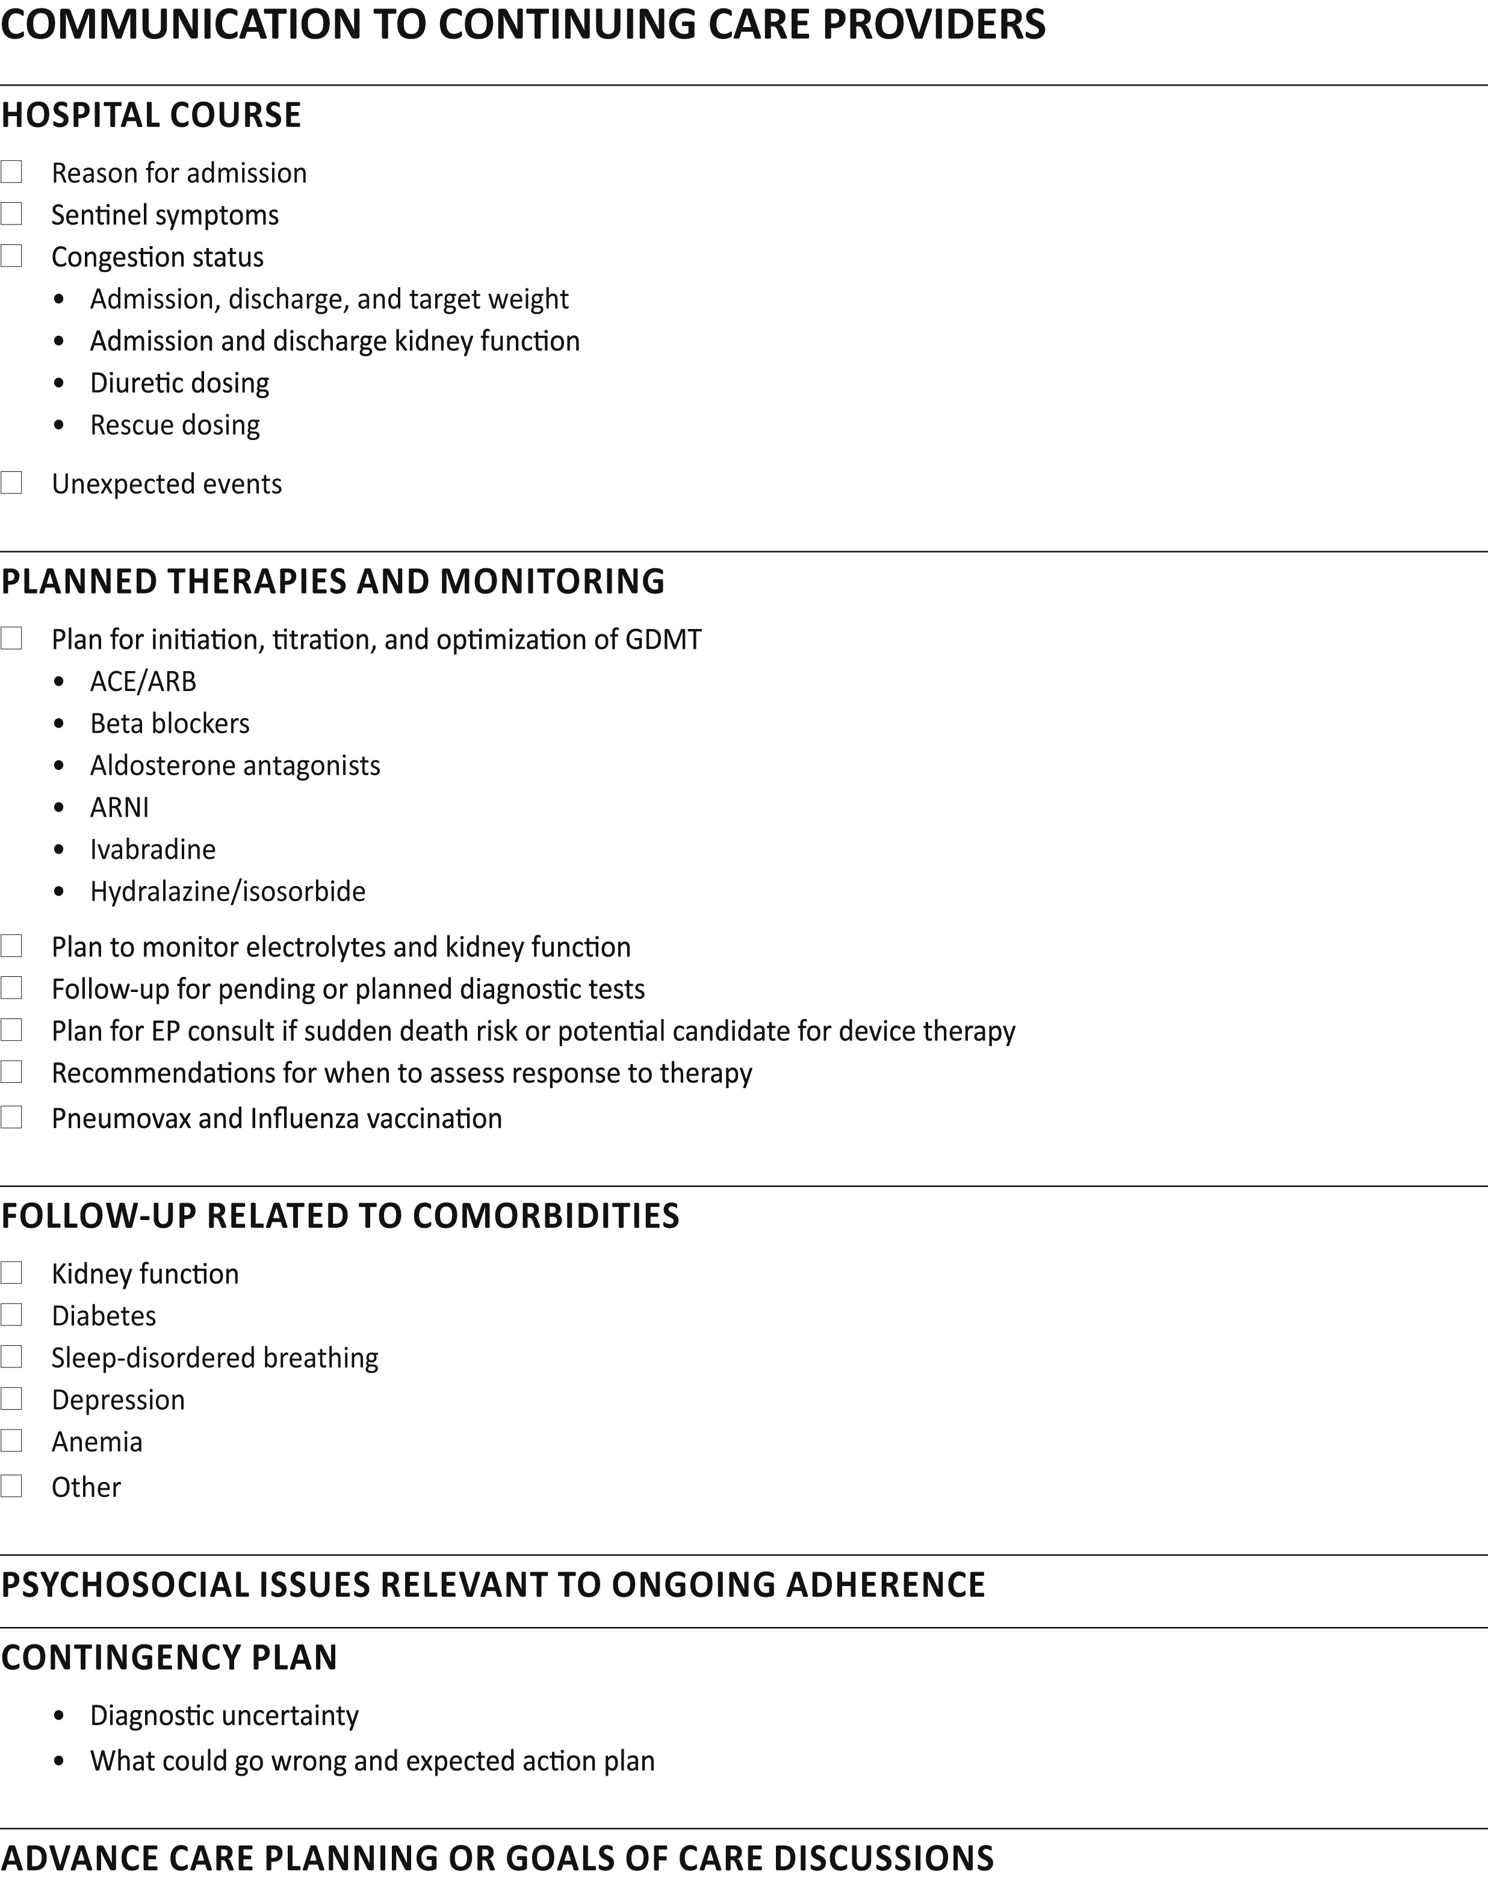
Circle of Care

Slide 16
Maintenance or Optimization of GDMT During Hospitalization
Hospitalization for HFrEF is a critical opportunity to continue, initiate, and further optimize GDMT
Continuation of oral GDMT during hospitalization for HF has been shown in registries to lower risk of post-discharge death and readmission compared with discontinuation
Initiation of oral GDMT during hospitalization for HF is associated with numerous clinical outcome benefits
It cannot be assumed that oral GDMT will be initiated or optimized after hospitalization for HFrEF
Oral GDMT should not be withheld for mild or transient reductions in blood pressure or mild deteriorations in renal function

Slide 17

How to Operationalize? The GDMT Clinic!
Education
Medication initiation
Medication titration
Biomarker monitoring
CPET, echo, KCCQ
Goals:
To institute and titrate GDMT
Improve patient care, health status, and reduce morbidity and mortality
Facilitate earlier referral to advanced HF specialists
Involvement of other specialties
Design:
“Catch and release”

