Slide 1
Bridging the Gap – How Do We Implement New Guidelines for HFrEF into Clinical Practice?
Biykem Bozkurt, MD, PhD, FHFSA, FACC, FAHA, FACP
The Mary and Gordon Cain Chair and Professor of Medicine
Associate Provost of Faculty Affairs, Senior Associate Dean of Faculty Development
Director, Winters Center for Heart Failure Research
Assoc. Director, Cardiovascular Research Institute
Houston, TX

Slide 2
Disclaimer
The views and opinions expressed in this educational activity are those of the faculty and do not necessarily represent the views of TotalCME, Inc., the CME providers, or the companies providing educational grants. This presentation is not intended to define an exclusive course of patient management; the participant should use their clinical judgment, knowledge, experience, and diagnostic skills in applying or adopting for professional use any of the information provided herein. Any procedures, medications, or other courses of diagnosis or treatment discussed or suggested in this activity should not be used by clinicians without evaluation of their patient's conditions and possible contraindications or dangers in use, review of any applicable manufacturer’s product information, and comparison with recommendations of other authorities. Links to other sites may be provided as additional sources of information.

Slide 3
Universal Definition Stages of HF
At-Risk for Heart Failure (STAGE A)
Pre-Heart Failure
(STAGE B)
Heart Failure (STAGE C)
Advanced Heart Failure
(STAGE D)
Patients at risk for HF but without current or prior symptoms or signs of HF and without structural, biomarker, or genetic markers of heart disease.
Patients without current or prior symptoms or signs of heart failure but evidence of one of the following
Patients with current or prior symptoms and/ or signs of HF caused by
Severe symptoms and/ or signs of HF at rest, recurrent hospitalizations despite GDMT, refractory or intolerant to GDMT
structural and/or functional cardiac abnormality
Structural Heart Disease:
e.g. LVH, chamber enlargement, wall motion abnormality, myocardial tissue abnormality, valvular heart disease
requiring advanced therapies such as consideration for transplant, mechanical circulatory support, or palliative care
Patients with HTN, CVD, DM, obesity, known exposure to cardiotoxins, family history of cardiomyopathy
Abnormal cardiac function: e.g. reduced LV or RV ventricular systolic function, evidence of increased filling pressures or abnormal diastolic dysfunction
Heart Failure in Remission
Persistent Heart Failure
with GDMT and risk factor modification
Elevated natriuretic peptide levels or elevated cardiac troponin levels in the setting of exposure to cardiotoxins

Slide 4
Universal Definition Stages of HF
At-Risk for Heart Failure (STAGE A)
Pre-Heart Failure
(STAGE B)
Heart Failure (STAGE C)
Advanced Heart Failure
(STAGE D)
Patients at risk for HF but without current or prior symptoms or signs of HF and without structural, biomarker, or genetic markers of heart disease.
Patients without current or prior symptoms or signs of heart failure but evidence of one of the following
Patients with current or prior symptoms and/ or signs of HF caused by
Severe symptoms and/ or signs of HF at rest, recurrent hospitalizations despite GDMT, refractory or intolerant to GDMT
structural and/or functional cardiac abnormality
Structural Heart Disease:
e.g. LVH, chamber enlargement, wall motion abnormality, myocardial tissue abnormality, valvular heart disease
requiring advanced therapies such as consideration for transplant, mechanical circulatory support, or palliative care
Patients with HTN, CVD, DM, obesity, known exposure to cardiotoxins, family history of cardiomyopathy
Abnormal cardiac function: e.g. reduced LV or RV ventricular systolic function, evidence of increased filling pressures or abnormal diastolic dysfunction
Heart Failure in Remission
Persistent Heart Failure
with GDMT and risk factor modification
Elevated natriuretic peptide levels or elevated cardiac troponin levels in the setting of exposure to cardiotoxins

Slide 5
Universal Definition Stages of HF
At-Risk for Heart Failure (STAGE A)
Pre-Heart Failure
(STAGE B)
Heart Failure (STAGE C)
Advanced Heart Failure
(STAGE D)
Patients at risk for HF but without current or prior symptoms or signs of HF and without structural, biomarker, or genetic markers of heart disease.
Patients without current or prior symptoms or signs of heart failure but evidence of one of the following
Patients with current or prior symptoms and/ or signs of HF caused by
Severe symptoms and/ or signs of HF at rest, recurrent hospitalizations despite GDMT, refractory or intolerant to GDMT
structural and/or functional cardiac abnormality
Structural Heart Disease:
e.g. LVH, chamber enlargement, wall motion abnormality, myocardial tissue abnormality, valvular heart disease
requiring advanced therapies such as consideration for transplant, mechanical circulatory support, or palliative care
Patients with HTN, CVD, DM, obesity, known exposure to cardiotoxins, family history of cardiomyopathy
Abnormal cardiac function: e.g. reduced LV or RV ventricular systolic function, evidence of increased filling pressures or abnormal diastolic dysfunction
Heart Failure in Remission
Persistent Heart Failure
with GDMT and risk factor modification
Elevated natriuretic peptide levels or elevated cardiac troponin levels in the setting of exposure to cardiotoxins

Slide 6
Universal Definition Stages of HF
At-Risk for Heart Failure (STAGE A)
Pre-Heart Failure
(STAGE B)
Heart Failure (STAGE C)
Advanced Heart Failure
(STAGE D)
Patients at risk for HF but without current or prior symptoms or signs of HF and without structural, biomarker, or genetic markers of heart disease.
Patients without current or prior symptoms or signs of heart failure but evidence of one of the following
Patients with current or prior symptoms and/ or signs of HF caused by
Severe symptoms and/ or signs of HF at rest, recurrent hospitalizations despite GDMT, refractory or intolerant to GDMT
structural and/or functional cardiac abnormality
Structural Heart Disease:
e.g. LVH, chamber enlargement, wall motion abnormality, myocardial tissue abnormality, valvular heart disease
requiring advanced therapies such as consideration for transplant, mechanical circulatory support, or palliative care
Patients with HTN, CVD, DM, obesity, known exposure to cardiotoxins, family history of cardiomyopathy
Abnormal cardiac function: e.g. reduced LV or RV ventricular systolic function, evidence of increased filling pressures or abnormal diastolic dysfunction
Heart Failure in Remission
Persistent Heart Failure
with GDMT and risk factor modification
Elevated natriuretic peptide levels or elevated cardiac troponin levels in the setting of exposure to cardiotoxins

Slide 7
Universal Definition Stages of HF
At-Risk for Heart Failure (STAGE A)
Pre-Heart Failure
(STAGE B)
Heart Failure (STAGE C)
Advanced Heart Failure
(STAGE D)
Patients at risk for HF but without current or prior symptoms or signs of HF and without structural, biomarker, or genetic markers of heart disease.
Patients without current or prior symptoms or signs of heart failure but evidence of one of the following
Patients with current or prior symptoms and/ or signs of HF caused by
Severe symptoms and/ or signs of HF at rest, recurrent hospitalizations despite GDMT, refractory or intolerant to GDMT
structural and/or functional cardiac abnormality
Structural Heart Disease:
e.g. LVH, chamber enlargement, wall motion abnormality, myocardial tissue abnormality, valvular heart disease
requiring advanced therapies such as consideration for transplant, mechanical circulatory support, or palliative care
Patients with HTN, CVD, DM, obesity, known exposure to cardiotoxins, family history of cardiomyopathy
Abnormal cardiac function: e.g. reduced LV or RV ventricular systolic function, evidence of increased filling pressures or abnormal diastolic dysfunction
Heart Failure in Remission
Persistent Heart Failure
with GDMT and risk factor modification
Elevated natriuretic peptide levels or elevated cardiac troponin levels in the setting of exposure to cardiotoxins

Slide 8
Universal Definition Stages of HF
At-Risk for Heart Failure (STAGE A)
Pre-Heart Failure
(STAGE B)
Heart Failure (STAGE C)
Advanced Heart Failure
(STAGE D)
Patients at risk for HF but without current or prior symptoms or signs of HF and without structural, biomarker, or genetic markers of heart disease.
Patients without current or prior symptoms or signs of heart failure but evidence of one of the following
Patients with current or prior symptoms and/ or signs of HF caused by
Severe symptoms and/ or signs of HF at rest, recurrent hospitalizations despite GDMT, refractory or intolerant to GDMT
structural and/or functional cardiac abnormality
Structural Heart Disease:
e.g. LVH, chamber enlargement, wall motion abnormality, myocardial tissue abnormality, valvular heart disease
requiring advanced therapies such as consideration for transplant, mechanical circulatory support, or palliative care
Patients with HTN, CVD, DM, obesity, known exposure to cardiotoxins, family history of cardiomyopathy
Abnormal cardiac function: e.g. reduced LV or RV ventricular systolic function, evidence of increased filling pressures or abnormal diastolic dysfunction
Heart Failure in Remission
Persistent Heart Failure
with GDMT and risk factor modification
Elevated natriuretic peptide levels or elevated cardiac troponin levels in the setting of exposure to cardiotoxins

Slide 9
Universal Definition Stages of HF
At-Risk for Heart Failure (STAGE A)
Pre-Heart Failure
(STAGE B)
Heart Failure (STAGE C)
Advanced Heart Failure
(STAGE D)
Patients at risk for HF but without current or prior symptoms or signs of HF and without structural, biomarker, or genetic markers of heart disease.
Patients without current or prior symptoms or signs of heart failure but evidence of one of the following
Patients with current or prior symptoms and/ or signs of HF caused by
Severe symptoms and/ or signs of HF at rest, recurrent hospitalizations despite GDMT, refractory or intolerant to GDMT
structural and/or functional cardiac abnormality
Structural Heart Disease:
e.g. LVH, chamber enlargement, wall motion abnormality, myocardial tissue abnormality, valvular heart disease
requiring advanced therapies such as consideration for transplant, mechanical circulatory support, or palliative care
Patients with HTN, CVD, DM, obesity, known exposure to cardiotoxins, family history of cardiomyopathy
Abnormal cardiac function: e.g. reduced LV or RV ventricular systolic function, evidence of increased filling pressures or abnormal diastolic dysfunction
Heart Failure in Remission
Persistent Heart Failure
with GDMT and risk factor modification
Elevated natriuretic peptide levels or elevated cardiac troponin levels in the setting of exposure to cardiotoxins

Slide 10
Universal Definition Stages of HF
At-Risk for Heart Failure (STAGE A)
Pre-Heart Failure
(STAGE B)
Heart Failure (STAGE C)
Advanced Heart Failure
(STAGE D)
Patients at risk for HF but without current or prior symptoms or signs of HF and without structural, biomarker, or genetic markers of heart disease.
Patients without current or prior symptoms or signs of heart failure but evidence of one of the following
Patients with current or prior symptoms and/ or signs of HF caused by
Severe symptoms and/ or signs of HF at rest, recurrent hospitalizations despite GDMT, refractory or intolerant to GDMT
structural and/or functional cardiac abnormality
Structural Heart Disease:
e.g. LVH, chamber enlargement, wall motion abnormality, myocardial tissue abnormality, valvular heart disease
requiring advanced therapies such as consideration for transplant, mechanical circulatory support, or palliative care
Patients with HTN, CVD, DM, obesity, known exposure to cardiotoxins, family history of cardiomyopathy
Abnormal cardiac function: e.g. reduced LV or RV ventricular systolic function, evidence of increased filling pressures or abnormal diastolic dysfunction
Heart Failure in Remission
Persistent Heart Failure
with GDMT and risk factor modification
Elevated natriuretic peptide levels or elevated cardiac troponin levels in the setting of exposure to cardiotoxins

Slide 11
Universal Definition Stages of HF
At-Risk for Heart Failure (STAGE A)
Pre-Heart Failure
(STAGE B)
Heart Failure (STAGE C)
Advanced Heart Failure
(STAGE D)
Patients at risk for HF but without current or prior symptoms or signs of HF and without structural, biomarker, or genetic markers of heart disease.
Patients without current or prior symptoms or signs of heart failure but evidence of one of the following
Patients with current or prior symptoms and/ or signs of HF caused by
Severe symptoms and/ or signs of HF at rest, recurrent hospitalizations despite GDMT, refractory or intolerant to GDMT
structural and/or functional cardiac abnormality
Structural Heart Disease:
e.g. LVH, chamber enlargement, wall motion abnormality, myocardial tissue abnormality, valvular heart disease
requiring advanced therapies such as consideration for transplant, mechanical circulatory support, or palliative care
Patients with HTN, CVD, DM, obesity, known exposure to cardiotoxins, family history of cardiomyopathy
Abnormal cardiac function: e.g. reduced LV or RV ventricular systolic function, evidence of increased filling pressures or abnormal diastolic dysfunction
Heart Failure in Remission
Persistent Heart Failure
with GDMT and risk factor modification
Elevated natriuretic peptide levels or elevated cardiac troponin levels in the setting of exposure to cardiotoxins

Slide 12
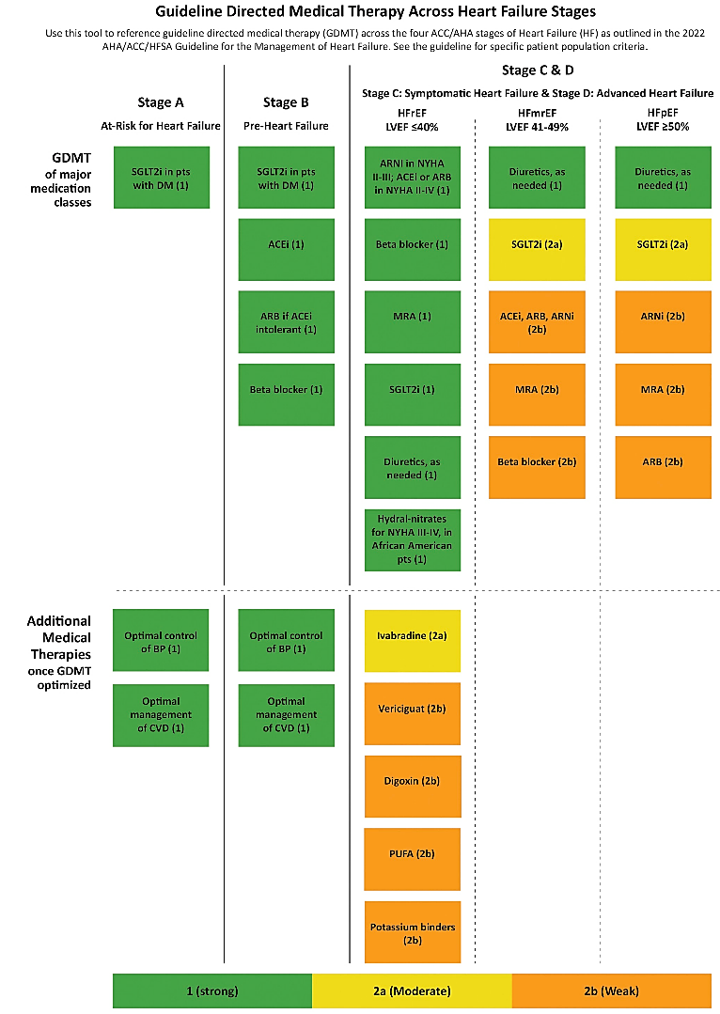

Slide 13
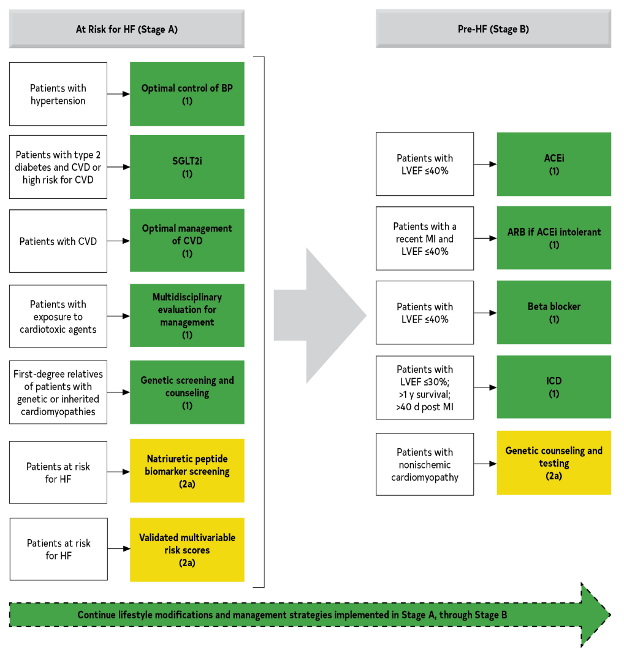
Recommendations for Patients at Risk of HF (Stage A) and Those With Pre-HF (Stage B)

Slide 14
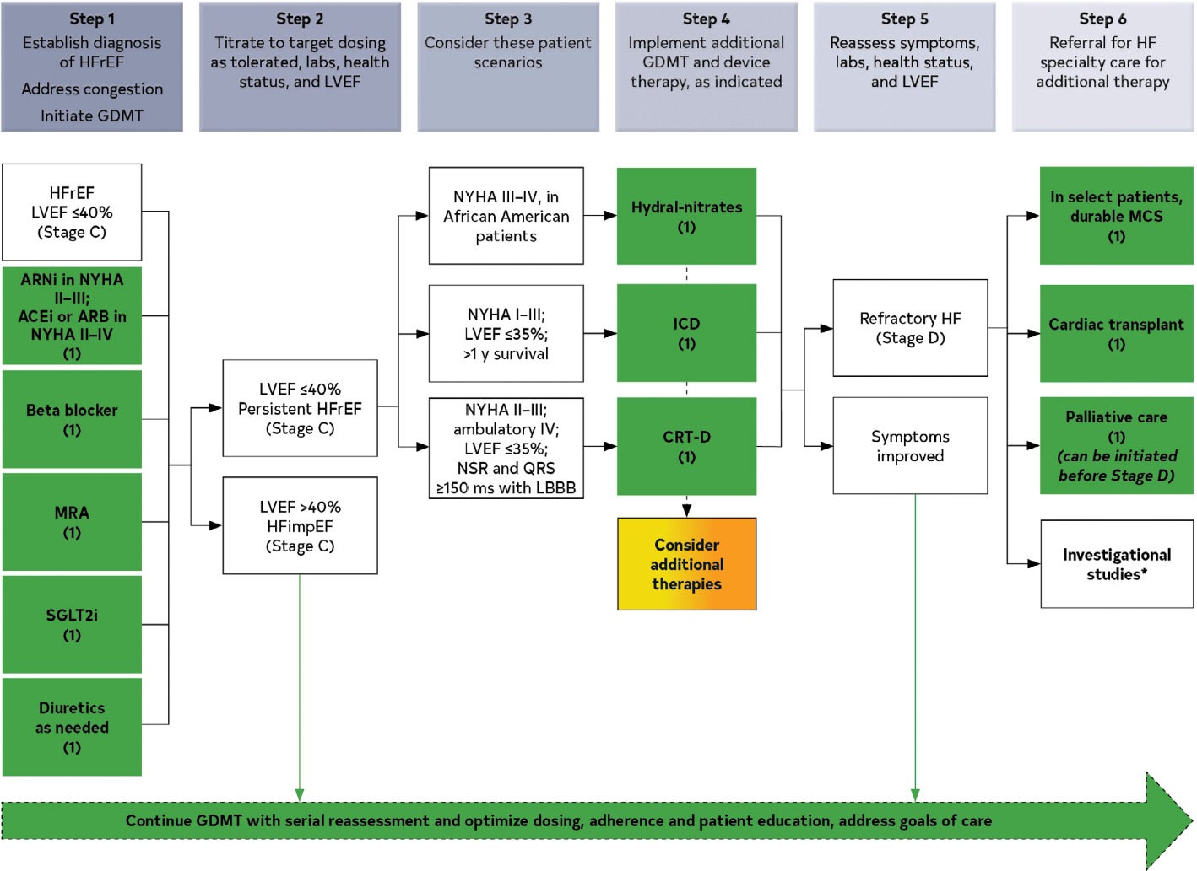
Treatment of HFrEF Stages C and D
Step 1 medications may be started simultaneously at initial (low) doses recommended for HFrEF.
Alternatively, these medications may be started sequentially, with sequence guided by clinical or other factors, without need to achieve target dosing before initiating next medication.
Medication doses should be increased to target as tolerated.

Slide 15
Treatment of HFrEF Stages C and D
Step 1 medications may be started simultaneously at initial (low) doses recommended for HFrEF.
Alternatively, these medications may be started sequentially, with sequence guided by clinical or other factors, without need to achieve target dosing before initiating next medication.
Medication doses should be increased to target as tolerated.

Slide 16
Other Clinical Trajectory Terminologies in UDHF
New onset/ de novo HF:
Worsening HF:
Improving HF:
Persistent HF:
HF in Remission:
Newly diagnosed HF
No former history of HF
Worsening symptom/signs/ functional capacity, and/or requiring escalation of therapies such as IV or other advanced therapies
and/or hospitalization
Improving symptoms/signs and or functional capacity
Persistent HF with ongoing symptoms/signs and or limited functional capacity
Resolution of symptoms and signs of HF, with resolution of previous structural/functional heart disease after a phase of symptomatic HF
Do not use
“Stable HF”, instead,
use “Persistent”
Do not use “Recovered HF” instead, use “HF in Remission”

Slide 17
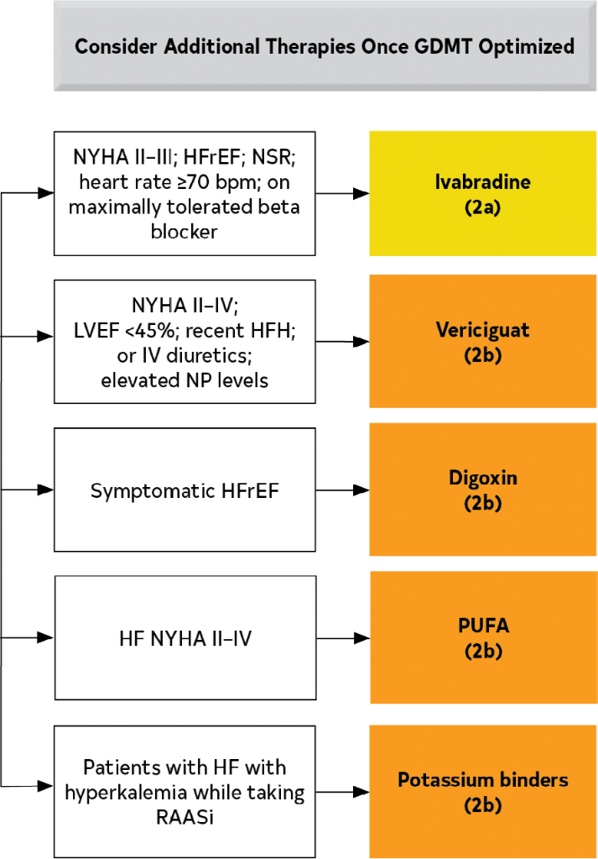
Additional Medical Therapies for Patients With HFrEF

Slide 18
STAGE C HFrEF Sequence According to Phenotypes / Etiology
NYHA Class II HF
Diuretic if congested
ARNi / ACEi
BB
MRA
SGLT2i
Early Post MI & Active Ischemia
BB
Diuretic if congested
ACEi
MRA
SGLT2i?
Tachycardia: Afib RVR, VT/PVC
BB
Diuretic if congested
ACEi (ARNi)
MRA
SGLT2i
CKD III-IV
Diuretic if congested
SGLT2i
ARNi
BB
MRA
NYHA Class III,  Congestion, Hospitalization
Diuretic if congested
SGLT2i
ARNi
MRA
BB
Vericiguat?
NYHA Class IV HF
Diuretic if congested
ACEi
SGLT2i
MRA
BB

Slide 19
Reversal of Remodeling
12 months in PROVE HF
9 months in SUGAR DM
ARNi
SGLT2i
Lee MMY, et al. Circulation. 2021;143(6):516-525.

Slide 20
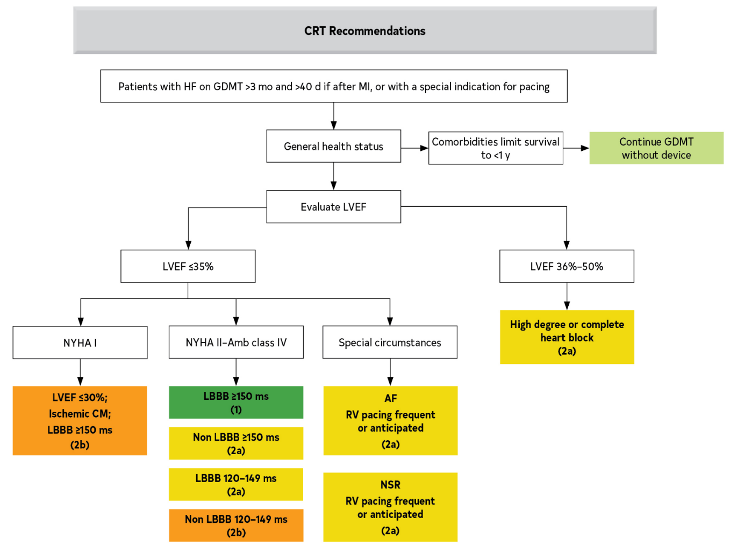
Algorithm for CRT Indications in Patients With Cardiomyopathy or HFrEF

Slide 21
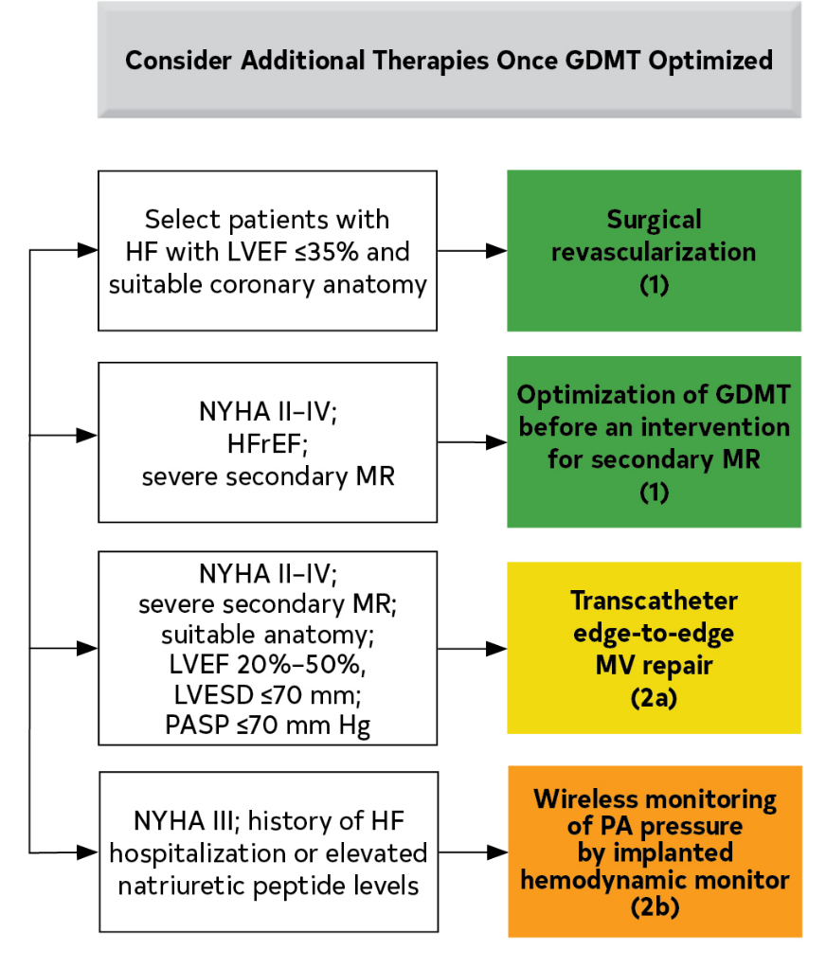
Additional Device Therapies

Slide 22
Maintenance or Optimization of GDMT During Hospitalization
Recommendations for Maintenance or Optimization of GDMT During Hospitalization Referenced studies that support the recommendations are summarized in the Online Data Supplements.
COR | LOE | Recommendations
1 | B-NR | In patients with HFrEF requiring hospitalization, preexisting GDMT should be continued and optimized to improve outcomes, unless contraindicated.
1 | B-NR | In patients experiencing mild decrease of renal function or asymptomatic reduction of blood pressure during HF hospitalization, diuresis and other GDMT should not routinely be discontinued.
1 | B-NR | In patients with HFrEF, GDMT should be initiated during hospitalization after clinical stability is achieved.
1 | B-NR | In patients with HFrEF, if discontinuation of GDMT is necessary during hospitalization, it should be reinitiated and further optimized as soon as possible.

Slide 23
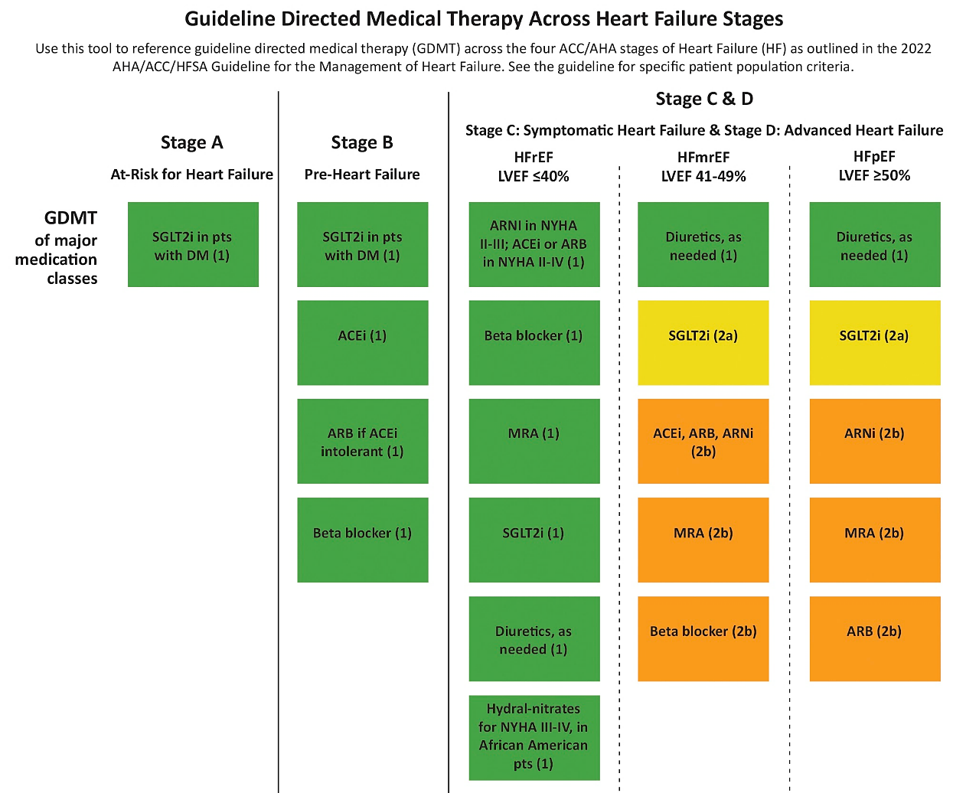
Summary

