Slide 1
New Therapies for HFrEF – How Do They Work? What Can They Offer?
Javed Butler, MD, MPH, MBA
President
Baylor Scott and White Research Institute
Distinguished Professor of Medicine
University of Mississippi
Jackson, MS

Slide 2
Disclaimer
The views and opinions expressed in this educational activity are those of the faculty and do not necessarily represent the views of TotalCME, Inc., the CME providers, or the companies providing educational grants. This presentation is not intended to define an exclusive course of patient management; the participant should use their clinical judgment, knowledge, experience, and diagnostic skills in applying or adopting for professional use any of the information provided herein. Any procedures, medications, or other courses of diagnosis or treatment discussed or suggested in this activity should not be used by clinicians without evaluation of their patient's conditions and possible contraindications or dangers in use, review of any applicable manufacturer’s product information, and comparison with recommendations of other authorities. Links to other sites may be provided as additional sources of information.

Slide 3
2022 AHA/ACC/HFSA HF Guidelines: SGLT2i are Now Recommended Across All Stages and Types of HF
GDMT Across HF Stages
Stage C and D
Stage C: Symptomatic HF and Stage D: Advanced HF
Stage A
At-Risk for HF
Stage B
Pre-HF
HFrEF: LVEF ≤40%
HFmrEF: LVEF 41-49%
HFpEF: LVEF ≥50%
GDMT
of major medication classes
SGLT2i in pts with DM
Class 1
SGLT2i in pts with DM
Class 1
ARNI in NYHA
II-III;
ACEI or ARB in NYHA II-IV
Class 1
Diuretics, as needed Class 1
Diuretics, as needed Class 1
ACEI
Class 1
Beta-blocker
Class 1
SGLT2i
Class 2a
SGLT2i
Class 2a
ARB if ACEI intolerant
Class 1
MRA
Class 1
ACEI, ARB, ARNI
Class 2b
ARNI
Class 2b
Beta-blocker
Class 1
SGLT2i
Class 1
MRA
Class 2b
MRA
Class 2b
Diuretics
as needed
Class 1
Beta-blocker
Class 2b
ARB
Class 2b
Hydral-nitrates for NYHA III-IV in African American pts
Class 1

Slide 4
Angiotensin receptor-neprilysin inhibitor (ARNI) Sacubitril/Valsartan
Indicated to reduce the risk of CV death and HHF in patients with chronic heart failure (NYHA Class II-IV) and reduced ejection fraction (11/2017), and preserved ejection fraction (2/2021)
Endogenous vasoactive peptides
Natriuretic peptides
Adrenomedullin
Bradykinin
Substance P
Calcitonin gene-related peptide
Decreases:
Neurohormonal activation
Vascular tone
Cardiac fibrosis, hypertrophy
Sodium retention
Neprilysin
Neprilysin inhibition
Inactive metabolites

Slide 5
ARNI: PARADIGM-HF
Composite CV Death or HHF
Randomized, double-blind trial
Patients with NYHA class II-IV HF, LVEF ≤40%
N = 4212 enalapril (10mg, twice daily + recommended therapy)
N = 4178 sacubitril/valsartan (200mg twice daily) + recommended therapy
Treatment with sacubitril/valsartan was superior to enalapril in reducing the risks of death and of hospitalization for heart failure: 20% relative risk reduction over median 27 months
1.0
Number needed to treat: 21
HR: 0.80 (95% CI: 0.73-0.87; P < .001)
0.6
0.5
0.4
Enalapril: 1117 events (26.5%)
Cumulative Probability
0.3
0.2
0.1
Sacubitril/valsartan: 914 events (21.8%)
0
0
180
360
540
720
900
1080
1260
Days Since Randomization

Slide 6
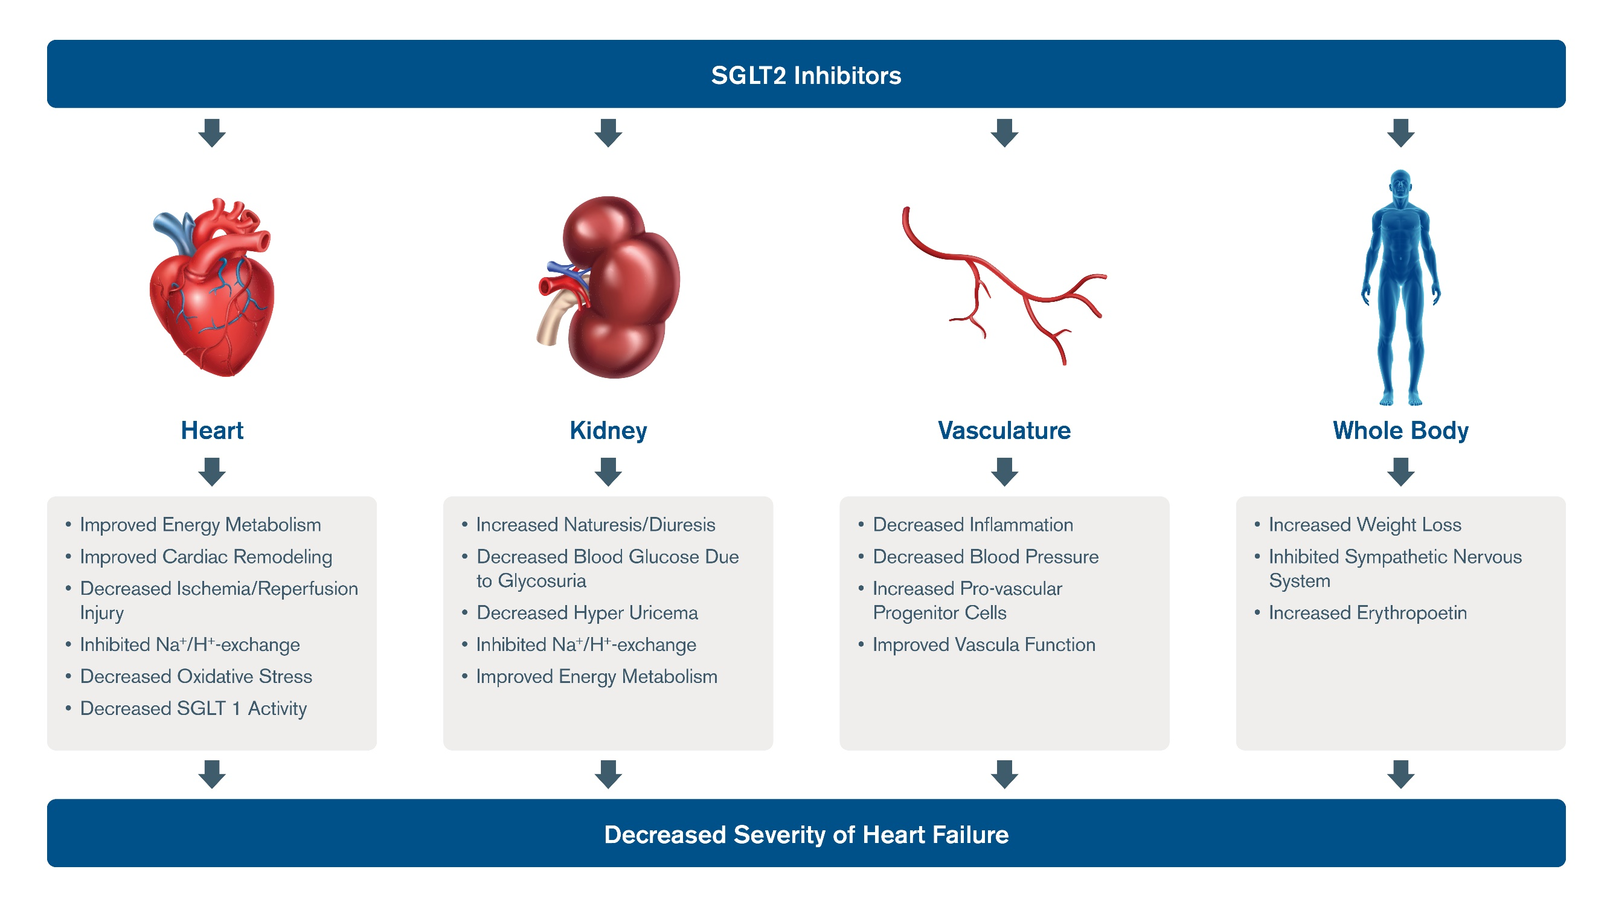
Sodium-GLucose coTransporter Type 2 (SGLT2) Inhibitors
Dapagliflozin: indicated for HFrEF (EF ≤40%) with or without diabetes, NYHA class II–IV HF, administered in conjunction with a background of GDMT for HF (5/20)
Under investigation:
empagliflozin (SGLT2i)
sotagliflozin (SGLT1/2i)
ertugliflozin (SGLTi)

Slide 7
Dapagliflozin: DAPA-HF, DAPA-CKD
DAPA-CKD primary composite outcome: sustained decline in eGFR of at least 50%, end-stage kidney disease, or death from renal or CV causes
DAPA-HF Trial: Among patients with HFrEF (≤40% and NYHA class II-IV symptoms), the risk of worsening heart failure or death from CV causes was lower among those who received dapagliflozin than among those who received placebo (16.3% vs 21.2%;HR 0.74; 95% CI 0.65-0.85), regardless of the presence or absence of diabetes

Slide 8
Empagliflozin: EMPEROR-Reduced
Composite CV Death or HHF
EMPEROR-Reduced Trial
Empagliflozin significantly decreased the incidence of:
CV composite end point- time to 1st event of CV death or HHF
Renal composite end point – chronic dialysis, renal transplant, sustained reduction of ≥40% eGFR, or sustained eGFR <15 mL/min/1.73 m² for patients with eGFR ≥30 mL/min/1.73 m² at baseline
in patients with heart failure (≤40% and NYHA class II-IV symptoms) independent of baseline diabetes status and across the continuum of HbA1c
2
Empagliflozin 10 mg (N=1863) vs placebo (N=1967)
1
0.5
Hazard ratio (95% CI)
0.25
0.125
6
8
10
12
Baseline HbA1c

Slide 9
Soluble Guanylate Cyclase Stimulator
Vericiguat is a first-in-class oral soluble guanylate cyclase stimulator approved for the treatment of HF patients following a HF-related hospitalization or need for outpatient IV diuretic (01/2021)
Heart
↓ Progressive myocardial
stiffening
↓ Myocardial thickening
↓ Ventricular remodeling
↓ Fibrosis
Vasculature
↓ Arterial constriction
↓ Vascular stiffness
Renal System
↓ Na+ and fluid retention
↑ Renal blood flow

Slide 10
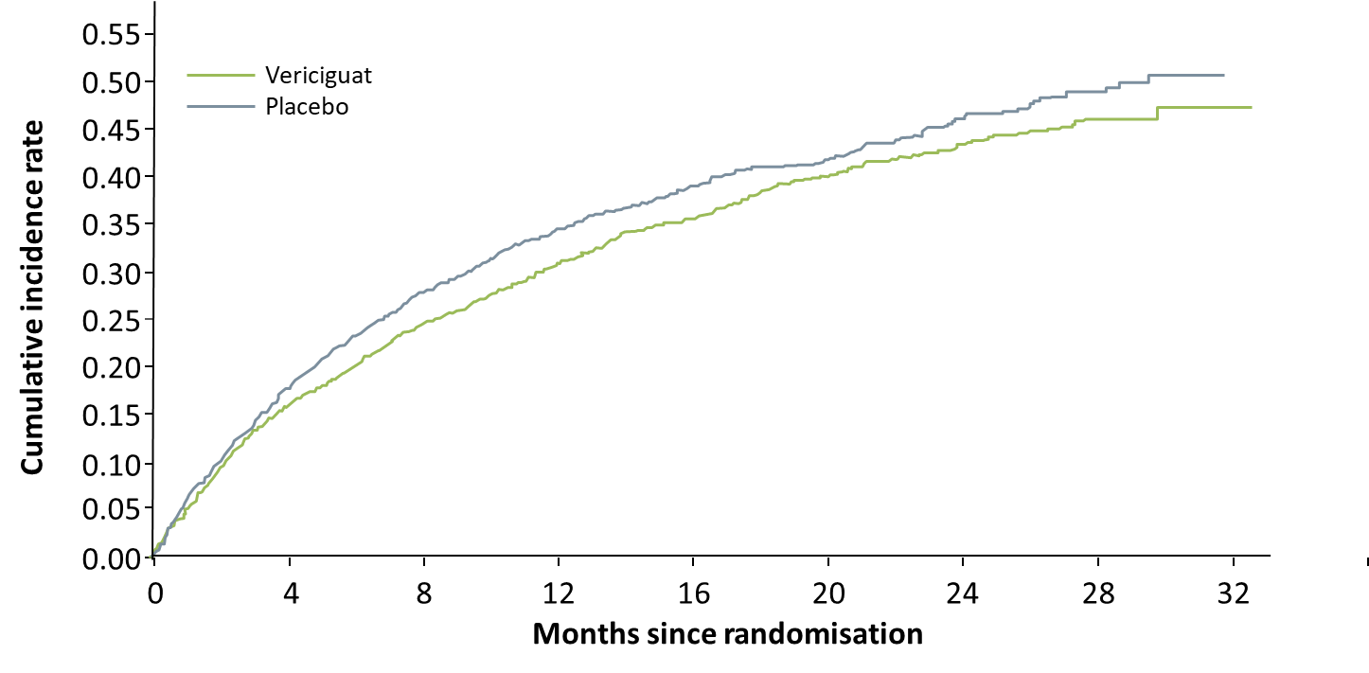
Vericiguat: VICTORIA
Vericiguat significantly reduced risk of HFH or CV death in symptomatic chronic HFrEF patients experiencing worsening heart failure.
Total Heart Failure Hospitalizations
Median treatment duration for primary endpoint: 10.8 months
Annual event rate for vericiguat vs placebo per 100 patient-years was 33.6% versus 37.8%, respectively
HR: 0.90 (95% CI: 0.82-0.98; P = 0.02)
ARR: 4.2%/year
Annual NNT: 24

Slide 11
Anemia & Iron Deficiency & Tissue Energy / Performance
Iron deficiency
Hb
Aerobic enzymes
(i.e. anemia)
Mitochondrion
Oxidative phosphorylation
O₂
ATP
O₂ delivery
O₂ utilization
tissue energy / performance status
Notes:
11

Slide 12
Ferric Carboxymaltose: AFFIRM-AHF Iron-Deficient Patients Discharged After Acute Heart Failure
Total Heart Failure Hospitalizations
100
RR: 0.74 (95% CI: 0.58-0.94; P = .013)
International, randomized, double-blind, placebo-controlled phase IV trial
Iron-deficient adults hospitalized for acute HF, LVEF <50%
N = 550 Placebo; N = 559 FCM
Treatment with ferric carboxymaltose (FCM) was safe and reduced the risk of heart failure hospitalizations
No apparent effect on the risk of cardiovascular death
80
60
Placebo
Mean Cumulative Evets/
100-Person -Yrs
40
20
FCM at discharge
0
4
24
48
0
12
52
Weeks

Slide 13
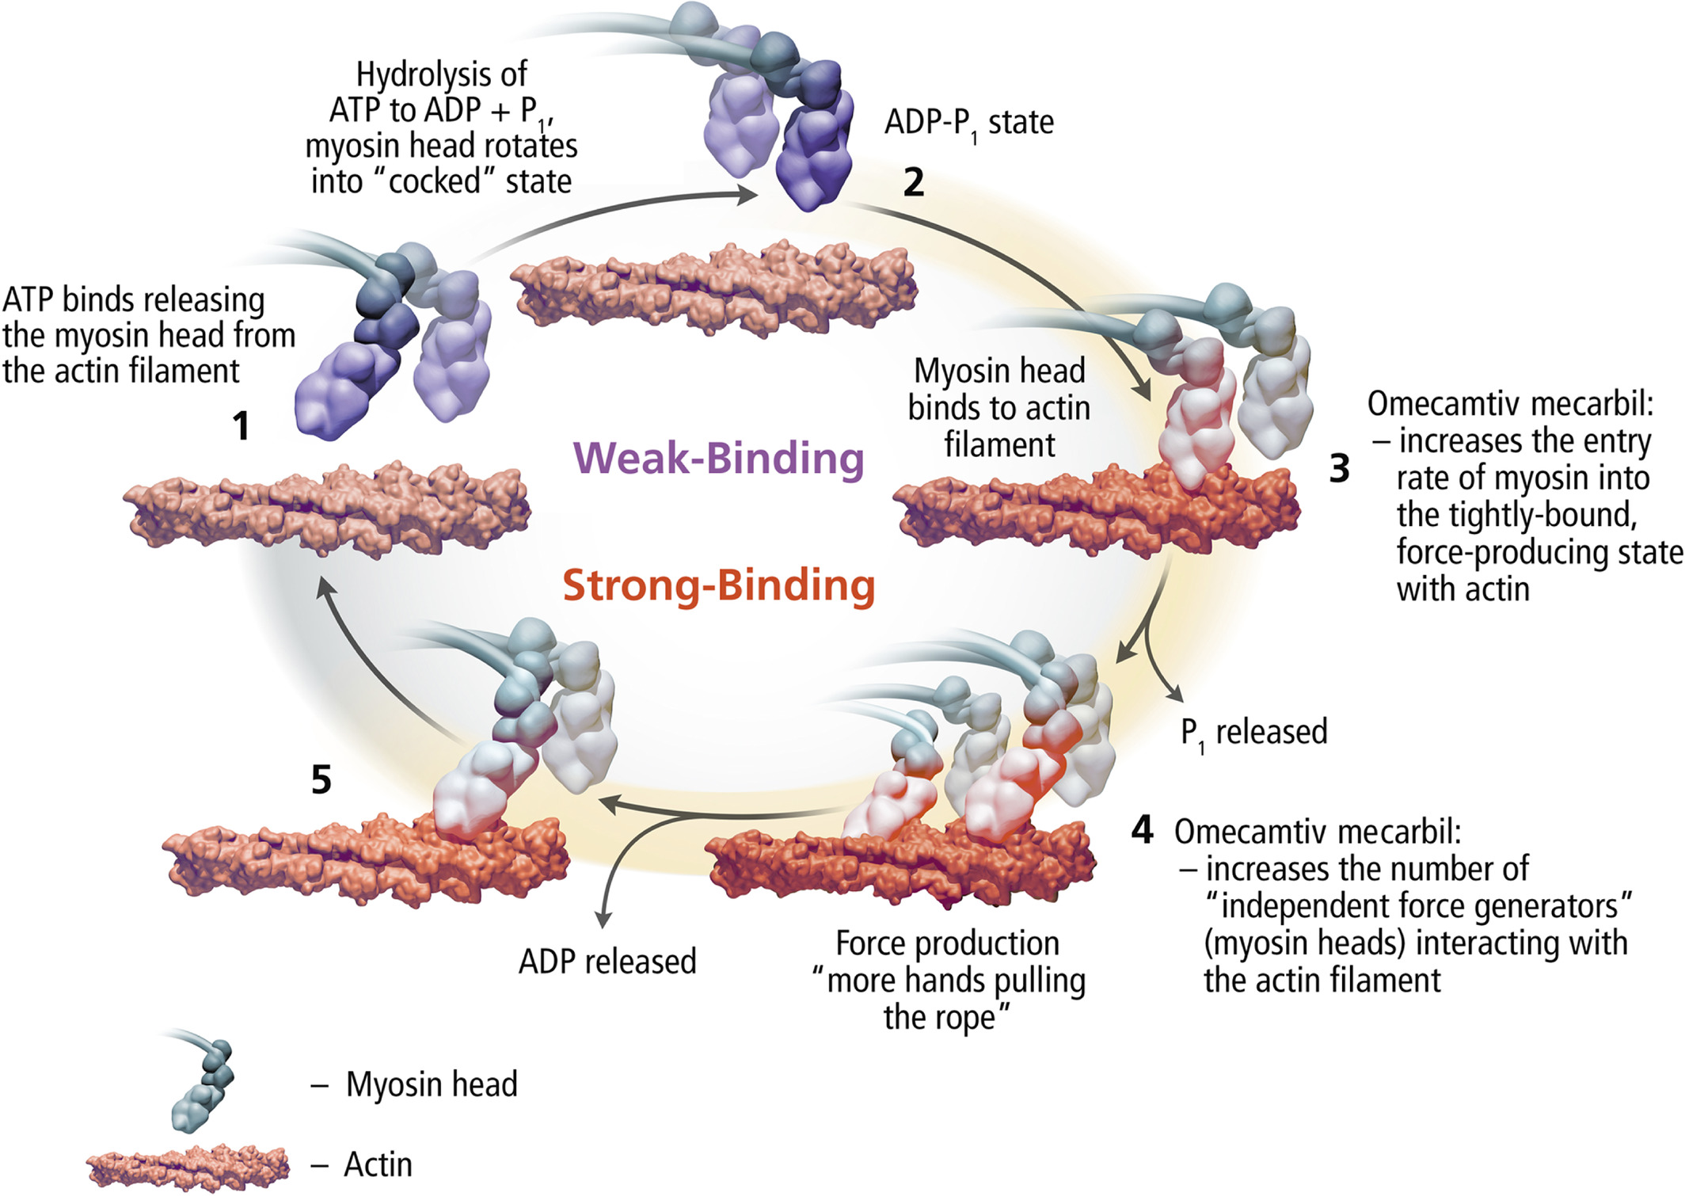
Omecamtiv Mecarbil

Slide 14
Omecamtiv Mecarbil: GALACTIC-HF
Omecamtiv mecarbil is a first-in-class myotrope that augments cardiac contractility by selectively binding to cardiac myosin. Clinical data demonstrated a reduction in the incidence of composite HF event or CV death in HFrEF in omecamtiv mecarbil treatment compared to placebo.
Primary Composite Endpoint Time to First HF Event or CV Death
 | HR (95% CI) | P Value
Time to first HF event or CV death (primary outcome) | 0.99 (0.86-0.99) | .025
Subgroup with baseline LVEF ≤ 28% | 0.84 (0.77-0.92) | P_{interaction} = .003
Subgroup with baseline LVEF > 28% | 1.04 (0.94-1.16)
Time to first HF event | 0.93 (0.86-1.00) | .06
Time to CV death | 1.01 (0.92-1.11) | .86
50
HR: 0.92 (95% CI: 0.86-0.99; P = .025)
Placebo
40
Omecamtiv mecarbil
30
Cumulative Incidence (%)
20
10
0
0
6
12
18
24
30
36

