Slide 1
Understanding the New Heart Failure Guidelines – What’s New for HFrEF?
Biykem Bozkurt, MD, PhD, FHFSA, FACC, FAHA, FACP
The Mary and Gordon Cain Chair and Professor of Medicine
Associate Provost of Faculty Affairs, Senior Associate Dean of Faculty Development
Director, Winters Center for Heart Failure Research
Assoc. Director, Cardiovascular Research Institute
Houston, TX

Slide 2
Disclaimer
The views and opinions expressed in this educational activity are those of the faculty and do not necessarily represent the views of TotalCME, Inc., the CME providers, or the companies providing educational grants. This presentation is not intended to define an exclusive course of patient management; the participant should use their clinical judgment, knowledge, experience, and diagnostic skills in applying or adopting for professional use any of the information provided herein. Any procedures, medications, or other courses of diagnosis or treatment discussed or suggested in this activity should not be used by clinicians without evaluation of their patient's conditions and possible contraindications or dangers in use, review of any applicable manufacturer’s product information, and comparison with recommendations of other authorities. Links to other sites may be provided as additional sources of information.

Slide 3
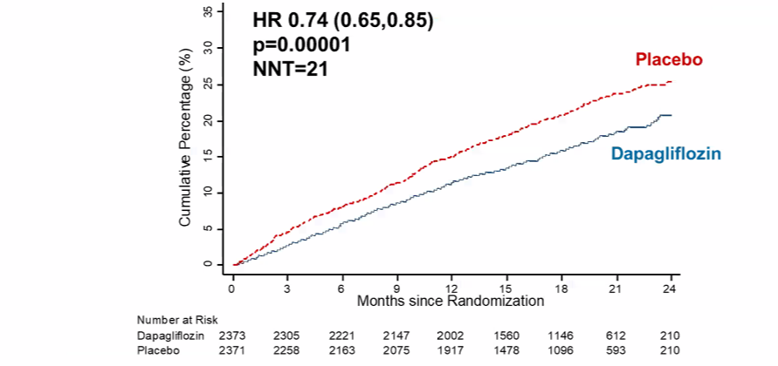
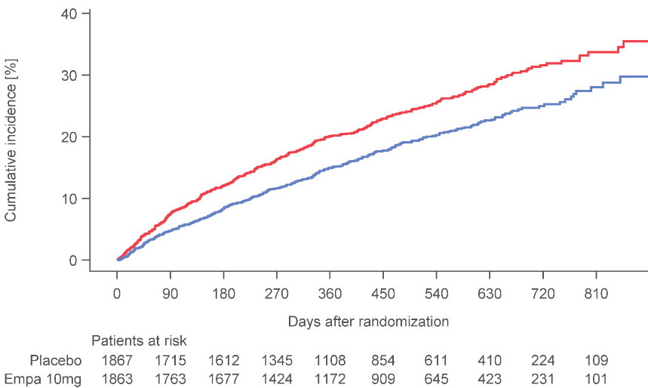
ARNi & SGLT2i in HFrEF
Primary Endpoint: CV Death or HFH
PARADIGM¹
40
1117
32
Enalapril
(n=4212)
914
24
LCZ696
(n=4187)
CV Death or HF Hospitalization
16
HR = 0.80 (0.73-0.87)
P = 0.0000002
Number needed to treat = 21
8
0
0
180
360
540
720
900
1080
1260
Days After Randomization
DAPA-HF²
EMPEROR-Reduced³
HR 0.75 (0.65, 0.86)
p< 0.0001
Placebo
3730 pts
4744 pts
Empagliflozin
55% was without DM, 41 % had CKD
50% was without DM, 48 % had CKD

Slide 4
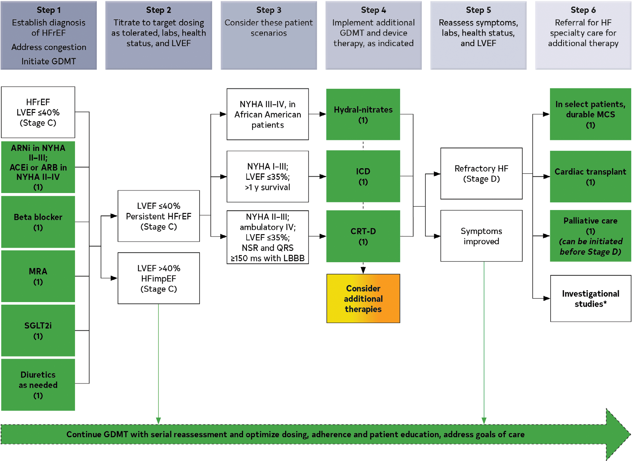
Treatment of HFrEF Stages C and D
Step 1 medications may be started simultaneously at initial (low) doses recommended for HFrEF.
Alternatively, these medications may be started sequentially, with sequence guided by clinical or other factors, without need to achieve target dosing before initiating next medication.
Medication doses should be increased to target as tolerated.

Slide 5
Treatment of HFrEF Stages C and D
Step 1 medications may be started simultaneously at initial (low) doses recommended for HFrEF.
Alternatively, these medications may be started sequentially, with sequence guided by clinical or other factors, without need to achieve target dosing before initiating next medication.
Medication doses should be increased to target as tolerated.

Slide 6
Treatment of HFrEF Stages C and D
Step 1 medications may be started simultaneously at initial (low) doses recommended for HFrEF.
Alternatively, these medications may be started sequentially, with sequence guided by clinical or other factors, without need to achieve target dosing before initiating next medication.
Medication doses should be increased to target as tolerated.

Slide 7
Treatment of HFrEF Stages C and D
Step 1 medications may be started simultaneously at initial (low) doses recommended for HFrEF.
Alternatively, these medications may be started sequentially, with sequence guided by clinical or other factors, without need to achieve target dosing before initiating next medication.
Medication doses should be increased to target as tolerated.

Slide 8
Treatment of HFrEF Stages C and D
Step 1 medications may be started simultaneously at initial (low) doses recommended for HFrEF.
Alternatively, these medications may be started sequentially, with sequence guided by clinical or other factors, without need to achieve target dosing before initiating next medication.
Medication doses should be increased to target as tolerated.

Slide 9
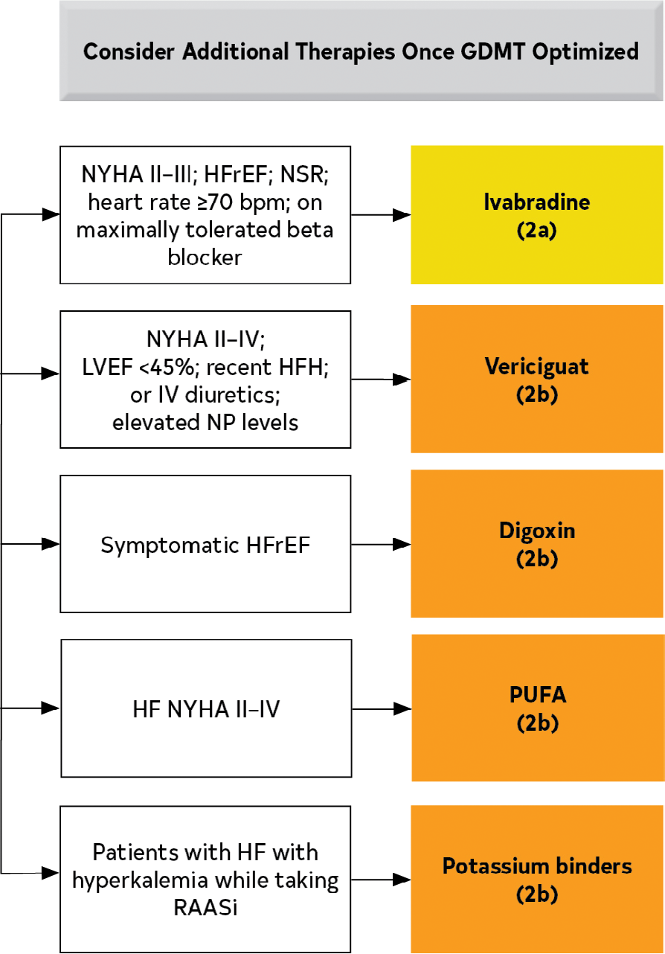
Additional Medical Therapies for Patients With HFrEF

Slide 10
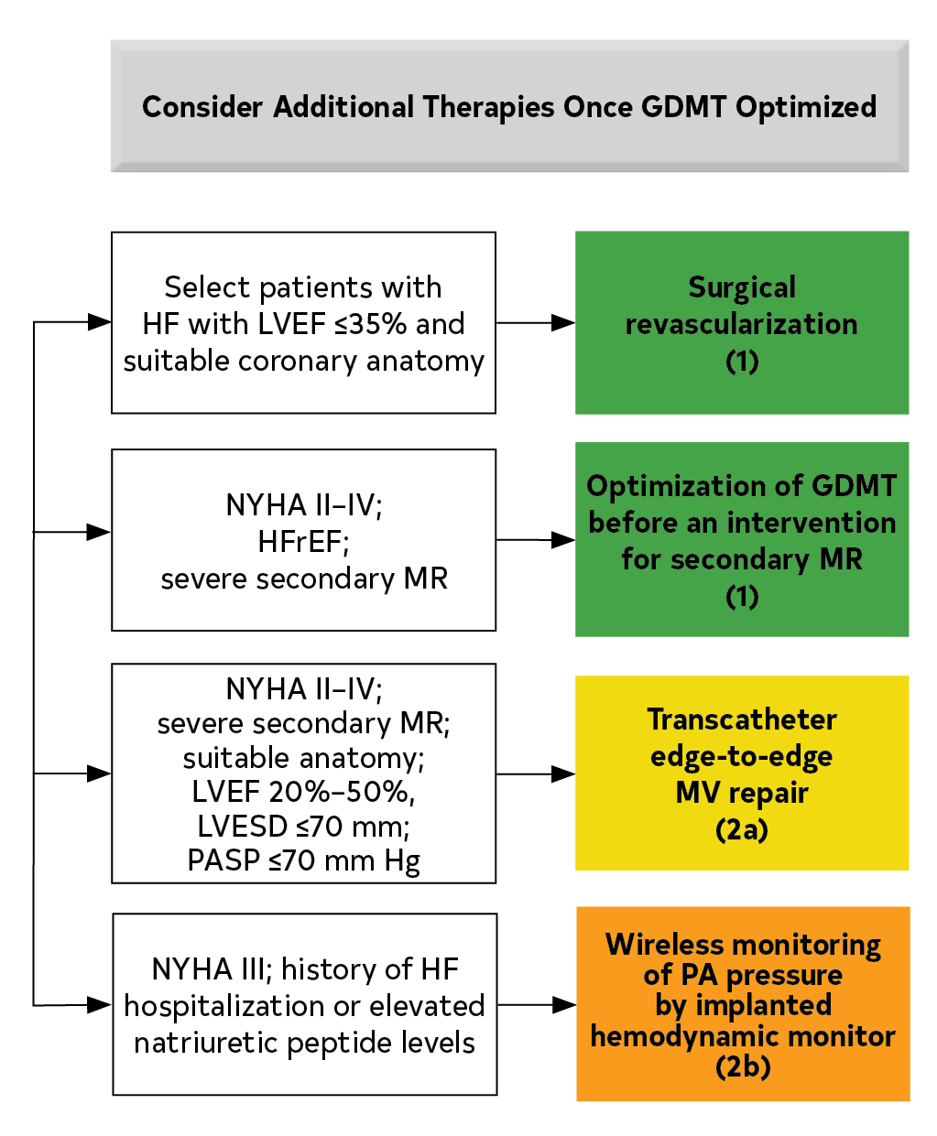
Additional Device Therapies

Slide 11
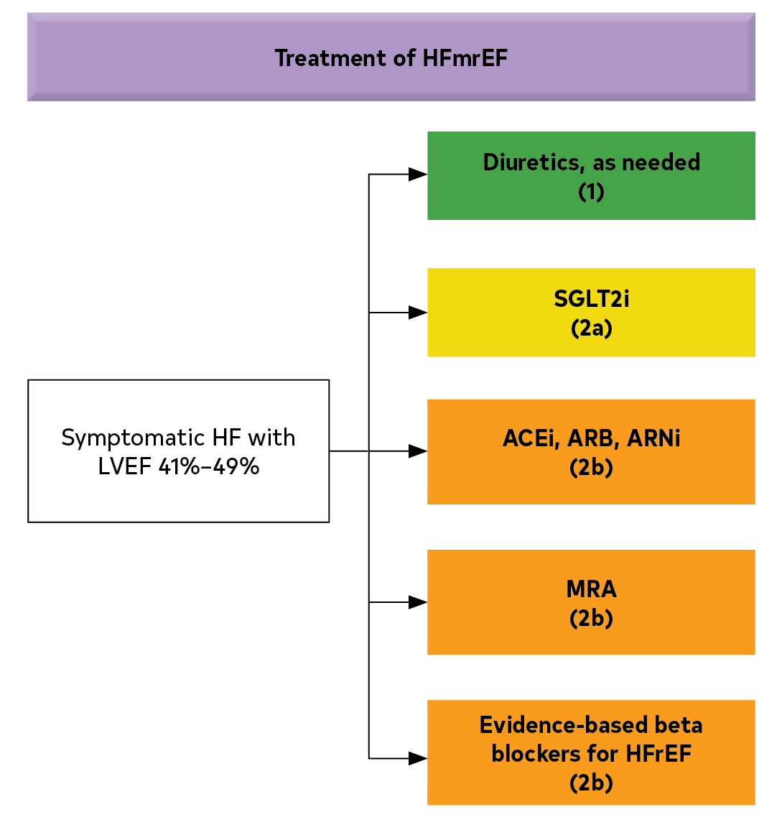
Recommendations for Patients With Mildly Reduced LVEF (41%–49%)

Slide 12
HF With Improved Ejection Fraction
Recommendation for HF With Improved Ejection Fraction Referenced studies that support the recommendation are summarized in the Online Data Supplements.
COR | LOE | Recommendation
1 | B-R | In HFimpEF after treatment, GDMT should be continued to prevent relapse of HF and LV dysfunction, even in patients who may become asymptomatic.

Slide 13
Maintenance or Optimization of GDMT During Hospitalization
Recommendations for Maintenance or Optimization of GDMT During Hospitalization Referenced studies that support the recommendations are summarized in the Online Data Supplements.
COR | LOE | Recommendations
1 | B-NR | In patients with HFrEF requiring hospitalization, preexisting GDMT should be continued and optimized to improve outcomes, unless contraindicated.
1 | B-NR | In patients experiencing mild decrease of renal function or asymptomatic reduction of blood pressure during HF hospitalization, diuresis and other GDMT should not routinely be discontinued.
1 | B-NR | In patients with HFrEF, GDMT should be initiated during hospitalization after clinical stability is achieved.
1 | B-NR | In patients with HFrEF, if discontinuation of GDMT is necessary during hospitalization, it should be reinitiated and further optimized as soon as possible.

Slide 14
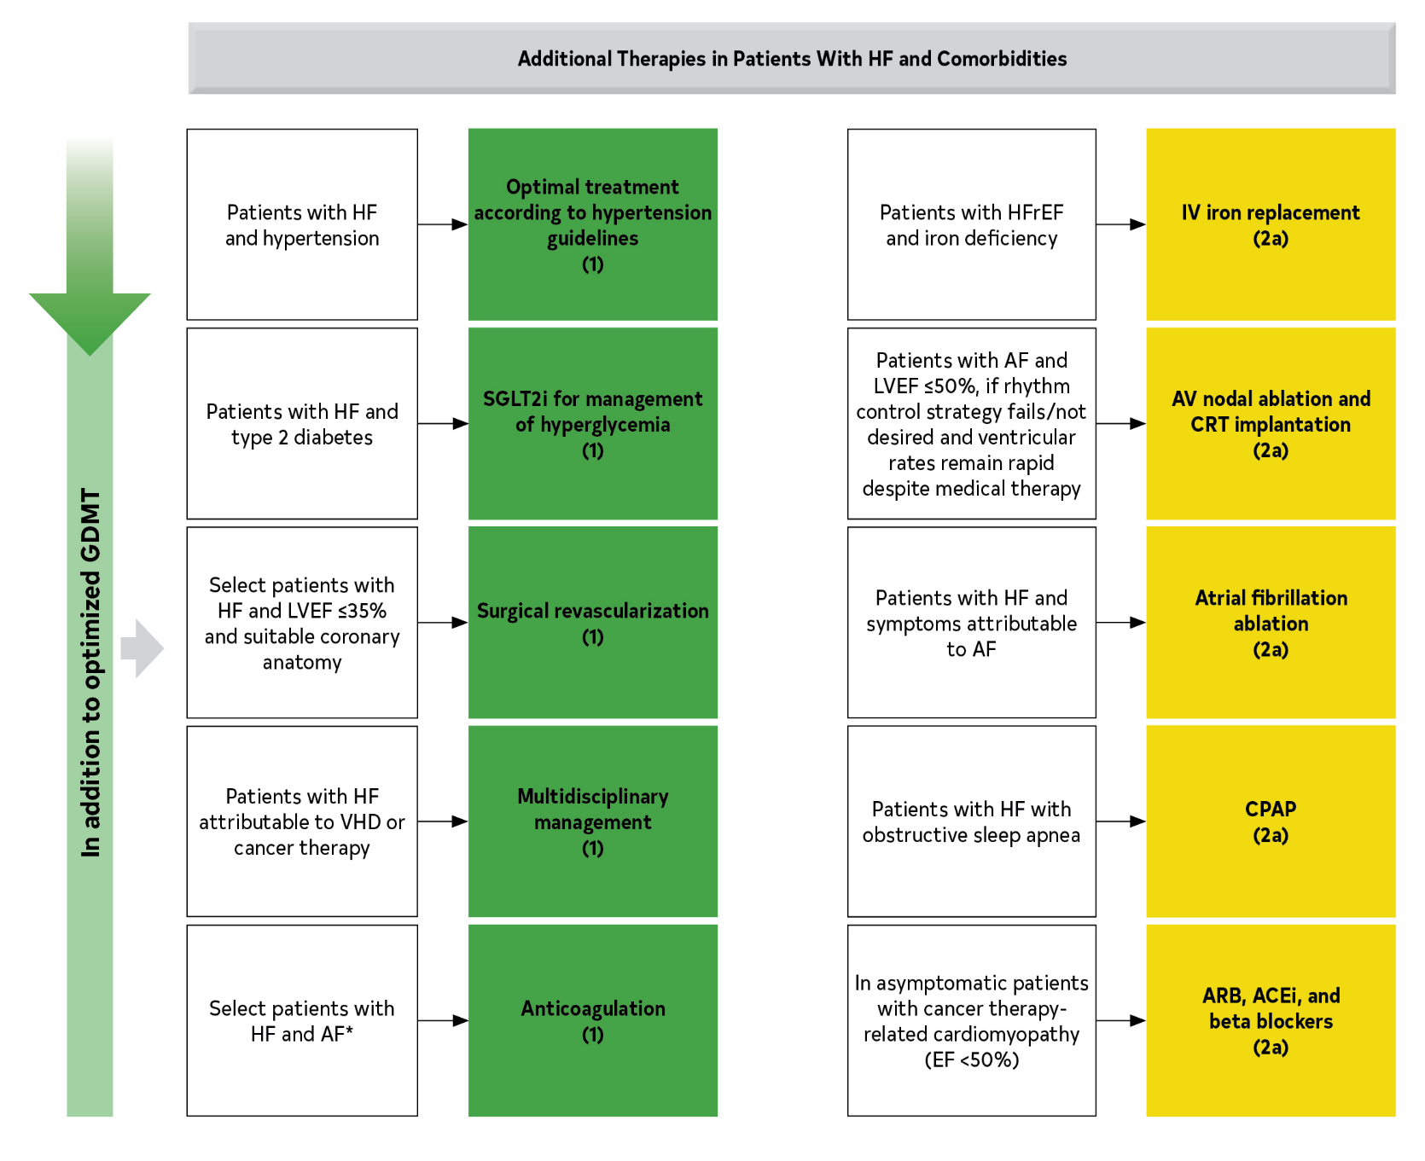
Recommendations for Treatment of Patients With HF and Selected Comorbidities

Slide 15
Summary
COR | LOE
1 | A | In patients with HFrEF, SGLT2i;RAASi with ARNi or ACEi/ARB; BB; MRA are recommended
HFrEF
2a | B-R | In patients with HFmrEF, SGLT2i can be beneficial in decreasing HFH and cardiovascular mortality
2b | B-NR | Among patients with symptomatic HFmrEF, use of BB, ARNi, ACEi or ARB, and MRAs may be considered to reduce the risk of HFH and CV mortality, particularly among patients with LVEF on the lower end of this spectrum.
HFmrEF
HFimpEF
1 | B-R | In HFimpEF after treatment, GDMT should be continued to prevent relapse of HF and LV dysfunction, even in patients who may become asymptomatic.

