Slide 1
Latest Guidance on Exercise Therapy & Lifestyle Modification: Treating Functional Limitations
Naomi Hamburg, MD, MS
Joseph Vita, Professor of Cardiovascular Medicine
Boston University Chobanian and Avedisian School of Medicine
Boston, MA

Slide 2



Resource Information
About This Resource
These slides are one component of a continuing education program available online at MedEd On The Go titled Guidelines on the Management of Patients with PAD
Program Learning Objectives:
Demonstrate an understanding of the recent developments in PAD management
Apply the latest guideline-directed approaches for PAD management
MedEd On The Go®
www.mededonthego.com
This content or portions thereof may not be published, posted online or used in presentations without permission.
This content can be saved for personal use (non-commercial use only) with credit given to the resource authors.
To contact us regarding inaccuracies, omissions or permissions please email us at support@MedEdOTG.com

Slide 3
Disclaimer
The views and opinions expressed in this educational activity are those of the faculty and do not necessarily represent the views of Total CME, LLC, the CME providers, or the companies providing educational grants. This presentation is not intended to define an exclusive course of patient management; the participant should use their clinical judgment, knowledge, experience, and diagnostic skills in applying or adopting for professional use any of the information provided herein. Any procedures, medications, or other courses of diagnosis or treatment discussed or suggested in this activity should not be used by clinicians without evaluation of their patient's conditions and possible contraindications or dangers in use, review of any applicable manufacturer’s product information, and comparison with recommendations of other authorities. Links to other sites may be provided as additional sources of information.

Slide 4
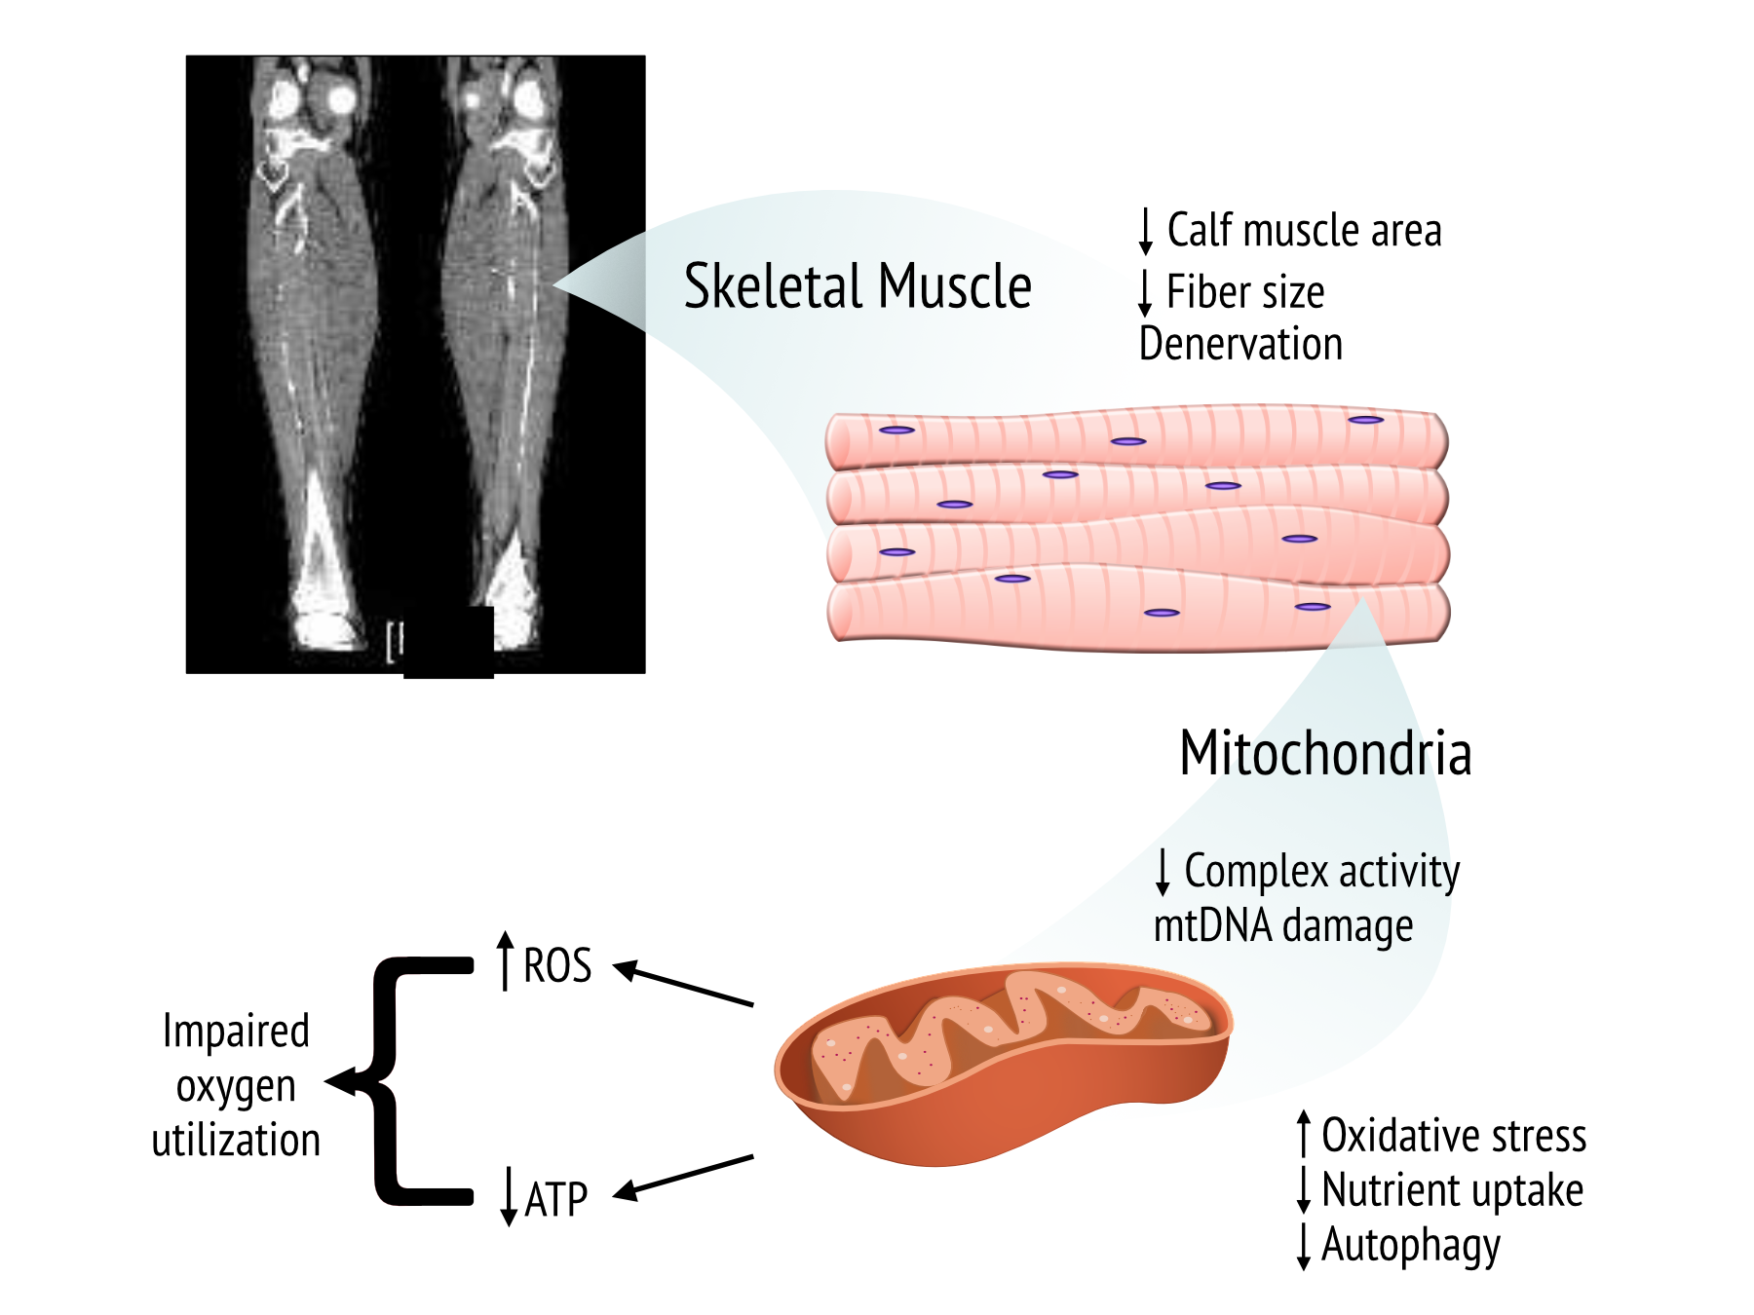
Leg Symptoms in Patients with PAD

Slide 5
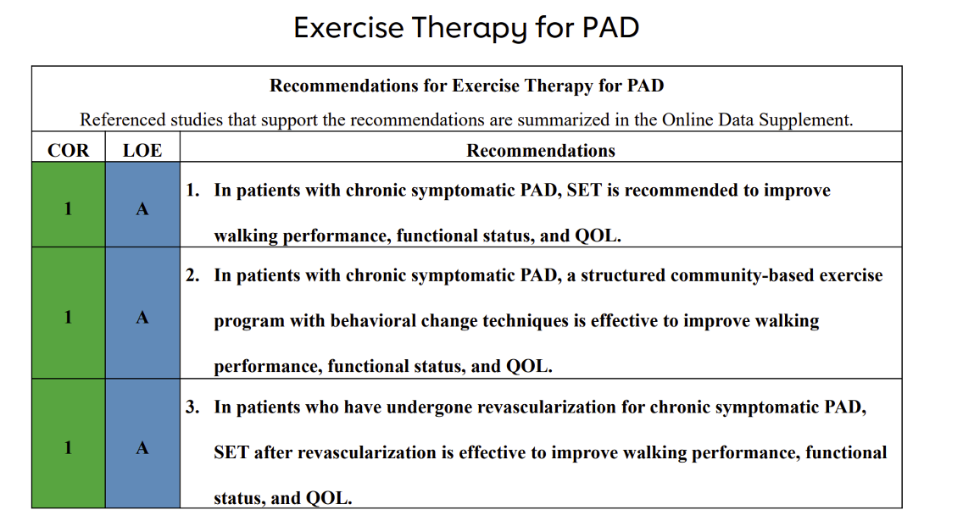
“Structured exercise is a core component of care for patients with PAD. It includes supervised exercise therapy and community-based (including structured home-based) programs”

Slide 6
Structured Exercise Program Elements in PAD
Supervised Program (SET):
Community-Based Program:
Intermittent walking exercise
In hospital or outpatient facility
Directly supervised
60 min session 3x/wk for 12wks
Walk to pain
Covered by insurance
Personal setting
Prescribed an exercise regimen
Self-directed and walking-based
Coaching and activity monitors
Periodic supervised sessions

Slide 7


Helping to Quit Tobacco
Develop a quit
plan combining pharmacologic and behavioral approaches
Dual nicotine replacement therapy, varenicline, buproprion
Avoid second-hand smoke

Slide 8


Slide 9



Looking for more resources
on this topic?
CME/CE in minutes
Congress highlights
Late-breaking data
Quizzes
Webinars
In-person events
Slides & resources
www.MedEdOTG.com

