Slide 1
Overcoming Disparities of Care - Impact of Social Determinants of Health of PAD
Schuyler Jones, MD
Associate Professor of Medicine
Duke University Health System
Durham, NC

Slide 2



Resource Information
About This Resource
These slides are one component of a continuing education program available online at MedEd On The Go titled Guidelines on the Management of Patients with PAD
Program Learning Objectives:
Demonstrate an understanding of the recent developments in PAD management
Apply the latest guideline-directed approaches for PAD management
MedEd On The Go®
www.mededonthego.com
This content or portions thereof may not be published, posted online or used in presentations without permission.
This content can be saved for personal use (non-commercial use only) with credit given to the resource authors.
To contact us regarding inaccuracies, omissions or permissions please email us at support@MedEdOTG.com

Slide 3
Disclaimer
The views and opinions expressed in this educational activity are those of the faculty and do not necessarily represent the views of Total CME, LLC, the CME providers, or the companies providing educational grants. This presentation is not intended to define an exclusive course of patient management; the participant should use their clinical judgment, knowledge, experience, and diagnostic skills in applying or adopting for professional use any of the information provided herein. Any procedures, medications, or other courses of diagnosis or treatment discussed or suggested in this activity should not be used by clinicians without evaluation of their patient's conditions and possible contraindications or dangers in use, review of any applicable manufacturer’s product information, and comparison with recommendations of other authorities. Links to other sites may be provided as additional sources of information.

Slide 4
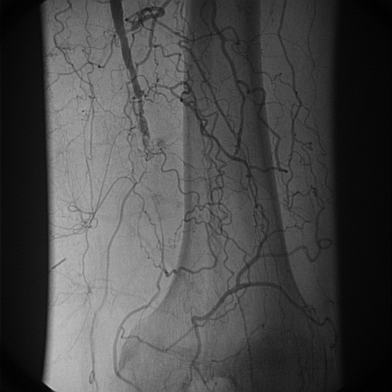
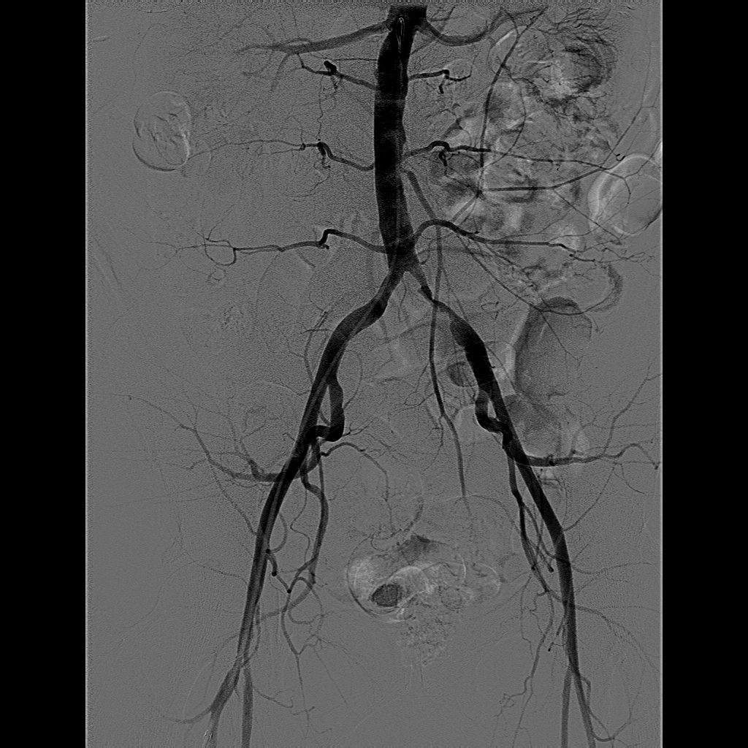
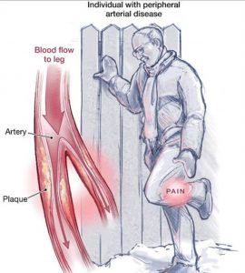
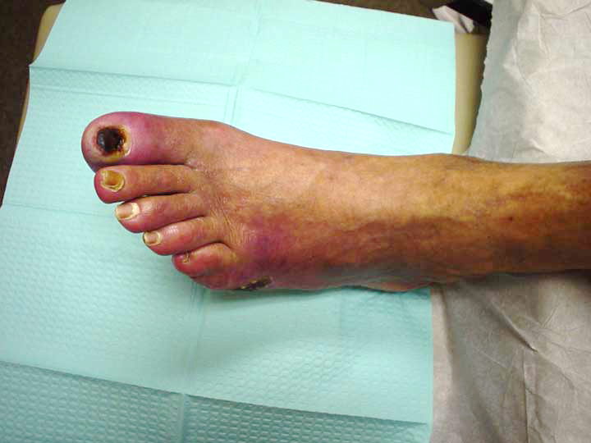
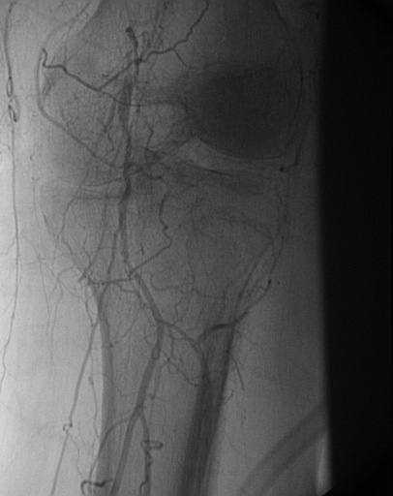
LE PAD
Intermittent claudication
Chronic limb threatening ischemia

Slide 5
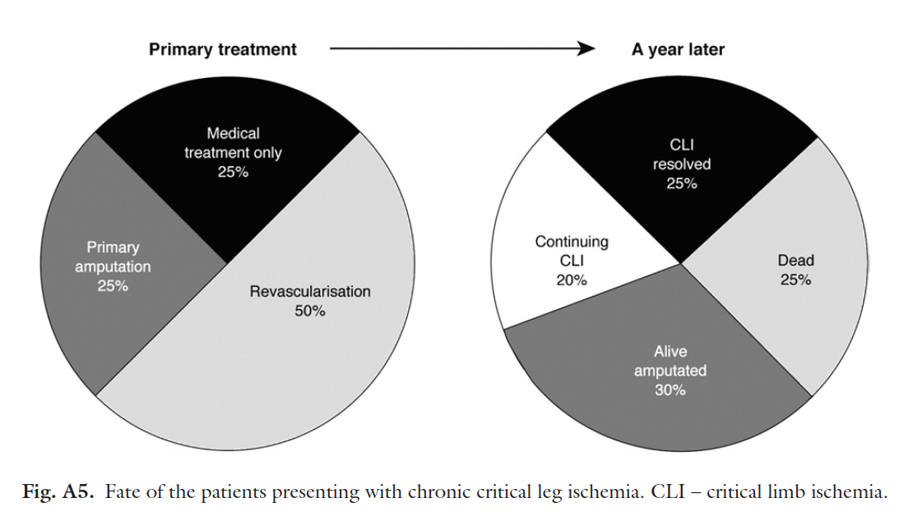
Epidemiology
CLI = most severe form of PAD
Less than 5% of all patients with PAD: ~ 2 million Americans annually
High rate of major amputation and all-cause mortality
Revascularization is cornerstone of treatment
  More than 30% of patients are
  not considered candidates
  (often due to comorbidities)
  Endo versus surg
Overall costs of PAD: ~ $10-20 billion

Slide 6
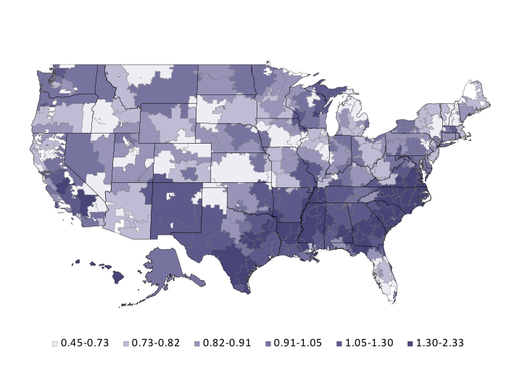
Lower Extremity Amputation
Overall rates decreasing but:
  Significant regional variation (up to 2 times)
  More than 30% of patients not imaged prior to amputation
  High-intensity vascular care associated with less amputation

Slide 8
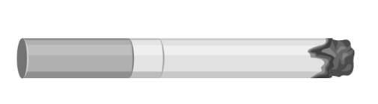



The Problem with PAD Care
29.8% not on any statin at all
62.6% of CLTI patients receiving PAD care from non-specialists
18.8% current smokers
Inadequate
Inequitable
Low-value
Medicaid: +20%
Black: +49%
Medicaid: +54%
49% hospitalization
8% amputation
15% mortality

Slide 9



Looking for more resources
on this topic?
CME/CE in minutes
Congress highlights
Late-breaking data
Quizzes
Webinars
In-person events
Slides & resources
www.MedEdOTG.com

