Slide 1
Protecting Insulin-Producing β-cells After Transplantation: Immunosuppression and Encapsulation
Melena D. Bellin, MD
Professor, Pediatric Endocrinology and Surgery
University of Minnesota Medical School
Masonic Children’s Hospital
Minneapolis, MN

Slide 2
Disclaimer
The views and opinions expressed in this educational activity are those of the faculty and do not necessarily represent the views of TotalCME, Inc., the CME providers, or the companies providing educational grants. This presentation is not intended to define an exclusive course of patient management; the participant should use their clinical judgment, knowledge, experience, and diagnostic skills in applying or adopting for professional use any of the information provided herein. Any procedures, medications, or other courses of diagnosis or treatment discussed or suggested in this activity should not be used by clinicians without evaluation of their patient's conditions and possible contraindications or dangers in use, review of any applicable manufacturer’s product information, and comparison with recommendations of other authorities. Links to other sites may be provided as additional sources of information.

Slide 3
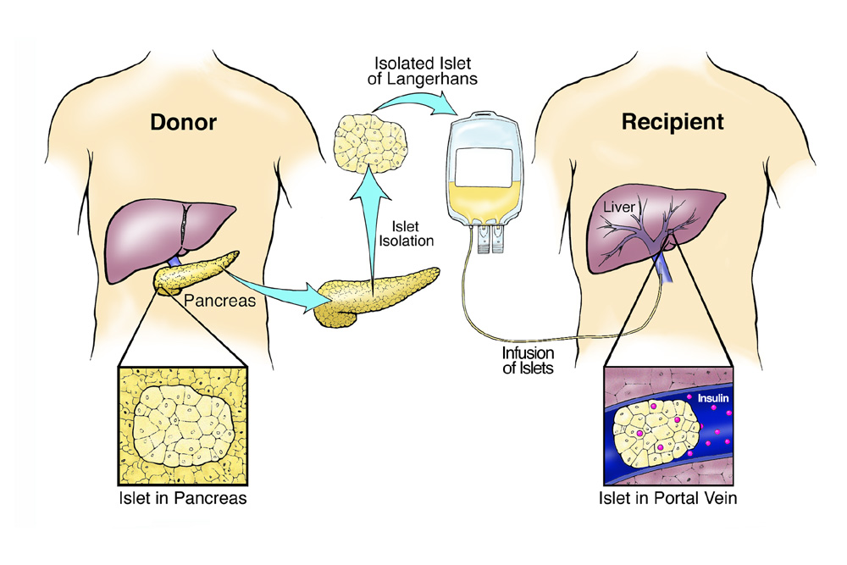
Islet Transplantation: Current State of Therapy
Cadaveric donor alloislet transplants restore endogenous insulin production
Islets under FDA regulation in US
Restricted to ‘high risk’ type 1 diabetes:
Severe hypoglycemia OR
Kidney transplant
Not obese, not insulin resistant
Notes:
Talking points:
Brief overview of state of islet transplant for clinical audience.
Points of emphasis: Diseased cadaveric donor (limited supply), infused into portal vein by mini lap or percuatenous. Minor surgical procedure (vs whole organ pancreas transplant)
In US, done under FDA regulation, largely in research setting; clinically available in areas of Canada and Europe
Very successful in restoring enough insulin production to allow stable, tight glycemic control w/o hypoglycemia in vast majority. And at experience centers, more than 80% may achieve insulin independence, though this requires more than one pancreatic islet infusion in some cases.
HOWEVER, just like a solid organ transplant, these donor islets are vulnerable to immune attack. Subject to both classical alloimmunity and autoimmunity
For this reason, all patients are on immunosuppression, and ONLY high risk patients with type 1 diabetes are candidates. Typically those with dangerous episodes of severe hypoglycemia, or have a kidney transplant and need immunosuppression regardless. Also work best in thin, insulin sensitive.

Slide 4
Steroid-Free Immunosuppression Led to Initial Success With Islet Transplants
INDUCTION (Short-term)
MAINTENANCE (Long-term)
Potent immunosuppression given only in the immediate peritransplant period
Antithymocyte globulin
OR
Alemtuzumab
OR
Basiliximab
Often +TNF-a (±IL-1) blockade for innate immunity
Start at time of transplant and continued ‘lifelong,’ or as long as islets last
Calcineurin inhibitor: Tacrolimus (usually) or cyclosporin
PLUS
Mycophenolate
OR
Sirolimus
CNI-sparing regimens (rare):
Efalizumab
Belatacept
Notes:
1999-2000 transplant trials in Edmonton
Tcell blockade vs IL-2Ra for induction.
CNI-based regmiens, steroid free maintenance.

Slide 5
Immunosuppression Selection Impacts Long-term Success
Best outcomes:
Age ≥35 years
Total infused islets ≥325,000 islet equivalents
T cell depletion and/or TNF-α inhibition
Sirolimus and CNI maintenance
Adapted from Bellin MD, et al. Am J Transplant. 2012;12(6):1576-1583. doi:10.1111/j.1600-6143.2011.03977.x
Notes:
Discuss impact of T-cell depletion and TNF-alpha/IL-1 blockade on 5 year outcomes. CITR data – use of tacrolimus + sirolimus, at least early on, with best success.

Slide 6
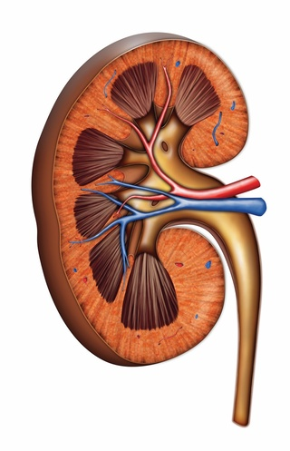
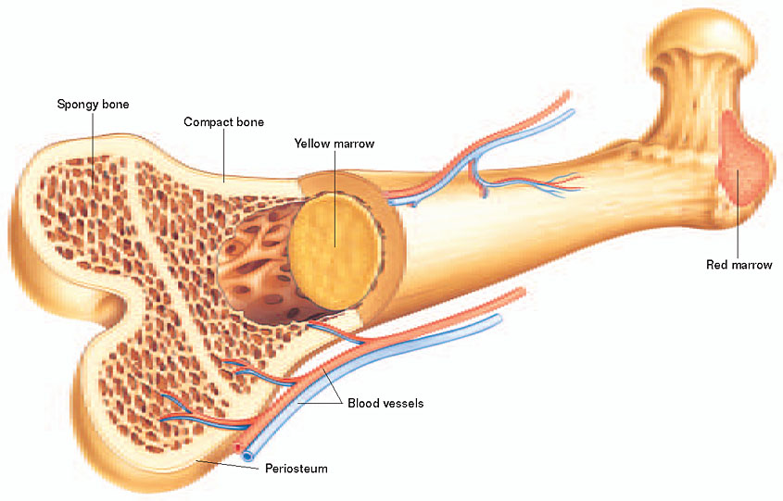
Monitoring Patients on Immunosuppression
Bone marrow suppression
Leukopenia (GCSF)
Anemia (iron, epogen)
Thrombocytopenia
Increased infection risk
Clinical symptoms (lower level of suspicion than ‘healthy’ pt)
EBV: Monitor PCR, not titers
CMV: Monitor PCR, not titers
Renal insufficiency
Creatinine/GFR (small drop in GFR common)
Most directly attributable to CNI-therapy
Neoplastic disease
Skin cancer: Annual dermatology visit long-term
Minor risk, but can be bothersome
GI symptoms
Mouth ulcers (sirolimus)
Edema
Tremors
Notes:
Balancing act– NO effective treatment for rejection in islet transplant, so need to keep immunosuppression sufficient to prevent rejection while minimizing risks

Slide 7

Approaching Transplant Differently…
To facilitate islet transplants (cadaveric or stem cell-derived) in more patients, immunosuppression needs to be minimized or eliminated
Need for immunosuppression is a major barrier to wide use of cell therapy in diabetes
TOLERANCE (Antigen-specific)
T-reg cells
Apoptotic donor leukocytes (negative vaccine)
GENE EDITING OF DONOR CELLS
CRSPR technology
Must address both auto- and alloimmunity
ENCAPSULATION TECHNOLOGIES
Full encapsulation or bioscaffolding

Slide 8
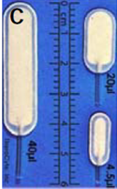
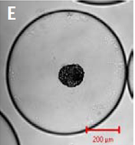
Encapsulation in Cell Therapy for T1D (In Development)
Type | Diffusion diameter of membrane | Advantages | Challenges
Macroencapsulation (multiple islets) | Thick 50-400 microns | Can be immunoprotective; easily retrievable (contains cells) | Hypoxia (diffusion); foreign body rx
Microencapsulation (1-3 islets) | Generally thick ~200 microns | Immunoprotective; +/-small diffusion diameter for O2 | Not retrievable, hypoxia remains a challenge
Nanoencapasulation (1 islet) | Very thin (single-layer coatings) | Immunoprotective; small diffusion diameter for O2 | Not retrievable, individual islet coating
Bioscaffold | Open device | Can be used for local release of trophic factors, immunosuppression w/o hypoxia/diffusion barrier | No immunoprotected barrier
Safely used in clinical trials with islets, xenoislets, and stem cell-derived islets

Slide 9
What to Know for Patients With Type 1 Diabetes
Cell therapy for diabetes is limited currently to patients who have type 1 diabetes complicated by severe hypoglycemia, or who need immunosuppression for a kidney transplant
May be a clinical procedure or clinical trial, depending on geography
However, approaches to reduce immunosuppression including encapsulation, tolerance induction, and gene editing are being actively studied, and would greatly improve safe access to islet (including stem cell-derived islet) transplants

