Slide 1
Transplanting Islet Cells:
How Do We Measure Success?
Thierry Berney, MD, MSc, FEBS (Transplant Surgery)
Medical Director, Bokeria University Hospital, Tbilisi, Georgia
Professor of Surgery, Ilia State University, Tbilisi, Georgia
Honorary Professor, University of Geneva, Switzerland

Slide 2
Disclaimer
The views and opinions expressed in this educational activity are those of the faculty and do not necessarily represent the views of TotalCME, Inc., the CME providers, or the companies providing educational grants. This presentation is not intended to define an exclusive course of patient management; the participant should use their clinical judgment, knowledge, experience, and diagnostic skills in applying or adopting for professional use any of the information provided herein. Any procedures, medications, or other courses of diagnosis or treatment discussed or suggested in this activity should not be used by clinicians without evaluation of their patient's conditions and possible contraindications or dangers in use, review of any applicable manufacturer’s product information, and comparison with recommendations of other authorities. Links to other sites may be provided as additional sources of information.

Slide 3
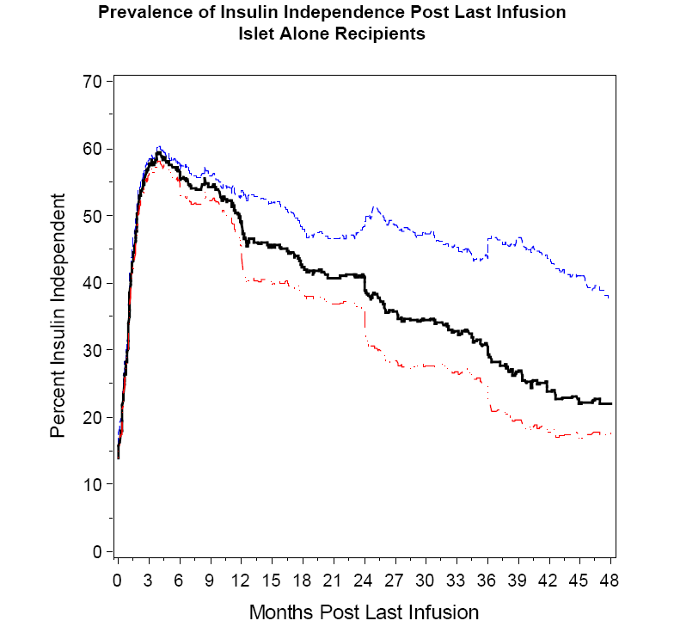
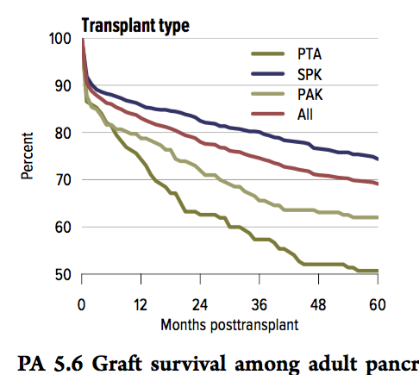
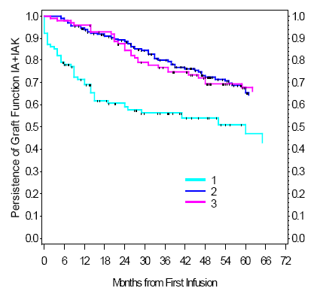
Measuring Success: Need for a Definition
Insulin independence
Graft function (C-peptide)

Slide 4
Measuring Success: Need for a Definition
Pancreas survival reported without uniform definition until this year
  New definition:
    Retransplant
    Death
    Relisting for an islet or pancreas transplant
    Need for insulin
  No metabolic outcome criteria
What is the real meaning of “insulin independence”?
  Insulin avoidance?
  What value in the absence of metabolic results?

Slide 5
Measuring Success: Outcomes of Interest
Indications and Objectives
Outcomes of Interest
Islet transplant alone (ITA)
  Prevent severe hypoglycemia
  Restore hypoglycemia awareness
  Prevent progression of other secondary diabetic complications
Islet after kidney (IAK)
  Protect kidney graft
  Prevent progression of other secondary diabetic complications
  Also for simultaneous islet-kidney (SIK)
Insulin independence – insulin needs
Fasting blood glucose
Functional parameters (C-peptide)
Islet transplant alone (ITA)
  Occurrence of severe hypoglycemic events (SHE)
  % time below range
Islet after kidney (IAK)
  HbA1c
  % time above range needs

Slide 6
Measuring Success: Outcomes of Interest
Indications and Objectives
Outcomes of Interest
Islet transplant alone (ITA)
  Prevent severe hypoglycemia
  Restore hypoglycemia awareness
  Prevent progression of other secondary diabetic complications
Islet after kidney (IAK)
  Protect kidney graft
  Prevent progression of other secondary diabetic complications
  Also for simultaneous islet-kidney (SIK)
Insulin independence – insulin needs
Fasting blood glucose
Functional parameters (C-peptide)
Islet transplant alone (ITA)
  Occurrence of severe hypoglycemic events (SHE)
  % time below range
Islet after kidney (IAK)
  HbA1c
  % time above range needs

Slide 7
Measuring Success: Outcomes of Interest
Indications and Objectives
Outcomes of Interest
Islet transplant alone (ITA)
  Prevent severe hypoglycemia
  Restore hypoglycemia awareness
  Prevent progression of other secondary diabetic complications
Islet after kidney (IAK)
  Protect kidney graft
  Prevent progression of other secondary diabetic complications
  Also for simultaneous islet-kidney (SIK)
Insulin independence – insulin needs
Fasting blood glucose
Functional parameters (C-peptide)
Islet transplant alone (ITA)
  Occurrence of severe hypoglycemic events (SHE)
  % time below range
Islet after kidney (IAK)
  HbA1c
  % time above range needs

Slide 8
Measuring Success: Outcomes of Interest
Indications and Objectives
Outcomes of Interest
Islet transplant alone (ITA)
  Prevent severe hypoglycemia
  Restore hypoglycemia awareness
  Prevent progression of other secondary diabetic complications
Islet after kidney (IAK)
  Protect kidney graft
  Prevent progression of other secondary diabetic complications
  Also for simultaneous islet-kidney (SIK)
Insulin independence – insulin needs
Fasting blood glucose
Functional parameters (C-peptide)
Islet transplant alone (ITA)
  Occurrence of severe hypoglycemic events (SHE)
  % time below range
Islet after kidney (IAK)
  HbA1c
  % time above range needs

Slide 9
Measuring Success: Outcomes of Interest
Indications and Objectives
Outcomes of Interest
Islet transplant alone (ITA)
  Prevent severe hypoglycemia
  Restore hypoglycemia awareness
  Prevent progression of other secondary diabetic complications
Islet after kidney (IAK)
  Protect kidney graft
  Prevent progression of other secondary diabetic complications
  Also for simultaneous islet-kidney (SIK)
Insulin independence – insulin needs
Fasting blood glucose
Functional parameters (C-peptide)
Islet transplant alone (ITA)
  Occurrence of severe hypoglycemic events (SHE)
  % time below range
Islet after kidney (IAK)
  HbA1c
  % time above range needs

Slide 10
Measuring Success: Outcomes of Interest
Indications and Objectives
Outcomes of Interest
Islet transplant alone (ITA)
  Prevent severe hypoglycemia
  Restore hypoglycemia awareness
  Prevent progression of other secondary diabetic complications
Islet after kidney (IAK)
  Protect kidney graft
  Prevent progression of other secondary diabetic complications
  Also for simultaneous islet-kidney (SIK)
Insulin independence – insulin needs
Fasting blood glucose
Functional parameters (C-peptide)
Islet transplant alone (ITA)
  Occurrence of severe hypoglycemic events (SHE)
  % time below range
Islet after kidney (IAK)
  HbA1c
  % time above range needs

Slide 11
Measuring Success: Outcomes of Interest
Indications and Objectives
Outcomes of Interest
Islet transplant alone (ITA)
  Prevent severe hypoglycemia
  Restore hypoglycemia awareness
  Prevent progression of other secondary diabetic complications
Islet after kidney (IAK)
  Protect kidney graft
  Prevent progression of other secondary diabetic complications
  Also for simultaneous islet-kidney (SIK)
Insulin independence – insulin needs
Fasting blood glucose
Functional parameters (C-peptide)
Islet transplant alone (ITA)
  Occurrence of severe hypoglycemic events (SHE)
  % time below range
Islet after kidney (IAK)
  HbA1c
  % time above range needs

Slide 12
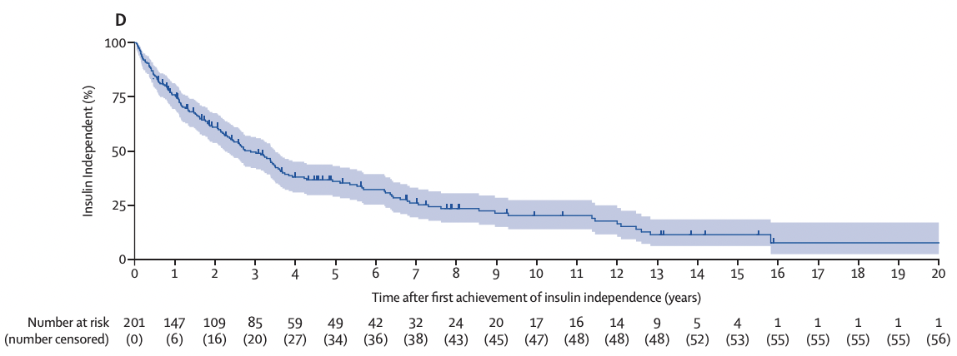
Success Does Not Equate to Insulin Independence
Insulin Independence: 8% at 20 Years

Slide 13
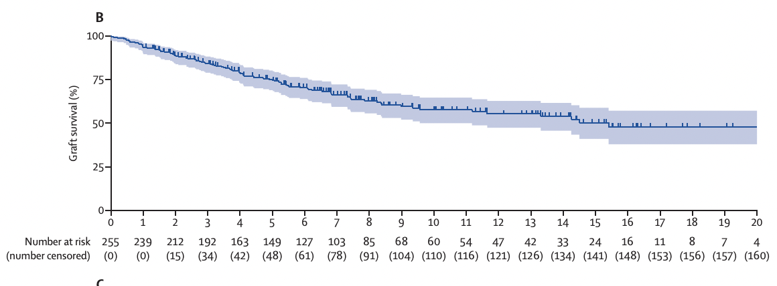
Success Does Not Equate to Insulin Independence
Insulin Independence: 8% at 20 Years
Graft Function: 48% at 20 Years

Slide 14
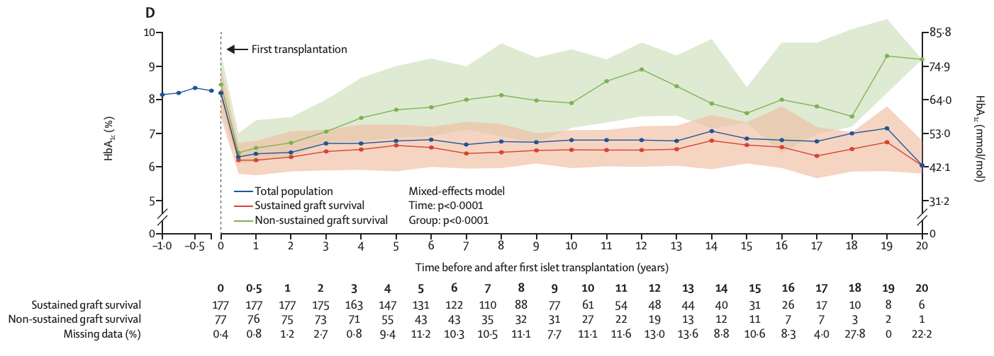
Success Does Not Equate to Insulin Independence
Insulin Independence: 8% at 20 Years
HbA1c in FCT Grafts: 6% at 20 Years
Graft Function: 48% at 20 Years

Slide 15
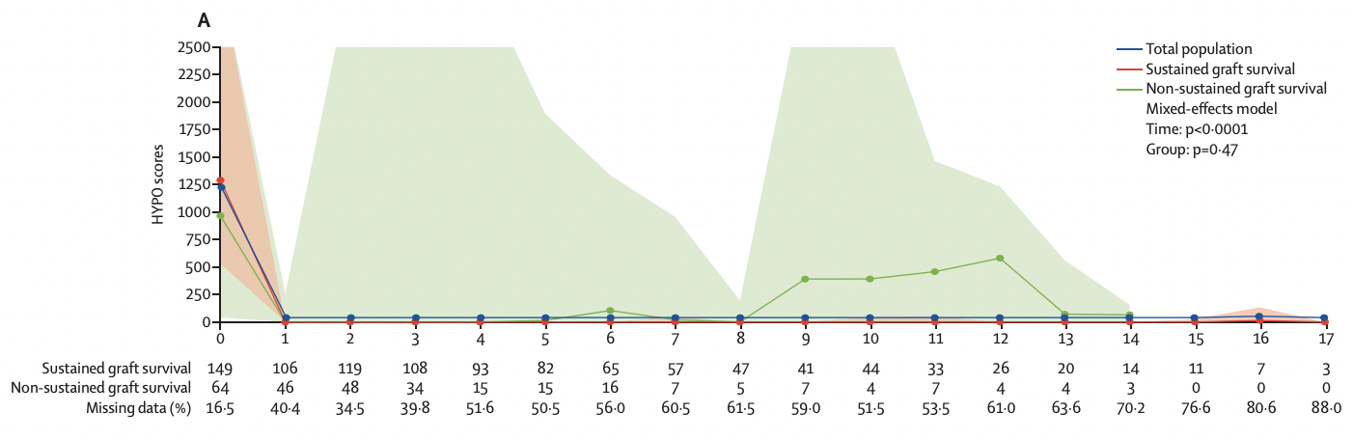
Success Does Not Equate to Insulin Independence
Insulin Independence: 8% at 20 Years
HbA1c in FCT Grafts: 6% at 20 Years
Graft Function: 48% at 20 Years
HYPO Score in FCT Grafts: 0 at 20 Years

Slide 16
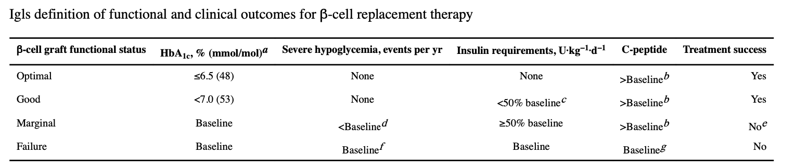
Defining Outcomes: The Igls Criteria
Integration of functional (C-peptide), metabolic (HbA1c), therapeutic (insulin), and clinical (SHE) criteria
Applicable equally to islet and pancreas treatment ➔ allows comparisons
Defines 4 categories of functional outcome: optimal, good, marginal, failure
Defines 2 categories of success/failure

Slide 17
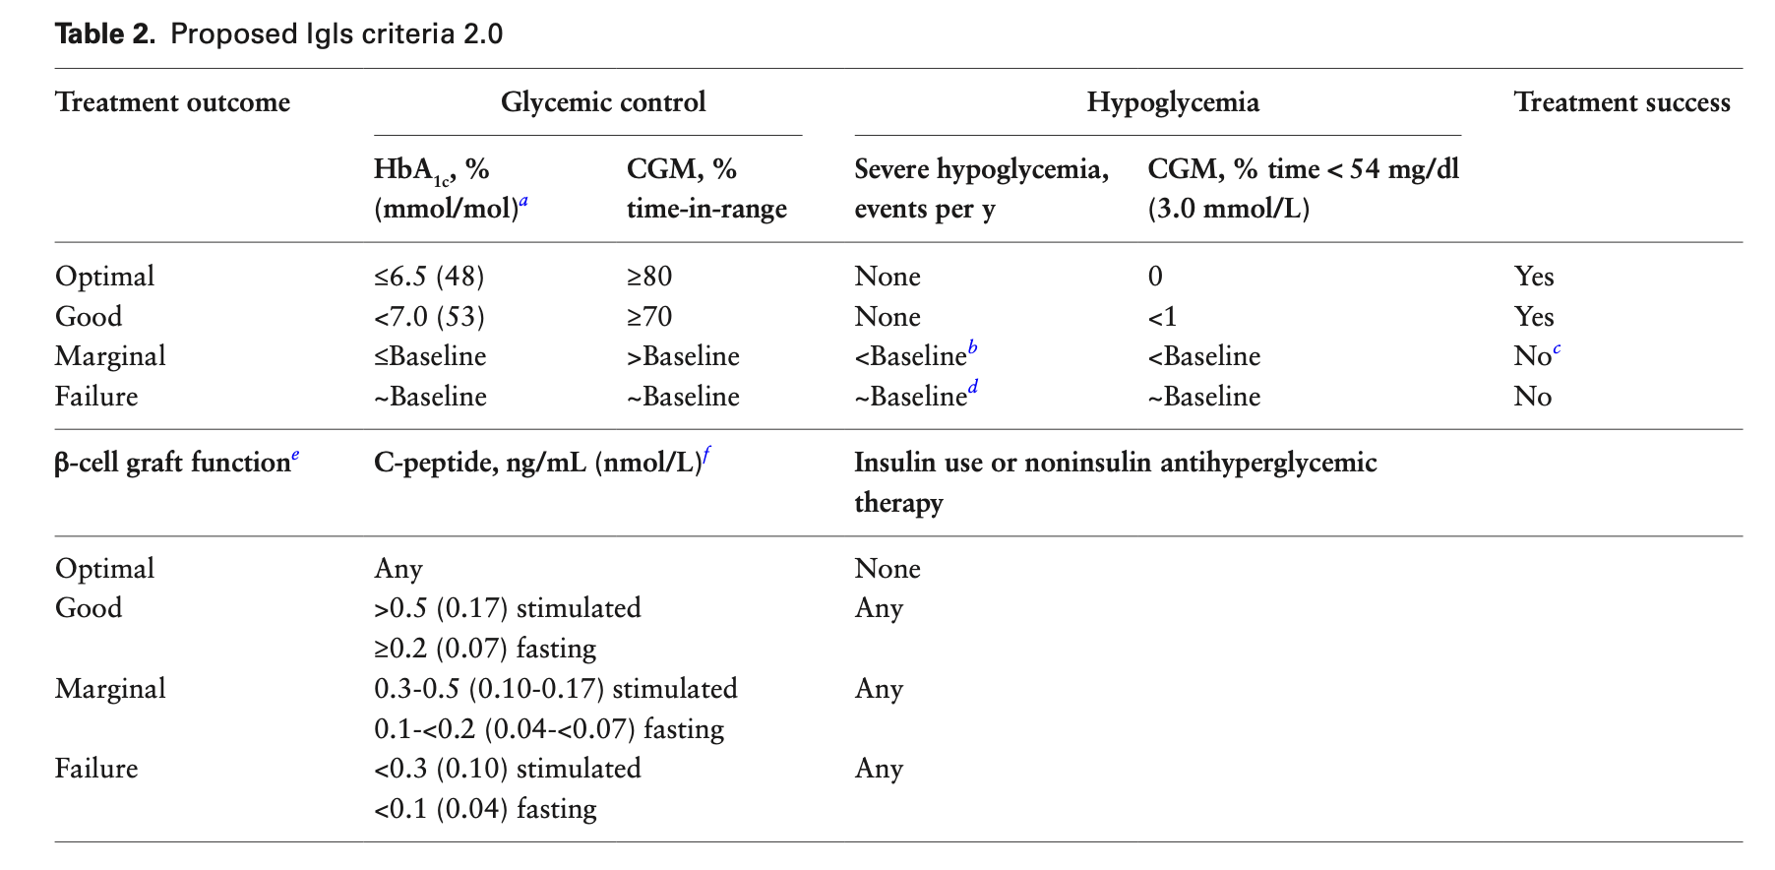
Defining Outcomes: The Igls 2.0 Criteria
Integration of CGMS data (time in range)
Differentiation of:
  Treatment outcome
  b-cell graft function assessment
Same categories of outcome and success

Slide 18
Conclusion
The Igls criteria provide reproducible definitions of outcomes and success for islet cell transplantion
Easy to use
Refined assessment outcome beyond the on/off-insulin criterion
Applicable to pancreas transplantation, allowing direct comparison with a unified vocabulary
Applicable to assessment of other forms of β-cell replacement therapies, notably stem cell-derived
Applicability to artificial pancreas systems should be tested

