Slide 1
What Is the Importance of Hypoglycemia Awareness in T1D Patients?
Michael R. Rickels, MD, MS
Willard and Rhoda Ware Professor in Diabetes and Metabolic Diseases
University of Pennsylvania Perelman School of Medicine
Philadelphia, PA

Slide 2
Disclaimer
The views and opinions expressed in this educational activity are those of the faculty and do not necessarily represent the views of TotalCME, Inc., the CME providers, or the companies providing educational grants. This presentation is not intended to define an exclusive course of patient management; the participant should use their clinical judgment, knowledge, experience, and diagnostic skills in applying or adopting for professional use any of the information provided herein. Any procedures, medications, or other courses of diagnosis or treatment discussed or suggested in this activity should not be used by clinicians without evaluation of their patient's conditions and possible contraindications or dangers in use, review of any applicable manufacturer’s product information, and comparison with recommendations of other authorities. Links to other sites may be provided as additional sources of information.

Slide 3
Risk Factors for Severe Hypoglycemia in Type 1 Diabetes
Hypoglycemia exposure
Glucose variability
Impaired awareness of hypoglycemia
(Clarke score ≥4)
Severe hypoglycemia
Type 1 diabetes
Severe hypoglycemia
Long duration disease
(>10-15 years)
C-peptide negative
(<0.5 ng/ml
[0.17 nmol/L])
Autonomic neuropathy
β-adrenergic blockade

Slide 4
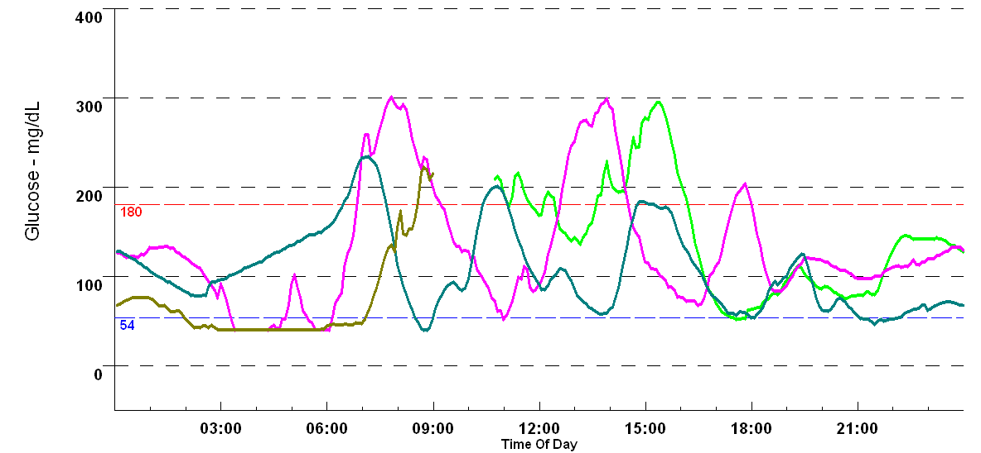
Case: Continuous Glucose Monitoring
mmoL
10
3.9

Slide 5
Case: Continuous Glucose Monitoring
mmoL
10
3.9

Slide 6
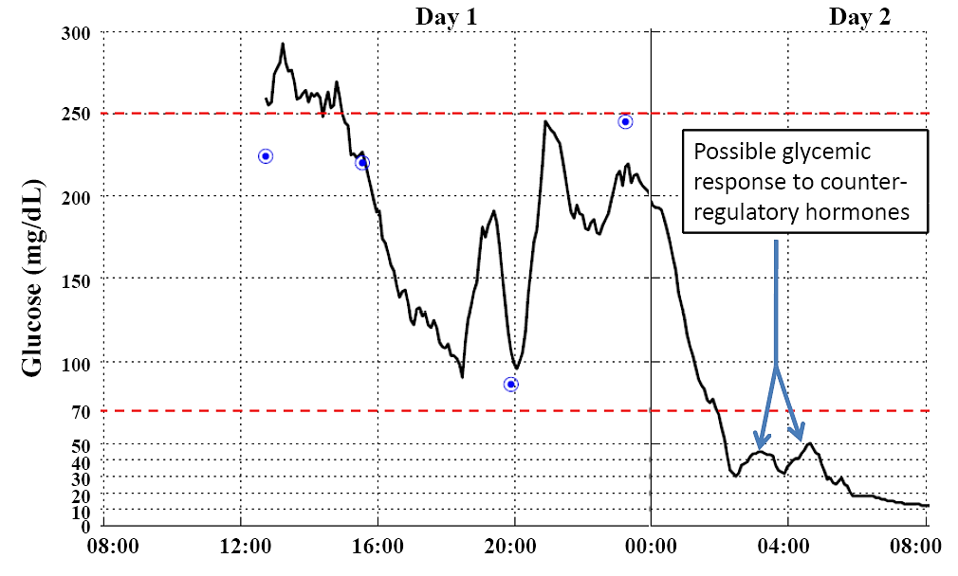
“Dead-in-Bed” Syndrome of Type 1 Diabetes

Slide 7
Mechanisms of Adaptation to Hypoglycemia
Hypoglycemia
↑Circulating lactate
↑Brain lactate
↑Brain glucose transport
↑Brain glucose
↑VMH GABA
↓Autonomic output
↓Epinephrine secretion
Defective glucose counterregulation
↓Autonomic symptoms
Impaired awareness of hypoglycemia
Hypoglycemia Associated Autonomic Failure (HAAF)

Slide 8
Impaired Counterregulatory Response Despite Intact Awareness
Hypoglycemia
exposure
Adrenomedullary
response
Hepatic glucose
production
Neurogenic
response

Slide 9
Impaired Counterregulatory Response Despite Intact Awareness
Hypoglycemia
exposure
Adrenomedullary
response
Hepatic glucose
production
Neurogenic
response

Slide 10
Impaired Counterregulatory Response Despite Intact Awareness
Hypoglycemia
exposure
Adrenomedullary
response
Hepatic glucose
production
Neurogenic
response

Slide 11
Impaired Counterregulatory Response Despite Intact Awareness
Hypoglycemia
exposure
Adrenomedullary
response
Hepatic glucose
production
Neurogenic
response

Slide 12
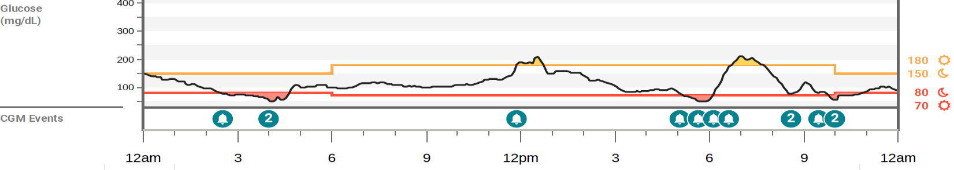
Incomplete Avoidance of Hypoglycemia With Real-Time CGM
Hypoglycemia
exposure
Adrenomedullary
response
Hepatic glucose
production
Neurogenic
response

Slide 13
Incomplete Avoidance of Hypoglycemia With Real-Time CGM
Hypoglycemia
exposure
Adrenomedullary
response
Hepatic glucose
production
Neurogenic
response

Slide 14
Incomplete Avoidance of Hypoglycemia With Real-Time CGM
Hypoglycemia
exposure
Adrenomedullary
response
Hepatic glucose
production
Neurogenic
response

Slide 15
Incomplete Avoidance of Hypoglycemia With Real-Time CGM
Hypoglycemia
exposure
Adrenomedullary
response
Hepatic glucose
production
Neurogenic
response

Slide 16
Incomplete Avoidance of Hypoglycemia With Real-Time CGM
Hypoglycemia
exposure
Adrenomedullary
response
Hepatic glucose
production
Neurogenic
response

Slide 17
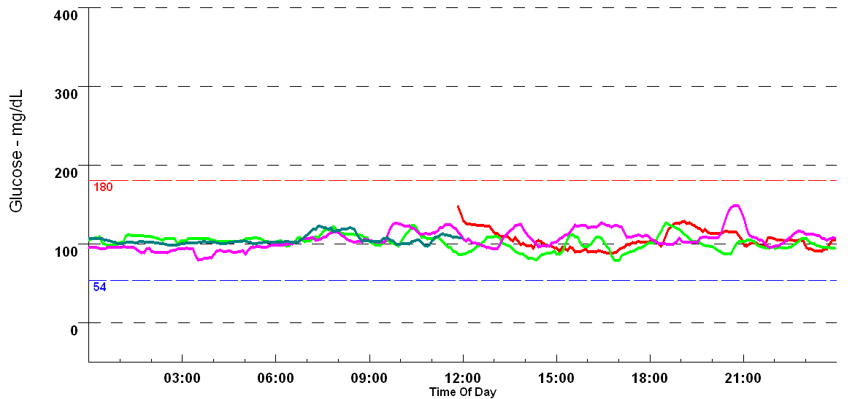
Case: Glycemic Control in Islet Transplantation
mmoL
10
3.9

Slide 18
Case: Glycemic Control in Islet Transplantation
mmoL
10
3.9

Slide 19
Summary
Hypoglycemia exposure and related glucose variability mediate increased risk for severe hypoglycemia through compromising physiologic glucose counterregulation and hypoglycemia symptom recognition to defend against low blood glucose
Impaired adrenomedullary epinephrine and endogenous glucose production responses exist in long-standing type 1 diabetes, even when symptom awareness of hypoglycemia remains intact
Hypoglycemia exposure may require targeting <2% time below range in order to preserve and/or restore physiologic counterregulatory defenses against hypoglycemia and symptom awareness as demonstrated by islet transplantation

